Slide 1
Hands-On Machine Learning with Scikit-Learn and TensorFlow
Concepts, Tools, and Techniques to Build Intelligent Systems

Slide 2
CHAPTER 10
Introduction to Artificial Neural Networks
ANNs are at the very core of Deep Learning. They are versatile, powerful, and scalable, making them ideal to tackle large and highly complex Machine Learning tasks, such as classifying billions of images (e.g., Google Images), powering speech recognition services (e.g., Apple’s Siri), recommending the best videos to watch to hundreds of millions of users every day (e.g., YouTube), or learning to beat the world champion at the game(DeepMind’s AlphaGo).

Slide 3
CHAPTER 10
Introduction to Artificial Neural Networks
In this chapter, we will introduce artificial neural networks, starting with a quick tour of the very first ANN architectures. Then we will present Multi-Layer Perceptrons (MLPs) and implement one using TensorFlow to tackle the MNIST digit classification problem (introduced in Chapter 3).

Slide 4
From Biological to Artificial Neurons
ANNs have been around for quite a while: they were first introduced back in 1943 by the neurophysiologist Warren McCulloch and the mathematician Walter Pitts.
McCulloch and Pitts presented a simplified computational model of how biological neurons might work together in animal brains to perform complex computations using propositional logic. This was the first artificial neural network architecture.

Slide 5
From Biological to Artificial Neurons
The early successes of ANNs until the 1960s led to the widespread belief that we would soon be conversing with truly intelligent machines. When it became clear that this promise would go unfulfilled (at least for quite a while), funding flew elsewhere and ANNs entered a long dark era. In the early 1980s there was a revival of interest in ANNs as new network architectures were invented and better training techniques were developed. But by the 1990s, powerful alternative Machine Learning techniques such as Support Vector Machines (see Chapter 5) were favored by most researchers, as they seemed to offer better results and stronger theoretical foundations.

Slide 6
From Biological to Artificial Neurons
Finally, we are now witnessing yet another wave of interest in ANNs. Will this wave die out like the previous ones did? There are a few good reasons to believe that this one is different and will have a much more profound impact on our lives:
There is a huge quantity of data available to train neural networks, and ANNs frequently outperform other ML techniques on large and complex problems.
The tremendous increase in computing power now makes it possible to train large NN in a reasonable amount of time.
The training algorithms have been improved. They are only slightly different from the ones used in the 1990s, but these relatively small tweaks have a huge positive impact.

Slide 7
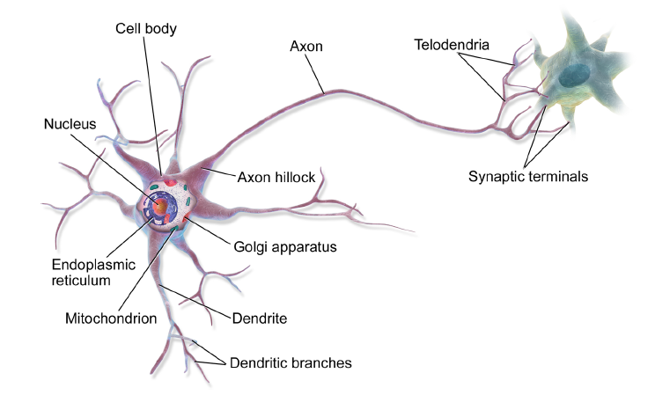
Biological Neurons
Finally, we are now witnessing yet another wave of interest in ANNs. Will this wave die out like the previous ones did? There are a few good reasons to believe that this one is different and will have a much more profound impact on our lives:
There is a huge quantity of data available to train neural networks, and ANNs frequently outperform other ML techniques on large and complex problems.
The tremendous increase in computing power now makes it possible to train large NN in a reasonable amount of time.
The training algorithms have been improved. They are only slightly different from the ones used in the 1990s, but these relatively small tweaks have a huge positive impact.

Slide 8
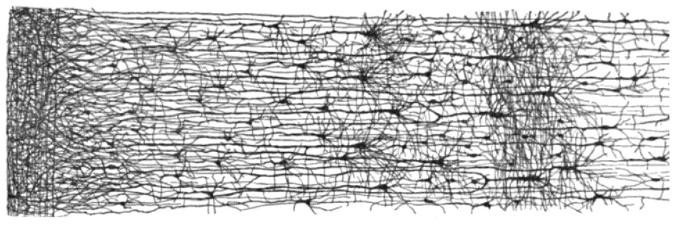
Multiple layers in a biological neural network (human cortex)

Slide 9
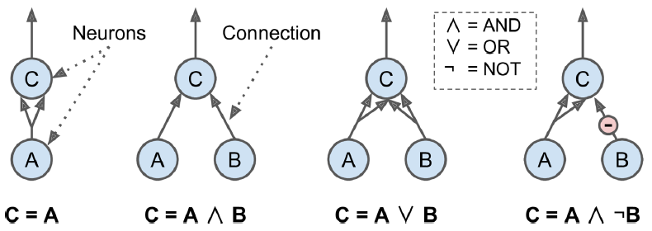
Logical Computations with Neurons
Warren McCulloch and Walter Pitts proposed a very simple model of the biological neuron, which later became known as an artificial neuron: it has one or more binary (on/off) inputs and one binary output. The artificial neuron simply activates its output when more than a certain number of its inputs are active.

Slide 10
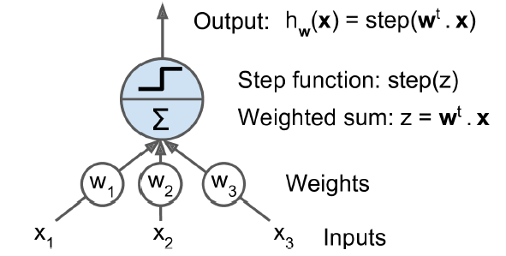
The Perceptron
The Perceptron is one of the simplest ANN architectures, invented in 1957 by Frank Rosenblatt. It is based on a linear threshold unit (LTU): the inputs and output are now numbers and each input connection is associated with a weight. The LTU computes a weighted sum of its inputs (z =w₁x₁+w₂x₂ +⋯ +w_{n}x_{n}= w^{T}・x), then applies a step function to that sum: h_{w}(x) = step (z) = step (w^{T}・x).

Slide 11
The Perceptron
A single LTU can be used for simple linear binary classification. It computes a linear combination of the inputs and if the result exceeds a threshold, it outputs the positive class or else outputs the negative class (just like a Logistic Regression classifier or a linear SVM). For example, you could use a single LTU to classify iris flowers based on the petal length and width (also adding an extra bias feature x0 = 1, just like we did in previous chapters). Training an LTU means finding the right values for w₀, w₁, and w₂ .

Slide 12
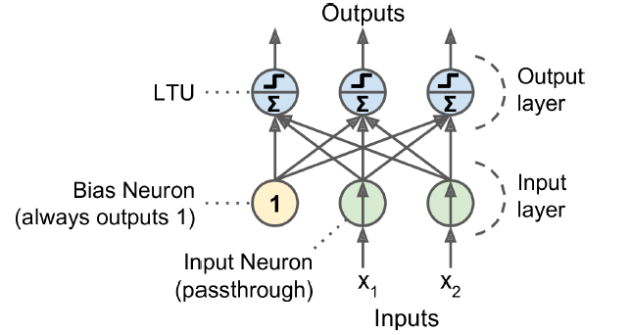
The Perceptron
A Perceptron is composed of a single layer of LTUs, with each neuron connected to all the inputs. These connections are often represented using special passthrough neurons called input neurons. Moreover, an extra bias feature is generally added (x₀ = 1). Using a bias neuron.

Slide 13
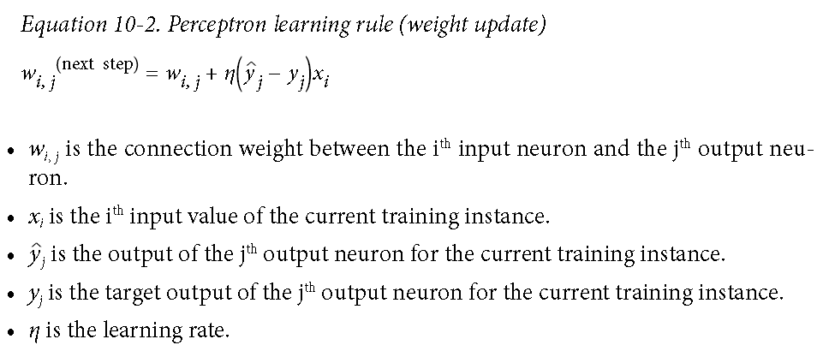
The Perceptron
in 1949, Donald Hebb suggested that when a biological neuron often triggers another neuron, the connection between these two neurons grows stronger. This rule later became known as Hebb’s rule (or Hebbian learning);

Slide 14
The Perceptron
import numpy as np
from sklearn.datasets import load_iris
from sklearn.linear_model import Perceptron
iris = load_iris()
X = iris.data[:, (2, 3)] # petal length, petal width
y = (iris.target == 0).astype(np.int) # Iris Setosa?
per_clf = Perceptron(random_state=42)
per_clf.fit(X, y)
y_pred = per_clf.predict([[2, 0.5]])

Slide 15
The Perceptron
In their 1969 monograph titled Perceptrons, Marvin Minsky and Seymour Papert highlighted a number of serious weaknesses of Perceptrons, in particular the fact that they are incapable of solving some trivial problems (e.g., the Exclusive OR (XOR) classification problem). Of course this is true of any other linear classification model as well (such as Logistic Regression classifiers), but researchers had expected much more from Perceptrons.
However, it turns out that some of the limitations of Perceptrons can be eliminated by stacking multiple Perceptrons. The resulting ANN is called a Multi-Layer Perceptron (MLP).

Slide 16
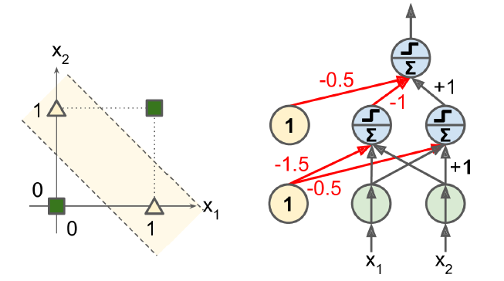
The Perceptron
In their 1969 monograph titled Perceptrons, Marvin Minsky and Seymour Papert highlighted a number of serious weaknesses of Perceptrons, in particular the fact that they are incapable of solving some trivial problems (e.g., the Exclusive OR (XOR) classification problem). Of course this is true of any other linear classification model as well (such as Logistic Regression classifiers), but researchers had expected much more from Perceptrons.
However, it turns out that some of the limitations of Perceptrons can be eliminated by stacking multiple Perceptrons. The resulting ANN is called a Multi-Layer Perceptron (MLP).

Slide 17
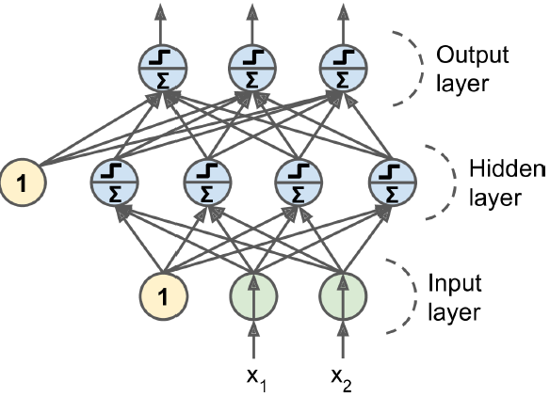
Multi-Layer Perceptron and Backpropagation
An MLP is composed of one input layer, one or more layers of LTUs, called hidden layers, and one final layer of LTUs called the output layer. When an ANN has two or more hidden layers, it is called a deep neural network (DNN).

Slide 18
Multi-Layer Perceptron and Backpropagation
For many years researchers struggled to find a way to train MLPs, without success. But in 1986, D. E. Rumelhart et al. published a groundbreaking article8 introducing the backpropagation training algorithm.
for each training instance the backpropagation algorithm first makes a prediction (forward pass), measures the error, then goes through each layer in reverse to measure the error contribution from each connection (reverse pass), and finally slightly tweaks the connection weights to reduce the error (Gradient Descent step).

Slide 19
Multi-Layer Perceptron and Backpropagation
In order for this algorithm to work properly, the authors made a key change to the MLP’s architecture: they replaced the step function with the logistic function, σ(z) = 1 / (1 + exp(–z)). This was essential because the step function contains only flat segments, so there is no gradient to work with (Gradient Descent cannot move on a flat surface), while the logistic function has a well-defined nonzero derivative everywhere, allowing Gradient Descent to make some progress at every step.

Slide 20
Multi-Layer Perceptron and Backpropagation
Two other popular activation functions are:
The hyperbolic tangent function tanh (z) = 2σ(2z) – 1 Just like the logistic function it is S-shaped, continuous, and differentiable, but its output value ranges from –1 to 1 (instead of 0 to 1 in the case of the logistic function), which tends to make each layer’s output more or less normalized (i.e., centered around 0) at the beginning of training. This often helps speed up convergence.
The ReLU function ReLU (z) = max (0, z). It is continuous but unfortunately not differentiable at z = 0. However, in practice it works very, the fact that it does not have a maximum output value also helps reduce some issues during Gradient Descent.

Slide 21
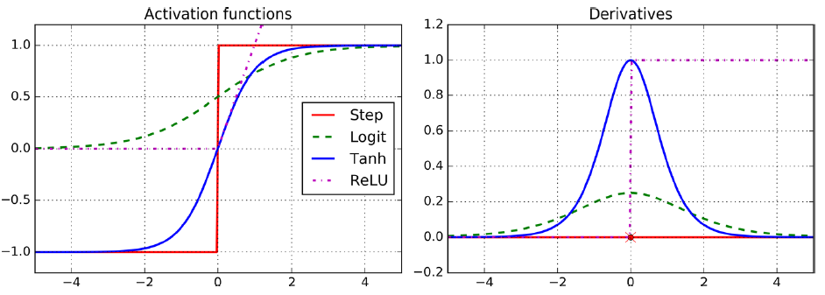
Activation functions and their derivatives

Slide 22
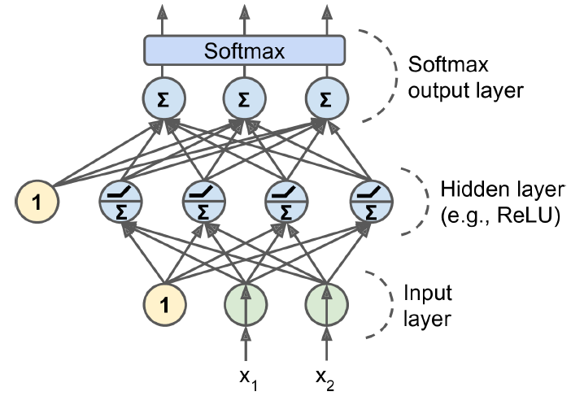
Multi-Layer Perceptron and Backpropagation
An MLP is often used for classification, with each output corresponding to a different binary class (e.g., spam/ham, urgent/not-urgent, and so on). When the classes are exclusive (e.g., classes 0 through 9 for digit image classification), the output layer is typically modified by replacing the individual activation functions by a shared softmax function.

Slide 23
Training an MLP with TensorFlow’s High-Level API (TF.Learn)
import tensorflow as tf
feature_columns = tf.contrib.learn.infer_real_valued_columns_from_input(X_train)
dnn_clf = tf.contrib.learn.DNNClassifier(hidden_units=[300, 100], n_classes=10,
feature_columns=feature_columns)
dnn_clf.fit(x=X_train, y=y_train, batch_size=50, steps=40000)
>>> from sklearn.metrics import accuracy_score
>>> y_pred = list(dnn_clf.predict(X_test))
>>> accuracy_score(y_test, y_pred)
0.98180000000000001
>>> dnn_clf.evaluate(X_test, y_test)
{'accuracy': 0.98180002, 'global_step': 40000, 'loss': 0.073678359}

Slide 24
Training a DNN Using Plain TensorFlow
In this section we will build the same model as before using this API, and we will implement Minibatch Gradient Descent to train it on the MNIST dataset. The first step is the construction phase, building the TensorFlow graph. The second step is the execution phase, where you actually run the graph to train the model.

Slide 25
Construction Phase
import tensorflow as tf
n_inputs = 28*28 # MNIST
n_hidden1 = 300
n_hidden2 = 100
n_outputs = 10
X = tf.placeholder(tf.float32, shape=(None, n_inputs), name="X")
y = tf.placeholder(tf.int64, shape=(None), name="y")

Slide 26
Construction Phase
def neuron_layer(X, n_neurons, name, activation=None):
with tf.name_scope(name):
n_inputs = int(X.get_shape()[1])
stddev = 2 / np.sqrt(n_inputs)
init = tf.truncated_normal((n_inputs, n_neurons), stddev=stddev)
W = tf.Variable(init, name="weights")
b = tf.Variable(tf.zeros([n_neurons]), name="biases")
z = tf.matmul(X, W) + b
if activation=="relu":
return tf.nn.relu(z)
else:
return z

Slide 27
Construction Phase
with tf.name_scope("dnn"):
hidden1 = neuron_layer(X, n_hidden1, "hidden1", activation="relu")
hidden2 = neuron_layer(hidden1, n_hidden2, "hidden2", activation="relu")
logits = neuron_layer(hidden2, n_outputs, "outputs")
from tensorflow.contrib.layers import fully_connected
with tf.name_scope("dnn"):
hidden1 = fully_connected(X, n_hidden1, scope="hidden1")
hidden2 = fully_connected(hidden1, n_hidden2, scope="hidden2")
logits = fully_connected(hidden2, n_outputs, scope="outputs", activation_fn=None)

Slide 28
with tf.name_scope("loss"):
xentropy = tf.nn.sparse_softmax_cross_entropy_with_logits(labels=y, logits=logits)
loss = tf.reduce_mean(xentropy, name="loss")
learning_rate = 0.01
with tf.name_scope("train"):
optimizer = tf.train.GradientDescentOptimizer(learning_rate)
training_op = optimizer.minimize(loss)
with tf.name_scope("eval"):
correct = tf.nn.in_top_k(logits, y, 1)
accuracy = tf.reduce_mean(tf.cast(correct, tf.float32))
init = tf.global_variables_initializer()
saver = tf.train.Saver()

Slide 29
Execution Phase
from tensorflow.examples.tutorials.mnist import input_data
mnist = input_data.read_data_sets("/tmp/data/")
n_epochs = 400
batch_size = 50
with tf.Session() as sess:
init.run()
for epoch in range(n_epochs):
for iteration in range(mnist.train.num_examples // batch_size):
X_batch, y_batch = mnist.train.next_batch(batch_size)
sess.run(training_op, feed_dict={X: X_batch, y: y_batch})
acc_train = accuracy.eval(feed_dict={X: X_batch, y: y_batch})
acc_test = accuracy.eval(feed_dict={X: mnist.test.images,y: mnist.test.labels})
print(epoch, "Train accuracy:", acc_train, "Test accuracy:", acc_test)
save_path = saver.save(sess, "./my_model_final.ckpt")

Slide 30
Using the Neural Network
Now that the neural network is trained, you can use it to make predictions. To do that, you can reuse the same construction phase, but change the execution phase like this:
with tf.Session() as sess:
saver.restore(sess, "./my_model_final.ckpt")
X_new_scaled = [...] # some new images (scaled from 0 to 1)
Z = logits.eval(feed_dict={X: X_new_scaled})
y_pred = np.argmax(Z, axis=1)

Slide 31
Fine-Tuning Neural Network Hyperparameters
The flexibility of neural networks is also one of their main drawbacks: there are many hyperparameters to tweak. Not only can you use any imaginable network topology (how neurons are interconnected), but even in a simple MLP you can change the number of layers, the number of neurons per layer, the type of activation function to use in each layer, the weight initialization logic, and much more. How do you know what combination of hyperparameters is the best for your task?

Slide 32
Number of Hidden Layers
For many problems, you can just begin with a single hidden layer and you will get reasonable results. It has actually been shown that an MLP with just one hidden layer can model even the most complex functions provided it has enough neurons. For a long time, these facts convinced researchers that there was no need to investigate any deeper neural networks. But they overlooked the fact that deep networks have a much higher parameter efficiency than shallow ones: they can model complex functions using exponentially fewer neurons than shallow nets, making them much faster to train.

Slide 33
Number of Hidden Layers
In summary, for many problems you can start with just one or two hidden layers and it will work just fine (e.g., you can easily reach above 97% accuracy on the MNIST dataset using just one hidden layer with a few hundred neurons, and above 98% accuracy using two hidden layers with the same total amount of neurons, in roughly the same amount of training time). For more complex problems, you can gradually ramp up the number of hidden layers, until you start overfitting the training set.

Slide 34
Number of Neurons per Hidden Layer
Obviously the number of neurons in the input and output layers is determined by the type of input and output your task requires. As for the hidden layers, a common practice is to size them to form a funnel, with fewer and fewer neurons at each layer— the rationale being that many low-level features can coalesce into far fewer high-level features. A simpler approach is to pick a model with more layers and neurons than you actually need, then use early stopping to prevent it from overfitting.

Slide 35
Activation Functions
In most cases you can use the ReLU activation function in the hidden layers. It is a bit faster to compute than other activation functions, and Gradient Descent does not get stuck as much on plateaus, thanks to the fact that it does not saturate for large input values (as opposed to the logistic function or the hyperbolic tangent function, which saturate at 1).
For the output layer, the softmax activation function is generally a good choice for classification tasks (when the classes are mutually exclusive). For regression tasks, you can simply use no activation function at all.

