Slide 1
Hands-On Machine Learning with Scikit-Learn and TensorFlow
Concepts, Tools, and Techniques to Build Intelligent Systems

Slide 2
CHAPTER 11
Training Deep Neural Nets
In this chapter, we will start by explaining the vanishing gradients problem and exploring some of the most popular solutions to this problem. Next we will look at various optimizers that can speed up training large models tremendously compared to plain Gradient Descent. Finally, we will go through a few popular regularization techniques for large neural networks.

Slide 3
Vanishing/Exploding Gradients Problems
As we discussed in Chapter 10, the backpropagation algorithm works by going from the output layer to the input layer, propagating the error gradient on the way. Once the algorithm has computed the gradient of the cost function with regards to each parameter in the network, it uses these gradients to update each parameter with a Gradient Descent step.

Slide 4
Vanishing/Exploding Gradients Problems
Unfortunately, gradients often get smaller and smaller as the algorithm progresses down to the lower layers. As a result, the Gradient Descent update leaves the lower layer connection weights virtually unchanged, and training never converges to a good solution. This is called the vanishing gradients problem. In some cases, the opposite can happen: the gradients can grow bigger and bigger, so many layers get insanely large weight updates and the algorithm diverges. This is the exploding gradients problem.

Slide 5
Vanishing/Exploding Gradients Problems
In 2010, Xavier Glorot and Yoshua Bengio showed that with logistic sigmoid activation function and this normal distribution initialization scheme, the variance of the outputs of each layer is much greater than the variance of its inputs. Going forward in the network, the variance keeps increasing after each layer until the activation function saturates at the top layers. This is actually made worse by the fact that the logistic function has a mean of 0.5, not 0.

Slide 6
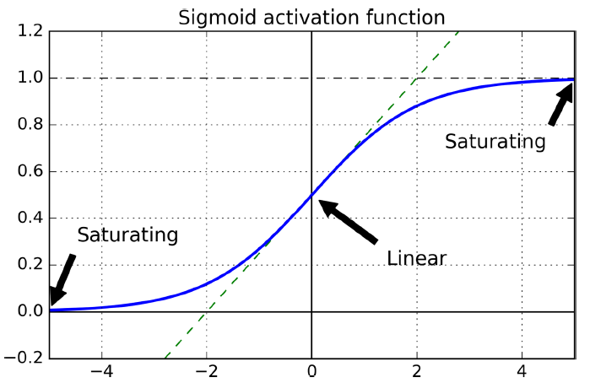
Vanishing/Exploding Gradients Problems
Looking at the logistic activation function, you can see that when inputs become large (negative or positive), the function saturates at 0 or 1, with a derivative extremely close to 0. Thus when backpropagation kicks in, it has virtually no gradient to propagate back through the network, and what little gradient exists keeps getting diluted as backpropagation progresses down through the top layers, so there is really nothing left for the lower layers.

Slide 7
Xavier and He Initialization
In their paper, Glorot and Bengio propose a good compromise that has proven to work very well in practice: the connection weights must be initialized randomly as described in Equation 11-1, where ninputs and noutputs are the number of input and output connections for the layer whose weights are being initialized (also called fan-in and fan-out). This initialization strategy is often called Xavier initialization.

Slide 8
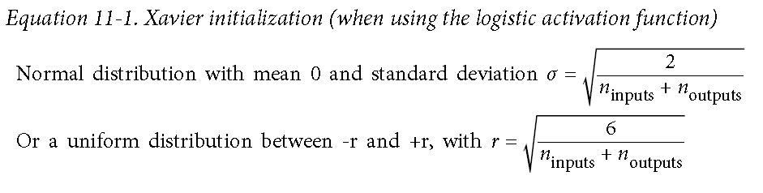
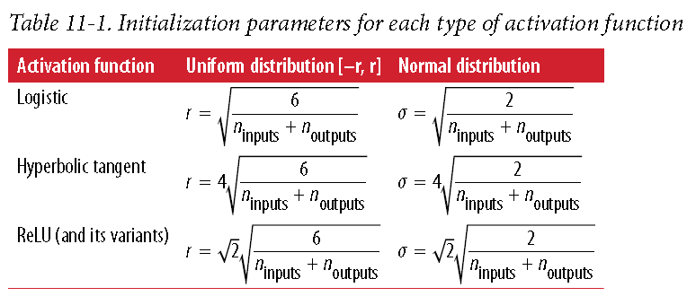
Xavier and He Initialization

Slide 9
Nonsaturating Activation Functions
it turns out that ReLU activation functions behave much better than sigmoid activation in deep neural networks, Unfortunately, the ReLU activation function is not perfect. It suffers from a problem known as the dying ReLUs: during training, some neurons effectively die, meaning they stop outputting anything other than 0.
To solve this problem, you may leaky ReLU. This function is defined as LeakyReLU_{α}(z) = max(αz, z) (see Figure 11-2). The hyperparameter α defines how much the function “leaks”.

Slide 10
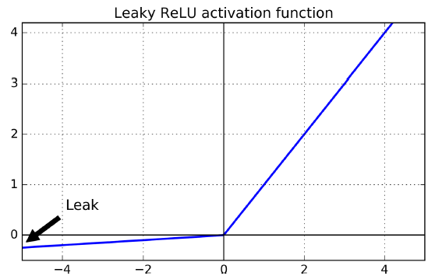
Nonsaturating Activation Functions
it turns out that ReLU activation functions behave much better than sigmoid activation in deep neural networks, Unfortunately, the ReLU activation function is not perfect. It suffers from a problem known as the dying ReLUs: during training, some neurons effectively die, meaning they stop outputting anything other than 0.
To solve this problem, you may leaky ReLU. This function is defined as LeakyReLU_{α}(z) = max(αz, z) (see Figure 11-2). The hyperparameter α defines how much the function “leaks”.

Slide 11
Nonsaturating Activation Functions
a 2015 paper by Djork-Arne Clevert et al.6 proposed a new activation function called the exponential linear unit (ELU) that outperformed all the ReLU variants in their experiments: training time was reduced and the neural network performed better on the test set.

Slide 12
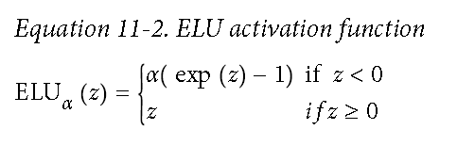
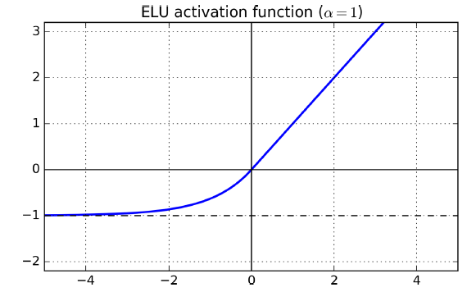
a 2015 paper by Djork-Arne Clevert et al.6 proposed a new activation function called the exponential linear unit (ELU) that outperformed all the ReLU variants in their experiments: training time was reduced and the neural network performed better on the test set.

Slide 13
Nonsaturating Activation Functions
TensorFlow offers an elu() function that you can use to build your neural network. Simply set the activation_fn argument when calling the fully_connected() function, like this:
hidden1 = fully_connected(X, n_hidden1, activation_fn=tf.nn.elu)
TensorFlow does not have a predefined function for leaky ReLUs, but it is easy enough to define:
def leaky_relu(z, name=None):
return tf.maximum(0.01 * z, z, name=name)
hidden1 = fully_connected(X, n_hidden1, activation_fn=leaky_relu)

Slide 14
Batch Normalization
Although using He initialization along with ELU (or any variant of ReLU) can significantly reduce the vanishing/exploding gradients problems at the beginning of training, it doesn’t guarantee that they won’t come back during training.
In a 2015 paper,7 Sergey Ioffe and Christian Szegedy proposed a technique called Batch Normalization (BN) to address the vanishing/exploding gradients problems, and more generally the problem that the distribution of each layer’s inputs changes during training, as the parameters of the previous layers change (which they call the Internal Covariate Shift problem).

Slide 15
Batch Normalization
The technique consists of adding an operation in the model just before the activation function of each layer, simply zero-centering and normalizing the inputs, then scaling and shifting the result using two new parameters per layer (one for scaling, the other for shifting). In other words, this operation lets the model learn the optimal scale and mean of the inputs for each layer.
In order to zero-center and normalize the inputs, the algorithm needs to estimate the inputs’ mean and standard deviation. It does so by evaluating the mean and standard deviation of the inputs over the current mini-batch (hence the name “Batch Normalization”).

Slide 16
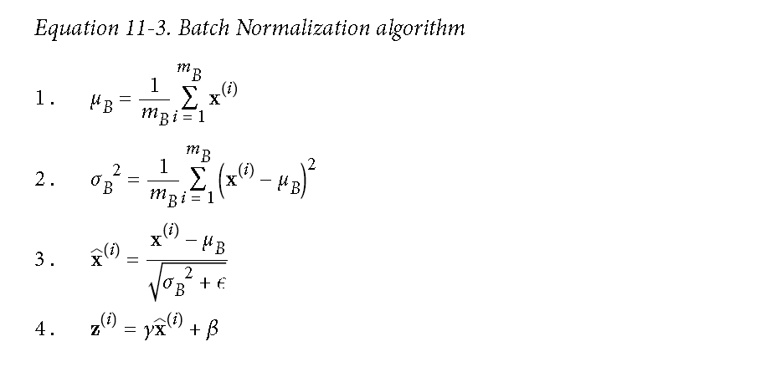
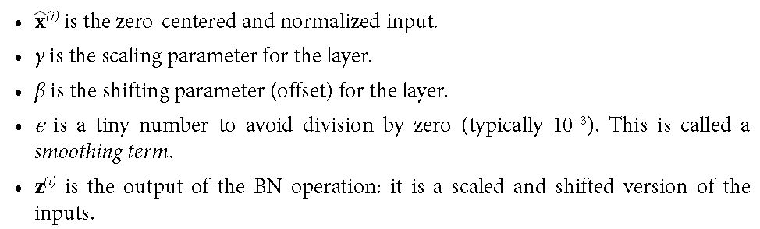
Batch Normalization
The technique consists of adding an operation in the model just before the activation function of each layer, simply zero-centering and normalizing the inputs, then scaling and shifting the result using two new parameters per layer (one for scaling, the other for shifting). In other words, this operation lets the model learn the optimal scale and mean of the inputs for each layer.
In order to zero-center and normalize the inputs, the algorithm needs to estimate the inputs’ mean and standard deviation. It does so by evaluating the mean and standard deviation of the inputs over the current mini-batch (hence the name “Batch Normalization”).

Slide 17
Batch Normalization
At test time, there is no mini-batch to compute the empirical mean and standard deviation, so instead you simply use the whole training set’s mean and standard deviation. These are typically efficiently computed during training using a moving average. So, in total, four parameters are learned for each batch-normalized layer: γ (scale), β (offset), μ (mean), and σ (standard deviation).

Slide 18
Implementing Batch Normalization with TensorFlow
import tensorflow as tf
from tensorflow.contrib.layers import batch_norm
n_inputs = 28 * 28
n_hidden1 = 300
n_hidden2 = 100
n_outputs = 10
X = tf.placeholder(tf.float32, shape=(None, n_inputs), name="X")
is_training = tf.placeholder(tf.bool, shape=(), name='is_training')
bn_params = {
'is_training': is_training,
'decay': 0.99,
'updates_collections': None
}

Slide 19
Implementing Batch Normalization with TensorFlow
hidden1 = fully_connected(X, n_hidden1, scope="hidden1",
normalizer_fn=batch_norm, normalizer_params=bn_params)
hidden2 = fully_connected(hidden1, n_hidden2, scope="hidden2",
normalizer_fn=batch_norm, normalizer_params=bn_params)
logits = fully_connected(hidden2, n_outputs, activation_fn=None,scope="outputs",
normalizer_fn=batch_norm, normalizer_params=bn_params)
[...]
with tf.contrib.framework.arg_scope([fully_connected], normalizer_fn=batch_norm,
normalizer_params=bn_params):
hidden1 = fully_connected(X, n_hidden1, scope="hidden1")
hidden2 = fully_connected(hidden1, n_hidden2, scope="hidden2")
logits = fully_connected(hidden2, n_outputs, scope="outputs“,activation_fn=None)

Slide 20
Implementing Batch Normalization with TensorFlow
with tf.Session() as sess:
sess.run(init)
for epoch in range(n_epochs):
[...]
for X_batch, y_batch in zip(X_batches, y_batches):
sess.run(training_op,
feed_dict={is_training: True, X: X_batch, y: y_batch})
accuracy_score = accuracy.eval(
feed_dict={is_training: False, X: X_test_scaled, y: y_test}))
print(accuracy_score)

Slide 21
Gradient Clipping
A popular technique to lessen the exploding gradients problem is to simply clip the gradients during backpropagation so that they never exceed some threshold (this is mostly useful for recurrent neural networks). This is called Gradient Clipping.8 In general people now prefer Batch Normalization, but it’s still useful to know about Gradient Clipping and how to implement it.

Slide 22
Gradient Clipping
In TensorFlow, the optimizer’s minimize() function takes care of both computing the gradients and applying them, so you must instead call the optimizer’s compute_gradi ents() method first, then create an operation to clip the gradients using the clip_by_value() function, and finally create an operation to apply the clipped gradients using the optimizer’s apply_gradients() method:
threshold = 1.0
optimizer = tf.train.GradientDescentOptimizer(learning_rate)
grads_and_vars = optimizer.compute_gradients(loss)
capped_gvs = [(tf.clip_by_value(grad, -threshold, threshold), var)
for grad, var in grads_and_vars]
training_op = optimizer.apply_gradients(capped_gvs)

Slide 23
Reusing Pretrained Layers
It is generally not a good idea to train a very large DNN from scratch: instead, you should always try to find an existing neural network that accomplishes a similar task to the one you are trying to tackle, then just reuse the lower layers of this network: this is called transfer learning. It will not only speed up training considerably, but will also require much less training data.

Slide 24
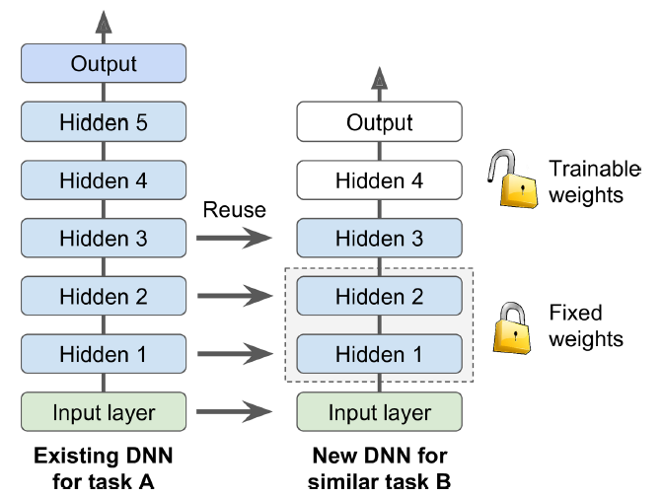
Reusing Pretrained Layers
It is generally not a good idea to train a very large DNN from scratch: instead, you should always try to find an existing neural network that accomplishes a similar task to the one you are trying to tackle, then just reuse the lower layers of this network: this is called transfer learning. It will not only speed up training considerably, but will also require much less training data.

Slide 25
Freezing the Lower Layers
It is likely that the lower layers of the first DNN have learned to detect low-level features in pictures that will be useful across both image classification tasks, so you can just reuse these layers as they are. It is generally a good idea to “freeze” their weights when training the new DNN: if the lower-layer weights are fixed, then the higher layer weights will be easier to train (because they won’t have to learn a moving target). The simplest solution is to give the optimizer the list of variables to train, excluding the variables from the lower layers:
train_vars = tf.get_collection(tf.GraphKeys.TRAINABLE_VARIABLES, scope="hidden[34]|outputs")
training_op = optimizer.minimize(loss, var_list=train_vars)

Slide 26
Caching the Frozen Layers
Since the frozen layers won’t change, it is possible to cache the output of the topmost frozen layer for each training instance. Since training goes through the whole dataset many times, this will give you a huge speed boost as you will only need to go through the frozen layers once per training instance (instead of once per epoch).

Slide 27
Caching the Frozen Layers
hidden2_outputs = sess.run(hidden2, feed_dict={X: X_train})
import numpy as np
n_epochs = 100
n_batches = 500
for epoch in range(n_epochs):
shuffled_idx = rnd.permutation(len(hidden2_outputs))
hidden2_batches = np.array_split(hidden2_outputs[shuffled_idx], n_batches)
y_batches = np.array_split(y_train[shuffled_idx], n_batches)
for hidden2_batch, y_batch in zip(hidden2_batches, y_batches):
sess.run(training_op, feed_dict={hidden2: hidden2_batch, y: y_batch})

Slide 28
Tweaking, Dropping, or Replacing the Upper Layers
The output layer of the original model should usually be replaced since it is most likely not useful at all for the new task, and it may not even have the right number of outputs for the new task.
Similarly, the upper hidden layers of the original model are less likely to be as useful as the lower layers, since the high-level features that are most useful for the new task may differ significantly from the ones that were most useful for the original task. You want to find the right number of layers to reuse.

Slide 29
Tweaking, Dropping, or Replacing the Upper Layers
Try freezing all the copied layers first, then train your model and see how it performs. Then try unfreezing one or two of the top hidden layers to let backpropagation tweak them and see if performance improves. The more training data you have, the more layers you can unfreeze.
If you still cannot get good performance, and you have little training data, try dropping the top hidden layer(s) and freeze all remaining hidden layers again. You can iterate until you find the right number of layers to reuse. If you have plenty of training data, you may try replacing the top hidden layers instead of dropping them, and even add more hidden layers.

Slide 30
Unsupervised Pretraining
if you have plenty of unlabeled training data, you can try to train the layers one by one, starting with the lowest layer and then going up, using an unsupervised feature detector algorithm such as Restricted Boltzmann Machines (RBMs; see Appendix E) or autoencoders (see Chapter 15). Each layer is trained on the output of the previously trained layers (all layers except the one being trained are frozen). Once all layers have been trained this way, you can finetune the network using supervised learning (i.e., with backpropagation).

Slide 31
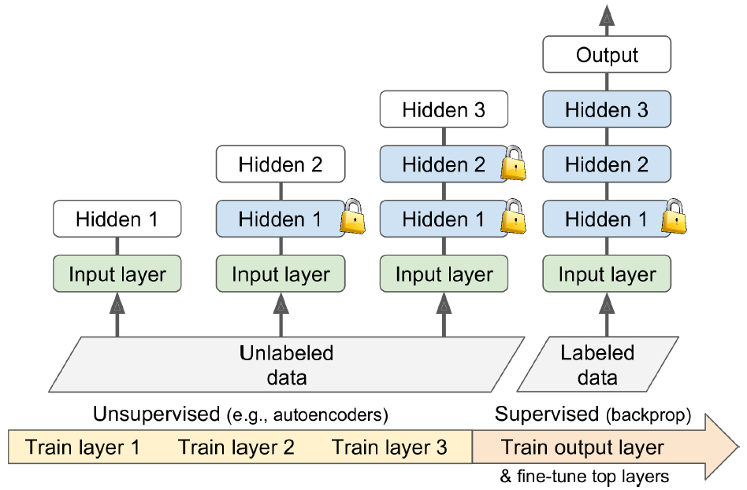
Unsupervised Pretraining
if you have plenty of unlabeled training data, you can try to train the layers one by one, starting with the lowest layer and then going up, using an unsupervised feature detector algorithm such as Restricted Boltzmann Machines (RBMs; see Appendix E) or autoencoders (see Chapter 15). Each layer is trained on the output of the previously trained layers (all layers except the one being trained are frozen). Once all layers have been trained this way, you can finetune the network using supervised learning (i.e., with backpropagation).

Slide 32
Pretraining on an Auxiliary Task
One last option is to train a first neural network on an auxiliary task for which you can easily obtain or generate labeled training data, then reuse the lower layers of that network for your actual task. The first neural network’s lower layers will learn feature detectors that will likely be reusable by the second neural network.
Another approach is to train a first network to output a score for each training instance, and use a cost function that ensures that a good instance’s score is greater than a bad instance’s score by at least some margin. This is called max margin learning.

Slide 33
Faster Optimizers
Training a very large deep neural network can be painfully slow. So far we have seen four ways to speed up training (and reach a better solution): applying a good initialization strategy for the connection weights, using a good activation function, using Batch Normalization, and reusing parts of a pretrained network. Another huge speed boost comes from using a faster optimizer than the regular Gradient Descent optimizer.
In this section we will present the most popular ones: Momentum optimization, Nesterov Accelerated Gradient, AdaGrad, RMSProp, and finally Adam optimization.

Slide 34
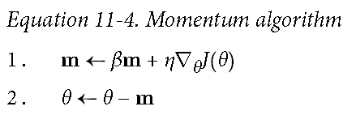
Momentum optimization
Recall that Gradient Descent simply updates the weights θ by directly subtracting the gradient of the cost function J(θ) with regards to the weights (∇_{θ}J(θ)) multiplied by the learning rate η. The equation is: θ ← θ – η∇_{θ}J(θ). It does not care about what the earlier gradients were. If the local gradient is tiny, it goes very slowly.
Momentum optimization cares a great deal about what previous gradients were: at each iteration, it adds the local gradient to the momentum vector m (multiplied by the learning rate η), and it updates the weights by simply subtracting this momentum vector.

Slide 35
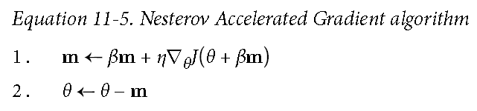
Nesterov Accelerated Gradient
One small variant to Momentum optimization, proposed by Yurii Nesterov in 1983, is almost always faster than vanilla Momentum optimization. The idea of Nesterov Momentum optimization, or Nesterov Accelerated Gradient (NAG), is to measure the gradient of the cost function not at the local position but slightly ahead in the direction of the momentum (see Equation 11-5). The only difference from vanilla Momentum optimization is that the gradient is measured at θ + βm rather than at θ.

Slide 36
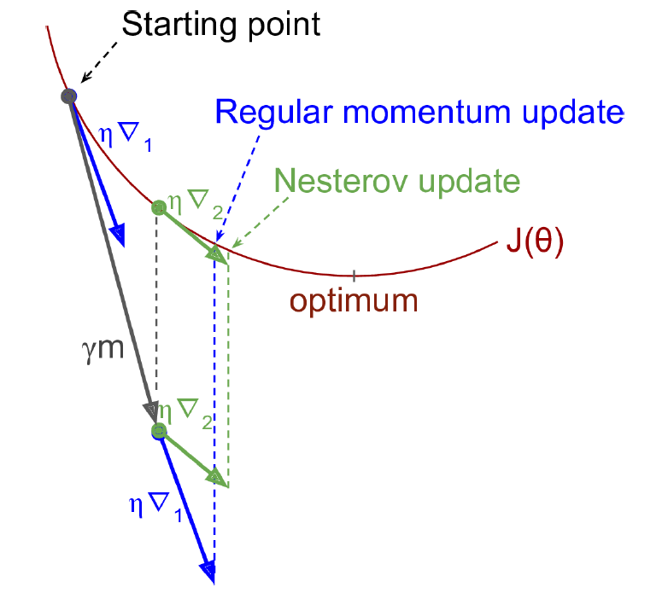
Nesterov Accelerated Gradient
One small variant to Momentum optimization, proposed by Yurii Nesterov in 1983, is almost always faster than vanilla Momentum optimization. The idea of Nesterov Momentum optimization, or Nesterov Accelerated Gradient (NAG), is to measure the gradient of the cost function not at the local position but slightly ahead in the direction of the momentum (see Equation 11-5). The only difference from vanilla Momentum optimization is that the gradient is measured at θ + βm rather than at θ.

Slide 37
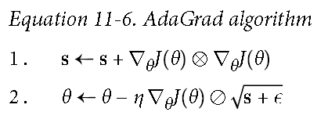
AdaGrad
Consider the elongated bowl problem again: Gradient Descent starts by quickly going down the steepest slope, then slowly goes down the bottom of the valley. It would be nice if the algorithm could detect this early on and correct its direction to point a bit more toward the global optimum.
The AdaGrad algorithm13 achieves this by scaling down the gradient vector along the steepest dimensions (see Equation 11-6):

Slide 38
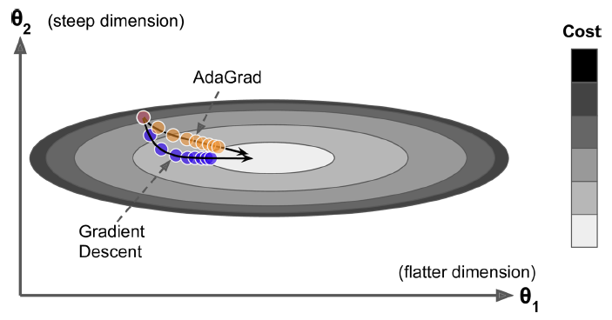
AdaGrad
Consider the elongated bowl problem again: Gradient Descent starts by quickly going down the steepest slope, then slowly goes down the bottom of the valley. It would be nice if the algorithm could detect this early on and correct its direction to point a bit more toward the global optimum.
The AdaGrad algorithm13 achieves this by scaling down the gradient vector along the steepest dimensions (see Equation 11-6):

Slide 39
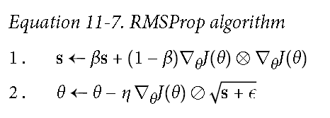
RMSProp
Although AdaGrad slows down a bit too fast and ends up never converging to the global optimum, the RMSProp algorithm14 fixes this by accumulating only the gradients from the most recent iterations (as opposed to all the gradients since the beginning of training). It does so by using exponential decay in the first step.

Slide 40
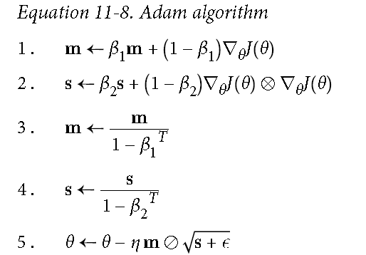
Adam Optimization
Adam,which stands for adaptive moment estimation, combines the ideas of Momentum optimization and RMSProp: just like Momentum optimization it keeps track of an exponentially decaying average of past gradients, and just like RMSProp it keeps track of an exponentially decaying average of past squared gradients.

Slide 41
Optimization OPs in tensorflow
optimizer = tf.train.MomentumOptimizer(learning_rate=learning_rate,
momentum=0.9)
optimizer = tf.train.MomentumOptimizer(learning_rate=learning_rate,
momentum=0.9, use_nesterov=True)
optimizer = tf.train.RMSPropOptimizer(learning_rate=learning_rate,
momentum=0.9, decay=0.9, epsilon=1e-10)
optimizer = tf.train.AdamOptimizer(learning_rate=learning_rate)

Slide 42
Learning Rate Scheduling
Finding a good learning rate can be tricky. If you set it way too high, training may actually diverge. If you set it too low, training will eventually converge to the optimum, but it will take a very long time. If you set it slightly too high, it will make progress very quickly at first, but it will end up dancing around the optimum, never settling down (unless you use an adaptive learning rate optimization algorithm such as AdaGrad, RMSProp, or Adam, but even then it may take time to settle). If you have a limited computing budget, you may have to interrupt training before it has converged properly, yielding a suboptimal solution.

Slide 43
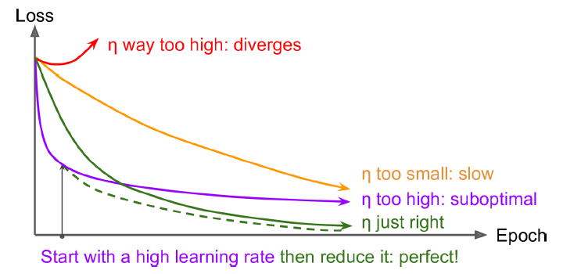
Learning Rate Scheduling
Finding a good learning rate can be tricky. If you set it way too high, training may actually diverge. If you set it too low, training will eventually converge to the optimum, but it will take a very long time. If you set it slightly too high, it will make progress very quickly at first, but it will end up dancing around the optimum, never settling down (unless you use an adaptive learning rate optimization algorithm such as AdaGrad, RMSProp, or Adam, but even then it may take time to settle). If you have a limited computing budget, you may have to interrupt training before it has converged properly, yielding a suboptimal solution.

Slide 44
Learning Rate Scheduling
if you start with a high learning rate and then reduce it once it stops making fast progress, you can reach a good solution faster than with the optimal constant learning rate. There are many different strategies to reduce the learning rate during training. These strategies are called learning schedules.
Predetermined piecewise constant learning rate
For example, set the learning rate to η0 = 0.1 at first, then to η1 = 0.001 after 50 epochs.
Performance scheduling
Measure the validation error every N steps (just like for early stopping) and reduce the learning rate by a factor of λ when the error stops dropping.

Slide 45
Learning Rate Scheduling
Exponential scheduling
Set the learning rate to a function of the iteration number t: η(t) = η₀ 10^{–t/r}. This works great, but it requires tuning η₀ and r. The learning rate will drop by a factor of 10 every r steps.
Power scheduling
Set the learning rate to η(t) = η₀ (1 + t/r)^{–c}. The hyperparameter c is typically set to 1. This is similar to exponential scheduling, but the learning rate drops much more slowly.

Slide 46
Learning Rate Scheduling
initial_learning_rate = 0.1
decay_steps = 10000
decay_rate = 1/10
global_step = tf.Variable(0, trainable=False)
learning_rate = tf.train.exponential_decay(initial_learning_rate, global_step, decay_steps, decay_rate)
optimizer = tf.train.MomentumOptimizer(learning_rate, momentum=0.9)
training_op = optimizer.minimize(loss, global_step=global_step)

Slide 47
Avoiding Overfitting Through Regularization
Deep neural networks typically have tens of thousands of parameters, sometimes even millions. With so many parameters, the network has an incredible amount of freedom and can fit a huge variety of complex datasets. But this great flexibility also means that it is prone to overfitting the training set.
With millions of parameters you can fit the whole zoo. In this section we will present some of the most popular regularization techniques for neural networks, and how to implement them with TensorFlow: early stopping, ℓ₁ and ℓ₂ regularization, dropout, max-norm regularization, and data augmentation.

Slide 48
Early Stopping
To avoid overfitting the training set, a great solution is early stopping (introduced in Chapter 4): just interrupt training when its performance on the validation set starts dropping.
One way to implement this with TensorFlow is to evaluate the model on a validation set at regular intervals (e.g., every 50 steps), and save a “winner” snapshot if it outperforms previous “winner” snapshots. Count the number of steps since the last “winner” snapshot was saved, and interrupt training when this number reaches some limit (e.g., 2,000 steps). Then restore the last “winner” snapshot.

Slide 49
ℓ₁ and ℓ₂ Regularization
One way to do this using TensorFlow is to simply add the appropriate regularization terms to your cost function. For example, assuming you have just one hidden layer with weights weights1 and one output layer with weights weights2, then you can apply ℓ₁ regularization like this:
[...] # construct the neural network
base_loss = tf.reduce_mean(xentropy, name="avg_xentropy")
reg_losses = tf.reduce_sum(tf.abs(weights1)) + tf.reduce_sum(tf.abs(weights2))
loss = tf.add(base_loss, scale * reg_losses, name="loss")

Slide 50
ℓ₁ and ℓ₂ Regularization
Many functions that create variables (such as get_variable() or fully_connected()) accept a *_regularizer argument for each created variable (e.g., weights_regularizer). You can pass any function that takes weights as an argument and returns the corresponding regularization loss.
with arg_scope( [fully_connected], weights_regularizer=tf.contrib.layers.l1_regularizer(scale=0.01)):
hidden1 = fully_connected(X, n_hidden1, scope="hidden1")
hidden2 = fully_connected(hidden1, n_hidden2, scope="hidden2")
logits = fully_connected(hidden2, n_outputs, activation_fn=None,scope="out")
reg_losses = tf.get_collection(tf.GraphKeys.REGULARIZATION_LOSSES)
loss = tf.add_n([base_loss] + reg_losses, name="loss")

Slide 51
Dropout
It is a fairly simple algorithm: at every training step, every neuron (including the input neurons but excluding the output neurons) has a probability p of being temporarily “dropped out,” meaning it will be entirely ignored during this training step, but it may be active during the next step. The hyperparameter p is called the dropout rate, and it is typically set to 50%. After training, neurons don’t get dropped anymore. And that’s all (except for a technical detail we will discuss momentarily).

Slide 52
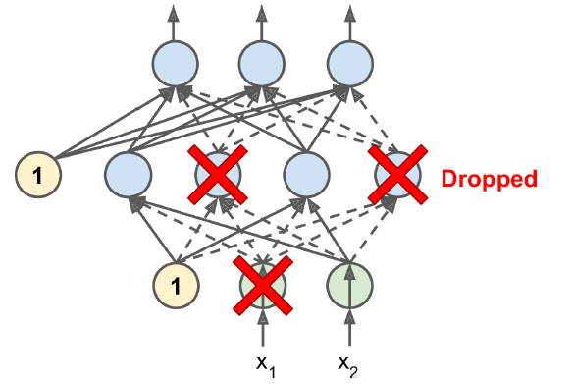
Dropout
It is a fairly simple algorithm: at every training step, every neuron (including the input neurons but excluding the output neurons) has a probability p of being temporarily “dropped out,” meaning it will be entirely ignored during this training step, but it may be active during the next step. The hyperparameter p is called the dropout rate, and it is typically set to 50%. After training, neurons don’t get dropped anymore. And that’s all (except for a technical detail we will discuss momentarily).

Slide 53
Dropout
To implement dropout using TensorFlow, you can simply apply the dropout() function to the input layer and to the output of every hidden layer. During training, this function randomly drops some items (setting them to 0) and divides the remaining items by the keep probability. After training, this function does nothing at all. The following code applies dropout regularization to our three-layer neural network:

Slide 54
Dropout
from tensorflow.contrib.layers import dropout
[...]
is_training = tf.placeholder(tf.bool, shape=(), name='is_training')
keep_prob = 0.5
X_drop = dropout(X, keep_prob, is_training=is_training)
hidden1 = fully_connected(X_drop, n_hidden1, scope="hidden1")
hidden1_drop = dropout(hidden1, keep_prob, is_training=is_training)
hidden2 = fully_connected(hidden1_drop, n_hidden2, scope="hidden2")
hidden2_drop = dropout(hidden2, keep_prob, is_training=is_training)
logits = fully_connected(hidden2_drop, n_outputs, activation_fn=None,
scope="outputs")

Slide 55
Max-Norm Regularization
Another regularization technique that is quite popular for neural networks is called max-norm regularization: for each neuron, it constrains the weights w of the incoming connections such that ||w||₂ ≤ r, where r is the max-norm hyperparameter and ||・||₂ is the ℓ2 norm. We typically implement this constraint by computing ||w||₂ after each training step and clipping w if needed.

Slide 56
Max-Norm Regularization
def max_norm_regularizer(threshold, axes=1, name="max_norm",
collection="max_norm"):
def max_norm(weights):
clipped = tf.clip_by_norm(weights, clip_norm=threshold, axes=axes)
clip_weights = tf.assign(weights, clipped, name=name)
tf.add_to_collection(collection, clip_weights)
return None # there is no regularization loss term
return max_norm
max_norm_reg = max_norm_regularizer(threshold=1.0)
hidden1 = fully_connected(X, n_hidden1, scope="hidden1",
weights_regularizer=max_norm_reg)

Slide 57
Data Augmentation
One last regularization technique, data augmentation, consists of generating new training instances from existing ones, artificially boosting the size of the training set. This will reduce overfitting, making this a regularization technique. The trick is to generate realistic training instances; ideally, a human should not be able to tell which instances were generated and which ones were not. Moreover, simply adding white noise will not help; the modifications you apply should be learnable (white noise is not).

Slide 58
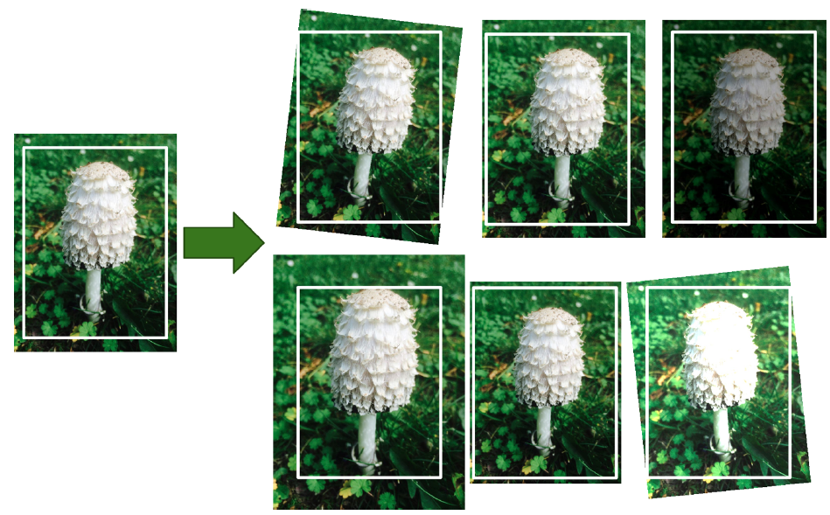
Data Augmentation
One last regularization technique, data augmentation, consists of generating new training instances from existing ones, artificially boosting the size of the training set. This will reduce overfitting, making this a regularization technique. The trick is to generate realistic training instances; ideally, a human should not be able to tell which instances were generated and which ones were not. Moreover, simply adding white noise will not help; the modifications you apply should be learnable (white noise is not).

Slide 59
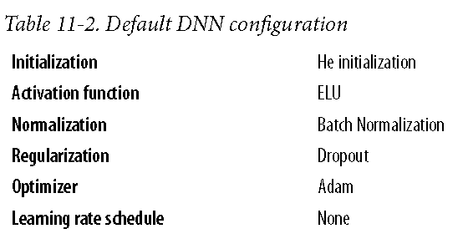
Practical Guidelines

