Slide 1
Hands-On Machine Learning with Scikit-Learn and TensorFlow
Concepts, Tools, and Techniques to Build Intelligent Systems

Slide 2
CHAPTER 13
Convolutional Neural Networks
Convolutional neural networks (CNNs) emerged from the study of the brain’s visual cortex, and they have been used in image recognition since the 1980s. In the last few years, thanks to the increase in computational power, the amount of available training data, and the tricks presented in Chapter 11 for training deep nets, CNNs have managed to achieve superhuman performance on some complex visual tasks.

Slide 3
CHAPTER 13
CNNs power image search services, self-driving cars, automatic video classification systems, and more.
In this chapter we will present where CNNs came from, what their building blocks look like, and how to implement them using TensorFlow. Then we will present some of the best CNN architectures.

Slide 4
The Architecture of the Visual Cortex
David H. Hubel and Torsten Wiesel performed a series of experiments on cats in 1958 and 1959, giving crucial insights on the structure of the visual cortex. In particular, they showed that many neurons in the visual cortex have a small local receptive field, meaning they react only to visual stimuli located in a limited region of the visual field.

Slide 5
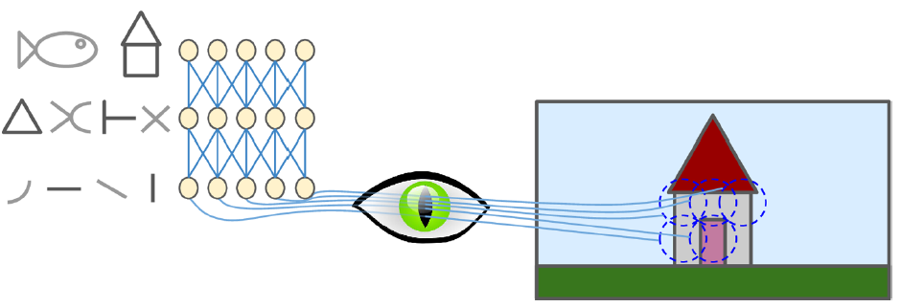
The Architecture of the Visual Cortex
The local receptive fields of five neurons are represented by dashed circles.
Each neuron is connected only to a few neurons from the previous layer.

Slide 6
The Architecture of the Visual Cortex
These studies of the visual cortex inspired the neocognitron, introduced in 1980, which gradually evolved into what we now call convolutional neural networks. An important milestone was a 1998 paper by Yann LeCun, Leon Bottou, Yoshua Bengio and Patrick Haffner, which introduced the famous LeNet-5 architecture, widely used to recognize handwritten check numbers. This architecture introduces two new building blocks: convolutional layers and pooling layers.

Slide 7
Convolutional Layer
The most important building block of a CNN is the convolutional layer: neurons in the first convolutional layer are not connected to every single pixel in the input image (like they were in previous chapters), but only to pixels in their receptive fields. In turn, each neuron in the second convolutional layer is connected only to neurons located within a small rectangle in the first layer.

Slide 8
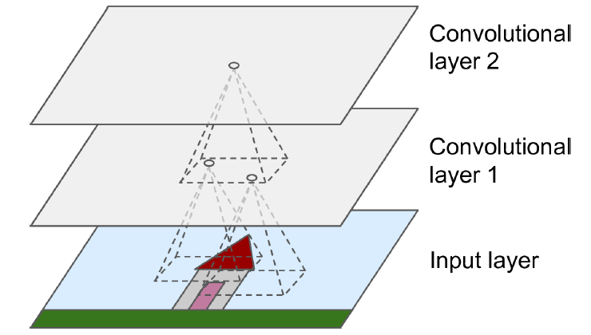
CNN layers with rectangular local receptive fields
The most important building block of a CNN is the convolutional layer: neurons in the first convolutional layer are not connected to every single pixel in the input image (like they were in previous chapters), but only to pixels in their receptive fields. In turn, each neuron in the second convolutional layer is connected only to neurons located within a small rectangle in the first layer.

Slide 9
Convolutional Layer
A neuron located in row i, column j of a given layer is connected to the outputs of the neurons in the previous layer located in rows i to i + f_{h} – 1, columns j to j + f_{w} – 1, where f_{h} and f_{w} are the height and width of the receptive field. In order for a layer to have the same height and width as the previous layer, it is common to add zeros around the inputs, as shown in the diagram. This is called zero padding.

Slide 10
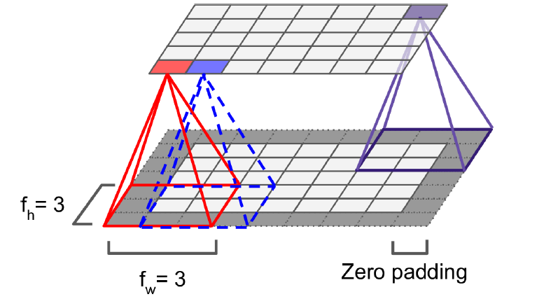
Convolutional Layer
A neuron located in row i, column j of a given layer is connected to the outputs of the neurons in the previous layer located in rows i to i + f_{h} – 1, columns j to j + f_{w} – 1, where f_{h} and f_{w} are the height and width of the receptive field. In order for a layer to have the same height and width as the previous layer, it is common to add zeros around the inputs, as shown in the diagram. This is called zero padding.

Slide 11
Convolutional Layer
It is also possible to connect a large input layer to a much smaller layer by spacing out the receptive fields. The distance between two consecutive receptive fields is called the stride. In the diagram, a 5 × 7 input layer (plus zero padding) is connected to a 3 × 4 layer, using 3 × 3 receptive fields and a stride of 2.

Slide 12
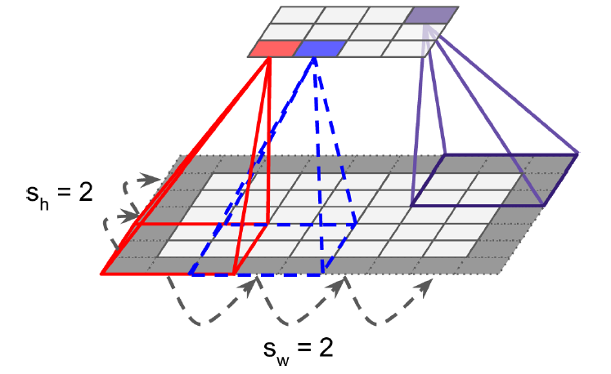
Convolutional Layer
It is also possible to connect a large input layer to a much smaller layer by spacing out the receptive fields. The distance between two consecutive receptive fields is called the stride. In the diagram, a 5 × 7 input layer (plus zero padding) is connected to a 3 × 4 layer, using 3 × 3 receptive fields and a stride of 2.

Slide 13
Filters
A neuron’s weights can be represented as a small image the size of the receptive field. For example, Figure 13-5 shows two possible sets of weights, called filters (or convolution kernels). The first one is represented as a black square with a vertical white line in the middle (it is a 7 × 7 matrix full of 0s except for the central column, which is full of 1s); neurons using these weights will ignore everything in their receptive field except for the central vertical line.

Slide 14
Filters
The second filter is a black square with a horizontal white line in the middle. Once again, neurons using these weights will ignore everything in their receptive field except for the central horizontal line.
a layer full of neurons using the same filter gives you a feature map, which highlights the areas in an image that are most similar to the filter. During training, a CNN finds the most useful filters for its task, and it learns to combine them into more complex patterns

Slide 15
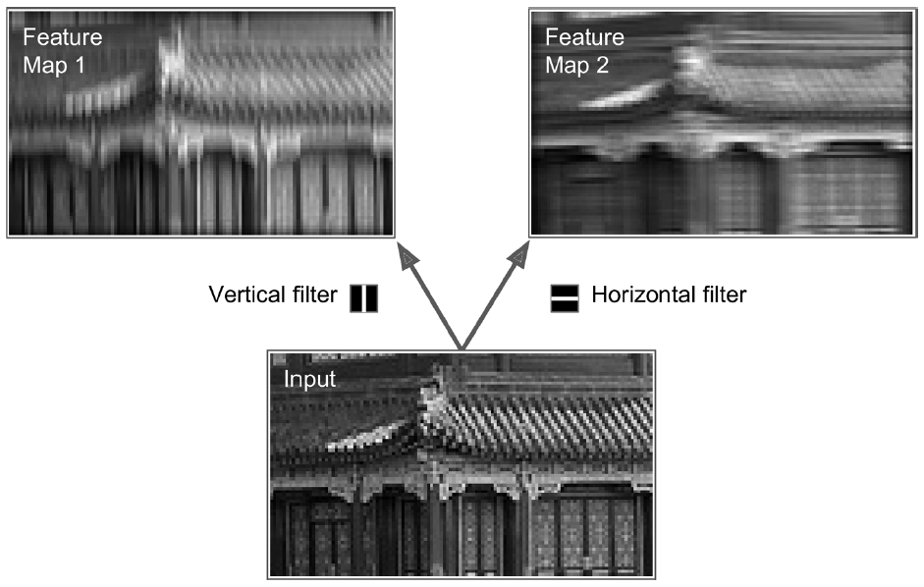
Filters
The second filter is a black square with a horizontal white line in the middle. Once again, neurons using these weights will ignore everything in their receptive field except for the central horizontal line.

Slide 16
Stacking Multiple Feature Maps
we have represented each convolutional layer as a thin 2D layer, but in reality it is composed of several feature maps of equal sizes, so it is more accurately represented in 3D. Within one feature map, all neurons share the same parameters (weights and bias term), but different feature maps may have different parameters. A neuron’s receptive field extends across all the previous layers’ feature maps.

Slide 17
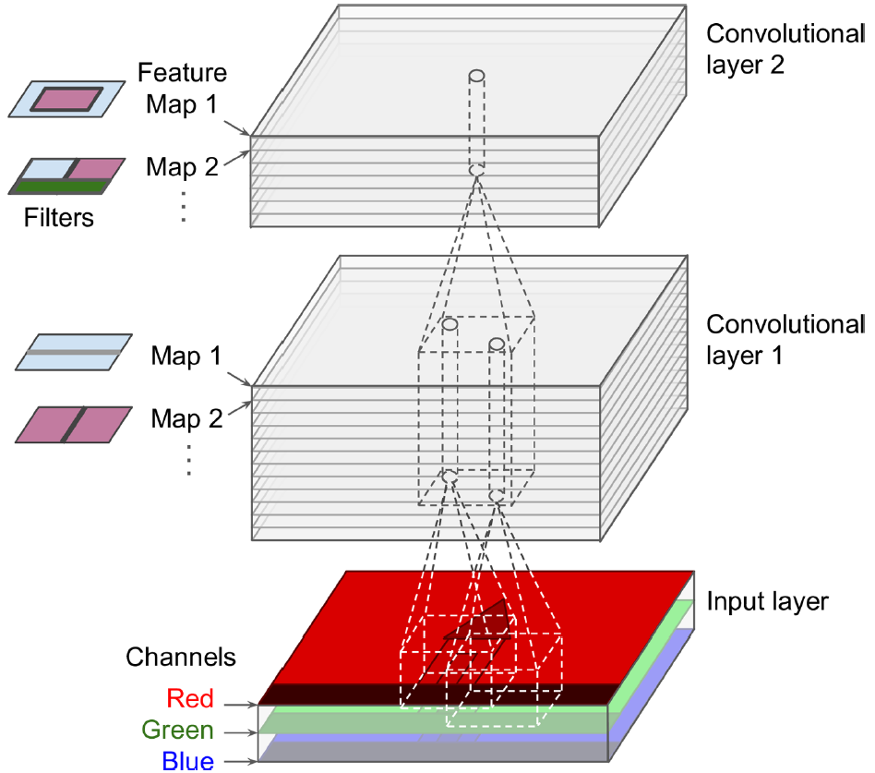
Stacking Multiple Feature Maps
we have represented each convolutional layer as a thin 2D layer, but in reality it is composed of several feature maps of equal sizes, so it is more accurately represented in 3D. Within one feature map, all neurons share the same parameters (weights and bias term), but different feature maps may have different parameters. A neuron’s receptive field extends across all the previous layers’ feature maps.

Slide 18
Stacking Multiple Feature Maps
Specifically, a neuron located in row i, column j of the feature map k in a given convolutional layer l is connected to the outputs of the neurons in the previous layer l – 1, located in rows i × s_{w} to i × s_{w} + f_{w} – 1 and columns j × s_{h} to j × s_{h} + f_{h} – 1, across all feature maps (in layer l – 1). Note that all neurons located in the same row i and column j but in different feature maps are connected to the outputs of the exact same neurons in the previous layer.

Slide 19
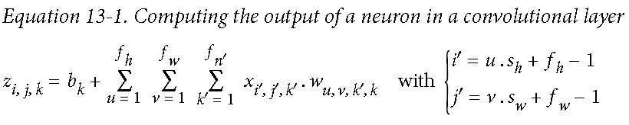
Stacking Multiple Feature Maps
Equation 13-1 summarizes the preceding explanations in one big mathematical equation: it shows how to compute the output of a given neuron in a convolutional layer.

Slide 20
TensorFlow Implementation
In TensorFlow, each input image is typically represented as a 3D tensor of shape [height, width, channels]. A mini-batch is represented as a 4D tensor of shape [mini-batch size, height, width, channels]. The weights of a convolutional layer are represented as a 4D tensor of shape [f_{h}, f_{w}, f_{n}, f_{n′}]. The bias terms of a convolutional layer are simply represented as a 1D tensor of shape [f_{n}].

Slide 21
import numpy as np
from sklearn.datasets import load_sample_images
# Load sample images
dataset = np.array(load_sample_images().images, dtype=np.float32)
batch_size, height, width, channels = dataset.shape
# Create 2 filters
filters_test = np.zeros(shape=(7, 7, channels, 2), dtype=np.float32)
filters_test[:, 3, :, 0] = 1 # vertical line
filters_test[3, :, :, 1] = 1 # horizontal line
# a graph with input X plus a convolutional layer applying the 2 filters
X = tf.placeholder(tf.float32, shape=(None, height, width, channels))
convolution = tf.nn.conv2d(X, filters, strides=[1,2,2,1], padding="SAME")
with tf.Session() as sess:
output = sess.run(convolution, feed_dict={X: dataset})
plt.imshow(output[0, :, :, 1]) # plot 1st image's 2nd feature map
plt.show()

Slide 22
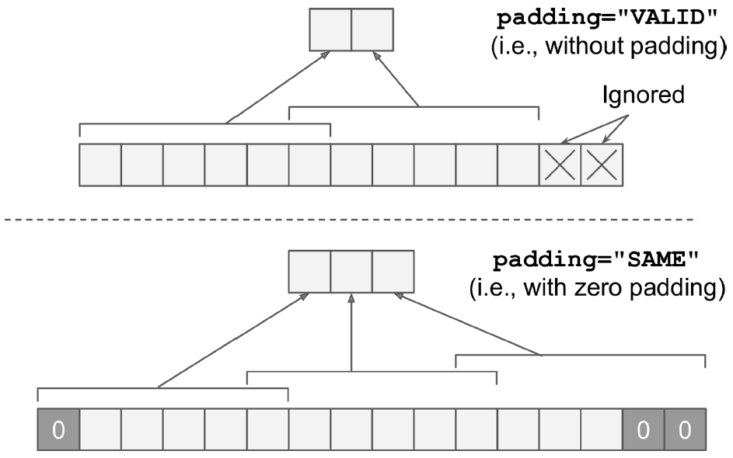
Padding options—input width: 13, filter width: 6, stride: 5

Slide 23
Memory Requirements
Another problem with CNNs is that the convolutional layers require a huge amount of RAM, especially during training, because the reverse pass of backpropagation requires all the intermediate values computed during the forward pass.

Slide 24
Memory Requirements
For example, consider a convolutional layer with 5 × 5 filters, outputting 200 feature maps of size 150 × 100, with stride 1 and SAME padding. If the input is a 150 × 100 RGB image (three channels), then the number of parameters is (5 × 5 × 3 + 1) × 200 = 15,200 (the +1 corresponds to the bias terms), which is fairly small compared to a fully connected layer.7 However, each of the 200 feature maps contains 150 × 100 neurons, and each of these neurons needs to compute a weighted sum of its 5 × 5 × 3 = 75 inputs.

Slide 25
Memory Requirements
Moreover, if the feature maps are represented using 32-bit floats, then the convolutional layer’s output will occupy 200 × 150 × 100 × 32 = 96 million bits (about 11.4 MB) of RAM.8 And that’s just for one instance! If a training batch contains 100 instances, then this layer will use up over 1 GB of RAM!

Slide 26
Pooling Layer
Once you understand how convolutional layers work, the pooling layers are quite easy to grasp. Their goal is to subsample (i.e., shrink) the input image in order to reduce the computational load, the memory usage, and the number of parameters (thereby limiting the risk of overfitting). Reducing the input image size also makes the neural network tolerate a little bit of image shift (location invariance).

Slide 27
Pooling Layer
Just like in convolutional layers, each neuron in a pooling layer is connected to the outputs of a limited number of neurons in the previous layer, located within a small rectangular receptive field. You must define its size, the stride, and the padding type, just like before. However, a pooling neuron has no weights; all it does is aggregate the inputs using an aggregation function such as the max or mean.

Slide 28
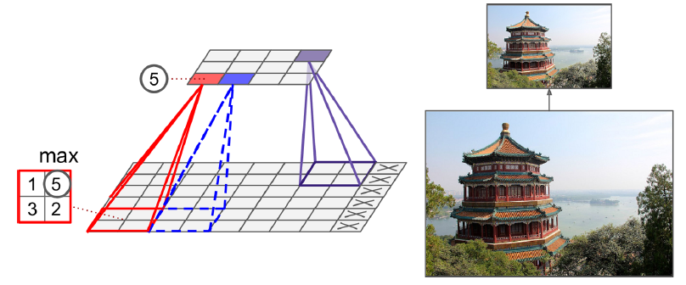
Max pooling layer (2 × 2 pooling kernel, stride 2, no padding)
Just like in convolutional layers, each neuron in a pooling layer is connected to the outputs of a limited number of neurons in the previous layer, located within a small rectangular receptive field. You must define its size, the stride, and the padding type, just like before. However, a pooling neuron has no weights; all it does is aggregate the inputs using an aggregation function such as the max or mean.

Slide 29
Pooling Layer
[...] # load the image dataset, just like above
# Create a graph with input X plus a max pooling layer
X = tf.placeholder(tf.float32, shape=(None, height, width, channels))
max_pool = tf.nn.max_pool(X, ksize=[1,2,2,1], strides=[1,2,2,1],padding="VALID")
with tf.Session() as sess:
output = sess.run(max_pool, feed_dict={X: dataset})
plt.imshow(output[0].astype(np.uint8)) # plot the output for the 1st image
plt.show()

Slide 30
CNN Architectures
Typical CNN architectures stack a few convolutional layers (each one generally followed by a ReLU layer), then a pooling layer, then another few convolutional layers (+ReLU), then another pooling layer, and so on. The image gets smaller and smaller as it progresses through the network, but it also typically gets deeper and deeper (i.e., with more feature maps) thanks to the convolutional layers. At the top of the stack, a regular feedforward neural network is added, composed of a few fully connected layers (+ReLUs), and the final layer outputs the prediction (e.g., a softmax layer that outputs estimated class probabilities).

Slide 31
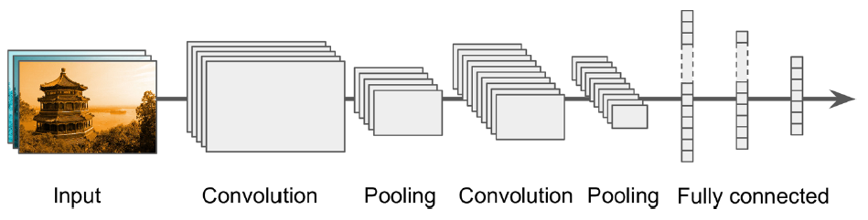
Typical CNN architecture

Slide 32
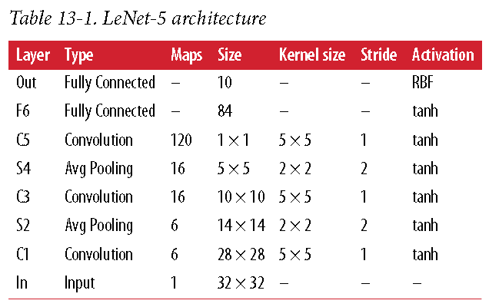
LeNet-5
Typical CNN architectures stack a few convolutional layers (each one generally followed by a ReLU layer), then a pooling layer, then another few convolutional layers (+ReLU), then another pooling layer, and so on. The image gets smaller and smaller as it progresses through the network, but it also typically gets deeper and deeper (i.e., with more feature maps) thanks to the convolutional layers. At the top of the stack, a regular feedforward neural network is added, composed of a few fully connected layers (+ReLUs), and the final layer outputs the prediction (e.g., a softmax layer that outputs estimated class probabilities).

Slide 33
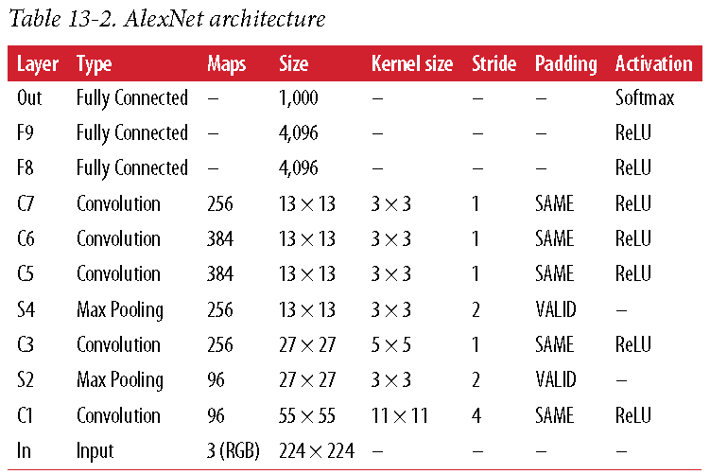
AlexNet
Typical CNN architectures stack a few convolutional layers (each one generally followed by a ReLU layer), then a pooling layer, then another few convolutional layers (+ReLU), then another pooling layer, and so on. The image gets smaller and smaller as it progresses through the network, but it also typically gets deeper and deeper (i.e., with more feature maps) thanks to the convolutional layers. At the top of the stack, a regular feedforward neural network is added, composed of a few fully connected layers (+ReLUs), and the final layer outputs the prediction (e.g., a softmax layer that outputs estimated class probabilities).

Slide 34
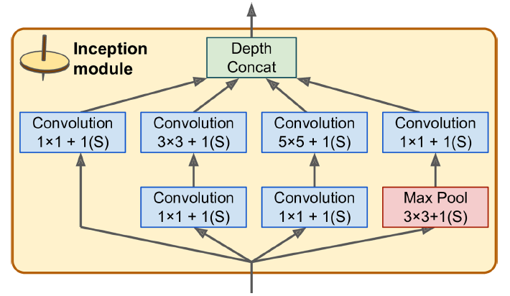
GoogLeNet
Typical CNN architectures stack a few convolutional layers (each one generally followed by a ReLU layer), then a pooling layer, then another few convolutional layers (+ReLU), then another pooling layer, and so on. The image gets smaller and smaller as it progresses through the network, but it also typically gets deeper and deeper (i.e., with more feature maps) thanks to the convolutional layers. At the top of the stack, a regular feedforward neural network is added, composed of a few fully connected layers (+ReLUs), and the final layer outputs the prediction (e.g., a softmax layer that outputs estimated class probabilities).

Slide 35
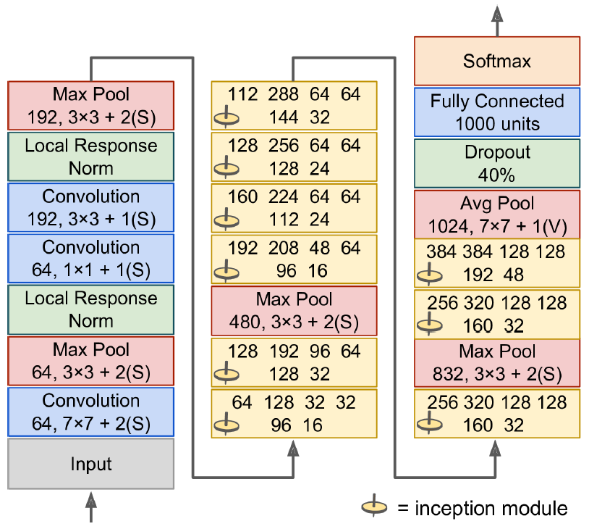
GoogLeNet

Slide 36
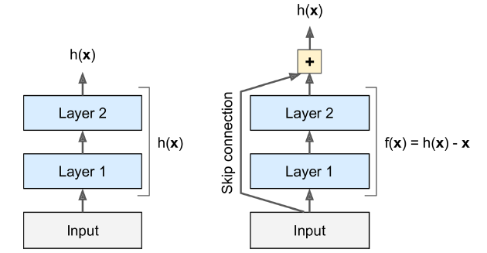
ResNet
Typical CNN architectures stack a few convolutional layers (each one generally followed by a ReLU layer), then a pooling layer, then another few convolutional layers (+ReLU), then another pooling layer, and so on. The image gets smaller and smaller as it progresses through the network, but it also typically gets deeper and deeper (i.e., with more feature maps) thanks to the convolutional layers. At the top of the stack, a regular feedforward neural network is added, composed of a few fully connected layers (+ReLUs), and the final layer outputs the prediction (e.g., a softmax layer that outputs estimated class probabilities).

Slide 37
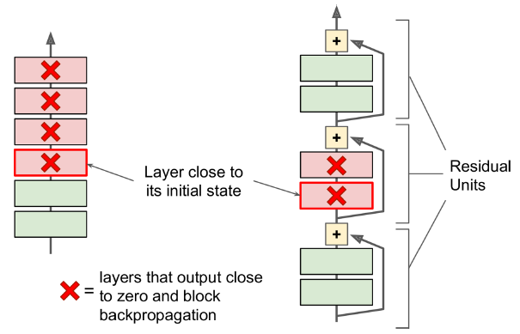
ResNet
Typical CNN architectures stack a few convolutional layers (each one generally followed by a ReLU layer), then a pooling layer, then another few convolutional layers (+ReLU), then another pooling layer, and so on. The image gets smaller and smaller as it progresses through the network, but it also typically gets deeper and deeper (i.e., with more feature maps) thanks to the convolutional layers. At the top of the stack, a regular feedforward neural network is added, composed of a few fully connected layers (+ReLUs), and the final layer outputs the prediction (e.g., a softmax layer that outputs estimated class probabilities).

Slide 38
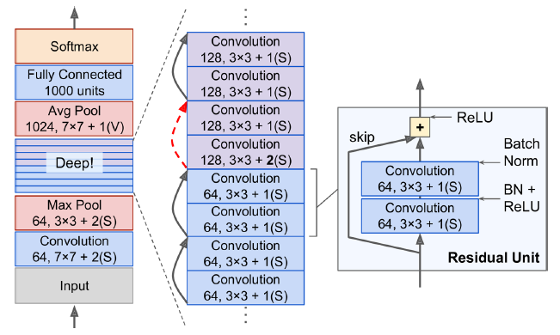
ResNet
Typical CNN architectures stack a few convolutional layers (each one generally followed by a ReLU layer), then a pooling layer, then another few convolutional layers (+ReLU), then another pooling layer, and so on. The image gets smaller and smaller as it progresses through the network, but it also typically gets deeper and deeper (i.e., with more feature maps) thanks to the convolutional layers. At the top of the stack, a regular feedforward neural network is added, composed of a few fully connected layers (+ReLUs), and the final layer outputs the prediction (e.g., a softmax layer that outputs estimated class probabilities).

Slide 39
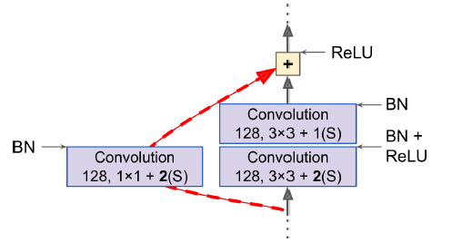
ResNet
Typical CNN architectures stack a few convolutional layers (each one generally followed by a ReLU layer), then a pooling layer, then another few convolutional layers (+ReLU), then another pooling layer, and so on. The image gets smaller and smaller as it progresses through the network, but it also typically gets deeper and deeper (i.e., with more feature maps) thanks to the convolutional layers. At the top of the stack, a regular feedforward neural network is added, composed of a few fully connected layers (+ReLUs), and the final layer outputs the prediction (e.g., a softmax layer that outputs estimated class probabilities).

