Slide 1
Hands-On Machine Learning with Scikit-Learn and TensorFlow
Concepts, Tools, and Techniques to Build Intelligent Systems

Slide 2
CHAPTER 14
Recurrent Neural Networks
In this chapter, we are going to discuss recurrent neural networks (RNN), a class of nets that can predict the future. They can analyze time series data such as stock prices, and tell you when to buy or sell. In autonomous driving systems, they can anticipate car trajectories and help avoid accidents. More generally, they can work on sequences of arbitrary lengths, rather than on fixed-sized inputs like all the nets we have discussed so far.

Slide 3
CHAPTER 14
Recurrent Neural Networks
In this chapter, we will look at the fundamental concepts underlying RNNs, the main problem they face (namely, vanishing/exploding gradients, discussed in Chapter 11), and the solutions widely used to fight it: LSTM and GRU cells. Along the way, as always, we will show how to implement RNNs using TensorFlow. Finally, we will take a look at the architecture of a machine translation system.

Slide 4
Recurrent Neurons
Up to now we have mostly looked at feedforward neural networks, where the activations flow only in one direction, from the input layer to the output layer (except for a few networks in Appendix E). A recurrent neural network looks very much like a feedforward neural network, except it also has connections pointing backward.

Slide 5
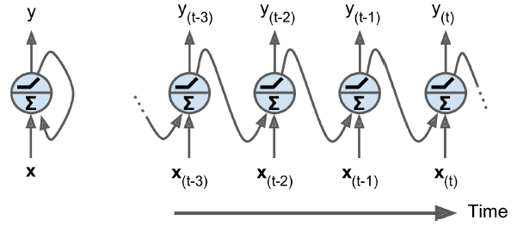
Recurrent Neurons
Let’s look at the simplest possible RNN, composed of just one neuron receiving inputs, producing an output, and sending that output back to itself, as shown in Figure 14-1 (left)

Slide 6
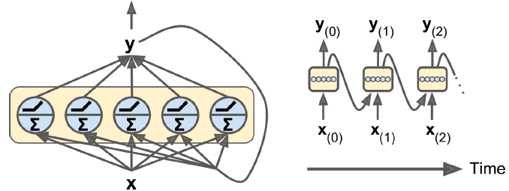
Recurrent Neurons
You can easily create a layer of recurrent neurons. At each time step t, every neuron receives both the input vector x_{(t)} and the output vector from the previous step y_{(t–1)} .

Slide 7
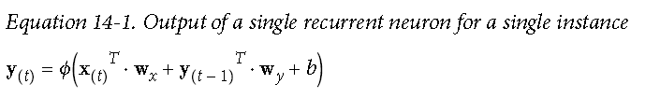
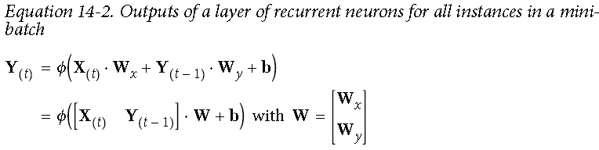
Recurrent Neurons
Each recurrent neuron has two sets of weights: one for the inputs x_{(t)} and the other for the outputs of the previous step, y_{(t–1)}. Let’s call these weight vectors w_{x} and w_{y}.

Slide 8
Memory Cells
Since the output of a recurrent neuron at time step t is a function of all the inputs from previous time steps, you could say it has a form of memory. A part of a neural network that preserves some state across time steps is called a memory cell (or simply a cell). A single recurrent neuron, or a layer of recurrent neurons, is a very basic cell, but later in this chapter we will look at some more complex and powerful types of cells.

Slide 9
Memory Cells
In general a cell’s state at time step t, denoted h_{(t)} (the “h” stands for “hidden”), is a function of some inputs at that time step and its state at the previous time step: h_{(t)} = f(h_{(t–1)}, x_{(t)}). Its output at time step t, denoted y(t), is also a function of the previous state and the current inputs. In the case of the basic cells we have discussed so far, the output is simply equal to the state, but in more complex cells this is not always the case.

Slide 10
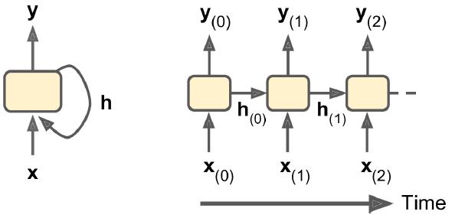
A cell’s hidden state and its output may be different
In general a cell’s state at time step t, denoted h_{(t)} (the “h” stands for “hidden”), is a function of some inputs at that time step and its state at the previous time step: h_{(t)} = f(h_{(t–1)}, x_{(t)}). Its output at time step t, denoted y(t), is also a function of the previous state and the current inputs. In the case of the basic cells we have discussed so far, the output is simply equal to the state, but in more complex cells this is not always the case.

Slide 11
Input and Output Sequences
An RNN can simultaneously take a sequence of inputs and produce a sequence of outputs. For example, this type of network is useful for predicting time series such as stock prices: you feed it the prices over the last N days, and it must output the prices shifted by one day into the future (i.e., from N – 1 days ago to tomorrow).

Slide 12
Input and Output Sequences
Alternatively, you could feed the network a sequence of inputs, and ignore all outputs except for the last one (see the top-right network). In other words, this is a sequence-to-vector network. For example, you could feed the network a sequence of words corresponding to a movie review, and the network would output a sentiment score (e.g., from –1 [hate] to +1 [love]).
Conversely, you could feed the network a single input at the first time step and let it output a sequence . This is a vector-to-sequence network.

Slide 13
Input and Output Sequences
Lastly, you could have a sequence-to-vector network, called an encoder, followed by a vector-to-sequence network, called a decoder. This two-step model, called an Encoder–Decoder, works much better than trying to translate on the fly with a single sequence-to-sequence RNN, since the last words of a sentence can affect the first words of the translation, so you need to wait until you have heard the whole sentence before translating it.

Slide 14
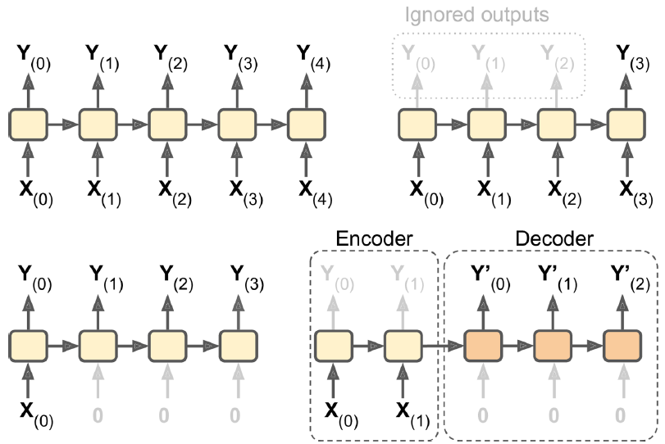
Seq to seq (top left), seq to vector (top right), vector to seq (bottom left), delayed seq to seq (bottom right)
Lastly, you could have a sequence-to-vector network, called an encoder, followed by a vector-to-sequence network, called a decoder. This two-step model, called an Encoder–Decoder, works much better than trying to translate on the fly with a single sequence-to-sequence RNN, since the last words of a sentence can affect the first words of the translation, so you need to wait until you have heard the whole sentence before translating it.

Slide 15
Basic RNNs in TensorFlow
n_inputs = 3
n_neurons = 5
X0 = tf.placeholder(tf.float32, [None, n_inputs])
X1 = tf.placeholder(tf.float32, [None, n_inputs])
Wx = tf.Variable(tf.random_normal(shape=[n_inputs, n_neurons],dtype=tf.float32))
Wy = tf.Variable(tf.random_normal(shape=[n_neurons,n_neurons],dtype=tf.float32))
b = tf.Variable(tf.zeros([1, n_neurons], dtype=tf.float32))
Y0 = tf.tanh(tf.matmul(X0, Wx) + b)
Y1 = tf.tanh(tf.matmul(Y0, Wy) + tf.matmul(X1, Wx) + b)
init = tf.global_variables_initializer()

Slide 16
Basic RNNs in TensorFlow
import numpy as np
# Mini-batch: instance 0,instance 1,instance 2,instance 3
X0_batch = np.array([[0, 1, 2], [3, 4, 5], [6, 7, 8], [9, 0, 1]]) # t = 0
X1_batch = np.array([[9, 8, 7], [0, 0, 0], [6, 5, 4], [3, 2, 1]]) # t = 1
with tf.Session() as sess:
init.run()
Y0_val, Y1_val = sess.run([Y0, Y1], feed_dict={X0: X0_batch, X1: X1_batch})

Slide 17
Basic RNNs in TensorFlow
>>> print(Y0_val) # output at t = 0
[[-0.2964572 0.82874775 -0.34216955 -0.75720584 0.19011548] # instance 0
[-0.12842922 0.99981797 0.84704727 -0.99570125 0.38665548] # instance 1
[ 0.04731077 0.99999976 0.99330056 -0.999933 0.55339795] # instance 2
[ 0.70323634 0.99309105 0.99909431 -0.85363263 0.7472108 ]] # instance 3
>>> print(Y1_val) # output at t = 1
[[ 0.51955646 1. 0.99999022 -0.99984968 -0.24616946] # instance 0
[-0.70553327 -0.11918639 0.48885304 0.08917919 -0.26579669] # instance 1
[-0.32477224 0.99996376 0.99933046 -0.99711186 0.10981458] # instance 2
[-0.43738723 0.91517633 0.97817528 -0.91763324 0.11047263]] # instance 3

Slide 18
Static Unrolling Through Time
The static_rnn() function creates an unrolled RNN network by chaining cells. The following code creates the exact same model as the previous one:
X0 = tf.placeholder(tf.float32, [None, n_inputs])
X1 = tf.placeholder(tf.float32, [None, n_inputs])
basic_cell = tf.contrib.rnn.BasicRNNCell(num_units=n_neurons)
output_seqs, states = tf.contrib.rnn.static_rnn( basic_cell, [X0, X1], dtype=tf.float32)
Y0, Y1 = output_seqs

Slide 19
X = tf.placeholder(tf.float32, [None, n_steps, n_inputs])
X_seqs = tf.unstack(tf.transpose(X, perm=[1, 0, 2]))
basic_cell = tf.contrib.rnn.BasicRNNCell(num_units=n_neurons)
output_seqs, states = tf.contrib.rnn.static_rnn( basic_cell, X_seqs, dtype=tf.float32)
outputs = tf.transpose(tf.stack(output_seqs), perm=[1, 0, 2])
X_batch = np.array([
# t = 0 t = 1
[[0, 1, 2], [9, 8, 7]], # instance 0
[[3, 4, 5], [0, 0, 0]], # instance 1
[[6, 7, 8], [6, 5, 4]], # instance 2
[[9, 0, 1], [3, 2, 1]], # instance 3
])
with tf.Session() as sess:
init.run()
outputs_val = outputs.eval(feed_dict={X: X_batch})

Slide 20
X = tf.placeholder(tf.float32, [None, n_steps, n_inputs])
X_seqs = tf.unstack(tf.transpose(X, perm=[1, 0, 2]))
basic_cell = tf.contrib.rnn.BasicRNNCell(num_units=n_neurons)
output_seqs, states = tf.contrib.rnn.static_rnn( basic_cell, X_seqs, dtype=tf.float32)
outputs = tf.transpose(tf.stack(output_seqs), perm=[1, 0, 2])
X_batch = np.array([
# t = 0 t = 1
[[0, 1, 2], [9, 8, 7]], # instance 0
[[3, 4, 5], [0, 0, 0]], # instance 1
[[6, 7, 8], [6, 5, 4]], # instance 2
[[9, 0, 1], [3, 2, 1]], # instance 3
])
with tf.Session() as sess:
init.run()
outputs_val = outputs.eval(feed_dict={X: X_batch})

Slide 21
Static Unrolling Through Time
>>> print(outputs_val)
[[[-0.2964572 0.82874775 -0.34216955 -0.75720584 0.19011548]
[ 0.51955646 1. 0.99999022 -0.99984968 -0.24616946]]
[[-0.12842922 0.99981797 0.84704727 -0.99570125 0.38665548]
[-0.70553327 -0.11918639 0.48885304 0.08917919 -0.26579669]]
[[ 0.04731077 0.99999976 0.99330056 -0.999933 0.55339795]
[-0.32477224 0.99996376 0.99933046 -0.99711186 0.10981458]]
[[ 0.70323634 0.99309105 0.99909431 -0.85363263 0.7472108 ]
[-0.43738723 0.91517633 0.97817528 -0.91763324 0.11047263]]]

Slide 22
Dynamic Unrolling Through Time
The dynamic_rnn() function uses a while_loop() operation to run over the cell the appropriate number of times, and you can set swap_memory=True if you want it to swap the GPU’s memory to the CPU’s memory during backpropagation to avoid OOM errors. Conveniently, it also accepts a single tensor for all inputs at every time step (shape [None, n_steps, n_inputs]) and it outputs a single tensor for all outputs at every time step (shape [None, n_steps, n_neurons]); there is no need to stack, unstack, or transpose.

Slide 23
Dynamic Unrolling Through Time
X = tf.placeholder(tf.float32, [None, n_steps, n_inputs])
basic_cell = tf.contrib.rnn.BasicRNNCell(num_units=n_neurons)
outputs, states = tf.nn.dynamic_rnn(basic_cell, X, dtype=tf.float32)
During backpropagation, the while_loop() operation does the appropriate magic: it stores the tensor values for each iteration during the forward pass so it can use them to compute gradients during the reverse pass.

Slide 24
Handling Variable Length Input Sequences
So far we have used only fixed-size input sequences (all exactly two steps long). What if the input sequences have variable lengths (e.g., like sentences)? In this case you should set the sequence_length parameter when calling the dynamic_rnn() (or static_rnn()) function; it must be a 1D tensor indicating the length of the input sequence for each instance.
seq_length = tf.placeholder(tf.int32, [None])
[...]
outputs, states = tf.nn.dynamic_rnn(basic_cell, X, dtype=tf.float32, sequence_length=seq_length)

Slide 25
Handling Variable Length Input Sequences
For example, suppose the second input sequence contains only one input instead of two. It must be padded with a zero vector in order to fit in the input tensor X (because the input tensor’s second dimension is the size of the longest sequence—i.e., 2).
X_batch = np.array([
# step 0 step 1
[[0, 1, 2], [9, 8, 7]], # instance 0
[[3, 4, 5], [0, 0, 0]], # instance 1 (padded with a zero vector)
[[6, 7, 8], [6, 5, 4]], # instance 2
[[9, 0, 1], [3, 2, 1]], # instance 3
])
seq_length_batch = np.array([2, 1, 2, 2])

Slide 26
with tf.Session() as sess:
init.run()
outputs_val, states_val = sess.run(
[outputs, states], feed_dict={X: X_batch, seq_length: seq_length_batch})
>>> print(outputs_val)
[[[-0.2964572 0.82874775 -0.34216955 -0.75720584 0.19011548]
[ 0.51955646 1. 0.99999022 -0.99984968 -0.24616946]] # final state
[[-0.12842922 0.99981797 0.84704727 -0.99570125 0.38665548] # final state
[ 0. 0. 0. 0. 0. ]] # zero vector
[[ 0.04731077 0.99999976 0.99330056 -0.999933 0.55339795]
[-0.32477224 0.99996376 0.99933046 -0.99711186 0.10981458]] # final state
[[ 0.70323634 0.99309105 0.99909431 -0.85363263 0.7472108 ]
[-0.43738723 0.91517633 0.97817528 -0.91763324 0.11047263]]] # final state
>>> print(states_val)
[[ 0.51955646 1. 0.99999022 -0.99984968 -0.24616946] # t = 1
[-0.12842922 0.99981797 0.84704727 -0.99570125 0.38665548] # t = 0 !!!
[-0.32477224 0.99996376 0.99933046 -0.99711186 0.10981458] # t = 1
[-0.43738723 0.91517633 0.97817528 -0.91763324 0.11047263]] # t = 1

Slide 27
Handling Variable-Length Output Sequences
What if the output sequences have variable lengths as well? If you know in advance what length each sequence will have (for example if you know that it will be the same length as the input sequence), then you can set the sequence_length parameter as described above. Unfortunately, in general this will not be possible: for example, the length of a translated sentence is generally different from the length of the input sentence. In this case, the most common solution is to define a special output called an end-of-sequence token (EOS token). Any output past the EOS should be ignored.

Slide 28
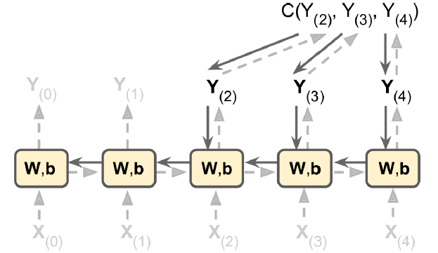
Training RNNs
To train an RNN, the trick is to unroll it through time (like we just did) and then simply use regular backpropagation (see Figure 14-5). This strategy is called backpropagation through time (BPTT).

Slide 29
Training a Sequence Classifier
Let’s train an RNN to classify MNIST images. A convolutional neural network would be better suited for image classification (see Chapter 13), but this makes for a simple example that you are already familiar with. We will treat each image as a sequence of 28 rows of 28 pixels each (since each MNIST image is 28 × 28 pixels). We will use cells of 150 recurrent neurons, plus a fully connected layer containing 10 neurons (one per class) connected to the output of the last time step, followed by a softmax layer.

Slide 30
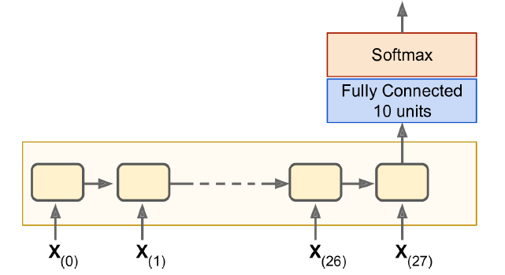
Sequence classifier
Let’s train an RNN to classify MNIST images. A convolutional neural network would be better suited for image classification (see Chapter 13), but this makes for a simple example that you are already familiar with. We will treat each image as a sequence of 28 rows of 28 pixels each (since each MNIST image is 28 × 28 pixels). We will use cells of 150 recurrent neurons, plus a fully connected layer containing 10 neurons (one per class) connected to the output of the last time step, followed by a softmax layer.

Slide 31
Training a Sequence Classifier
The construction phase is quite straightforward; it’s pretty much the same as the MNIST classifier we built in Chapter 10 except that an unrolled RNN replaces the hidden layers. Note that the fully connected layer is connected to the states tensor, which contains only the final state of the RNN (i.e., the 28th output). Also note that y is a placeholder for the target classes.

Slide 32
from tensorflow.contrib.layers import fully_connected
n_steps = 28
n_inputs = 28
n_neurons = 150
n_outputs = 10
learning_rate = 0.001
X = tf.placeholder(tf.float32, [None, n_steps, n_inputs])
y = tf.placeholder(tf.int32, [None])
basic_cell = tf.contrib.rnn.BasicRNNCell(num_units=n_neurons)
outputs, states = tf.nn.dynamic_rnn(basic_cell, X, dtype=tf.float32)
logits = fully_connected(states, n_outputs, activation_fn=None)
xentropy = tf.nn.sparse_softmax_cross_entropy_with_logits(labels=y, logits=logits)
loss = tf.reduce_mean(xentropy)
optimizer = tf.train.AdamOptimizer(learning_rate=learning_rate)
training_op = optimizer.minimize(loss)
correct = tf.nn.in_top_k(logits, y, 1)
accuracy = tf.reduce_mean(tf.cast(correct, tf.float32))
init = tf.global_variables_initializer()

Slide 33
from tensorflow.examples.tutorials.mnist import input_data
mnist = input_data.read_data_sets("/tmp/data/")
X_test = mnist.test.images.reshape((-1, n_steps, n_inputs))
y_test = mnist.test.labels
n_epochs = 100
batch_size = 150
with tf.Session() as sess:
init.run()
for epoch in range(n_epochs):
for iteration in range(mnist.train.num_examples // batch_size):
X_batch, y_batch = mnist.train.next_batch(batch_size)
X_batch = X_batch.reshape((-1, n_steps, n_inputs))
sess.run(training_op, feed_dict={X: X_batch, y: y_batch})
acc_train = accuracy.eval(feed_dict={X: X_batch, y: y_batch})
acc_test = accuracy.eval(feed_dict={X: X_test, y: y_test})
print(epoch, "Train accuracy:", acc_train, "Test accuracy:", acc_test)

Slide 34
0 Train accuracy: 0.713333 Test accuracy: 0.7299
1 Train accuracy: 0.766667 Test accuracy: 0.7977
...
98 Train accuracy: 0.986667 Test accuracy: 0.9777
99 Train accuracy: 0.986667 Test accuracy: 0.9809
You can specify an initializer for the RNN by wrapping its construction code in a variable scope (e.g., use variable_scope("rnn", initializer=variance_scaling_initializer()) to use He initialization).

Slide 35
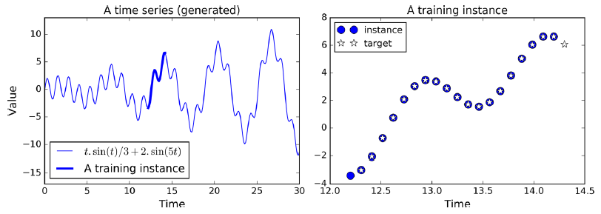
Training to Predict Time Series
Now let’s take a look at how to handle time series, like stock prices. In this section we will train an RNN to predict the next value in a generated time series. Each training instance is a randomly selected sequence of 20 consecutive values from the time series, and the target sequence is the same as the input sequence, except it is shifted by one time step into the future.

Slide 36
Training to Predict Time Series
n_steps = 20
n_inputs = 1
n_neurons = 100
n_outputs = 1
X = tf.placeholder(tf.float32, [None, n_steps, n_inputs])
y = tf.placeholder(tf.float32, [None, n_steps, n_outputs])
cell = tf.contrib.rnn.BasicRNNCell(num_units=n_neurons, activation=tf.nn.relu)
outputs, states = tf.nn.dynamic_rnn(cell, X, dtype=tf.float32)

Slide 37
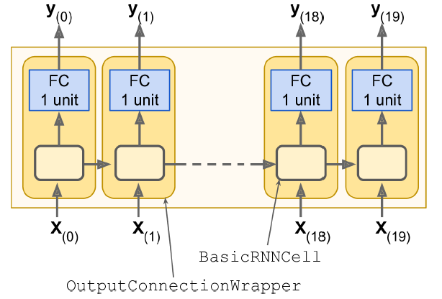
RNN cells using output projections
At each time step we now have an output vector of size 100. But what we actually want is a single output value at each time step.

Slide 38
RNN cells using output projections
cell = tf.contrib.rnn.OutputProjectionWrapper(
tf.contrib.rnn.BasicRNNCell(num_units=n_neurons, activation=tf.nn.relu), output_size=n_outputs)
learning_rate = 0.001
loss = tf.reduce_mean(tf.square(outputs - y))
optimizer = tf.train.AdamOptimizer(learning_rate=learning_rate)
training_op = optimizer.minimize(loss)
init = tf.global_variables_initializer()

Slide 39
n_iterations = 10000
batch_size = 50
with tf.Session() as sess:
init.run()
for iteration in range(n_iterations):
X_batch, y_batch = [...] # fetch the next training batch
sess.run(training_op, feed_dict={X: X_batch, y: y_batch})
if iteration % 100 == 0:
mse = loss.eval(feed_dict={X: X_batch, y: y_batch})
print(iteration, "\tMSE:", mse)
0 MSE: 379.586
100 MSE: 14.58426
200 MSE: 7.14066
300 MSE: 3.98528
400 MSE: 2.00254 [...]

Slide 40
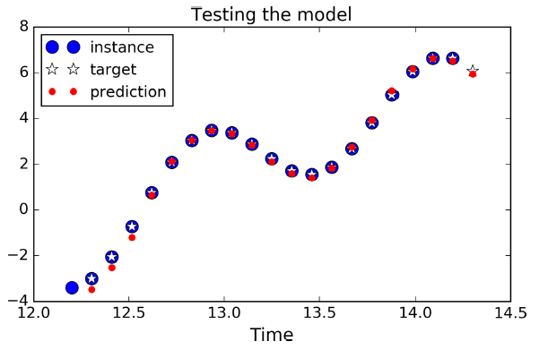
RNN cells using output projections
X_new = [...] # New sequences
y_pred = sess.run(outputs, feed_dict={X: X_new})

Slide 41
RNN cells using output projections
Although using an OutputProjectionWrapper is the simplest solution to reduce the dimensionality of the RNN’s output sequences down to just one value per time step (per instance), it is not the most efficient. There is a trickier but more efficient solution: you can reshape the RNN outputs from [batch_size, n_steps, n_neurons] to [batch_size * n_steps, n_neurons], then apply a single fully connected layer with the appropriate output size (in our case just 1), which will result in an output tensor of shape [batch_size * n_steps, n_outputs], and then reshape this tensor to [batch_size, n_steps, n_outputs].

Slide 42
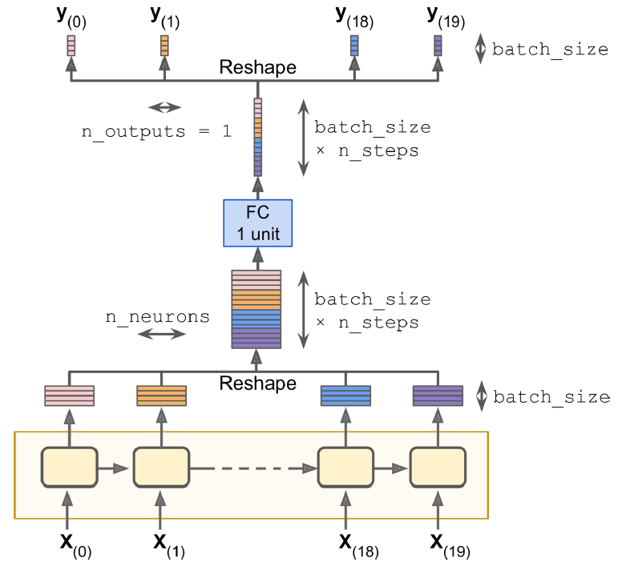
RNN cells using output projections

Slide 43
Training to Predict Time Series
cell = tf.contrib.rnn.BasicRNNCell(num_units=n_neurons, activation=tf.nn.relu)
rnn_outputs, states = tf.nn.dynamic_rnn(cell, X, dtype=tf.float32)
stacked_rnn_outputs = tf.reshape(rnn_outputs, [-1, n_neurons])
stacked_outputs = fully_connected(stacked_rnn_outputs, n_outputs,
activation_fn=None)
outputs = tf.reshape(stacked_outputs, [-1, n_steps, n_outputs])
This can provide a significant speed boost since there is just one fully connected layer instead of one per time step.

Slide 44
Creative RNN
Now that we have a model that can predict the future, we can use it to generate some creative sequences, as explained at the beginning of the chapter. All we need is to provide it a seed sequence containing n_steps values (e.g., full of zeros), use the model to predict the next value, append this predicted value to the sequence, feed the last n_steps values to the model to predict the next value, and so on. This process generates a new sequence that has some resemblance to the original time series.

Slide 45
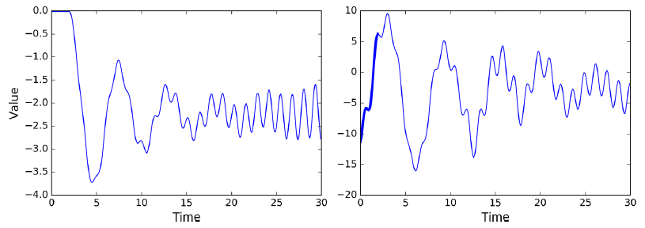
Creative RNN
sequence = [0.] * n_steps
for iteration in range(300):
X_batch = np.array(sequence[-n_steps:]).reshape(1, n_steps, 1)
y_pred = sess.run(outputs, feed_dict={X: X_batch})
sequence.append(y_pred[0, -1, 0])

Slide 46
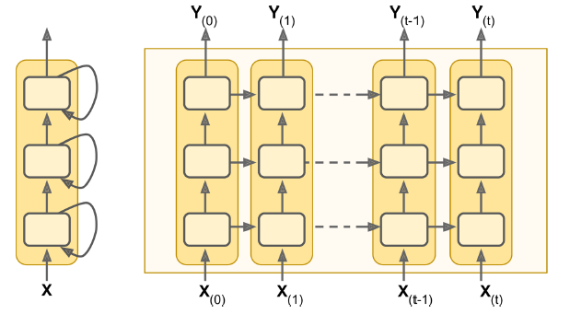
Deep RNNs
It is quite common to stack multiple layers of cells. This gives you a deep RNN.

Slide 47
Deep RNNs
To implement a deep RNN in TensorFlow, you can create several cells and stack them into a MultiRNNCell.
n_neurons = 100
n_layers = 3
basic_cell = tf.contrib.rnn.BasicRNNCell(num_units=n_neurons)
multi_layer_cell = tf.contrib.rnn.MultiRNNCell([basic_cell] * n_layers)
outputs, states = tf.nn.dynamic_rnn(multi_layer_cell, X, dtype=tf.float32)

Slide 48
Applying Dropout
If you build a very deep RNN, it may end up overfitting the training set. To prevent that, a common technique is to apply dropout (introduced in Chapter 11). You can simply add a dropout layer before or after the RNN as usual, but if you also want to apply dropout between the RNN layers, you need to use a DropoutWrapper. The following code applies dropout to the inputs of each layer in the RNN, dropping each input with a 50% probability:
keep_prob = 0.5
cell = tf.contrib.rnn.BasicRNNCell(num_units=n_neurons)
cell_drop = tf.contrib.rnn.DropoutWrapper(cell, input_keep_prob=keep_prob)
multi_layer_cell = tf.contrib.rnn.MultiRNNCell([cell_drop] * n_layers)
rnn_outputs, states = tf.nn.dynamic_rnn(multi_layer_cell, X, dtype=tf.float32)

Slide 49
The Difficulty of Training over Many Time Steps
To train an RNN on long sequences, you will need to run it over many time steps, making the unrolled RNN a very deep network. Just like any deep neural network it may suffer from the vanishing/exploding gradients problem (discussed in Chapter 11) and take forever to train. Many of the tricks we discussed to alleviate this problem can be used for deep unrolled RNNs as well: good parameter initialization, nonsaturating activation functions (e.g., ReLU), Batch Normalization, Gradient Clipping, and faster optimizers. However, if the RNN needs to handle even moderately long sequences (e.g., 100 inputs), then training will still be very slow.

Slide 50
The Difficulty of Training over Many Time Steps
The simplest and most common solution to this problem is to unroll the RNN only over a limited number of time steps during training. This is called truncated backpropagation through time. In TensorFlow you can implement it simply by truncating the input sequences. For example, in the time series prediction problem, you would simply reduce n_steps during training. The problem, of course, is that the model will not be able to learn long-term patterns.

Slide 51
The Difficulty of Training over Many Time Steps
One workaround could be to make sure that these shortened sequences contain both old and recent data, so that the model can learn to use both (e.g., the sequence could contain monthly data for the last five months, then weekly data for the last five weeks, then daily data over the last five days). But this workaround has its limits: what if fine-grained data from last year is actually useful? What if there was a brief but significant event that absolutely must be taken into account, even years later (e.g., the result of an election)?

Slide 52
The Difficulty of Training over Many Time Steps
Besides the long training time, a second problem faced by long-running RNNs is the fact that the memory of the first inputs gradually fades away. Indeed, due to the transformations that the data goes through when traversing an RNN, some information is lost after each time step. After a while, the RNN’s state contains virtually no trace of the first inputs. This can be a showstopper.

Slide 53
The Difficulty of Training over Many Time Steps
For example, say you want to perform sentiment analysis on a long review that starts with the four words “I loved this movie,” but the rest of the review lists the many things that could have made the movie even better. If the RNN gradually forgets the first four words, it will completely misinterpret the review. To solve this problem, various types of cells with long-term memory have been introduced. They have proved so successful that the basic cells are not much used anymore. Let’s first look at the most popular of these long memory cells: the LSTM cell.

Slide 54
LSTM Cell
The Long Short-Term Memory (LSTM) cell was proposed in 1997 by Sepp Hochreiter and Jurgen Schmidhuber, and it was gradually improved over the. If you consider the LSTM cell as a black box, it can be used very much like a basic cell, except it will perform much better; training will converge faster and it will detect long-term dependencies in the data. In TensorFlow, you can simply use a BasicLSTM Cell instead of a BasicRNNCell:
lstm_cell = tf.contrib.rnn.BasicLSTMCell(num_units=n_neurons)
LSTM cells manage two state vectors kept separate by default. You can change this default behavior by setting state_is_tuple=False when creating the BasicLSTMCell.

Slide 55
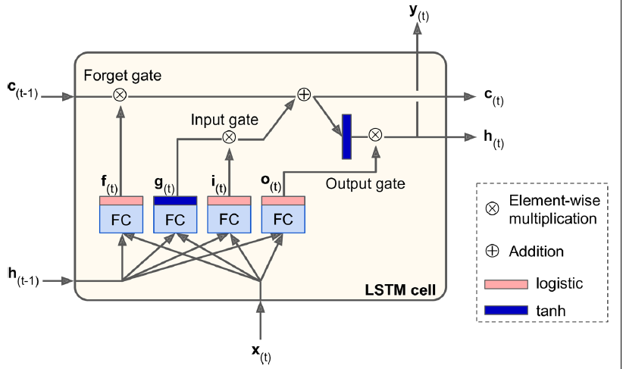
LSTM Cell

Slide 56
LSTM Cell
If you don’t look at what’s inside the box, the LSTM cell looks exactly like a regular cell, except that its state is split in two vectors: h_{(t)} and c_{(t)} (“c” stands for “cell”). You can think of h_{(t)} as the short-term state and c_{(t)} as the long-term state.

Slide 57
LSTM Cell
Now let’s open the box! The key idea is that the network can learn what to store in the long-term state, what to throw away, and what to read from it. As the long-term state c_{(t–1)} traverses the network from left to right, you can see that it first goes through a forget gate, dropping some memories, and then it adds some new memories via the addition operation (which adds the memories that were selected by an input gate). The result c_{(t)} is sent straight out, without any further transformation.

Slide 58
LSTM Cell
So, at each time step, some memories are dropped and some memories are added. Moreover, after the addition operation, the long-term state is copied and passed through the tanh function, and then the result is filtered by the output gate. This produces the short-term state h(t) (which is equal to the cell’s output for this time step y(t)). Now let’s look at where new memories come from and how the gates work.

Slide 59
LSTM Cell
First, the current input vector x_{(t)} and the previous short-term state h_{(t–1)} are fed to four different fully connected layers. They all serve a different purpose:
The main layer is the one that outputs g_{(t)}. It has the usual role of analyzing the current inputs x_{(t)} and the previous (short-term) state h_{(t–1)}. In a basic cell, there is nothing else than this layer, and its output goes straight out to y_{(t)} and h_{(t)}. In contrast, in an LSTM cell this layer’s output does not go straight out, but instead it is partially stored in the long-term state.

Slide 60
LSTM Cell
The three other layers are gate controllers. Since they use the logistic activation function, their outputs range from 0 to 1. As you can see, their outputs are fed to element-wise multiplication operations, so if they output 0s, they close the gate, and if they output 1s, they open it. Specifically:
—The forget gate (controlled by f_{(t)}) controls which parts of the long-term state should be erased.
—The input gate (controlled by i_{(t)}) controls which parts of g(t) should be added to the long-term state (this is why we said it was only “partially stored”).
—Finally, the output gate (controlled by o_{(t)}) controls which parts of the longterm state should be read and output at this time step (both to h_{(t)}) and y_{(t)}.

Slide 61
LSTM Cell
In short, an LSTM cell can learn to recognize an important input (that’s the role of the input gate), store it in the long-term state, learn to preserve it for as long as it is needed (that’s the role of the forget gate), and learn to extract it whenever it is needed. This explains why they have been amazingly successful at capturing long-term patterns in time series, long texts, audio recordings, and more.

Slide 62
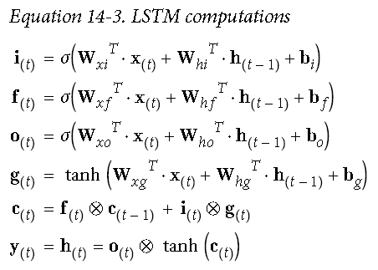
LSTM Cell
Equation 14-3 summarizes how to compute the cell’s long-term state, its short-term state, and its output at each time step for a single instance (the equations for a whole mini-batch are very similar).

Slide 63
Peephole Connections
In a basic LSTM cell, the gate controllers can look only at the input x_{(t)} and the previous short-term state h_{(t–1)}. It may be a good idea to give them a bit more context by letting them peek at the long-term state as well. This idea was proposed by Felix Gers and Jurgen Schmidhuber in 2000. They proposed an LSTM variant with extra connections called peephole connections: the previous long-term state c_{(t–1)} is added as an input to the controllers of the forget gate and the input gate, and the current longterm state c_{(t)} is added as input to the controller of the output gate.

Slide 64
Peephole Connections
To implement peephole connections in TensorFlow, you must use the LSTMCell instead of the BasicLSTMCell and set use_peepholes=True:
lstm_cell = tf.contrib.rnn.LSTMCell(num_units=n_neurons, use_peepholes=True)

Slide 65
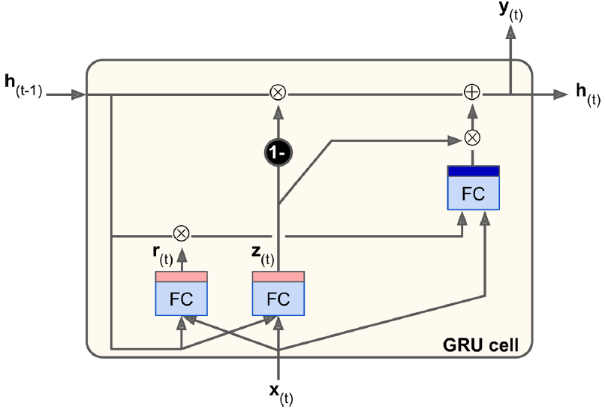
GRU Cell
The Gated Recurrent Unit (GRU) cell (see Figure 14-14) was proposed by Kyunghyun Cho et al. in a 2014 paper that also introduced the Encoder–Decoder network.

Slide 66
GRU Cell
The GRU cell is a simplified version of the LSTM cell, and it seems to perform just as well (which explains its growing popularity). The main simplifications are:
Both state vectors are merged into a single vector h(t).
A single gate controller controls both the forget gate and the input gate. If the gate controller outputs a 1, the input gate is open and the forget gate is closed. If it outputs a 0, the opposite happens. In other words, whenever a memory must be stored, the location where it will be stored is erased first. This is actually a frequent variant to the LSTM cell in and of itself.
There is no output gate; the full state vector is output at every time step. However, there is a new gate controller that controls which part of the previous state will be shown to the main layer.

Slide 67
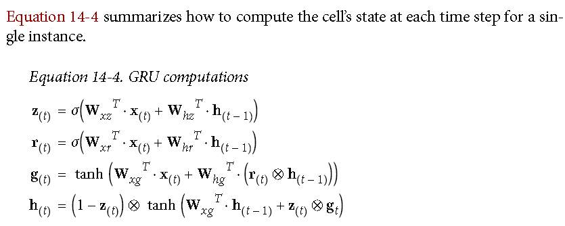
GRU Cell
Creating a GRU cell in TensorFlow:
gru_cell = tf.contrib.rnn.GRUCell(num_units=n_neurons)
LSTM or GRU cells are one of the main reasons behind the success of RNNs in recent years, in particular for applications in natural language processing (NLP).

Slide 68
Natural Language Processing
Most of the state-of-the-art NLP applications, such as machine translation, automatic summarization, parsing, sentiment analysis, and more, are now based (at least in part) on RNNs. In this last section, we will take a quick look at what a machine translation model looks like. This topic is very well covered by TensorFlow’s awesome Word2Vec and Seq2Seq tutorials, so you should definitely check them out.

Slide 69
Word Embeddings
Before we start, we need to choose a word representation. One option could be to represent each word using a one-hot vector. Suppose your vocabulary contains 50,000 words, then the nth word would be represented as a 50,000-dimensional vector, full of 0s except for a 1 at the nth position. However, with such a large vocabulary, this sparse representation would not be efficient at all. Ideally, you want similar words to have similar representations, making it easy for the model to generalize what it learns about a word to all similar words.

Slide 70
Word Embeddings
The most common solution is to represent each word in the vocabulary using a fairly small and dense vector (e.g., 150 dimensions), called an embedding, and just let the neural network learn a good embedding for each word during training. At the beginning of training, embeddings are simply chosen randomly, but during training, backpropagation automatically moves the embeddings around in a way that helps the neural network perform its task. Typically this means that similar words will gradually cluster close to one another, and even end up organized in a rather meaningful way.

Slide 71
Word Embeddings
In TensorFlow, you first need to create the variable representing the embeddings for every word in your vocabulary (initialized randomly):
vocabulary_size = 50000
embedding_size = 150
embeddings = tf.Variable(
tf.random_uniform([vocabulary_size, embedding_size], -1.0, 1.0))
train_inputs = tf.placeholder(tf.int32, shape=[None]) # from ids
embed = tf.nn.embedding_lookup(embeddings, train_inputs)# to embd

Slide 72
Word Embeddings
Once your model has learned good word embeddings, they can actually be reused fairly efficiently in any NLP application: after all, “milk” is still close to “water” and far from “shoes” no matter what your application is. In fact, instead of training your own word embeddings, you may want to download pretrained word embeddings. Just like when reusing pretrained layers (see Chapter 11), you can choose to freeze the pretrained embeddings (e.g., creating the embeddings variable using trainable=False) or let backpropagation tweak them for your application. The first option will speed up training, but the second may lead to slightly higher performance.

Slide 73
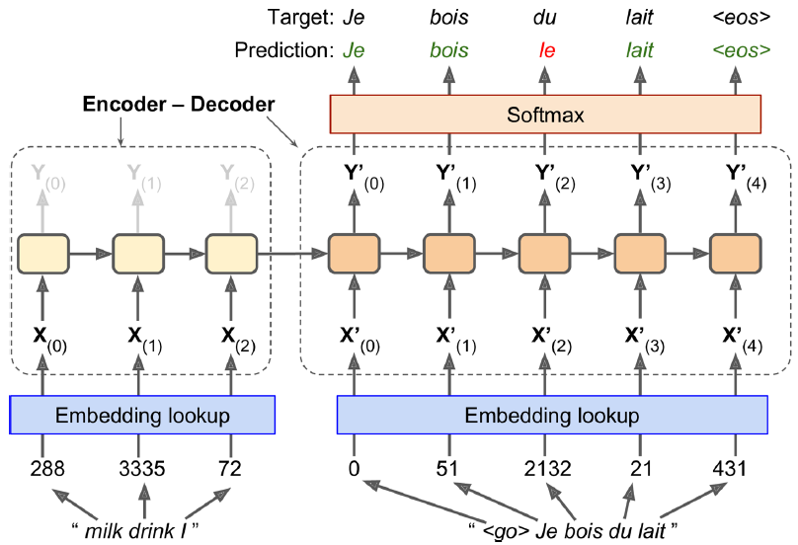
An Encoder–Decoder Network for Machine Translation
Once your model has learned good word embeddings, they can actually be reused fairly efficiently in any NLP application: after all, “milk” is still close to “water” and far from “shoes” no matter what your application is. In fact, instead of training your own word embeddings, you may want to download pretrained word embeddings. Just like when reusing pretrained layers (see Chapter 11), you can choose to freeze the pretrained embeddings (e.g., creating the embeddings variable using trainable=False) or let backpropagation tweak them for your application. The first option will speed up training, but the second may lead to slightly higher performance.

Slide 74
An Encoder–Decoder Network for Machine Translation
The English sentences are fed to the encoder, and the decoder outputs the French translations. Note that the French translations are also used as inputs to the decoder, but pushed back by one step. In other words, the decoder is given as input the word that it should have output at the previous step (regardless of what it actually output). For the very first word, it is given a token that represents the beginning of the sentence (e.g., “<go>”). The decoder is expected to end the sentence with an end-of-sequence (EOS) token (e.g., “<eos>”).

Slide 75
An Encoder–Decoder Network for Machine Translation
Note that the English sentences are reversed before they are fed to the encoder. For example “I drink milk” is reversed to “milk drink I.” This ensures that the beginning of the English sentence will be fed last to the encoder, which is useful because that’s generally the first thing that the decoder needs to translate.
Each word is initially represented by a simple integer identifier (e.g., 288 for the word “milk”). Next, an embedding lookup returns the word embedding (as explained earlier, this is a dense, fairly low-dimensional vector). These word embeddings are what is actually fed to the encoder and the decoder.

Slide 76
An Encoder–Decoder Network for Machine Translation
At each step, the decoder outputs a score for each word in the output vocabulary (i.e., French), and then the Softmax layer turns these scores into probabilities. For example, at the first step the word “Je” may have a probability of 20%, “Tu” may have a probability of 1%, and so on. The word with the highest probability is output. This is very much like a regular classification task, so you can train the model using the soft max_cross_entropy_with_logits() function.
Note that at inference time (after training), you will not have the target sentence to feed to the decoder. Instead, simply feed the decoder the word that it output at the previous step, as shown in Figure 14-16 (this will require an embedding lookup that is not shown on the diagram).

Slide 77
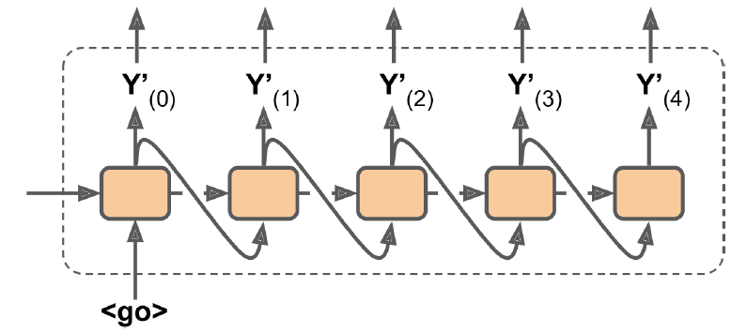
Feeding the previous output word as input at inference time

