Slide 1
Hands-On Machine Learning with Scikit-Learn and TensorFlow
Concepts, Tools, and Techniques to Build Intelligent Systems

Slide 2
CHAPTER 15
Autoencoders
Autoencoders are artificial neural networks capable of learning efficient representations of the input data, called codings, without any supervision (i.e., the training set is unlabeled). These codings typically have a much lower dimensionality than the input data, making autoencoders useful for dimensionality reduction. More importantly, autoencoders act as powerful feature detectors, and they can be used for unsupervised pretraining of deep neural networks.

Slide 3
CHAPTER 15
Autoencoders
Lastly, they are capable of randomly generating new data that looks very similar to the training data; this is called a generative model. For example, you could train an autoencoder on pictures of faces, and it would then be able to generate new faces.
Surprisingly, autoencoders work by simply learning to copy their inputs to their outputs. This may sound like a trivial task, but we will see that constraining the network in various ways can make it rather difficult.

Slide 4
CHAPTER 15
Autoencoders
In this chapter we will explain in more depth how autoencoders work, what types of constraints can be imposed, and how to implement them using TensorFlow, whether it is for dimensionality reduction, feature extraction, unsupervised pretraining, or as generative models.

Slide 5
Efficient Data Representations
The relationship between memory, perception, and pattern matching was famously studied by William Chase and Herbert Simon in the early 1970s. They observed that expert chess players were able to memorize the positions of all the pieces in a game by looking at the board for just 5 seconds, a task that most people would find impossible. However, this was only the case when the pieces were placed in realistic positions. Chess experts just see chess patterns more easily. Noticing patterns helps them store information efficiently.

Slide 6
Efficient Data Representations
Just like the chess players in this memory experiment, an autoencoder looks at the inputs, converts them to an efficient internal representation, and then spits out something that (hopefully) looks very close to the inputs. An autoencoder is always composed of two parts: an encoder (or recognition network) that converts the inputs to an internal representation, followed by a decoder (or generative network) that converts the internal representation to the outputs (see Figure 15-1).

Slide 7
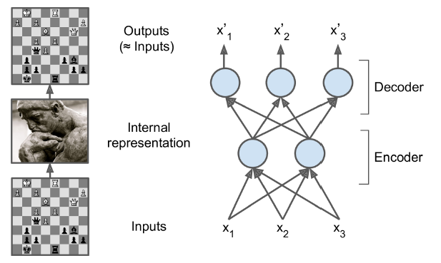
Efficient Data Representations
Just like the chess players in this memory experiment, an autoencoder looks at the inputs, converts them to an efficient internal representation, and then spits out something that (hopefully) looks very close to the inputs. An autoencoder is always composed of two parts: an encoder (or recognition network) that converts the inputs to an internal representation, followed by a decoder (or generative network) that converts the internal representation to the outputs (see Figure 15-1).

Slide 8
Efficient Data Representations
Because the internal representation has a lower dimensionality than the input data (it is 2D instead of 3D), the autoencoder is said to be undercomplete. An undercomplete autoencoder cannot trivially copy its inputs to the codings, yet it must find a way to output a copy of its inputs. It is forced to learn the most important features in the input data (and drop the unimportant ones).

Slide 9
Performing PCA with an Undercomplete Linear Autoencoder
If the autoencoder uses only linear activations and the cost function is the Mean Squared Error (MSE), then it can be shown that it ends up performing Principal Component Analysis.

Slide 10
Performing PCA with an Undercomplete Linear Autoencoder
import tensorflow as tf
from tensorflow.contrib.layers import fully_connected
n_inputs = 3 # 3D inputs
n_hidden = 2 # 2D codings
n_outputs = n_inputs
learning_rate = 0.01
X = tf.placeholder(tf.float32, shape=[None, n_inputs])
hidden = fully_connected(X, n_hidden, activation_fn=None)
outputs = fully_connected(hidden, n_outputs, activation_fn=None)
reconstruction_loss = tf.reduce_mean(tf.square(outputs - X)) # MSE
optimizer = tf.train.AdamOptimizer(learning_rate)
training_op = optimizer.minimize(reconstruction_loss)
init = tf.global_variables_initializer()

Slide 11
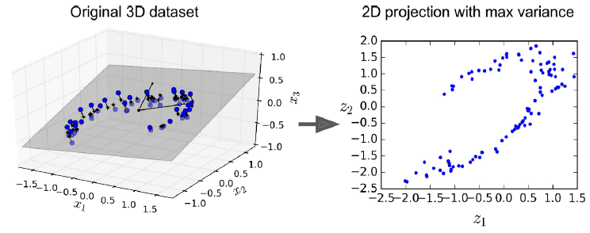
X_train, X_test = [...] # load the dataset
n_iterations = 1000
codings = hidden # the output of the hidden layer provides the codings
with tf.Session() as sess:
init.run()
for iteration in range(n_iterations):
training_op.run(feed_dict={X: X_train}) # no labels (unsupervised)
codings_val = codings.eval(feed_dict={X: X_test})

Slide 12
Stacked Autoencoders
Just like other neural networks we have discussed, autoencoders can have multiple hidden layers. In this case they are called stacked autoencoders. Adding more layers helps the autoencoder learn more complex codings. However, one must be careful not to make the autoencoder too powerful. Imagine an encoder so powerful that it just learns to map each input to a single arbitrary number. Obviously such an autoencoder will reconstruct the training data perfectly, but it will not have learned any useful data representation in the process.

Slide 13
Stacked Autoencoders
The architecture of a stacked autoencoder is typically symmetrical with regards to the central hidden layer (the coding layer). To put it simply, it looks like a sandwich. For example, an autoencoder for MNIST (introduced in Chapter 3) may have 784 inputs, followed by a hidden layer with 300 neurons, then a central hidden layer of 150 neurons, then another hidden layer with 300 neurons, and an output layer with 784 neurons.

Slide 14
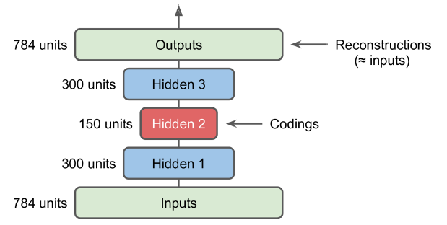
Stacked Autoencoders
The architecture of a stacked autoencoder is typically symmetrical with regards to the central hidden layer (the coding layer). To put it simply, it looks like a sandwich. For example, an autoencoder for MNIST (introduced in Chapter 3) may have 784 inputs, followed by a hidden layer with 300 neurons, then a central hidden layer of 150 neurons, then another hidden layer with 300 neurons, and an output layer with 784 neurons.

Slide 15
TensorFlow Implementation
You can implement a stacked autoencoder very much like a regular deep MLP. In particular, the same techniques we used in Chapter 11 for training deep nets can be applied. For example, the following code builds a stacked autoencoder for MNIST, using He initialization, the ELU activation function, and ℓ2 regularization. The code should look very familiar, except that there are no labels (no y):

Slide 16
n_inputs = 28 * 28 # for MNIST
n_hidden1 = 300
n_hidden2 = 150 # codings
n_hidden3 = n_hidden1
n_outputs = n_inputs
learning_rate = 0.01
l2_reg = 0.001
X = tf.placeholder(tf.float32, shape=[None, n_inputs])
with tf.contrib.framework.arg_scope(
[fully_connected], activation_fn=tf.nn.elu, weights_initializer=tf.contrib.layers.variance_scaling_initializer(), weights_regularizer=tf.contrib.layers.l2_regularizer(l2_reg)):
hidden1 = fully_connected(X, n_hidden1)
hidden2 = fully_connected(hidden1, n_hidden2) # codings
hidden3 = fully_connected(hidden2, n_hidden3)
outputs = fully_connected(hidden3, n_outputs, activation_fn=None)

Slide 17
reconstruction_loss = tf.reduce_mean(tf.square(outputs - X)) # MSE
reg_losses = tf.get_collection(tf.GraphKeys.REGULARIZATION_LOSSES)
loss = tf.add_n([reconstruction_loss] + reg_losses)
optimizer = tf.train.AdamOptimizer(learning_rate)
training_op = optimizer.minimize(loss)
init = tf.global_variables_initializer()
n_epochs = 5
batch_size = 150
with tf.Session() as sess:
init.run()
for epoch in range(n_epochs):
n_batches = mnist.train.num_examples // batch_size
for iteration in range(n_batches):
X_batch, y_batch = mnist.train.next_batch(batch_size)
sess.run(training_op, feed_dict={X: X_batch})

Slide 18
Tying Weights
When an autoencoder is neatly symmetrical, like the one we just built, a common technique is to tie the weights of the decoder layers to the weights of the encoder layers. This halves the number of weights in the model, speeding up training and limiting the risk of overfitting. Specifically, if the autoencoder has a total of N layers (not counting the input layer), and W_{L} represents the connection weights of the Lth layer, then the decoder layer weights can be defined simply as: W_{N–L+1} = W_{L} ^{T} (with L = 1, 2, ⋯, N/2 ).

Slide 19
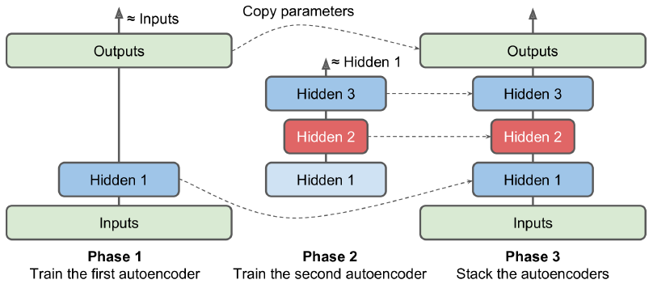
Training One Autoencoder at a Time
Rather than training the whole stacked autoencoder in one go like we just did, it is often much faster to train one shallow autoencoder at a time, then stack all of them into a single stacked autoencoder (hence the name. This is especially useful for very deep autoencoders.

Slide 20
Training One Autoencoder at a Time
During the first phase of training, the first autoencoder learns to reconstruct the inputs. During the second phase, the second autoencoder learns to reconstruct the output of the first autoencoder’s hidden layer. Finally, you just build a big sandwich using all these autoencoders, as shown in Figure 15-4 (i.e., you first stack the hidden layers of each autoencoder, then the output layers in reverse order). This gives you the final stacked autoencoder. You could easily train more autoencoders this way, building a very deep stacked autoencoder.

Slide 21
Training One Autoencoder at a Time
To implement this multiphase training algorithm, the simplest approach is to use a different TensorFlow graph for each phase. After training an autoencoder, you just run the training set through it and capture the output of the hidden layer. This output then serves as the training set for the next autoencoder. Once all autoencoders have been trained this way, you simply copy the weights and biases from each autoencoder and use them to build the stacked autoencoder.

Slide 22
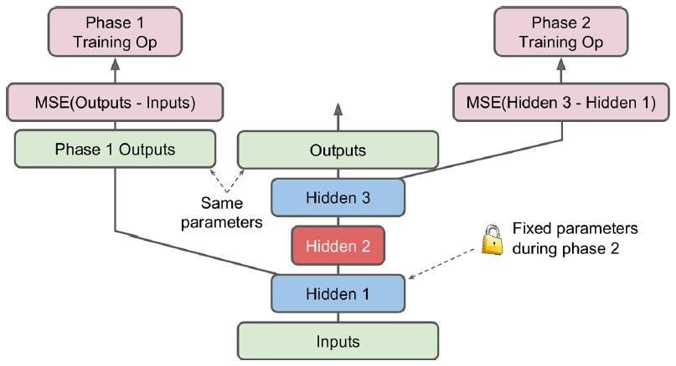
Training One Autoencoder at a Time
Another approach is to use a single graph containing the whole stacked autoencoder, plus some extra operations to perform each training phase.

Slide 23
Training One Autoencoder at a Time
[...] # Build the whole stacked autoencoder normally.
# In this example, the weights are not tied.
optimizer = tf.train.AdamOptimizer(learning_rate)
with tf.name_scope("phase1"):
phase1_outputs = tf.matmul(hidden1, weights4) + biases4
phase1_reconstruction_loss = tf.reduce_mean(tf.square(phase1_outputs - X))
phase1_reg_loss = regularizer(weights1) + regularizer(weights4)
phase1_loss = phase1_reconstruction_loss + phase1_reg_loss
phase1_training_op = optimizer.minimize(phase1_loss)
with tf.name_scope("phase2"):
phase2_reconstruction_loss = tf.reduce_mean(tf.square(hidden3 - hidden1))
phase2_reg_loss = regularizer(weights2) + regularizer(weights3)
phase2_loss = phase2_reconstruction_loss + phase2_reg_loss
train_vars = [weights2, biases2, weights3, biases3]
phase2_training_op = optimizer.minimize(phase2_loss, var_list=train_vars)

Slide 24
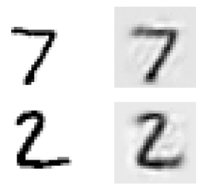
Visualizing the Reconstructions
n_test_digits = 2
X_test = mnist.test.images[:n_test_digits]
with tf.Session() as sess:
[...] # Train the Autoencoder
outputs_val = outputs.eval(feed_dict={X: X_test})
def plot_image(image, shape=[28, 28]):
plt.imshow(image.reshape(shape), cmap="Greys", interpolation="nearest")
plt.axis("off")
for digit_index in range(n_test_digits):
plt.subplot(n_test_digits, 2, digit_index * 2 + 1)
plot_image(X_test[digit_index])
plt.subplot(n_test_digits, 2, digit_index * 2 + 2)
plot_image(outputs_val[digit_index])

Slide 25
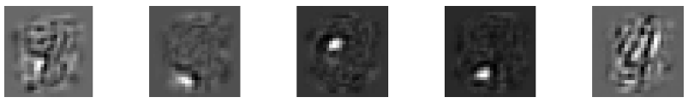
Visualizing Features
with tf.Session() as sess:
[...] # train autoencoder
weights1_val = weights1.eval()
for i in range(5):
plt.subplot(1, 5, i + 1)
plot_image(weights1_val.T[i])

Slide 26
Unsupervised Pretraining Using Stacked Autoencoders
As we discussed in Chapter 11, if you are tackling a complex supervised task but you do not have a lot of labeled training data, one solution is to find a neural network that performs a similar task, and then reuse its lower layers. This makes it possible to train a high-performance model using only little training data because your neural network won’t have to learn all the low-level features; it will just reuse the feature detectors learned by the existing net.

Slide 27
Unsupervised Pretraining Using Stacked Autoencoders
Similarly, if you have a large dataset but most of it is unlabeled, you can first train a stacked autoencoder using all the data, then reuse the lower layers to create a neural network for your actual task, and train it using the labeled data. For example, Figure 15-8 shows how to use a stacked autoencoder to perform unsupervised pretraining for a classification neural network. The stacked autoencoder itself is typically trained one autoencoder at a time, as discussed earlier. When training the classifier, if you really don’t have much labeled training data, you may want to freeze the pretrained layers (at least the lower ones).

Slide 28
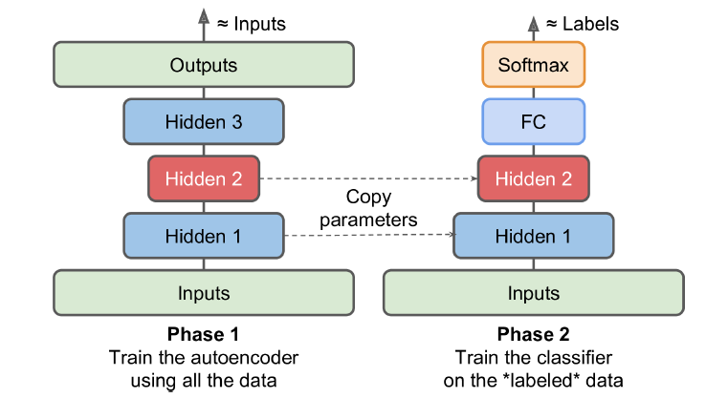
Unsupervised pretraining using autoencoders
Similarly, if you have a large dataset but most of it is unlabeled, you can first train a stacked autoencoder using all the data, then reuse the lower layers to create a neural network for your actual task, and train it using the labeled data. For example, Figure 15-8 shows how to use a stacked autoencoder to perform unsupervised pretraining for a classification neural network. The stacked autoencoder itself is typically trained one autoencoder at a time, as discussed earlier. When training the classifier, if you really don’t have much labeled training data, you may want to freeze the pretrained layers (at least the lower ones).

Slide 29
Denoising Autoencoders
Another way to force the autoencoder to learn useful features is to add noise to its inputs, training it to recover the original, noise-free inputs. This prevents the autoencoder from trivially copying its inputs to its outputs, so it ends up having to find patterns in the data.
The noise can be pure Gaussian noise added to the inputs, or it can be randomly switched off inputs, just like in dropout (introduced in Chapter 11). Figure 15-9 shows both options.

Slide 30
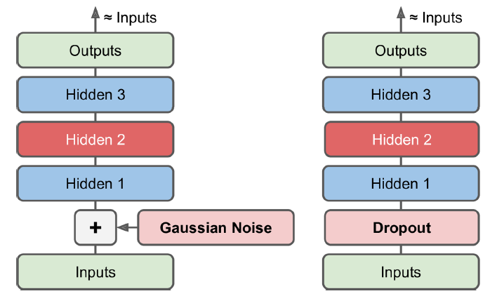
Denoising Autoencoders
Another way to force the autoencoder to learn useful features is to add noise to its inputs, training it to recover the original, noise-free inputs. This prevents the autoencoder from trivially copying its inputs to its outputs, so it ends up having to find patterns in the data.
The noise can be pure Gaussian noise added to the inputs, or it can be randomly switched off inputs, just like in dropout (introduced in Chapter 11). Figure 15-9 shows both options.

Slide 31
TensorFlow Implementation
X = tf.placeholder(tf.float32, shape=[None, n_inputs])
X_noisy = X + tf.random_normal(tf.shape(X))
[...]
hidden1 = activation(tf.matmul(X_noisy, weights1) + biases1)
[...]
reconstruction_loss = tf.reduce_mean(tf.square(outputs - X)) # MSE
[...]

Slide 32
TensorFlow Implementation
from tensorflow.contrib.layers import dropout
keep_prob = 0.7
is_training = tf.placeholder_with_default(False, shape=(), name='is_training')
X = tf.placeholder(tf.float32, shape=[None, n_inputs])
X_drop = dropout(X, keep_prob, is_training=is_training)
[...]
hidden1 = activation(tf.matmul(X_drop, weights1) + biases1)
[...]
reconstruction_loss = tf.reduce_mean(tf.square(outputs - X)) # MSE
[...]

Slide 33
Sparse Autoencoders
Another kind of constraint that often leads to good feature extraction is sparsity: by adding an appropriate term to the cost function, the autoencoder is pushed to reduce the number of active neurons in the coding layer. For example, it may be pushed to have on average only 5% significantly active neurons in the coding layer. This forces the autoencoder to represent each input as a combination of a small number of activations. As a result, each neuron in the coding layer typically ends up representing a useful feature (if you could speak only a few words per month, you would probably try to make them worth listening to).

Slide 34
Sparse Autoencoders
In order to favor sparse models, we must first measure the actual sparsity of the coding layer at each training iteration. We do so by computing the average activation of each neuron in the coding layer, over the whole training batch. The batch size must not be too small, or else the mean will not be accurate.

Slide 35
Sparse Autoencoders
Once we have the mean activation per neuron, we want to penalize the neurons that are too active by adding a sparsity loss to the cost function. For example, if we measure that a neuron has an average activation of 0.3, but the target sparsity is 0.1, it must be penalized to activate less. One approach could be simply adding the squared error (0.3 – 0.1)2 to the cost function, but in practice a better approach is to use the Kullback– Leibler divergence (briefly discussed in Chapter 4), which has much stronger gradients than the Mean Squared Error, as you can see in Figure 15-10.

Slide 36
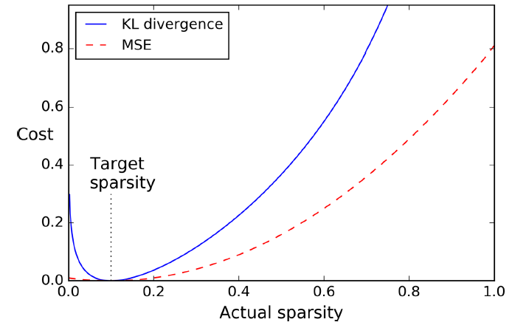
Sparsity loss
Once we have the mean activation per neuron, we want to penalize the neurons that are too active by adding a sparsity loss to the cost function. For example, if we measure that a neuron has an average activation of 0.3, but the target sparsity is 0.1, it must be penalized to activate less. One approach could be simply adding the squared error (0.3 – 0.1)2 to the cost function, but in practice a better approach is to use the Kullback– Leibler divergence (briefly discussed in Chapter 4), which has much stronger gradients than the Mean Squared Error, as you can see in Figure 15-10.

Slide 37
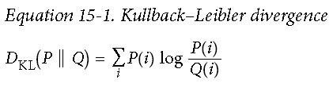
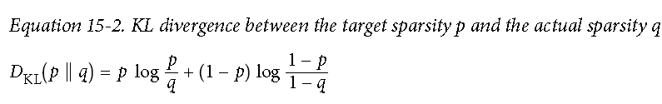
Sparsity loss
Given two discrete probability distributions P and Q, the KL divergence between these distributions, noted D_{KL}(P||Q), can be computed using Equation 15-1.
In our case, we want to measure the divergence between the target probability p that a neuron in the coding layer will activate, and the actual probability q (i.e., the mean activation over the training batch).

Slide 38
TensorFlow Implementation
def kl_divergence(p, q):
return p * tf.log(p / q) + (1 - p) * tf.log((1 - p) / (1 - q))
learning_rate = 0.01
sparsity_target = 0.1
sparsity_weight = 0.2
[...] # Build a normal autoencoder (the coding layer is hidden1)
optimizer = tf.train.AdamOptimizer(learning_rate)
hidden1_mean = tf.reduce_mean(hidden1, axis=0) # batch mean
sparsity_loss = tf.reduce_sum(kl_divergence(sparsity_target, hidden1_mean))
reconstruction_loss = tf.reduce_mean(tf.square(outputs - X)) # MSE
loss = reconstruction_loss + sparsity_weight * sparsity_loss
training_op = optimizer.minimize(loss)

Slide 39
TensorFlow Implementation
hidden1 = tf.nn.sigmoid(tf.matmul(X, weights1) + biases1)
[...]
logits = tf.matmul(hidden1, weights2) + biases2)
outputs = tf.nn.sigmoid(logits)
reconstruction_loss = tf.reduce_sum(
tf.nn.sigmoid_cross_entropy_with_logits(labels=X, logits=logits))

Slide 40
Variational Autoencoders
Another important category of autoencoders was introduced in 2014 by Diederik Kingma and Max Welling, and has quickly become one of the most popular types of autoencoders: variational autoencoders.
They are quite different from all the autoencoders we have discussed so far, in particular:
They are probabilistic autoencoders, meaning that their outputs are partly determined by chance, even after training (as opposed to denoising autoencoders, which use randomness only during training).
Most importantly, they are generative autoencoders, meaning that they can generate new instances that look like they were sampled from the training set.

Slide 41
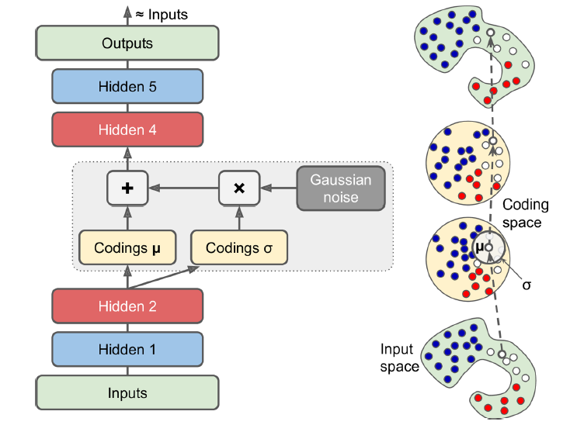
Variational Autoencoders
Another important category of autoencoders was introduced in 2014 by Diederik Kingma and Max Welling, and has quickly become one of the most popular types of autoencoders: variational autoencoders.
They are quite different from all the autoencoders we have discussed so far, in particular:
They are probabilistic autoencoders, meaning that their outputs are partly determined by chance, even after training (as opposed to denoising autoencoders, which use randomness only during training).
Most importantly, they are generative autoencoders, meaning that they can generate new instances that look like they were sampled from the training set.

Slide 42
Variational Autoencoders
eps = 1e-10 # smoothing term to avoid computing log(0)
latent_loss = 0.5 * tf.reduce_sum(
tf.square(hidden3_sigma) + tf.square(hidden3_mean)
- 1 - tf.log(eps + tf.square(hidden3_sigma)))
latent_loss = 0.5 * tf.reduce_sum(
tf.exp(hidden3_gamma) + tf.square(hidden3_mean) - 1 - hidden3_gamma)

Slide 43
n_inputs = 28 * 28 # for MNIST
n_hidden1 = 500
n_hidden2 = 500
n_hidden3 = 20 # codings
n_hidden4 = n_hidden2
n_hidden5 = n_hidden1
n_outputs = n_inputs
learning_rate = 0.001

Slide 44
with tf.contrib.framework.arg_scope(
[fully_connected],
activation_fn=tf.nn.elu,
weights_initializer=tf.contrib.layers.variance_scaling_initializer()):
X = tf.placeholder(tf.float32, [None, n_inputs])
hidden1 = fully_connected(X, n_hidden1)
hidden2 = fully_connected(hidden1, n_hidden2)
hidden3_mean = fully_connected(hidden2, n_hidden3, activation_fn=None)
hidden3_gamma = fully_connected(hidden2, n_hidden3, activation_fn=None)
hidden3_sigma = tf.exp(0.5 * hidden3_gamma)
noise = tf.random_normal(tf.shape(hidden3_sigma), dtype=tf.float32)
hidden3 = hidden3_mean + hidden3_sigma * noise
hidden4 = fully_connected(hidden3, n_hidden4)
hidden5 = fully_connected(hidden4, n_hidden5)
logits = fully_connected(hidden5, n_outputs, activation_fn=None)
outputs = tf.sigmoid(logits)

Slide 45
reconstruction_loss = tf.reduce_sum(
tf.nn.sigmoid_cross_entropy_with_logits(labels=X, logits=logits))
latent_loss = 0.5 * tf.reduce_sum(
tf.exp(hidden3_gamma) + tf.square(hidden3_mean) - 1 – hidden3_gamma)
cost = reconstruction_loss + latent_loss
optimizer = tf.train.AdamOptimizer(learning_rate=learning_rate)
training_op = optimizer.minimize(cost)
init = tf.global_variables_initializer()

Slide 46
Generating Digits
import numpy as np
n_digits = 60
n_epochs = 50
batch_size = 150
with tf.Session() as sess:
init.run()
for epoch in range(n_epochs):
n_batches = mnist.train.num_examples // batch_size
for iteration in range(n_batches):
X_batch, y_batch = mnist.train.next_batch(batch_size)
sess.run(training_op, feed_dict={X: X_batch})
codings_rnd = np.random.normal(size=[n_digits, n_hidden3])
outputs_val = outputs.eval(feed_dict={hidden3: codings_rnd})

Slide 47
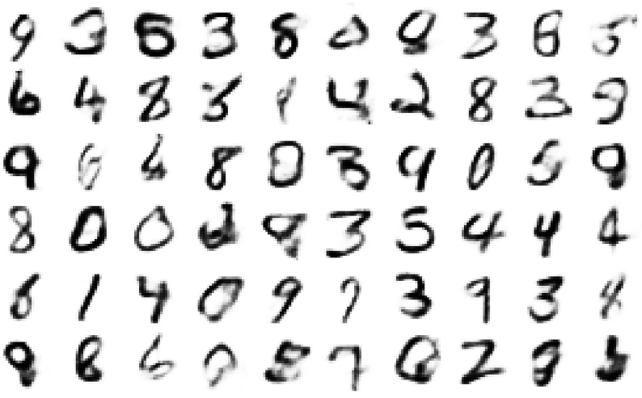
Generating Digits
for iteration in range(n_digits):
plt.subplot(n_digits, 10, iteration + 1)
plot_image(outputs_val[iteration])

Slide 48
Other Autoencoders
The amazing successes of supervised learning in image recognition, speech recognition, text translation, and more have somewhat overshadowed unsupervised learning, but it is actually booming. New architectures for autoencoders and other unsupervised learning algorithms are invented regularly, so much so that we cannot cover them all in this book. Here is a brief (by no means exhaustive) overview of a few more types of autoencoders that you may want to check out:

Slide 49
Other Autoencoders
Contractive autoencoder (CAE)
The autoencoder is constrained during training so that the derivatives of the codings with regards to the inputs are small. In other words, two similar inputs must have similar codings.
Stacked convolutional autoencoders
Autoencoders that learn to extract visual features by reconstructing images processed through convolutional layers.
Generative stochastic network (GSN)
A generalization of denoising autoencoders, with the added capability to generate data.

Slide 50
Other Autoencoders
Winner-take-all (WTA) autoencoder
During training, after computing the activations of all the neurons in the coding layer, only the top k% activations for each neuron over the training batch are preserved, and the rest are set to zero. Naturally this leads to sparse codings. Moreover, a similar WTA approach can be used to produce sparse convolutional autoencoders.
Adversarial autoencoders
One network is trained to reproduce its inputs, and at the same time another is trained to find inputs that the first network is unable to properly reconstruct. This pushes the first autoencoder to learn robust codings.

