Slide 1
Hands-On Machine Learning with Scikit-Learn and TensorFlow
Concepts, Tools, and Techniques to Build Intelligent Systems

Slide 2
CHAPTER 16
Reinforcement Learning
In this chapter we will first explain what Reinforcement Learning is, and then we will present two of the most important techniques in deep Reinforcement Learning: policy gradients and deep Q-networks (DQN), including a discussion of Markov decision processes (MDP). We will use these techniques to train a model to balance a pole on a moving cart, and another to play Atari games. The techniques can be used for a wide variety of tasks, from walking robots to self-driving cars.

Slide 3
Learning to Optimize Rewards
In Reinforcement Learning, a software agent makes observations and takes actions within an environment, and in return it receives rewards. Its objective is to learn to act in a way that will maximize its expected long-term rewards. If you don’t mind a bit of anthropomorphism, you can think of positive rewards as pleasure, and negative rewards as pain. In short, the agent acts in the environment and learns by trial and error to maximize its pleasure and minimize its pain.

Slide 4
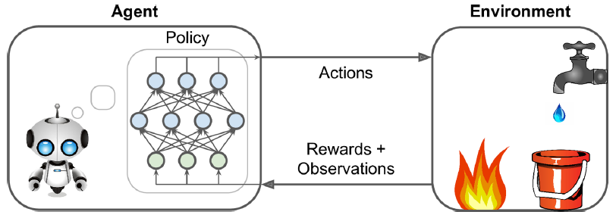
Policy Search
The algorithm used by the software agent to determine its actions is called its policy. For example, the policy could be a neural network taking observations as inputs and outputting the action to take.

Slide 5
Policy Search
The policy can be any algorithm and it does not even have to be deterministic. For example, consider a robotic vacuum cleaner whose reward is the amount of dust it picks up in 30 minutes. Its policy could be to move forward with some probability p every second, or randomly rotate left or right with probability 1 – p. The rotation angle would be a random angle between –r and +r. Since this policy involves some randomness, it is called a stochastic policy.

Slide 6
Policy Search
How would you train such a robot? There are just two policy parameters you can tweak: the probability p and the angle range r. One possible learning algorithm could be to try out many different values for these parameters, and pick the combination that performs best. This is an example of policy search, in this case using a brute force approach. However, when the policy space is too large (which is generally the case), finding a good set of parameters this way is like searching for a needle in a gigantic haystack.

Slide 7
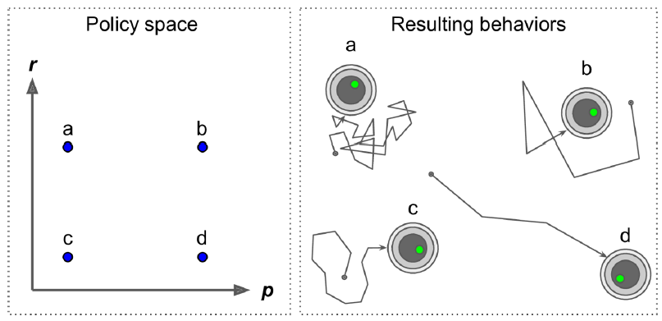
Policy Search

Slide 8
Policy Search
another approach is to use optimization techniques, by evaluating the gradients of the rewards with regards to the policy parameters, then tweaking these parameters by following the gradient toward higher rewards (gradient ascent). This approach is called policy gradients (PG).
We will implement a popular PG algorithm using TensorFlow, but before we do we need to create an environment for the agent to live in, so it’s time to introduce OpenAI gym.

Slide 9
Introduction to OpenAI Gym
One of the challenges of Reinforcement Learning is that in order to train an agent, you first need to have a working environment. If you want to program an agent that will learn to play an Atari game, you will need an Atari game simulator. If you want to program a walking robot, then the environment is the real world and you can directly train your robot in that environment, but this has its limits. In short, training is hard and slow in the real world, so you generally need a simulated environment at least to bootstrap training.

Slide 10
Introduction to OpenAI Gym
OpenAI gym8 is a toolkit that provides a wide variety of simulated environments (Atari games, board games, 2D and 3D physical simulations, and so on), so you can train agents, compare them, or develop new RL algorithms.
Let’s install OpenAI gym. For a minimal OpenAI gym installation, simply use pip:
$ pip3 install --upgrade gym

Slide 11
Introduction to OpenAI Gym
>>> import gym
>>> env = gym.make("CartPole-v0")
[2016-10-14 16:03:23,199] Making new env: MsPacman-v0
>>> obs = env.reset()
>>> obs
array([-0.03799846, -0.03288115, 0.02337094, 0.00720711])
>>> env.render()

Slide 12
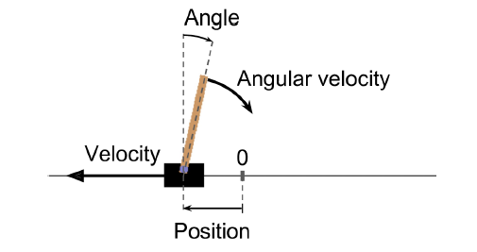
Introduction to OpenAI Gym
The make() function creates an environment, in this case a CartPole environment. This is a 2D simulation in which a cart can be accelerated left or right in order to balance a pole placed on top of it.

Slide 13
Introduction to OpenAI Gym
>>> env.action_space
Discrete(2)
>>> action = 1 # accelerate right
>>> obs, reward, done, info = env.step(action)
>>> obs
array([-0.03865608, 0.16189797, 0.02351508, -0.27801135])
>>> reward
1.0
>>> done
False
>>> info
{}

Slide 14
def basic_policy(obs):
angle = obs[2]
return 0 if angle < 0 else 1
totals = []
for episode in range(500):
episode_rewards = 0
obs = env.reset()
for step in range(1000): # 1000 steps max
action = basic_policy(obs)
obs, reward, done, info = env.step(action)
episode_rewards += reward
if done:
break
totals.append(episode_rewards)
>>> np.mean(totals), np.std(totals), np.min(totals), np.max(totals)
(42.125999999999998, 9.1237121830974033, 24.0, 68.0)

Slide 15
Neural Network Policies
Let’s create a neural network policy. Just like the policy we hardcoded earlier, this neural network will take an observation as input, and it will output the action to be executed. More precisely, it will estimate a probability for each action, and then we will select an action randomly according to the estimated probabilities. In the case of the CartPole environment, there are just two possible actions (left or right), so we only need one output neuron. It will output the probability p of action 0 (left), and of course the probability of action 1 (right) will be 1 – p. For example, if it outputs 0.7, then we will pick action 0 with 70% probability, and action 1 with 30% probability.

Slide 16
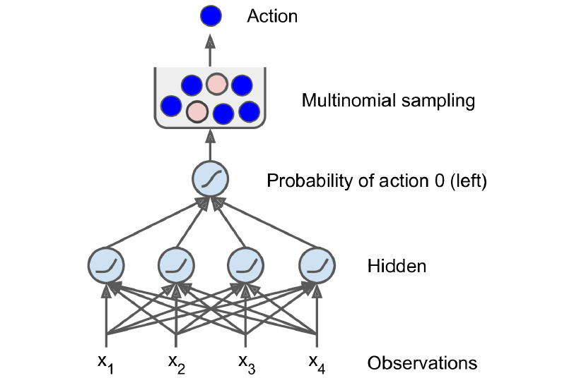
Neural Network Policies
Let’s create a neural network policy. Just like the policy we hardcoded earlier, this neural network will take an observation as input, and it will output the action to be executed. More precisely, it will estimate a probability for each action, and then we will select an action randomly according to the estimated probabilities. In the case of the CartPole environment, there are just two possible actions (left or right), so we only need one output neuron. It will output the probability p of action 0 (left), and of course the probability of action 1 (right) will be 1 – p. For example, if it outputs 0.7, then we will pick action 0 with 70% probability, and action 1 with 30% probability.

Slide 17
import tensorflow as tf
from tensorflow.contrib.layers import fully_connected
# 1. Specify the neural network architecture
n_inputs = 4 # == env.observation_space.shape[0]
n_hidden = 4 # it's a simple task, we don't need more hidden neurons
n_outputs = 1 # only outputs the probability of accelerating left
initializer = tf.contrib.layers.variance_scaling_initializer()
# 2. Build the neural network
X = tf.placeholder(tf.float32, shape=[None, n_inputs])
hidden = fully_connected(X, n_hidden, activation_fn=tf.nn.elu, weights_initializer=initializer)
logits = fully_connected(hidden, n_outputs, activation_fn=None, weights_initializer=initializer)
outputs = tf.nn.sigmoid(logits)
# 3. Select a random action based on the estimated probabilities
p_left_and_right = tf.concat(axis=1, values=[outputs, 1 - outputs])
action = tf.multinomial(tf.log(p_left_and_right), num_samples=1)
init = tf.global_variables_initializer()

Slide 18
Evaluating Actions: The Credit Assignment Problem
If we knew what the best action was at each step, we could train the neural network as usual, by minimizing the cross entropy between the estimated probability and the target probability. It would just be regular supervised learning. However, in Reinforcement Learning the only guidance the agent gets is through rewards, and rewards are typically sparse and delayed.

Slide 19
Evaluating Actions: The Credit Assignment Problem
To tackle this problem, a common strategy is to evaluate an action based on the sum of all the rewards that come after it, usually applying a discount rate r at each step. For example, if an agent decides to go right three times in a row and gets +10 reward after the first step, 0 after the second step, and finally –50 after the third step, then assuming we use a discount rate r = 0.8, the first action will have a total score of 10 + r × 0 + r2 × (–50) = –22.

Slide 20
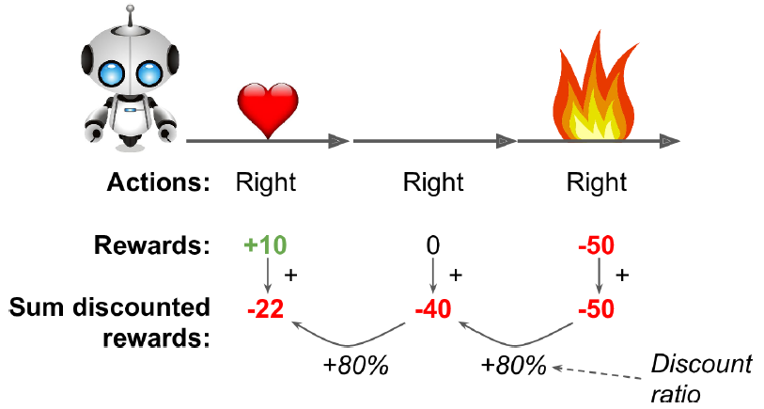
Evaluating Actions: The Credit Assignment Problem
To tackle this problem, a common strategy is to evaluate an action based on the sum of all the rewards that come after it, usually applying a discount rate r at each step. For example, if an agent decides to go right three times in a row and gets +10 reward after the first step, 0 after the second step, and finally –50 after the third step, then assuming we use a discount rate r = 0.8, the first action will have a total score of 10 + r × 0 + r2 × (–50) = –22.

Slide 21
Policy Gradients
As discussed earlier, PG algorithms optimize the parameters of a policy by following the gradients toward higher rewards. One popular class of PG algorithms, called REINFORCE algorithms, was introduced back in 1992 by Ronald Williams. Here is one common variant:
First, let the neural network policy play the game several times and at each step compute the gradients that would make the chosen action even more likely, but don’t apply these gradients yet.

Slide 22
Policy Gradients
Once you have run several episodes, compute each action’s score.
If an action’s score is positive, it means that the action was good and you want to apply the gradients computed earlier to make the action even more likely to be chosen in the future. However, if the score is negative, it means the action was bad and you want to apply the opposite gradients to make this action slightly less likely in the future. The solution is simply to multiply each gradient vector by the corresponding action’s score.
Finally, compute the mean of all the resulting gradient vectors, and use it to perform a Gradient Descent step.

Slide 23
n_inputs = 4
n_hidden = 4
n_outputs = 1
initializer = tf.contrib.layers.variance_scaling_initializer()
learning_rate = 0.01
X = tf.placeholder(tf.float32, shape=[None, n_inputs])
hidden = fully_connected(X, n_hidden, activation_fn=tf.nn.elu, weights_initializer=initializer)
logits = fully_connected(hidden, n_outputs, activation_fn=None, weights_initializer=initializer)
outputs = tf.nn.sigmoid(logits)
p_left_and_right = tf.concat(axis=1, values=[outputs, 1 - outputs])
action = tf.multinomial(tf.log(p_left_and_right), num_samples=1)

Slide 24
y = 1. - tf.to_float(action)
cross_entropy = tf.nn.sigmoid_cross_entropy_with_logits(labels=y, logits=logits)
optimizer = tf.train.AdamOptimizer(learning_rate)
grads_and_vars = optimizer.compute_gradients(cross_entropy)
gradients = [grad for grad, variable in grads_and_vars]
gradient_placeholders = []
grads_and_vars_feed = []
for grad, variable in grads_and_vars:
gradient_placeholder = tf.placeholder(tf.float32, shape=grad.get_shape())
gradient_placeholders.append(gradient_placeholder)
grads_and_vars_feed.append((gradient_placeholder, variable))
training_op = optimizer.apply_gradients(grads_and_vars_feed)
init = tf.global_variables_initializer()
saver = tf.train.Saver()

Slide 25
def discount_rewards(rewards, discount_rate):
discounted_rewards = np.empty(len(rewards))
cumulative_rewards = 0
for step in reversed(range(len(rewards))):
cumulative_rewards = rewards[step] + cumulative_rewards * discount_rate
discounted_rewards[step] = cumulative_rewards
return discounted_rewards
def discount_and_normalize_rewards(all_rewards, discount_rate):
all_discounted_rewards = [discount_rewards(rewards) for rewards in all_rewards]
flat_rewards = np.concatenate(all_discounted_rewards)
reward_mean = flat_rewards.mean()
reward_std = flat_rewards.std()
return [(discounted_rewards - reward_mean)/reward_std for discounted_rewards in all_discounted_rewards]

Slide 26
>>> discount_rewards([10, 0, -50], discount_rate=0.8)
array([-22., -40., -50.])
>>> discount_and_normalize_rewards([[10, 0, -50], [10, 20]], discount_rate=0.8)
[array([-0.28435071, -0.86597718, -1.18910299]),
array([ 1.26665318, 1.0727777 ])]

Slide 27
n_iterations = 250 # number of training iterations
n_max_steps = 1000 # max steps per episode
n_games_per_update = 10 # train the policy every 10 episodes
save_iterations = 10 # save the model every 10 training iterations
discount_rate = 0.95

Slide 28
with tf.Session() as sess: init.run()
for iteration in range(n_iterations):
all_rewards = [] # all sequences of raw rewards for each episode
all_gradients = [] # gradients saved at each step of each episode
for game in range(n_games_per_update):
current_rewards = [] # all raw rewards from the current episode
current_gradients = [] # all gradients from the current episode
obs = env.reset()
for step in range(n_max_steps):
action_val, gradients_val = sess.run([action, gradients],
feed_dict={X: obs.reshape(1, n_inputs)}) # one obs
obs, reward, done, info = env.step(action_val[0][0])
current_rewards.append(reward)
current_gradients.append(gradients_val) all_rewards.append(current_rewards)
all_gradients.append(current_gradients)

Slide 29
# At this point we have run the policy for 10 episodes, and we are
# ready for a policy update using the algorithm described earlier.
all_rewards = discount_and_normalize_rewards(all_rewards)
feed_dict = {}
for var_index, grad_placeholder in enumerate(gradient_placeholders):
# multiply the gradients by the action scores, and compute the mean
mean_gradients = np.mean(
[reward * all_gradients[game_index][step][var_index]
for game_index, rewards in enumerate(all_rewards)
for step, reward in enumerate(rewards)],
axis=0)
feed_dict[grad_placeholder] = mean_gradients
sess.run(training_op, feed_dict=feed_dict)
if iteration % save_iterations == 0:
saver.save(sess, "./my_policy_net_pg.ckpt")

Slide 30
Policy Gradients
We will now look at another popular family of algorithms. Whereas PG algorithms directly try to optimize the policy to increase rewards, the algorithms we will look at now are less direct: the agent learns to estimate the expected sum of discounted future rewards for each state, or the expected sum of discounted future rewards for each action in each state, then uses this knowledge to decide how to act. To understand these algorithms, we must first introduce Markov decision processes (MDP).

Slide 31
Markov Decision Processes
In the early 20th century, the mathematician Andrey Markov studied stochastic processes with no memory, called Markov chains. Such a process has a fixed number of states, and it randomly evolves from one state to another at each step. The probability for it to evolve from a state s to a state s′ is fixed, and it depends only on the pair (s,s′), not on past states (the system has no memory).

Slide 32
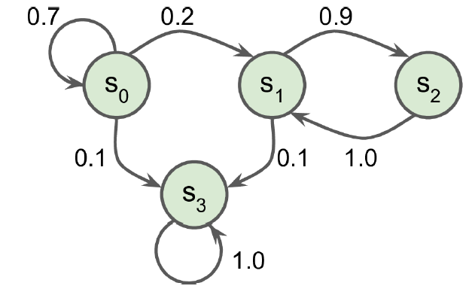
Markov Decision Processes
In the early 20th century, the mathematician Andrey Markov studied stochastic processes with no memory, called Markov chains. Such a process has a fixed number of states, and it randomly evolves from one state to another at each step. The probability for it to evolve from a state s to a state s′ is fixed, and it depends only on the pair (s,s′), not on past states (the system has no memory).

Slide 33
Markov Decision Processes
Markov decision processes were first described in the 1950s by Richard Bellman. They resemble Markov chains but with a twist: at each step, an agent can choose one of several possible actions, and the transition probabilities depend on the chosen action. Moreover, some state transitions return some reward (positive or negative), and the agent’s goal is to find a policy that will maximize rewards over time.

Slide 34
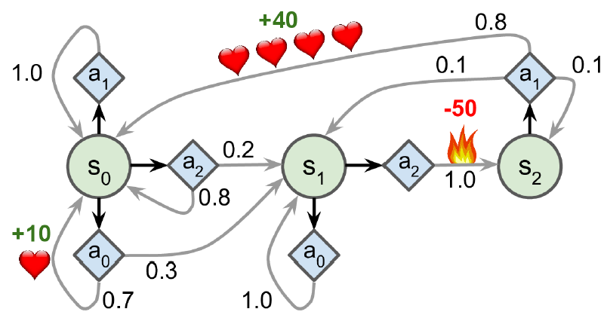
Markov Decision Processes
Markov decision processes were first described in the 1950s by Richard Bellman. They resemble Markov chains but with a twist: at each step, an agent can choose one of several possible actions, and the transition probabilities depend on the chosen action. Moreover, some state transitions return some reward (positive or negative), and the agent’s goal is to find a policy that will maximize rewards over time.

Slide 35

Markov Decision Processes
Bellman found a way to estimate the optimal state value of any state s, noted V*(s), which is the sum of all discounted future rewards the agent can expect on average after it reaches a state s, assuming it acts optimally. He showed that if the agent acts optimally, then the Bellman Optimality Equation applies (see Equation 16-1). This recursive equation says that if the agent acts optimally, then the optimal value of the current state is equal to the reward it will get on average after taking one optimal action, plus the expected optimal value of all possible next states that this action can lead to.

Slide 36
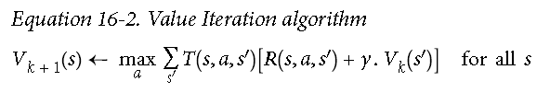
Markov Decision Processes
This equation leads directly to an algorithm that can precisely estimate the optimal state value of every possible state: you first initialize all the state value estimates to zero, and then you iteratively update them using the Value Iteration algorithm (see Equation 16-2). A remarkable result is that, given enough time, these estimates are guaranteed to converge to the optimal state values, corresponding to the optimal policy.

Slide 37

Markov Decision Processes
Knowing the optimal state values can be useful, in particular to evaluate a policy, but it does not tell the agent explicitly what to do. Luckily, Bellman found a very similar algorithm to estimate the optimal state-action values, generally called Q-Values. The optimal Q-Value of the state-action pair (s,a), noted Q*(s,a), is the sum of discounted future rewards the agent can expect on average after it reaches the state s and chooses action a, but before it sees the outcome of this action, assuming it acts optimally after that action.

Slide 38
Markov Decision Processes
nan=np.nan # represents impossible actions
T = np.array([ # shape=[s, a, s']
[[0.7, 0.3, 0.0], [1.0, 0.0, 0.0], [0.8, 0.2, 0.0]],
[[0.0, 1.0, 0.0], [nan, nan, nan], [0.0, 0.0, 1.0]],
[[nan, nan, nan], [0.8, 0.1, 0.1], [nan, nan, nan]],
])
R = np.array([ # shape=[s, a, s']
[[10., 0.0, 0.0], [0.0, 0.0, 0.0], [0.0, 0.0, 0.0]],
[[10., 0.0, 0.0], [nan, nan, nan], [0.0, 0.0, -50.]],
[[nan, nan, nan], [40., 0.0, 0.0], [nan, nan, nan]],
])
possible_actions = [[0, 1, 2], [0, 2], [1]]

Slide 39
Q = np.full((3, 3), -np.inf) # -inf for impossible actions
for state, actions in enumerate(possible_actions):
Q[state, actions] = 0.0 # Initial value = 0.0, for all possible actions
learning_rate = 0.01
discount_rate = 0.95
n_iterations = 100
for iteration in range(n_iterations):
Q_prev = Q.copy()
for s in range(3):
for a in possible_actions[s]:
Q[s, a] = np.sum([
T[s, a, sp] * (R[s, a, sp] + discount_rate * np.max(Q_prev[sp]))
for sp in range(3)
])

Slide 40
>>> Q
array([[ 21.89498982, 20.80024033, 16.86353093],
[ 1.11669335, -inf, 1.17573546],
[ -inf, 53.86946068, -inf]])
>>> np.argmax(Q, axis=1) # optimal action for each state
array([0, 2, 1])

Slide 41
Temporal Difference Learning and Q-Learning
Reinforcement Learning problems with discrete actions can often be modeled as Markov decision processes, but the agent initially has no idea what the transition probabilities are (it does not know T(s, a, s′)), and it does not know what the rewards are going to be either (it does not know R(s, a, s′)). It must experience each state and each transition at least once to know the rewards, and it must experience them multiple times if it is to have a reasonable estimate of the transition probabilities.

Slide 42
Temporal Difference Learning and Q-Learning
The Temporal Difference Learning (TD Learning) algorithm is very similar to the Value Iteration algorithm, but tweaked to take into account the fact that the agent has only partial knowledge of the MDP. In general we assume that the agent initially knows only the possible states and actions, and nothing more. The agent uses an exploration policy—for example, a purely random policy—to explore the MDP, and as it progresses the TD Learning algorithm updates the estimates of the state values based on the transitions and rewards that are actually observed.

Slide 43
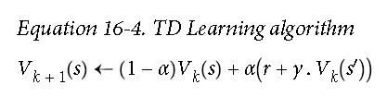
Temporal Difference Learning and Q-Learning
For each state s, this algorithm simply keeps track of a running average of the immediate rewards the agent gets upon leaving that state, plus the rewards it expects to get later (assuming it acts optimally).

Slide 44
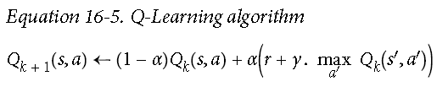
Temporal Difference Learning and Q-Learning
Similarly, the Q-Learning algorithm is an adaptation of the Q-Value Iteration algorithm to the situation where the transition probabilities and the rewards are initially unknown (see Equation 16-5).

Slide 45
import numpy.random as rnd
learning_rate0 = 0.05
learning_rate_decay = 0.1
n_iterations = 20000
s = 0 # start in state 0
Q = np.full((3, 3), -np.inf) # -inf for impossible actions
for state, actions in enumerate(possible_actions):
Q[state, actions] = 0.0 # Initial value = 0.0, for all possible actions
for iteration in range(n_iterations):
a = rnd.choice(possible_actions[s]) # choose an action (randomly)
sp = rnd.choice(range(3), p=T[s, a]) # pick next state using T[s, a]
reward = R[s, a, sp]
learning_rate = learning_rate0 / (1 + iteration * learning_rate_decay)
Q[s, a] = learning_rate * Q[s, a] + (1 - learning_rate) * (
reward + discount_rate * np.max(Q[sp]))
s = sp # move to next state

Slide 46
Exploration Policies
Of course Q-Learning can work only if the exploration policy explores the MDP thoroughly enough. Although a purely random policy is guaranteed to eventually visit every state and every transition many times, it may take an extremely long time to do so. Therefore, a better option is to use the ε-greedy policy: at each step it acts randomly with probability ε, or greedily with probability 1-ε. The advantage of the ε-greedy policy is that it will spend more and more time exploring the interesting parts of the environment, as the Q-Value estimates get better and better, while still spending some time visiting unknown regions of the MDP. It is quite common to start with a high value for ε (e.g., 1.0) and then gradually reduce it (e.g., down to 0.05).

Slide 47
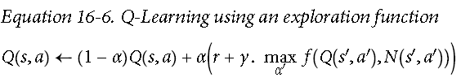
Exploration Policies
Alternatively, rather than relying on chance for exploration, another approach is to encourage the exploration policy to try actions that it has not tried much before. This can be implemented as a bonus added to the Q-Value estimates, as shown in Equation 16-6.
f(q, n) is an exploration function, such as f(q, n) = q + K/(1 + n), where K is a curiosity hyperparameter that measures how much the agent is attracted to to the unknown.

Slide 48
Approximate Q-Learning
The main problem with Q-Learning is that it does not scale well to large (or even medium) MDPs with many states and actions. Consider trying to use Q-Learning to train an agent to play Ms. Pac-Man. There are over 250 pellets that Ms. Pac-Man can eat, each of which can be present or absent (i.e., already eaten). So the number of possible states is greater than 2²⁵⁰ ≈ 10⁷⁵ (and that’s considering the possible states only of the pellets). This is way more than atoms in the observable universe, so there’s absolutely no way you can keep track of an estimate for every single Q-Value.

Slide 49
Approximate Q-Learning
The solution is to find a function that approximates the Q-Values using a manageable number of parameters. This is called Approximate Q-Learning. For years it was recommended to use linear combinations of hand-crafted features extracted from the state (e.g., distance of the closest ghosts, their directions, and so on) to estimate Qvalues, but DeepMind showed that using deep neural networks can work much better, especially for complex problems, and it does not require any feature engineering. A DNN used to estimate Q-Values is called a deep Q-network (DQN), and using a DQN for Approximate Q-Learning is called Deep Q-Learning.

Slide 50
Learning to Play Ms. Pac-Man Using Deep Q-Learning
Since we will be using an Atari environment, we must first install OpenAI gym’s Atari dependencies. While we’re at it, we will also install dependencies for other OpenAI gym environments that you may want to play with. On macOS, assuming you have installed Homebrew, you need to run:
$ brew install cmake boost boost-python sdl2 swig wget
$ apt-get install -y python3-numpy python3-dev cmake zlib1g-dev libjpeg-dev xvfb libav-tools xorg-dev python3-opengl libboost-all-dev libsdl2-dev swig
$ pip3 install --upgrade 'gym[all]'

Slide 51
Learning to Play Ms. Pac-Man Using Deep Q-Learning
>>> env = gym.make("MsPacman-v0")
>>> obs = env.reset()
>>> obs.shape # [height, width, channels]
(210, 160, 3)
>>> env.action_space
Discrete(9)
mspacman_color = np.array([210, 164, 74]).mean()
def preprocess_observation(obs):
img = obs[1:176:2, ::2] # crop and downsize
img = img.mean(axis=2) # to greyscale
img[img==mspacman_color] = 0 # improve contrast
img = (img - 128) / 128 - 1 # normalize from -1. to 1.
return img.reshape(88, 80, 1)

Slide 52
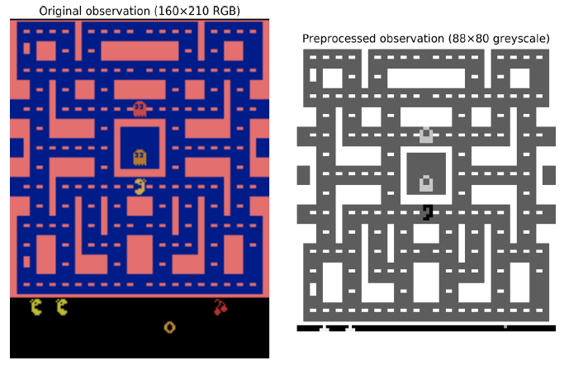
Learning to Play Ms. Pac-Man Using Deep Q-Learning
>>> env = gym.make("MsPacman-v0")
>>> obs = env.reset()
>>> obs.shape # [height, width, channels]
(210, 160, 3)
>>> env.action_space
Discrete(9)
mspacman_color = np.array([210, 164, 74]).mean()
def preprocess_observation(obs):
img = obs[1:176:2, ::2] # crop and downsize
img = img.mean(axis=2) # to greyscale
img[img==mspacman_color] = 0 # improve contrast
img = (img - 128) / 128 - 1 # normalize from -1. to 1.
return img.reshape(88, 80, 1)

Slide 53
Learning to Play Ms. Pac-Man Using Deep Q-Learning
Next, let’s create the DQN. It could just take a state-action pair (s,a) as input, and output an estimate of the corresponding Q-Value Q(s,a), but since the actions are discrete it is more convenient to use a neural network that takes only a state s as input and outputs one Q-Value estimate per action. The DQN will be composed of three convolutional layers, followed by two fully connected layers, including the output layer (see Figure 16-10).

Slide 54
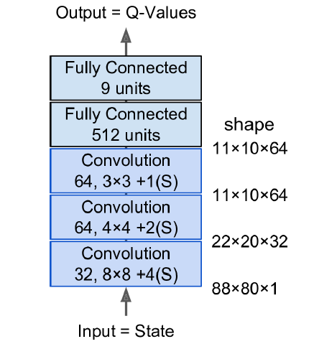

Slide 55
from tensorflow.contrib.layers import convolution2d, fully_connected
input_height = 88
input_width = 80
input_channels = 1
conv_n_maps = [32, 64, 64]
conv_kernel_sizes = [(8,8), (4,4), (3,3)]
conv_strides = [4, 2, 1]
conv_paddings = ["SAME"]*3
conv_activation = [tf.nn.relu]*3
n_hidden_in = 64 * 11 * 10 # conv3 has 64 maps of 11x10 each
n_hidden = 512
hidden_activation = tf.nn.relu
n_outputs = env.action_space.n # 9 discrete actions are available
initializer = tf.contrib.layers.variance_scaling_initializer()

Slide 56
def q_network(X_state, scope):
prev_layer = X_state
conv_layers = []
with tf.variable_scope(scope) as scope:
for n_maps, kernel_size, stride, padding, activation in zip( conv_n_maps, conv_kernel_sizes, conv_strides,conv_paddings, conv_activation):
prev_layer = convolution2d( prev_layer, num_outputs=n_maps, kernel_size=kernel_size, stride=stride, padding=padding, activation_fn=activation,weights_initializer=initializer)
conv_layers.append(prev_layer)
last_conv_layer_flat = tf.reshape(prev_layer, shape=[-1, n_hidden_in])
hidden = fully_connected( last_conv_layer_flat, n_hidden, activation_fn=hidden_activation, weights_initializer=initializer)
outputs = fully_connected( hidden, n_outputs, activation_fn=None,
weights_initializer=initializer)
trainable_vars = tf.get_collection(tf.GraphKeys.TRAINABLE_VARIABLES, scope=scope.name)
trainable_vars_by_name = {var.name[len(scope.name):]: var for var in trainable_vars}
return outputs, trainable_vars_by_name

Slide 57
>>> trainable_vars_by_name
{'/Conv/biases:0': <tensorflow.python.ops.variables.Variable at 0x121cf7b50>,
'/Conv/weights:0': <tensorflow.python.ops.variables.Variable...>,
'/Conv_1/biases:0': <tensorflow.python.ops.variables.Variable...>,
'/Conv_1/weights:0': <tensorflow.python.ops.variables.Variable...>,
'/Conv_2/biases:0': <tensorflow.python.ops.variables.Variable...>,
'/Conv_2/weights:0': <tensorflow.python.ops.variables.Variable...>,
'/fully_connected/biases:0': <tensorflow.python.ops.variables.Variable...>,
'/fully_connected/weights:0': <tensorflow.python.ops.variables.Variable...>,
'/fully_connected_1/biases:0': <tensorflow.python.ops.variables.Variable...>,
'/fully_connected_1/weights:0': <tensorflow.python.ops.variables.Variable...>}

Slide 58
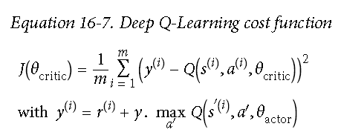
X_state = tf.placeholder(tf.float32, shape=[None, input_height, input_width, input_channels])
actor_q_values, actor_vars = q_network(X_state, scope="q_networks/actor")
critic_q_values, critic_vars = q_network(X_state, scope="q_networks/critic")
copy_ops = [actor_var.assign(critic_vars[var_name])
for var_name, actor_var in actor_vars.items()]
copy_critic_to_actor = tf.group(*copy_ops)

Slide 59
X_action = tf.placeholder(tf.int32, shape=[None])
q_value = tf.reduce_sum(critic_q_values * tf.one_hot(X_action, n_outputs), axis=1, keep_dims=True)
y = tf.placeholder(tf.float32, shape=[None, 1])
cost = tf.reduce_mean(tf.square(y - q_value))
global_step = tf.Variable(0, trainable=False, name='global_step')
optimizer = tf.train.AdamOptimizer(learning_rate)
training_op = optimizer.minimize(cost, global_step=global_step)
init = tf.global_variables_initializer()
saver = tf.train.Saver()

Slide 60
from collections import deque
replay_memory_size = 10000
replay_memory = deque([], maxlen=replay_memory_size)
def sample_memories(batch_size):
indices = rnd.permutation(len(replay_memory))[:batch_size]
cols = [[], [], [], [], []] # state, action, reward, next_state, continue
for idx in indices:
memory = replay_memory[idx]
for col, value in zip(cols, memory):
col.append(value)
cols = [np.array(col) for col in cols]
return (cols[0], cols[1], cols[2].reshape(-1, 1), cols[3], cols[4].reshape(-1, 1))

Slide 61
eps_min = 0.05
eps_max = 1.0
eps_decay_steps = 50000
def epsilon_greedy(q_values, step):
epsilon = max(eps_min, eps_max - (eps_max-eps_min) * step/eps_decay_steps)
if rnd.rand() < epsilon:
return rnd.randint(n_outputs) # random action
else:
return np.argmax(q_values) # optimal action

Slide 62
n_steps = 100000 # total number of training steps
training_start = 1000 # start training after 1,000 game iterations
training_interval = 3 # run a training step every 3 game iterations
save_steps = 50 # save the model every 50 training steps
copy_steps = 25 # copy the critic to the actor every 25 training steps
discount_rate = 0.95
skip_start = 90 # skip the start of every game (it's just waiting time)
batch_size = 50
iteration = 0 # game iterations
checkpoint_path = "./my_dqn.ckpt"
done = True # env needs to be reset

Slide 63
# Actor plays
obs, reward, done, info = env.step(action)
next_state = preprocess_observation(obs)
# Let's memorize what just happened
replay_memory.append((state, action, reward, next_state, 1.0 – done))
state = next_state
if iteration < training_start or iteration % training_interval != 0:
continue

Slide 64
# Critic learns
X_state_val, X_action_val, rewards, X_next_state_val, continues = (
sample_memories(batch_size))
next_q_values = actor_q_values.eval( feed_dict={X_state: X_next_state_val})
max_next_q_values = np.max(next_q_values, axis=1, keepdims=True)
y_val = rewards + continues * discount_rate * max_next_q_values
training_op.run(feed_dict={X_state: X_state_val,
X_action: X_action_val, y: y_val})
# Regularly copy critic to actor
if step % copy_steps == 0:
copy_critic_to_actor.run()
# And save regularly
if step % save_steps == 0:
saver.save(sess, checkpoint_path)

