Slide 1
Hands-On Machine Learning with Scikit-Learn and TensorFlow
Concepts, Tools, and Techniques to Build Intelligent Systems

Slide 2
CHAPTER 3
Classification
In Chapter 1 we mentioned that the most common supervised learning tasks are regression (predicting values) and classification (predicting classes). In Chapter 2 we explored a regression task, predicting housing values, using various algorithms such as Linear Regression, Decision Trees, and Random Forests. Now we will turn our attention to classification systems.

Slide 3
MNIST
In this chapter, we will be using the MNIST dataset, which is a set of 70,000 small images of digits handwritten by high school students and employees of the US Census Bureau. Each image is labeled with the digit it represents. This set has been studied so much that it is often called the “Hello World” of Machine Learning: whenever people come up with a new classification algorithm, they are curious to see how it will perform on MNIST. Whenever someone learns Machine Learning, sooner or later they tackle MNIST.
Scikit-Learn provides many helper functions to download popular datasets. MNIST is one of them. The following code fetches the MNIST dataset:

Slide 4
MNIST
>>> from sklearn.datasets import fetch_mldata
>>> mnist = fetch_mldata('MNIST original')
>>> mnist
{'COL_NAMES': ['label', 'data'],
'DESCR': 'mldata.org dataset: mnist-original',
'data': array([[0, 0, 0, ..., 0, 0, 0],
[0, 0, 0, ..., 0, 0, 0],
[0, 0, 0, ..., 0, 0, 0],
...,
[0, 0, 0, ..., 0, 0, 0],
[0, 0, 0, ..., 0, 0, 0],
[0, 0, 0, ..., 0, 0, 0]], dtype=uint8),
'target': array([ 0., 0., 0., ..., 9., 9., 9.])}

Slide 5
MNIST
Datasets loaded by Scikit-Learn generally have a similar dictionary structure including:
A DESCR key describing the dataset
A data key containing an array with one row per instance and one column per feature
A target key containing an array with the labels
>>> X, y = mnist["data"], mnist["target"]
>>> X.shape
(70000, 784)
>>> y.shape
(70000,)

Slide 6
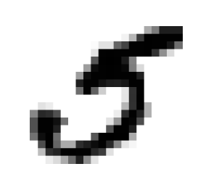
MNIST
%matplotlib inline
import matplotlib
import matplotlib.pyplot as plt
some_digit = X[36000]
some_digit_image = some_digit.reshape(28, 28)
plt.imshow(some_digit_image, cmap = matplotlib.cm.binary,
interpolation="nearest")
plt.axis("off")
plt.show()
>>> y[36000]
5.0

Slide 7
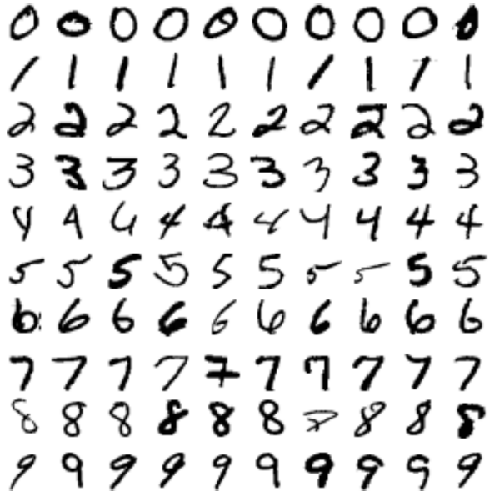
MNIST

Slide 8
MNIST
The MNIST dataset is actually already split into a training set (the first 60,000 images) and a test set (the last 10,000 images):
X_train, X_test, y_train, y_test = X[:60000], X[60000:], y[:60000], y[60000:]
Let’s also shuffle the training set; this will guarantee that all cross-validation folds will be similar (you don’t want one fold to be missing some digits). Moreover, some learning algorithms are sensitive to the order of the training instances, and they perform poorly if they get many similar instances in a row. Shuffling the dataset ensures that this won’t happen:
import numpy as np
shuffle_index = np.random.permutation(60000)
X_train, y_train = X_train[shuffle_index], y_train[shuffle_index]

Slide 9
Training a Binary Classifier
Let’s simplify the problem for now and only try to identify one digit—for example, the number 5. This “5-detector” will be an example of a binary classifier, capable of distinguishing between just two classes, 5 and not-5. Let’s create the target vectors for this classification task:
y_train_5 = (y_train == 5) # True for all 5s, False for all other digits.
y_test_5 = (y_test == 5)

Slide 10
Training a Binary Classifier
now let’s pick a classifier and train it. A good place to start is with a Stochastic Gradient Descent (SGD) classifier, using Scikit-Learn’s SGDClassifier class. This classifier has the advantage of being capable of handling very large datasets efficiently. This is in part because SGD deals with training instances independently, one at a time. Let’s create an SGDClassifier and train it on the whole training set:
from sklearn.linear_model import SGDClassifier
sgd_clf = SGDClassifier(random_state=42)
sgd_clf.fit(X_train, y_train_5)
>>> sgd_clf.predict([some_digit])
array([ True], dtype=bool)

Slide 11
Performance Measures
Evaluating a classifier is often significantly trickier than evaluating a regressor. Let’s use the cross_val_score() function to evaluate your SGDClassifier model using K-fold cross-validation, with three folds. Remember that K-fold crossvalidation means splitting the training set into K-folds (in this case, three), then making predictions and evaluating them on each fold using a model trained on the remaining folds.
>>> from sklearn.model_selection import cross_val_score
>>> cross_val_score(sgd_clf, X_train, y_train_5, cv=3, scoring="accuracy")
array([ 0.9502 , 0.96565, 0.96495])

Slide 12
Performance Measures
from sklearn.base import BaseEstimator
class Never5Classifier(BaseEstimator):
def fit(self, X, y=None):
pass
def predict(self, X):
return np.zeros((len(X), 1), dtype=bool)
Can you guess this model’s accuracy? Let’s find out:
>>> never_5_clf = Never5Classifier()
>>> cross_val_score(never_5_clf, X_train, y_train_5, cv=3, scoring="accuracy")
array([ 0.909 , 0.90715, 0.9128 ])

Slide 13
Performance Measures
This demonstrates why accuracy is generally not the preferred performance measure for classifiers, especially when you are dealing with skewed datasets (i.e., when some classes are much more frequent than others).

Slide 14
Confusion Matrix
A much better way to evaluate the performance of a classifier is to look at the confusion matrix. The general idea is to count the number of times instances of class A are classified as class B. For example, to know the number of times the classifier confused images of 5s with 3s, you would look in the 5th row and 3rd column of the confusion matrix.

Slide 15
Confusion Matrix
To compute the confusion matrix, you first need to have a set of predictions, so they can be compared to the actual targets. You could make predictions on the test set, but let’s keep it untouched for now (remember that you want to use the test set only at the very end of your project, once you have a classifier that you are ready to launch). Instead, you can use the cross_val_predict() function:
from sklearn.model_selection import cross_val_predict
y_train_pred = cross_val_predict(sgd_clf, X_train, y_train_5, cv=3)

Slide 16
Confusion Matrix
Just like the cross_val_score() function, cross_val_predict() performs K-fold cross-validation, but instead of returning the evaluation scores, it returns the predictions made on each test fold. This means that you get a clean prediction for each instance in the training set (“clean” meaning that the prediction is made by a model that never saw the data during training).

Slide 17
Confusion Matrix
Now you are ready to get the confusion matrix using the confusion_matrix() function. Just pass it the target classes (y_train_5) and the predicted classes (y_train_pred):
>>> from sklearn.metrics import confusion_matrix
>>> confusion_matrix(y_train_5, y_train_pred)
array([[53272, 1307],
[ 1077, 4344]])

Slide 18
Confusion Matrix
array([[53272, 1307],
[ 1077, 4344]])
Each row in a confusion matrix represents an actual class, while each column represents a predicted class. The first row of this matrix considers non-5 images (the negative class): 53,272 of them were correctly classified as non-5s (they are called true negatives), while the remaining 1,307 were wrongly classified as 5s (false positives). The second row considers the images of 5s (the positive class): 1,077 were wrongly classified as non-5s (false negatives), while the remaining 4,344 were correctly classified as 5s (true positives).

Slide 19
Confusion Matrix
An interesting metric to look at is the accuracy of the positive predictions; this is called the precision of the classifier
Equation 3-1. Precision
precision = TP/ (TP + FP)
TP is the number of true positives, and FP is the number of false positives.

Slide 20
Confusion Matrix
A trivial way to have perfect precision is to make one single positive prediction and ensure it is correct (precision = 1/1 = 100%). This would not be very useful since the classifier would ignore all but one positive instance. So precision is typically used along with another metric named recall, also called sensitivity or true positive rate (TPR): this is the ratio of positive instances that are correctly detected by the classifier (Equation 3-2).
Equation 3-2. Recall
recall = TP/(TP + FN)
FN is of course the number of false negatives.

Slide 21
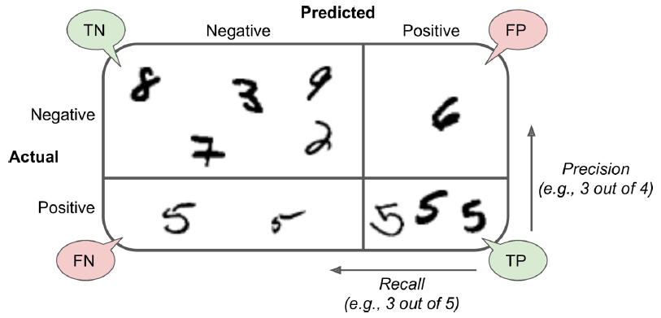
Confusion Matrix
An illustrated confusion matrix

Slide 22
Precision and Recall
Scikit-Learn provides several functions to compute classifier metrics, including precision and recall:
>>> from sklearn.metrics import precision_score, recall_score
>>> precision_score(y_train_5, y_pred) # == 4344 / (4344 + 1307)
0.76871350203503808
>>> recall_score(y_train_5, y_train_pred) # == 4344 / (4344 + 1077)
0.79136690647482011

Slide 23
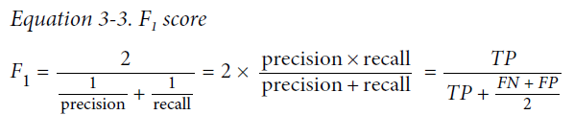
Precision and Recall
It is often convenient to combine precision and recall into a single metric called the F1 score, in particular if you need a simple way to compare two classifiers. The F1 score is the harmonic mean of precision and recall (Equation 3-3). Whereas the regular mean treats all values equally, the harmonic mean gives much more weight to low values. As a result, the classifier will only get a high F1 score if both recall and precision are high.

Slide 24
Precision and Recall
To compute the F1 score, simply call the f1_score() function:
>>> from sklearn.metrics import f1_score
>>> f1_score(y_train_5, y_pred)
0.78468208092485547

Slide 25
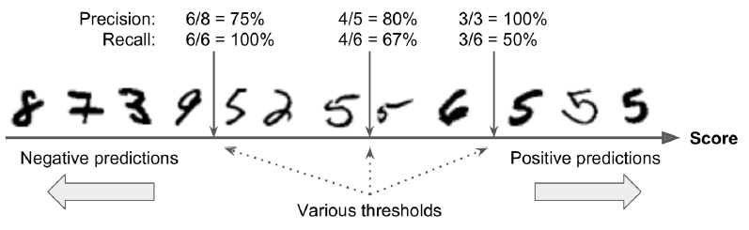
Precision/Recall Tradeoff
To compute the F1 score, simply call the f1_score() function:
>>> from sklearn.metrics import f1_score
>>> f1_score(y_train_5, y_pred)
0.78468208092485547

Slide 26
Precision/Recall Tradeoff
Scikit-Learn does not let you set the threshold directly, but it does give you access to the decision scores that it uses to make predictions. Instead of calling the classifier’s predict() method, you can call its decision_function() method, which returns a score for each instance, and then make predictions based on those scores using any threshold you want:
>>> y_scores = sgd_clf.decision_function([some_digit])
>>> y_scores
array([ 161855.74572176])
>>> threshold = 0
>>> y_some_digit_pred = (y_scores > threshold)
array([ True], dtype=bool)

Slide 27
Precision/Recall Tradeoff
The SGDClassifier uses a threshold equal to 0, so the previous code returns the same result as the predict() method (i.e., True). Let’s raise the threshold:
>>> threshold = 200000
>>> y_some_digit_pred = (y_scores > threshold)
>>> y_some_digit_pred
array([False], dtype=bool)
This confirms that raising the threshold decreases recall. The image actually represents a 5, and the classifier detects it when the threshold is 0, but it misses it when the threshold is increased to 200,000.

Slide 28
Precision/Recall Tradeoff
So how can you decide which threshold to use? For this you will first need to get the scores of all instances in the training set using the cross_val_predict() function again, but this time specifying that you want it to return decision scores instead of predictions:
y_scores = cross_val_predict(sgd_clf, X_train, y_train_5, cv=3,
method="decision_function")
Now with these scores you can compute precision and recall for all possible thresholds using the precision_recall_curve() function:

Slide 29
Precision/Recall Tradeoff
from sklearn.metrics import precision_recall_curve
precisions, recalls, thresholds = precision_recall_curve(y_train_5, y_scores)
Finally, you can plot precision and recall as functions of the threshold value using Matplotlib:
def plot_precision_recall_vs_threshold(precisions, recalls, thresholds):
plt.plot(thresholds, precisions[:-1], "b--", label="Precision")
plt.plot(thresholds, recalls[:-1], "g-", label="Recall")
plt.xlabel("Threshold")
plt.legend(loc="upper left")
plt.ylim([0, 1])
plot_precision_recall_vs_threshold(precisions, recalls, thresholds)
plt.show()

Slide 30
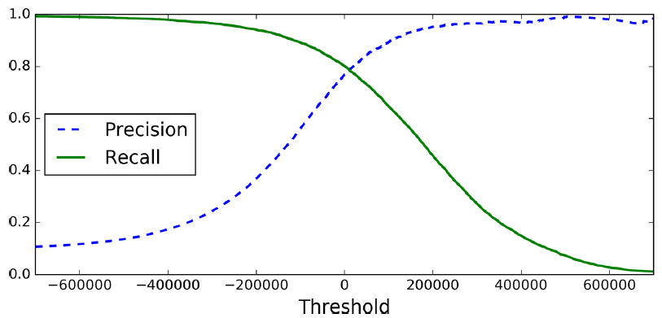
Precision/Recall Tradeoff

Slide 31
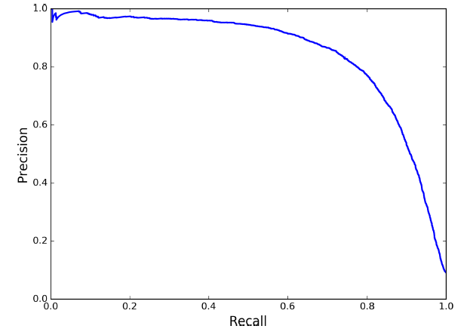
Precision/Recall Tradeoff
Now you can simply select the threshold value that gives you the best precision/recall tradeoff for your task. Another way to select a good precision/recall tradeoff is to plot precision directly against recall.

Slide 32
Precision/Recall Tradeoff
So let’s suppose you decide to aim for 90% precision. You look up the first plot (zooming in a bit) and find that you need to use a threshold of about 70,000. To make predictions (on the training set for now), instead of calling the classifier’s predict() method, you can just run this code:
y_train_pred_90 = (y_scores > 70000)
Let’s check these predictions’ precision and recall:
>>> precision_score(y_train_5, y_train_pred_90)
0.8998702983138781
>>> recall_score(y_train_5, y_train_pred_90)
0.63991883416343853

Slide 33
The ROC Curve
The receiver operating characteristic (ROC) curve is another common tool used with binary classifiers. It is very similar to the precision/recall curve, but instead of plotting precision versus recall, the ROC curve plots the true positive rate (another name for recall) against the false positive rate. The FPR is the ratio of negative instances that are incorrectly classified as positive. It is equal to one minus the true negative rate, which is the ratio of negative instances that are correctly classified as negative. The TNR is also called specificity. Hence the ROC curve plots sensitivity (recall) versus 1 – specificity.

Slide 34
The ROC Curve
To plot the ROC curve, you first need to compute the TPR and FPR for various threshold values, using the roc_curve() function:
from sklearn.metrics import roc_curve
fpr, tpr, thresholds = roc_curve(y_train_5, y_scores)
Then you can plot the FPR against the TPR using Matplotlib.
def plot_roc_curve(fpr, tpr, label=None):
plt.plot(fpr, tpr, linewidth=2, label=label)
plt.plot([0, 1], [0, 1], 'k--')
plt.axis([0, 1, 0, 1])
plt.xlabel('False Positive Rate')
plt.ylabel('True Positive Rate')
plot_roc_curve(fpr, tpr)
plt.show()

Slide 35
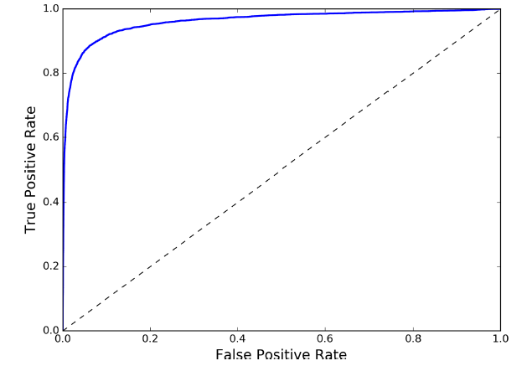
The ROC Curve
To plot the ROC curve, you first need to compute the TPR and FPR for various threshold values, using the roc_curve() function:
from sklearn.metrics import roc_curve
fpr, tpr, thresholds = roc_curve(y_train_5, y_scores)
Then you can plot the FPR against the TPR using Matplotlib.
def plot_roc_curve(fpr, tpr, label=None):
plt.plot(fpr, tpr, linewidth=2, label=label)
plt.plot([0, 1], [0, 1], 'k--')
plt.axis([0, 1, 0, 1])
plt.xlabel('False Positive Rate')
plt.ylabel('True Positive Rate')
plot_roc_curve(fpr, tpr)
plt.show()

Slide 36
The ROC Curve
Once again there is a tradeoff: the higher the recall (TPR), the more false positives (FPR) the classifier produces. The dotted line represents the ROC curve of a purely random classifier; a good classifier stays as far away from that line as possible (toward the top-left corner).
One way to compare classifiers is to measure the area under the curve (AUC). A perfect classifier will have a ROC AUC equal to 1, whereas a purely random classifier will have a ROC AUC equal to 0.5. Scikit-Learn provides a function to compute the ROC AUC:
>>> from sklearn.metrics import roc_auc_score
>>> roc_auc_score(y_train_5, y_scores)
0.97061072797174941

Slide 37
The ROC Curve
Let’s train a RandomForestClassifier and compare its ROC curve and ROC AUC score to the SGDClassifier. First, you need to get scores for each instance in the training set. But due to the way it works, the RandomForestClassifier class does not have a decision_function() method. Instead it has a predict_proba() method. Scikit-Learn classifiers generally have one or the other. The predict_proba() method returns an array containing a row per instance and a column per class, each containing the probability that the given instance belongs to the given class (e.g., 70% chance that the image represents a 5):

Slide 38
The ROC Curve
from sklearn.ensemble import RandomForestClassifier
forest_clf = RandomForestClassifier(random_state=42)
y_probas_forest = cross_val_predict(forest_clf, X_train, y_train_5, cv=3,
method="predict_proba")
But to plot a ROC curve, you need scores, not probabilities. A simple solution is to use the positive class’s probability as the score:
y_scores_forest = y_probas_forest[:, 1] # score = proba of positive class
fpr_forest, tpr_forest, thresholds_forest = roc_curve(y_train_5,y_scores_forest)

Slide 39
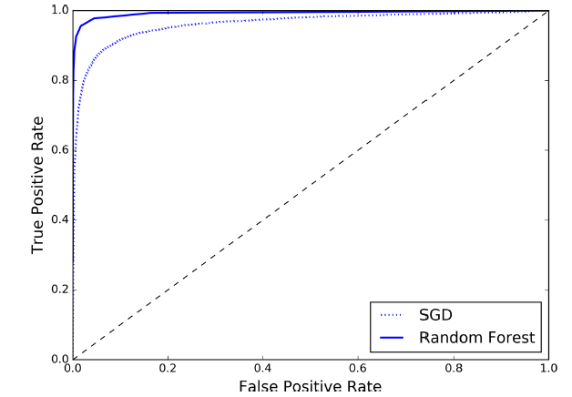
The ROC Curve
Now you are ready to plot the ROC curve. It is useful to plot the first ROC curve as well to see how they compare (Figure 3-7):
plt.plot(fpr, tpr, "b:", label="SGD")
plot_roc_curve(fpr_forest, tpr_forest, "Random Forest")
plt.legend(loc="bottom right")
plt.show()
>>> roc_auc_score(y_train_5,
y_scores_forest)
0.99312433660038291

Slide 40
The ROC Curve
Hopefully you now know how to train binary classifiers, choose the appropriate metric for your task, evaluate your classifiers using cross-validation, select the precision/ recall tradeoff that fits your needs, and compare various models using ROC curves and ROC AUC scores. Now let’s try to detect more than just the 5s.

Slide 41
Multiclass Classification
Whereas binary classifiers distinguish between two classes, multiclass classifiers (also called multinomial classifiers) can distinguish between more than two classes.
Some algorithms (such as Random Forest classifiers or naive Bayes classifiers) are capable of handling multiple classes directly. Others (such as Support Vector Machine classifiers or Linear classifiers) are strictly binary classifiers. However, there are various strategies that you can use to perform multiclass classification using multiple binary classifiers.

Slide 42
Multiclass Classification
For example, one way to create a system that can classify the digit images into 10 classes (from 0 to 9) is to train 10 binary classifiers, one for each digit (a 0-detector, a 1-detector, a 2-detector, and so on). Then when you want to classify an image, you get the decision score from each classifier for that image and you select the class whose classifier outputs the highest score. This is called the one-versus-all (OvA) strategy (also called one-versus-the-rest).

Slide 43
Multiclass Classification
Another strategy is to train a binary classifier for every pair of digits: one to distinguish 0s and 1s, another to distinguish 0s and 2s, another for 1s and 2s, and so on. This is called the one-versus-one (OvO) strategy. If there are N classes, you need to train N × (N – 1) / 2 classifiers. For the MNIST problem, this means training 45 binary classifiers! When you want to classify an image, you have to run the image through all 45 classifiers and see which class wins the most duels. The main advantage of OvO is that each classifier only needs to be trained on the part of the training set for the two classes that it must distinguish.

Slide 44
Multiclass Classification
Some algorithms (such as Support Vector Machine classifiers) scale poorly with the size of the training set, so for these algorithms OvO is preferred since it is faster to train many classifiers on small training sets than training few classifiers on large training sets. For most binary classification algorithms, however, OvA is preferred.

Slide 45
Multiclass Classification
Scikit-Learn detects when you try to use a binary classification algorithm for a multiclass classification task, and it automatically runs OvA (except for SVM classifiers for which it uses OvO). Let’s try this with the SGDClassifier:
>>> sgd_clf.fit(X_train, y_train) # y_train, not y_train_5
>>> sgd_clf.predict([some_digit])
array([ 5.])

Slide 46
Multiclass Classification
This code trains the SGDClassifier on the training set using the original target classes from 0 to 9 (y_train), instead of the 5-versus-all target classes (y_train_5). Then it makes a prediction (a correct one in this case). Under the hood, Scikit-Learn actually trained 10 binary classifiers, got their decision scores for the image, and selected the class with the highest score.

Slide 47
Multiclass Classification
To see that this is indeed the case, you can call the decision_function() method. Instead of returning just one score per instance, it now returns 10 scores, one per class:
>>> some_digit_scores = sgd_clf.decision_function([some_digit])
>>> some_digit_scores
array([[-311402.62954431, -363517.28355739, -446449.5306454 ,
-183226.61023518, -414337.15339485, 161855.74572176,
-452576.39616343, -471957.14962573, -518542.33997148,
-536774.63961222]])

Slide 48
Multiclass Classification
>>> np.argmax(some_digit_scores)
5
>>> sgd_clf.classes_
array([ 0., 1., 2., 3., 4., 5., 6., 7., 8., 9.])
>>> sgd_clf.classes[5]
5.0

Slide 49
Multiclass Classification
If you want to force ScikitLearn to use one-versus-one or one-versus-all, you can use the OneVsOneClassifier or OneVsRestClassifier classes. Simply create an instance and pass a binary classifier to its constructor. For example, this code creates a multiclass classifier using the OvO strategy, based on a SGDClassifier:
>>> from sklearn.multiclass import OneVsOneClassifier
>>> ovo_clf = OneVsOneClassifier(SGDClassifier(random_state=42))
>>> ovo_clf.fit(X_train, y_train)
>>> ovo_clf.predict([some_digit])
array([ 5.])
>>> len(ovo_clf.estimators_)
45

Slide 50
Multiclass Classification
Training a RandomForestClassifier is just as easy:
>>> forest_clf.fit(X_train, y_train)
>>> forest_clf.predict([some_digit])
array([ 5.])
This time Scikit-Learn did not have to run OvA or OvO because Random Forest classifiers can directly classify instances into multiple classes. You can call predict_proba() to get the list of probabilities that the classifier assigned to each instance for each class:
>>> forest_clf.predict_proba([some_digit])
array([[ 0.1, 0. , 0. , 0.1, 0. , 0.8, 0. , 0. , 0. , 0. ]])

Slide 51
Multiclass Classification
Now of course you want to evaluate these classifiers. As usual, you want to use crossvalidation. Let’s evaluate the SGDClassifier’s accuracy using the cross_val_score() function:
>>> cross_val_score(sgd_clf, X_train, y_train, cv=3, scoring="accuracy")
array([ 0.84063187, 0.84899245, 0.86652998])

Slide 52
Multiclass Classification
It gets over 84% on all test folds. If you used a random classifier, you would get 10% accuracy, so this is not such a bad score, but you can still do much better. For example, simply scaling the inputs increases accuracy above 90%:
>>> from sklearn.preprocessing import StandardScaler
>>> scaler = StandardScaler()
>>> X_train_scaled = scaler.fit_transform(X_train.astype(np.float64))
>>> cross_val_score(sgd_clf, X_train_scaled, y_train, cv=3, scoring="accuracy")
array([ 0.91011798, 0.90874544, 0.906636 ])

Slide 53
Error Analysis
Here, we will assume that you have found a promising model and you want to find ways to improve it. First, you can look at the confusion matrix. You need to make predictions using the cross_val_predict() function, then call the confusion_matrix() function:
>>> y_train_pred = cross_val_predict(sgd_clf, X_train_scaled, y_train, cv=3)
>>> conf_mx = confusion_matrix(y_train, y_train_pred)
>>> conf_mx
array([[5725, 3, 24, 9, 10, 49, 50, 10, 39, 4],
[ 2, 6493, 43, 25, 7, 40, 5, 10, 109, 8],
[ 51, 41, 5321, 104, 89, 26, 87, 60, 166, 13],
[ 47, 46, 141, 5342, 1, 231, 40, 50, 141, 92],
[ 19, 29, 41, 10, 5366, 9, 56, 37, 86, 189],
[ 73, 45, 36, 193, 64, 4582, 111, 30, 193, 94],
[ 29, 34, 44, 2, 42, 85, 5627, 10, 45, 0],
[ 25, 24, 74, 32, 54, 12, 6, 5787, 15, 236],
[ 52, 161, 73, 156, 10, 163, 61, 25, 5027, 123],
[ 43, 35, 26, 92, 178, 28, 2, 223, 82, 5240]])

Slide 54
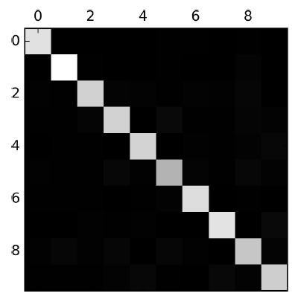
Error Analysis
plt.matshow(conf_mx, cmap=plt.cm.gray)
plt.show()

Slide 55
Error Analysis
Let’s focus the plot on the errors. First, you need to divide each value in the confusion matrix by the number of images in the corresponding class, so you can compare error rates instead of absolute number of errors (which would make abundant classes look unfairly bad):
row_sums = conf_mx.sum(axis=1, keepdims=True)
norm_conf_mx = conf_mx / row_sums
Now let’s fill the diagonal with zeros to keep only the errors, and let’s plot the result:
np.fill_diagonal(norm_conf_mx, 0)
plt.matshow(norm_conf_mx, cmap=plt.cm.gray)
plt.show()

Slide 56
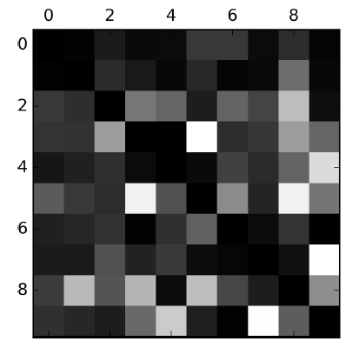
Error Analysis

Slide 57
Error Analysis
Analyzing the confusion matrix can often give you insights on ways to improve your classifier. Looking at this plot, it seems that your efforts should be spent on improving classification of 8s and 9s, as well as fixing the specific 3/5 confusion. For example, you could try to gather more training data for these digits. Or you could engineer new features that would help the classifier—for example, writing an algorithm to count the number of closed loops (e.g., 8 has two, 6 has one, 5 has none). Or you could preprocess the images (e.g., using Scikit-Image, Pillow, or OpenCV) to make some patterns stand out more, such as closed loops.

Slide 58
Error Analysis
Analyzing individual errors can also be a good way to gain insights on what your classifier is doing and why it is failing, but it is more difficult and time-consuming. For example, let’s plot examples of 3s and 5s:
cl_a, cl_b = 3, 5
X_aa = X_train[(y_train == cl_a) & (y_train_pred == cl_a)]
X_ab = X_train[(y_train == cl_a) & (y_train_pred == cl_b)]
X_ba = X_train[(y_train == cl_b) & (y_train_pred == cl_a)]
X_bb = X_train[(y_train == cl_b) & (y_train_pred == cl_b)]
plt.figure(figsize=(8,8))
plt.subplot(221); plot_digits(X_aa[:25], images_per_row=5)
plt.subplot(222); plot_digits(X_ab[:25], images_per_row=5)

Slide 59
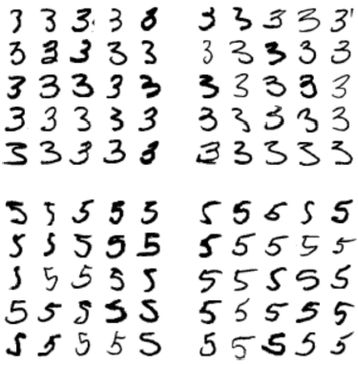
Error Analysis

Slide 60
Multilabel Classification
Until now each instance has always been assigned to just one class. In some cases you may want your classifier to output multiple classes for each instance. For example, consider a face-recognition classifier: what should it do if it recognizes several people on the same picture? Of course it should attach one label per person it recognizes. Say the classifier has been trained to recognize three faces, Alice, Bob, and Charlie; then when it is shown a picture of Alice and Charlie, it should output [1, 0, 1] (meaning “Alice yes, Bob no, Charlie yes”). Such a classification system that outputs multiple binary labels is called a multilabel classification system.

Slide 61
Multilabel Classification
We won’t go into face recognition just yet, but let’s look at a simpler example, just for illustration purposes:
from sklearn.neighbors import KNeighborsClassifier
y_train_large = (y_train >= 7)
y_train_odd = (y_train % 2 == 1)
y_multilabel = np.c_[y_train_large, y_train_odd]
knn_clf = KNeighborsClassifier()
knn_clf.fit(X_train, y_multilabel)

Slide 62
Multilabel Classification
This code creates a y_multilabel array containing two target labels for each digit image: the first indicates whether or not the digit is large (7, 8, or 9) and the second indicates whether or not it is odd. The next lines create a KNeighborsClassifier instance (which supports multilabel classification, but not all classifiers do) and we train it using the multiple targets array. Now you can make a prediction, and notice that it outputs two labels:
>>> knn_clf.predict([some_digit])
array([[False, True]], dtype=bool)

Slide 63
Multilabel Classification
There are many ways to evaluate a multilabel classifier, and selecting the right metric really depends on your project. For example, one approach is to measure the F1 score for each individual label (or any other binary classifier metric discussed earlier), then simply compute the average score. This code computes the average F1 score across all labels:
>>> y_train_knn_pred = cross_val_predict(knn_clf, X_train, y_train, cv=3)
>>> f1_score(y_train, y_train_knn_pred, average="macro")
0.96845540180280221

Slide 64
Multioutput Classification
The last type of classification task we are going to discuss here is called multioutputmulticlass classification (or simply multioutput classification). It is simply a generalization of multilabel classification where each label can be multiclass (i.e., it can have more than two possible values).
To illustrate this, let’s build a system that removes noise from images. It will take as input a noisy digit image, and it will (hopefully) output a clean digit image, represented as an array of pixel intensities, just like the MNIST images. Notice that the classifier’s output is multilabel (one label per pixel) and each label can have multiple values (pixel intensity ranges from 0 to 255). It is thus an example of a multioutput classification system.

Slide 65
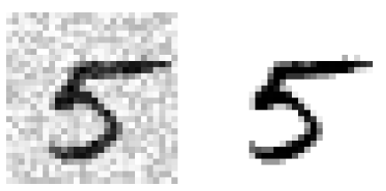
Multioutput Classification
Let’s start by creating the training and test sets by taking the MNIST images and adding noise to their pixel intensities using NumPy’s randint() function. The target images will be the original images:
noise = rnd.randint(0, 100, (len(X_train), 784))
noise = rnd.randint(0, 100, (len(X_test), 784))
X_train_mod = X_train + noise
X_test_mod = X_test + noise
y_train_mod = X_train
y_test_mod = X_test
Let’s take a peek at an image from the test set (yes, we’re snooping on the test data, so you should be frowning right now):

Slide 66

Multioutput Classification
knn_clf.fit(X_train_mod, y_train_mod)
clean_digit = knn_clf.predict([X_test_mod[some_index]])
plot_digit(clean_digit)
Looks close enough to the target! This concludes our tour of classification. Hopefully you should now know how to select good metrics for classification tasks, pick the appropriate precision/recall tradeoff, compare classifiers, and more generally build good classification systems for a variety of tasks.

