Slide 1
Hands-On Machine Learning with Scikit-Learn and TensorFlow
Concepts, Tools, and Techniques to Build Intelligent Systems

Slide 2
CHAPTER 5
Support Vector Machines
A Support Vector Machine (SVM) is a very powerful and versatile Machine Learning model, capable of performing linear or nonlinear classification, regression, and even outlier detection. It is one of the most popular models in Machine Learning, and anyone interested in Machine Learning should have it in their toolbox. SVMs are particularly well suited for classification of complex but small- or medium-sized datasets.

Slide 3
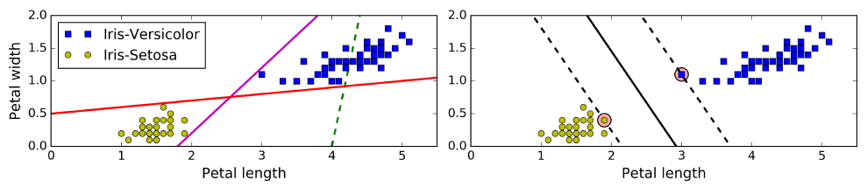
Linear SVM Classification
The fundamental idea behind SVMs is best explained with some pictures. The two classes can clearly be separated easily with a straight line (they are linearly separable). You can think of an SVM classifier as fitting the widest possible street (represented by the parallel dashed lines) between the classes. This is called large margin classification.

Slide 4
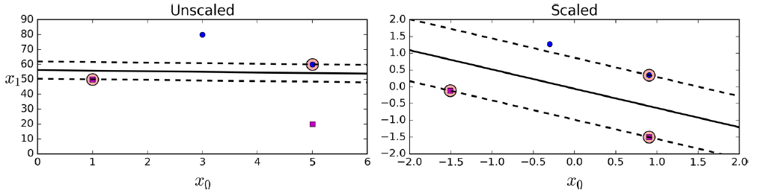
Linear SVM Classification
SVMs are sensitive to the feature scales, as you can see in Figure 5-2: on the left plot, the vertical scale is much larger than the horizontal scale, so the widest possible street is close to horizontal. After feature scaling (e.g., using Scikit-Learn’s StandardScaler), the decision boundary looks much better (on the right plot).

Slide 5
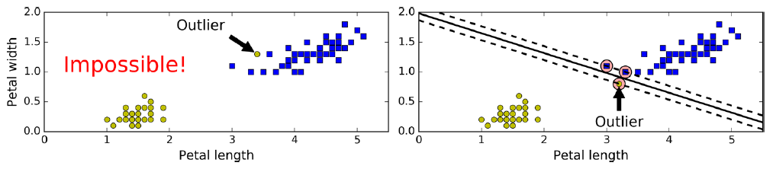
Soft Margin Classification
If we strictly impose that all instances be off the street and on the right side, this is called hard margin classification. There are two main issues with hard margin classification.First, it only works if the data is linearly separable, and second it is quite sensitive to outliers.

Slide 6
Soft Margin Classification
To avoid these issues it is preferable to use a more flexible model. The objective is to find a good balance between keeping the street as large as possible and limiting the margin violations (i.e., instances that end up in the middle of the street or even on the wrong side). This is called soft margin classification.

Slide 7
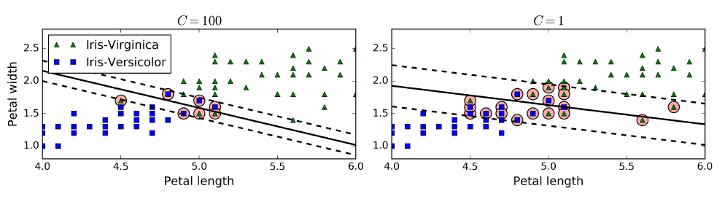
Soft Margin Classification
In Scikit-Learn’s SVM classes, you can control this balance using the C hyperparameter: a smaller C value leads to a wider street but more margin violations. If your SVM model is overfitting, you can try regularizing it by reducing C.

Slide 8
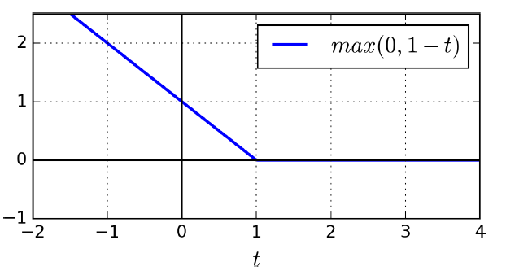
Hinge Loss
The function max(0, 1 – t) is called the hinge loss function. It is equal to 0 when t ≥ 1. Its derivative (slope) is equal to –1 if t < 1 and 0 if t > 1. It is not differentiable at t = 1, but just like for Lasso Regression. you can still use Gradient Descent using any subderivative at t = 0.

Slide 9
import numpy as np
from sklearn import datasets
from sklearn.pipeline import Pipeline
from sklearn.preprocessing import StandardScaler
from sklearn.svm import LinearSVC
iris = datasets.load_iris()
X = iris["data"][:, (2, 3)] # petal length, petal width
y = (iris["target"] == 2).astype(np.float64) # Iris-Virginica
svm_clf = Pipeline((
("scaler", StandardScaler()),
("linear_svc", LinearSVC(C=1, loss="hinge")),
))
svm_clf.fit(X_scaled, y)
>>> svm_clf.predict([[5.5, 1.7]])
array([ 1.])

Slide 10
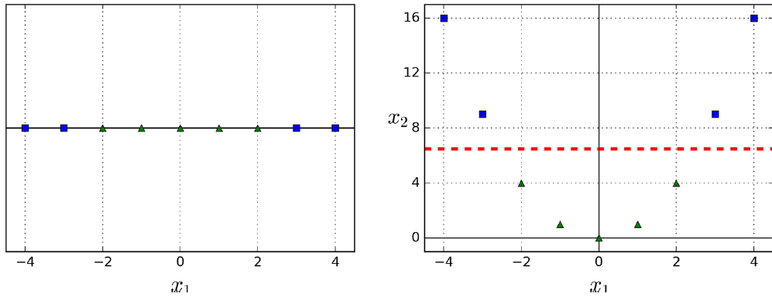
Nonlinear SVM Classification
many datasets are not even close to being linearly separable. One approach to handling nonlinear datasets is to add more features, such as polynomial features; in some cases this can result in a linearly separable dataset.

Slide 11
from sklearn.datasets import make_moons
from sklearn.pipeline import Pipeline
from sklearn.preprocessing import PolynomialFeatures
polynomial_svm_clf = Pipeline((
("poly_features", PolynomialFeatures(degree=3)),
("scaler", StandardScaler()),
("svm_clf", LinearSVC(C=10, loss="hinge"))
))
polynomial_svm_clf.fit(X, y)

Slide 12
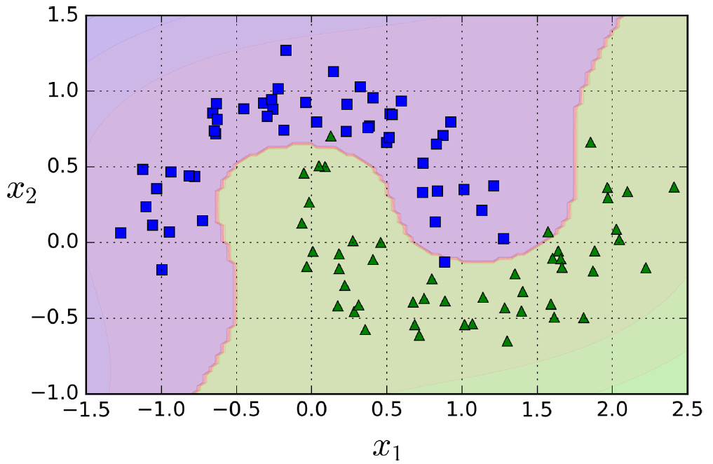

Slide 13
Polynomial Kernel
Adding polynomial features is simple to implement and can work great with all sorts of Machine Learning algorithms (not just SVMs), but at a low polynomial degree it cannot deal with very complex datasets, and with a high polynomial degree it creates a huge number of features, making the model too slow.
Fortunately, when using SVMs you can apply an almost miraculous mathematical technique called the kernel trick . It makes it possible to get the same result as if you added many polynomial features, even with very highdegree polynomials, without actually having to add them. So there is no combinatorial explosion of the number of features since you don’t actually add any features.

Slide 14
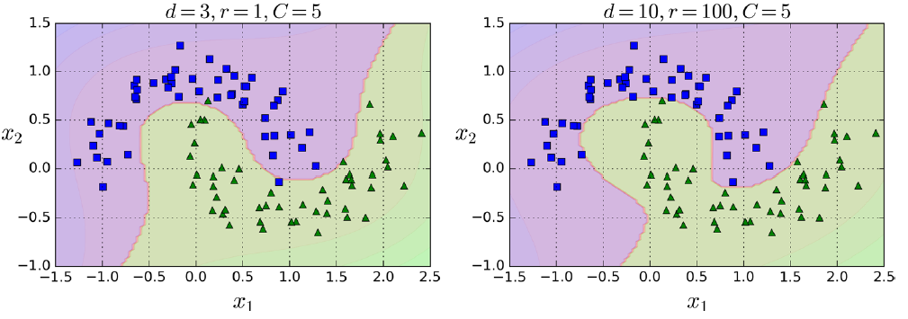
from sklearn.svm import SVC
poly_kernel_svm_clf = Pipeline((
("scaler", StandardScaler()),
("svm_clf", SVC(kernel="poly", degree=3, coef0=1, C=5))
))
poly_kernel_svm_clf.fit(X, y)

Slide 15
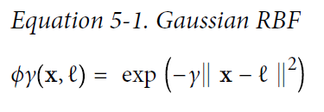
Adding Similarity Features
Another technique to tackle nonlinear problems is to add features computed using a similarity function that measures how much each instance resembles a particular landmark. For example, let’s take the one-dimensional dataset discussed earlier and add two landmarks to it at x1 = –2 and x1 = 1. Next, let’s define the similarity function to be the Gaussian Radial Basis Function (RBF) with γ = 0.3 .

Slide 16
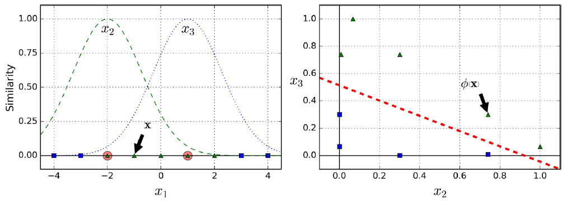
Adding Similarity Features
Another technique to tackle nonlinear problems is to add features computed using a similarity function that measures how much each instance resembles a particular landmark. For example, let’s take the one-dimensional dataset discussed earlier and add two landmarks to it at x1 = –2 and x1 = 1. Next, let’s define the similarity function to be the Gaussian Radial Basis Function (RBF) with γ = 0.3 .

Slide 17
Gaussian RBF Kernel
Just like the polynomial features method, the similarity features method can be useful with any Machine Learning algorithm, but it may be computationally expensive to compute all the additional features, especially on large training sets. However, it makes it possible to obtain a similar result as if you had added many similarity features, without actually having to add them:
rbf_kernel_svm_clf = Pipeline((
("scaler", StandardScaler()),
("svm_clf", SVC(kernel="rbf", gamma=5, C=0.001))
))
rbf_kernel_svm_clf.fit(X, y)

Slide 18
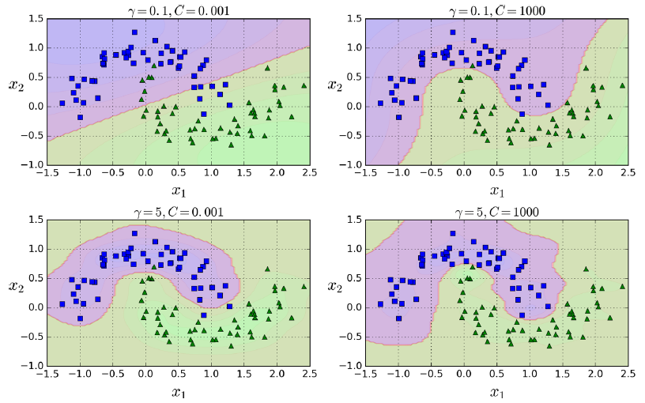
Gaussian RBF Kernel
Just like the polynomial features method, the similarity features method can be useful with any Machine Learning algorithm, but it may be computationally expensive to compute all the additional features, especially on large training sets. However, it makes it possible to obtain a similar result as if you had added many similarity features, without actually having to add them:
rbf_kernel_svm_clf = Pipeline((
("scaler", StandardScaler()),
("svm_clf", SVC(kernel="rbf", gamma=5, C=0.001))
))
rbf_kernel_svm_clf.fit(X, y)

Slide 19
Computational Complexity
The LinearSVC class is based on the liblinear library, which implements an optimized algorithm for linear SVMs.1 It does not support the kernel trick, but it scales almost linearly with the number of training instances and the number of features: its training time complexity is roughly O(m × n).
The algorithm takes longer if you require a very high precision. This is controlled by the tolerance hyperparameter ϵ (called tol in Scikit-Learn). In most classification tasks, the default tolerance is fine.

Slide 20
Computational Complexity
The SVC class is based on the libsvm library, which implements an algorithm that supports the kernel trick.2 The training time complexity is usually between O(m2 × n) and O(m3 × n). Unfortunately, this means that it gets dreadfully slow when the number of training instances gets large (e.g., hundreds of thousands of instances). This algorithm is perfect for complex but small or medium training sets. However, it scales well with the number of features, especially with sparse features (i.e., when each instance has few nonzero features). In this case, the algorithm scales roughly with the average number of nonzero features per instance.

Slide 21
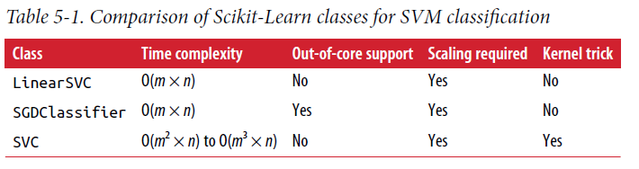
Computational Complexity

Slide 22
SVM Regression
As we mentioned earlier, the SVM algorithm is quite versatile: not only does it support linear and nonlinear classification, but it also supports linear and nonlinear regression. The trick is to reverse the objective: instead of trying to fit the largest possible street between two classes while limiting margin violations, SVM Regression tries to fit as many instances as possible on the street while limiting margin violations (i.e., instances off the street). The width of the street is controlled by a hyperparameter ϵ.

Slide 23
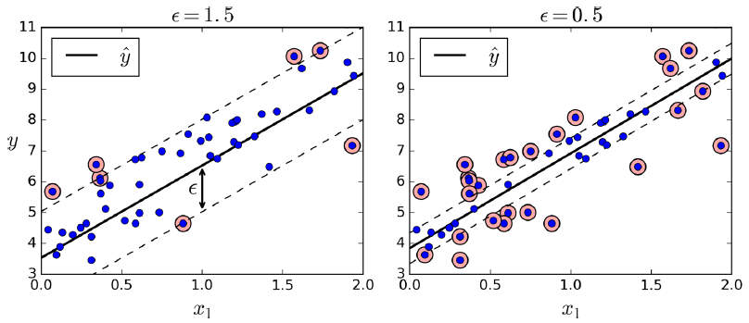
SVM Regression
from sklearn.svm import LinearSVR
svm_reg = LinearSVR(epsilon=1.5)
svm_reg.fit(X, y)

Slide 24
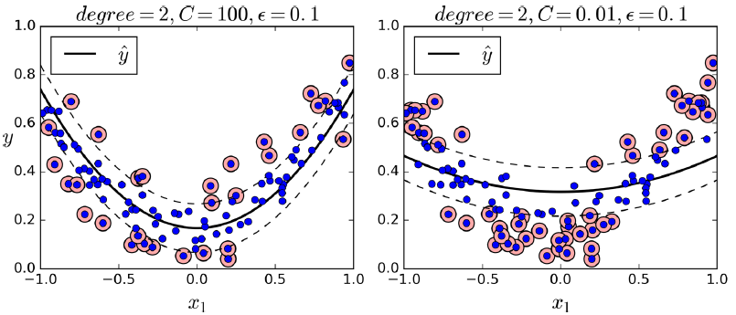
SVM Regression
from sklearn.svm import SVR
svm_poly_reg = SVR(kernel="poly", degree=2, C=100, epsilon=0.1)
svm_poly_reg.fit(X, y)

Slide 25
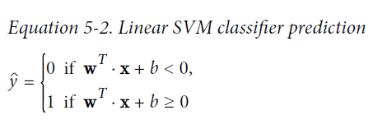
Under the Hood
Decision Function and Predictions
The linear SVM classifier model predicts the class of a new instance x by simply computing the decision function w^{T} ・ x + b = w₁ x₁ + ⋯ + w_{n} x_{n} + b: if the result is positive, the predicted class ŷ is the positive class (1), or else it is the negative class (0); see Equation 5-2.

Slide 26
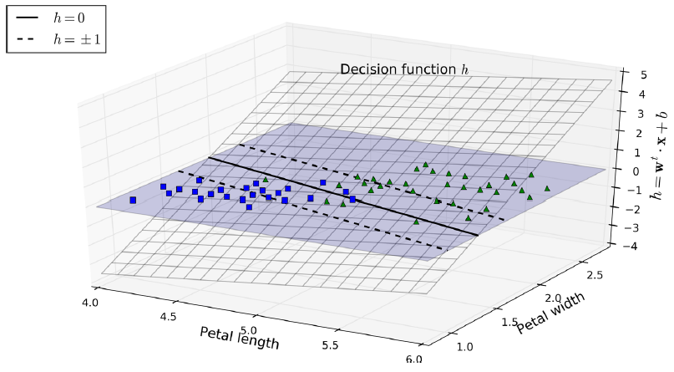
Under the Hood
Decision Function and Predictions
The linear SVM classifier model predicts the class of a new instance x by simply computing the decision function w^{T} ・ x + b = w₁ x₁ + ⋯ + w_{n} x_{n} + b: if the result is positive, the predicted class ŷ is the positive class (1), or else it is the negative class (0); see Equation 5-2.

Slide 27
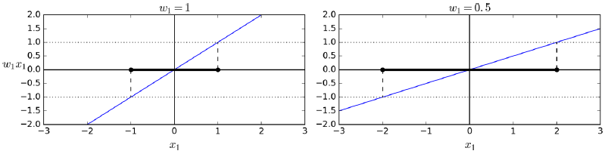
Under the Hood
Training Objective
Consider the slope of the decision function: it is equal to the norm of the weight vector, ||w||. If we divide this slope by 2, the points where the decision function is equal to ±1 are going to be twice as far away from the decision boundary. The smaller the weight vector w, the larger the margin.

Slide 28
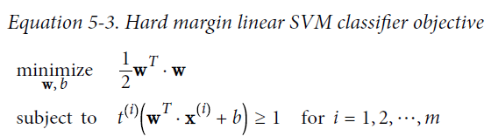
Training Objective
So we want to minimize ||w|| to get a large margin. However, if we also want to avoid any margin violation (hard margin), then we need the decision function to be greater than 1 for all positive training instances, and lower than –1 for negative training instances. If we define t^{(i)} = –1 for negative instances (if y^{(i)} = 0) and t^{(i)} = 1 for positive instances (if y^{(i)} = 1), then we can express this constraint as t^{(i)}(w^{T}・x^{(i)} + b) ≥ 1 for all instances.

Slide 29
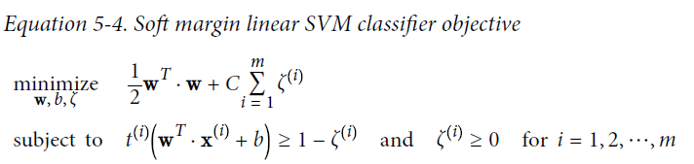
Training Objective
To get the soft margin objective, we need to introduce a slack variable ζ(i) ≥ 0 for each instance:4 ζ(i) measures how much the ith instance is allowed to violate the margin. We now have two conflicting objectives: making the slack variables as small as possible to reduce the margin violations, and making 12 w^{T}・w as small as possible to increase the margin. This is where the C hyperparameter comes in: it allows us to define the tradeoff between these two objectives.

Slide 30
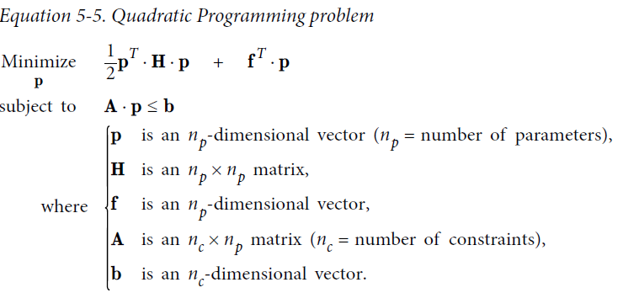
Quadratic Programming
The hard margin and soft margin problems are both convex quadratic optimization problems with linear constraints. Such problems are known as Quadratic Programming (QP) problems.

Slide 31
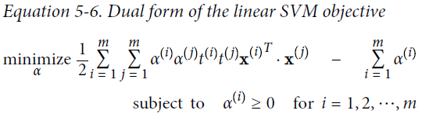
The Dual Problem
Given a constrained optimization problem, known as the primal problem, it is possible to express a different but closely related problem, called its dual problem. The solution to the dual problem typically gives a lower bound to the solution of the primal problem, but under some conditions it can even have the same solutions as the primal problem. Luckily, the SVM problem happens to meet these conditions.

Slide 32
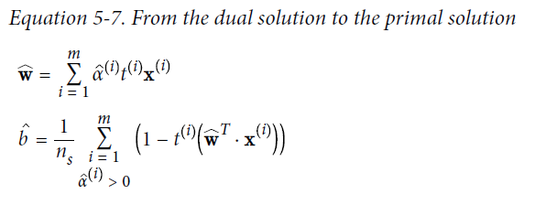
The Dual Problem
Once you find the vector α that minimizes this equation (using a QP solver), you can compute w and b that minimize the primal problem by using Equation 5-7.

Slide 33
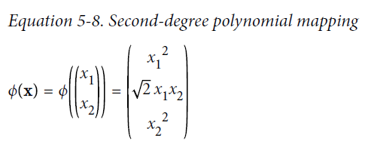
Kernelized SVM
Suppose you want to apply a 2nd-degree polynomial transformation to a twodimensional training set (such as the moons training set), then train a linear SVM classifier on the transformed training set. Equation 5-8 shows the 2nd-degree polynomial mapping function ϕ that you want to apply.

Slide 34
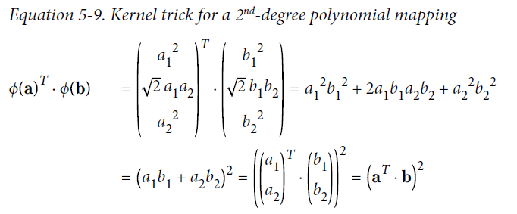
Kernelized SVM
Notice that the transformed vector is three-dimensional instead of two-dimensional. Now let’s look at what happens to a couple of two-dimensional vectors, a and b, if we apply this 2nd-degree polynomial mapping and then compute the dot product of the transformed.

Slide 35

Kernelized SVM
The dot product of the transformed vectors is equal to the square of the dot product of original vectors: ϕ(a)^{T}・ϕ(b) = (a^{T}・b)². if you apply the transformation ϕ to all training instances, then the dual problem (see Equation 5-6) will contain the dot product ϕ(x^{(i)})^{T}・ϕ(x^{(j)}). But if ϕ is the 2nd-degree polynomial transformation defined in Equation 5-8, then you can replace this dot product of transformed vectors simply by So you don’t actually need to transform the training instances at all: just replace the dot product by its square in Equation 5-6. The result will be strictly the same as if you went through the trouble of actually transforming the training set then fitting a linear SVM algorithm, but this trick makes the whole process much more computationally efficient.

Slide 36
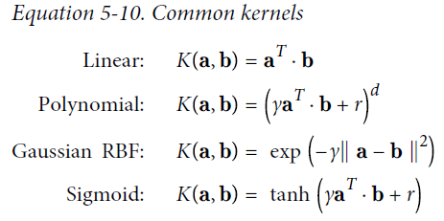
Kernelized SVM
The function K(a, b) = (a^{T}・b)² is called a 2nd-degree polynomial kernel. In Machine Learning, a kernel is a function capable of computing dot product ϕ(a)^{T}・ϕ(b) based only on the original vectors a and b, without having to compute (or even to know about) the transformation ϕ.

Slide 37
Kernelized SVM
There is still one loose end we must tie. Equation 5-7 shows how to go from the dual solution to the primal solution in the case of a linear SVM classifier, but if you apply the kernel trick you end up with equations that include ϕ(x^{(i)}). In fact, w must have the same number of dimensions as ϕ(x^{(i)}), which may be huge or even infinite, so you can’t compute it. But how can you make predictions without knowing w?

Slide 38
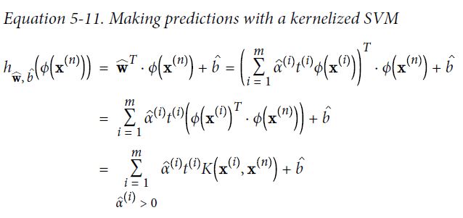
Kernelized SVM
Well, the good news is that you can plug in the formula for w from Equation 5-7 into the decision function for a new instance x^{(n)}, and you get an equation with only dot products between input vectors. This makes it possible to use the kernel trick, once again (Equation 5-11).

Slide 39
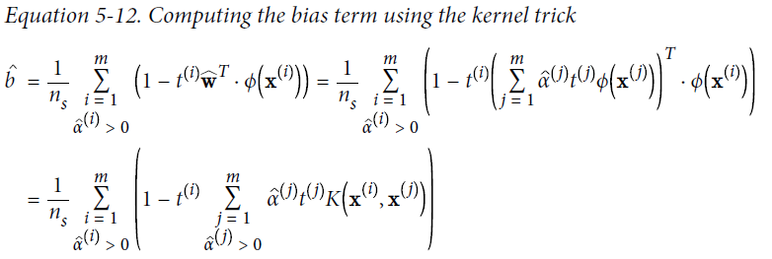
Kernelized SVM
Note that since α^{(i)} ≠ 0 only for support vectors, making predictions involves computing the dot product of the new input vector x^{(n)} with only the support vectors, not all the training instances. Of course, you also need to compute the bias term b, using the same trick (Equation 5-12).

Slide 40
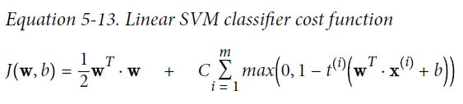
Online SVMs
For linear SVM classifiers, one method is to use Gradient Descent (e.g., using SGDClassifier) to minimize the cost function in Equation 5-13, which is derived from the primal problem. Unfortunately it converges much more slowly than the methods based on QP.

Slide 41
Online SVMs
The first sum in the cost function will push the model to have a small weight vector w, leading to a larger margin. The second sum computes the total of all margin violations. An instance’s margin violation is equal to 0 if it is located off the street and on the correct side, or else it is proportional to the distance to the correct side of the street. Minimizing this term ensures that the model makes the margin violations as small and as few as possible

