Slide 1
Hands-On Machine Learning with Scikit-Learn and TensorFlow
Concepts, Tools, and Techniques to Build Intelligent Systems

Slide 2
CHAPTER 6
Decision Trees
In this chapter we will start by discussing how to train, visualize, and make predictions with Decision Trees. Then we will go through the CART training algorithm used by Scikit-Learn, and we will discuss how to regularize trees and use them for regression tasks. Finally, we will discuss some of the limitations of Decision Trees.

Slide 3
Training and Visualizing a Decision Tree
from sklearn.datasets import load_iris
from sklearn.tree import DecisionTreeClassifier
iris = load_iris()
X = iris.data[:, 2:] # petal length and width
y = iris.target
tree_clf = DecisionTreeClassifier(max_depth=2)
tree_clf.fit(X, y)

Slide 4
Training and Visualizing a Decision Tree
from sklearn.tree import export_graphviz
export_graphviz(
tree_clf,
out_file=image_path("iris_tree.dot"),
feature_names=iris.feature_names[2:],
class_names=iris.target_names,
rounded=True,
filled=True
)

Slide 5
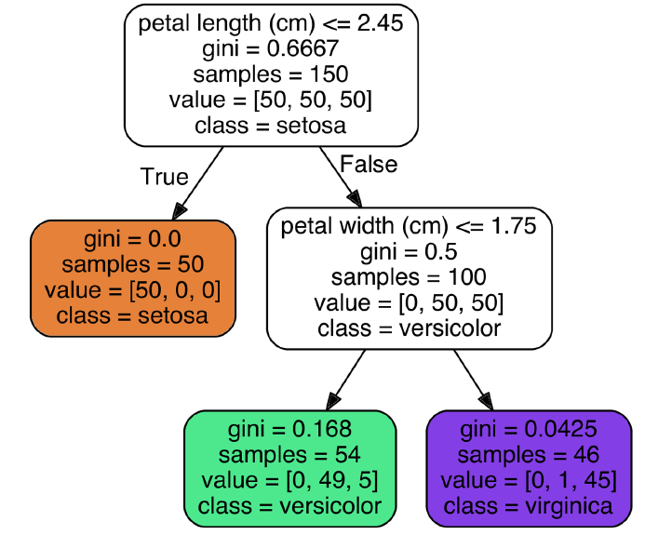
$ dot -Tpng iris_tree.dot -o iris_tree.png

Slide 6
Making Predictions
Suppose you find an iris flower and you want to classify it. You start at the root node (depth 0, at the top): this node asks whether the flower’s petal length is smaller than 2.45 cm. If it is, then you move down to the root’s left child node (depth 1, left). In this case, it is a leaf node (i.e., it does not have any children nodes), so it does not ask any questions: you can simply look at the predicted class for that node and the Decision Tree predicts that your flower is an Iris-Setosa (class=setosa).

Slide 7
Making Predictions
A node’s samples attribute counts how many training instances it applies to. A node’s value attribute tells you how many training instances of each class this node applies to. Finally, a node’s gini attribute measures its impurity: a node is “pure” (gini=0) if all training instances it applies to belong to the same class. For example, since the depth-1 left node applies only to Iris-Setosa training instances, it is pure and its gini score is 0.

Slide 8
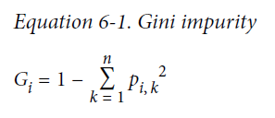
Making Predictions
Equation 6-1 shows how the training algorithm computes the gini score Gi of the ith node. For example, the depth-2 left node has a gini score equal to 1 – (0/54)² – (49/54)² – (5/54)² ≈ 0.168.

Slide 9
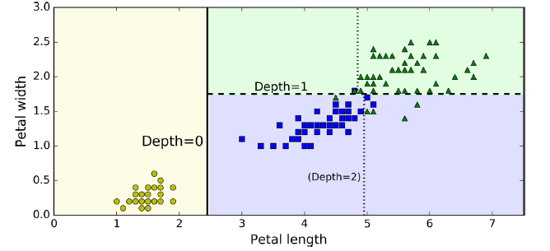
Decision Tree decision boundaries
Equation 6-1 shows how the training algorithm computes the gini score Gi of the ith node. For example, the depth-2 left node has a gini score equal to 1 – (0/54)² – (49/54)² – (5/54)² ≈ 0.168.

Slide 10
Estimating Class Probabilities
A Decision Tree can also estimate the probability that an instance belongs to a particular class k: first it traverses the tree to find the leaf node for this instance, and then it returns the ratio of training instances of class k in this node.
>>> tree_clf.predict_proba([[5, 1.5]])
array([[ 0. , 0.90740741, 0.09259259]])
>>> tree_clf.predict([[5, 1.5]])
array([1])

Slide 11
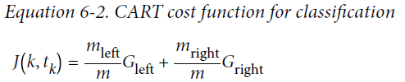
The CART Training Algorithm
Scikit-Learn uses the Classification And Regression Tree (CART) algorithm to train Decision Trees. The algorithm first splits the training set in two subsets using a single feature k and a threshold t_{k} (e.g., “petal length ≤ 2.45 cm”). How does it choose k and tk? It searches for the pair (k, tk) that produces the purest subsets (weighted by their size).

Slide 12
The CART Training Algorithm
Once it has successfully split the training set in two, it splits the subsets using the same logic, then the sub-subsets and so on, recursively. It stops recursing once it reaches the maximum depth (defined by the max_depth hyperparameter), or if it cannot find a split that will reduce impurity.
Unfortunately, finding the optimal tree is known to be an NP-Complete problem: it requires O(exp(m)) time, making the problem intractable even for fairly small training sets.

Slide 13
Computational Complexity
Making predictions requires traversing the Decision Tree from the root to a leaf. Decision Trees are generally approximately balanced, so traversing the Decision Tree requires going through roughly O(log₂(m)) nodes.3 Since each node only requires checking the value of one feature, the overall prediction complexity is just O(log₂(m)), independent of the number of features. So predictions are very fast, even when dealing with large training sets.

Slide 14
Computational Complexity
However, the training algorithm compares all features (or less if max_features is set) on all samples at each node. This results in a training complexity of O(n × m log(m)). For small training sets (less than a few thousand instances), Scikit-Learn can speed up training by presorting the data (set presort=True), but this slows down training considerably for larger training sets.

Slide 15
Gini Impurity or Entropy?
However, the training algorithm compares all features (or less if max_features is set) on all samples at each node. This results in a training complexity of O(n × m log(m)). For small training sets (less than a few thousand instances), Scikit-Learn can speed up training by presorting the data (set presort=True), but this slows down training considerably for larger training sets.

Slide 16
Gini Impurity or Entropy?
The concept of entropy originated in thermodynamics as a measure of molecular disorder: entropy approaches zero when molecules are still and well ordered. It later spread to a wide variety of domains, including Shannon’s information theory, where it measures the average information content of a message: entropy is zero when all messages are identical. In Machine Learning, it is frequently used as an impurity measure.

Slide 17
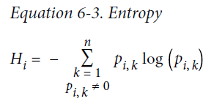
Gini Impurity or Entropy?
So should you use Gini impurity or entropy? Gini impurity is slightly faster to compute, so it is a good default. However, when they differ, Gini impurity tends to isolate the most frequent class in its own branch of the tree, while entropy tends to produce slightly more balanced trees.

Slide 18
Regularization Hyperparameters
Decision Trees make very few assumptions about the training data (as opposed to linear models). If left unconstrained, the tree structure will adapt itself to the training data, fitting it very closely, and most likely overfitting it. Such a model is often called a nonparametric model, because the number of parameters is not determined prior to training, so the model structure is free to stick closely to the data. In contrast, a parametric model has a predetermined number of parameters, so its degree of freedom is limited, reducing the risk of overfitting (but increasing the risk of underfitting).

Slide 19
Regularization Hyperparameters
To avoid overfitting the training data, you need to restrict the Decision Tree’s freedom during training. As you know by now, this is called regularization. The regularization hyperparameters depend on the algorithm used, but generally you can at least restrict the maximum depth of the Decision Tree. In Scikit-Learn, this is controlled by the max_depth hyperparameter (the default value is None, which means unlimited). Reducing max_depth will regularize the model and thus reduce the risk of overfitting.

Slide 20
Regularization Hyperparameters
The DecisionTreeClassifier class has a few other parameters that similarly restrict the shape of the Decision Tree: min_samples_split (the minimum number of samples a node must have before it can be split), min_samples_leaf (the minimum number of samples a leaf node must have), min_weight_fraction_leaf, max_leaf_nodes, and max_features. Increasing min_* hyperparameters or reducing max_* hyperparameters will regularize the model.

Slide 21
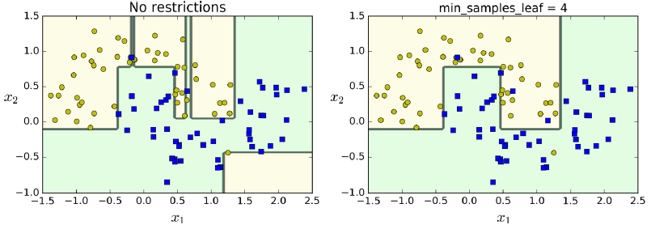
Regularization using min_samples_leaf

Slide 22
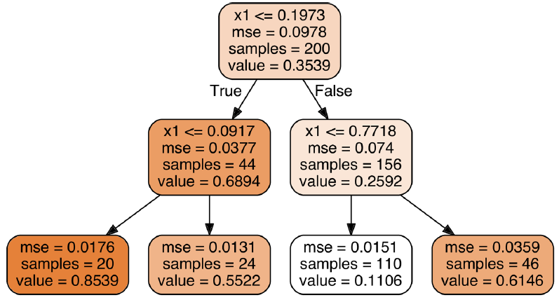
Regression
from sklearn.tree import DecisionTreeRegressor
tree_reg = DecisionTreeRegressor(max_depth=2)
tree_reg.fit(X, y)

Slide 23
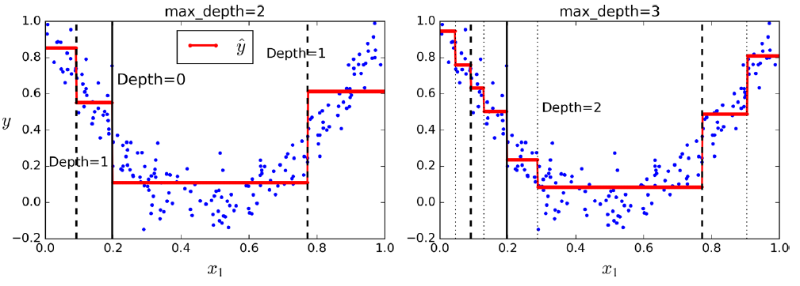
Predictions of two Decision Tree regression models

Slide 24
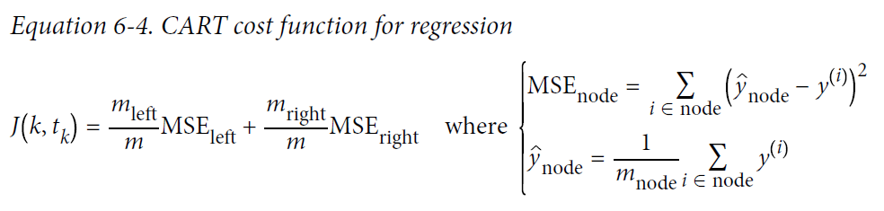
Regression
The CART algorithm works mostly the same way as earlier, except that instead of trying to split the training set in a way that minimizes impurity, it now tries to split the training set in a way that minimizes the MSE. Equation 6-4 shows the cost function that the algorithm tries to minimize.

Slide 25
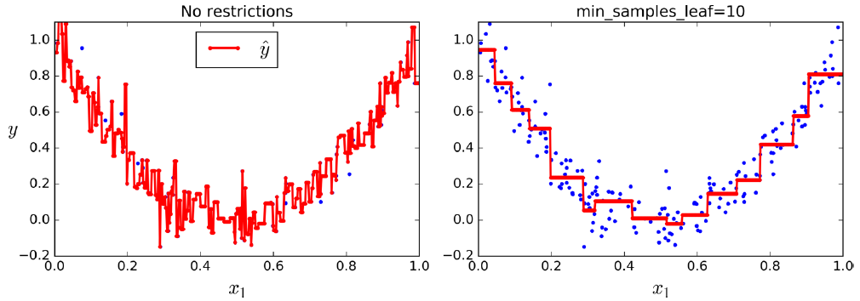
Regression
Just like for classification tasks, Decision Trees are prone to overfitting when dealing with regression tasks. Without any regularization, you get the graph on the left. Setting min_samples_leaf = 10 results in a more reasonable model.

Slide 26
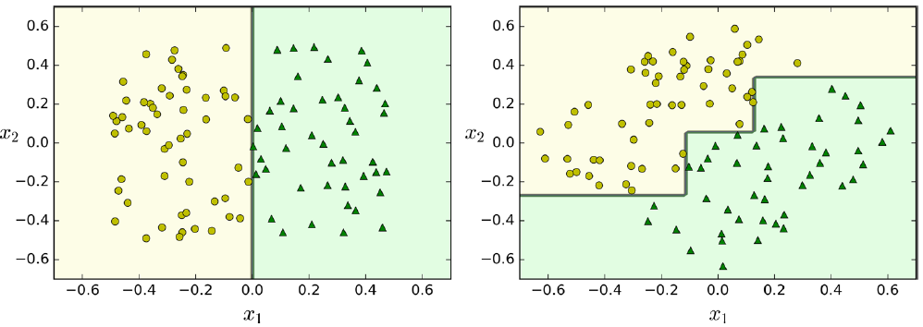
Instability
Decision Trees are simple to understand and interpret, easy to use, versatile, and powerful. However they do have a few limitations. First, as you may have noticed, Decision Trees love orthogonal decision boundaries, which makes them sensitive to training set rotation.

Slide 27
Instability
More generally, the main issue with Decision Trees is that they are very sensitive to small variations in the training data. For example, if you just remove the widest Iris-Versicolor from the iris training set and train a new Decision Tree, you may get the model represented in Figure 6-8. As you can see, it looks very different from the previous Decision Tree (Figure 6-2). Actually, since the training algorithm used by Scikit-Learn is stochastic6 you may get very different models even on the same training data.

Slide 28
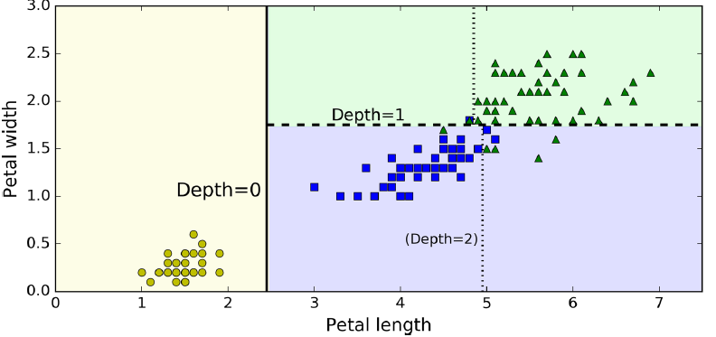
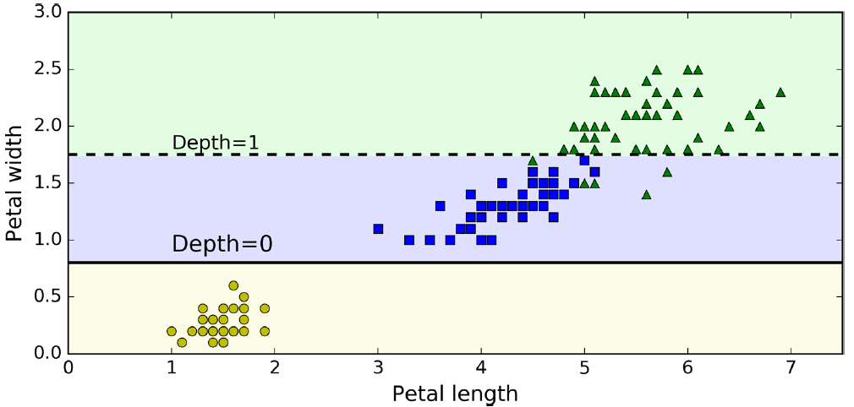
Instability

