Slide 1
Hands-On Machine Learning with Scikit-Learn and TensorFlow
Concepts, Tools, and Techniques to Build Intelligent Systems

Slide 2
CHAPTER 7
Ensemble Learning and Random Forests
Suppose you ask a complex question to thousands of people, then aggregate the answers. In many cases you will find that this aggregated answer is better than an expert’s answer. This is called the wisdom of the crowd. Similarly, if you aggregate the predictions of a group of predictors, you will often get better predictions than with the best individual predictor. This technique is called Ensemble Learning.

Slide 3
Ensemble Learning and Random Forests
For example, you can train a group of Decision Tree classifiers, each on a different random subset of the training set. To make predictions, you just obtain the predictions of all individual trees, then predict the class that gets the most votes. Such an ensemble of Decision Trees is called a Random Forest, and despite its simplicity, this is one of the most powerful Machine Learning algorithms available today.

Slide 4
Ensemble Learning and Random Forests
you will often use Ensemble methods near the end of a project, once you have already built a few good predictors, to combine them into an even better predictor. In fact, the winning solutions in Machine Learning competitions often involve several Ensemble methods.
In this chapter we will discuss the most popular Ensemble methods, including bagging, boosting, stacking, and a few others. We will also explore Random Forests.

Slide 5
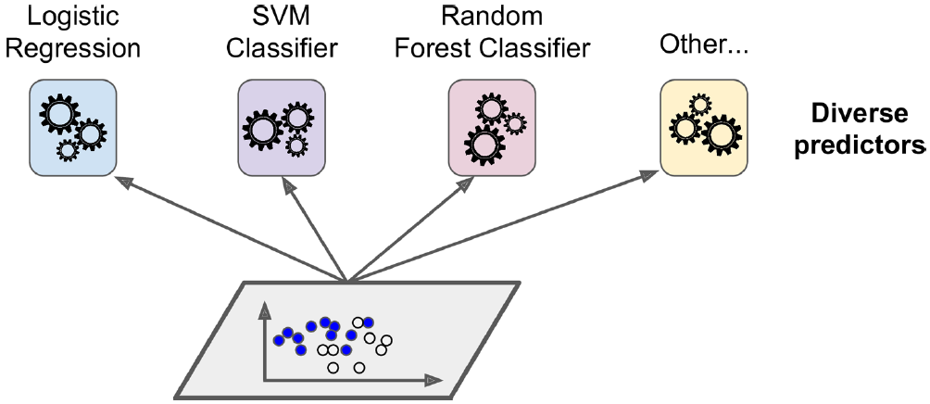
Voting Classifiers
Suppose you have trained a few classifiers, each one achieving about 80% accuracy. You may have a Logistic Regression classifier, an SVM classifier, a Random Forest classifier, a K-Nearest Neighbors classifier, and perhaps a few more.

Slide 6
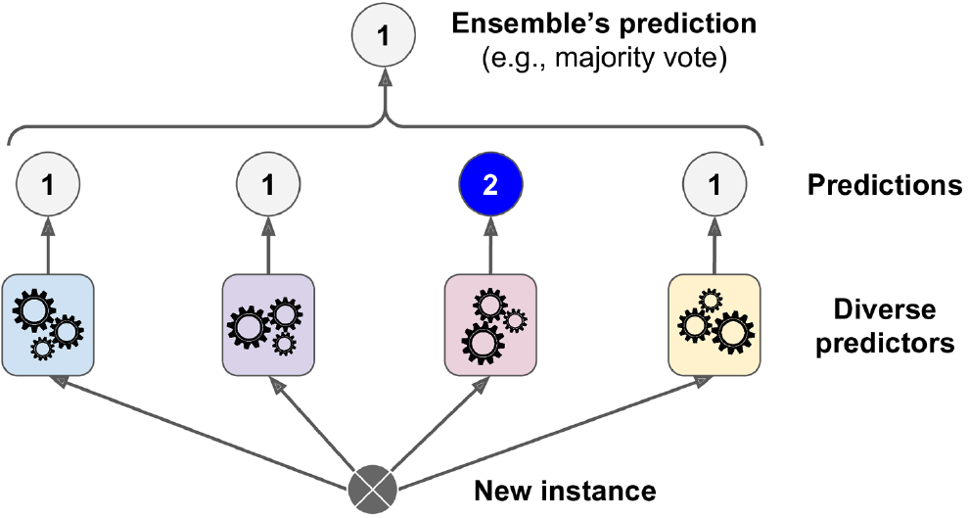
Voting Classifiers
A very simple way to create an even better classifier is to aggregate the predictions of each classifier and predict the class that gets the most votes. This majority-vote classifier is called a hard voting classifier.

Slide 7
Voting Classifiers
Somewhat surprisingly, this voting classifier often achieves a higher accuracy than the best classifier in the ensemble. In fact, even if each classifier is a weak learner (meaning it does only slightly better than random guessing), the ensemble can still be a strong learner (achieving high accuracy), provided there are a sufficient number of weak learners and they are sufficiently diverse.

Slide 8
Voting Classifiers
Ensemble methods work best when the predictors are as independent from one another as possible. One way to get diverse classifiers is to train them using very different algorithms. This increases the chance that they will make very different types of errors, improving the ensemble’s accuracy.

Slide 9
Voting Classifiers
from sklearn.ensemble import RandomForestClassifier
from sklearn.ensemble import VotingClassifier
from sklearn.linear_model import LogisticRegression
from sklearn.svm import SVC
log_clf = LogisticRegression()
rnd_clf = RandomForestClassifier()
svm_clf = SVC()
voting_clf = VotingClassifier(
estimators=[('lr', log_clf), ('rf', rnd_clf), ('svc', svm_clf)],
voting='hard'
)
voting_clf.fit(X_train, y_train)

Slide 10
Voting Classifiers
>>> from sklearn.metrics import accuracy_score
>>> for clf in (log_clf, rnd_clf, svm_clf, voting_clf):
>>> clf.fit(X_train, y_train)
>>> y_pred = clf.predict(X_test)
>>> print(clf.__class__.__name__, accuracy_score(y_test, y_pred))
LogisticRegression 0.864
RandomForestClassifier 0.872
SVC 0.888
VotingClassifier 0.896

Slide 11
Voting Classifiers
If all classifiers are able to estimate class probabilities (i.e., they have a pre dict_proba() method), then you can tell Scikit-Learn to predict the class with the highest class probability, averaged over all the individual classifiers. This is called soft voting. It often achieves higher performance than hard voting because it gives more weight to highly confident votes.

Slide 12
Bagging and Pasting
One way to get a diverse set of classifiers is to use very different training algorithms, as just discussed. Another approach is to use the same training algorithm for every predictor, but to train them on different random subsets of the training set. When sampling is performed with replacement, this method is called bagging (short for bootstrap aggregating). When sampling is performed without replacement, it is called pasting.

Slide 13
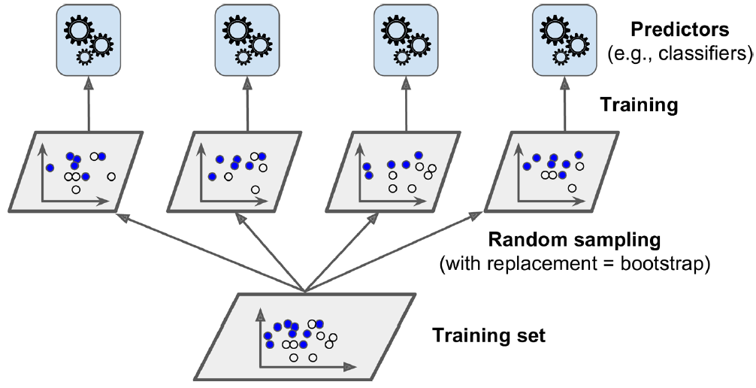
Bagging and Pasting
both bagging and pasting allow training instances to be sampled several times across multiple predictors, only bagging allows training instances to be sampled several times for the same predictor.

Slide 14
Bagging and Pasting
Once all predictors are trained, the ensemble can make a prediction for a new instance by simply aggregating the predictions of all predictors. The aggregation function is typically the statistical mode for classification, or the average for regression. Each individual predictor has a higher bias than if it were trained on the original training set, but aggregation reduces both bias and variance.4 Generally, the net result is that the ensemble has a similar bias but a lower variance than a single predictor trained on the original training set.

Slide 15
Bagging and Pasting in Scikit-Learn
Scikit-Learn offers a simple API for both bagging and pasting with the BaggingClassifier class (or BaggingRegressor for regression). The following code trains an ensemble of 500 Decision Tree classifiers,5 each trained on 100 training instances randomly sampled from the training set with replacement (this is an example of bagging, but if you want to use pasting instead, just set bootstrap=False). The n_jobs parameter tells Scikit-Learn the number of CPU cores to use for training and predictions (–1 tells Scikit-Learn to use all available cores):

Slide 16
Bagging and Pasting in Scikit-Learn
from sklearn.ensemble import BaggingClassifier
from sklearn.tree import DecisionTreeClassifier
bag_clf = BaggingClassifier(
DecisionTreeClassifier(), n_estimators=500,
max_samples=100, bootstrap=True, n_jobs=-1
)
bag_clf.fit(X_train, y_train)
y_pred = bag_clf.predict(X_test)

Slide 17
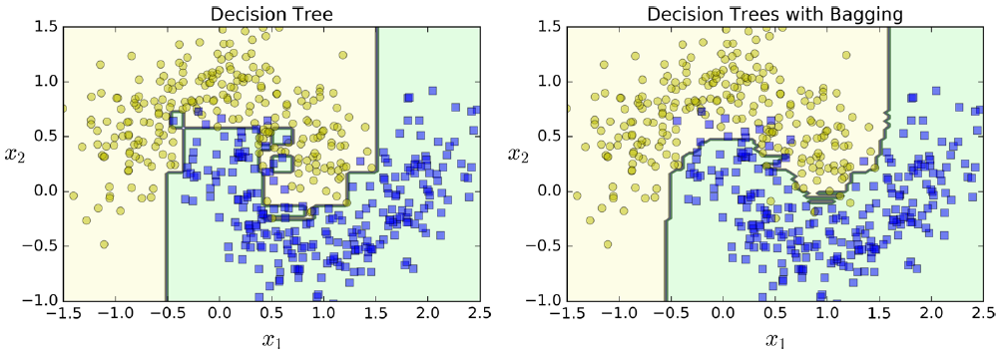
A single Decision Tree versus a bagging ensemble of 500 trees

Slide 18
Bagging and Pasting in Scikit-Learn
Bootstrapping introduces a bit more diversity in the subsets that each predictor is trained on, so bagging ends up with a slightly higher bias than pasting, but this also means that predictors end up being less correlated so the ensemble’s variance is reduced. Overall, bagging often results in better models, which explains why it is generally preferred. However, if you have spare time and CPU power you can use crossvalidation to evaluate both bagging and pasting and select the one that works best.

Slide 19
Out-of-Bag Evaluation
With bagging, some instances may be sampled several times for any given predictor, while others may not be sampled at all. By default a BaggingClassifier samples m training instances with replacement (bootstrap=True), where m is the size of the training set. This means that only about 63% of the training instances are sampled on average for each predictor.6 The remaining 37% of the training instances that are not sampled are called out-of-bag (oob) instances. Note that they are not the same 37% for all predictors

Slide 20
Out-of-Bag Evaluation
In Scikit-Learn, you can set oob_score=True when creating a BaggingClassifier to request an automatic oob evaluation after training. The following code demonstrates this. The resulting evaluation score is available through the oob_score_ variable:
>>> bag_clf = BaggingClassifier(
>>> DecisionTreeClassifier(), n_estimators=500,
>>> bootstrap=True, n_jobs=-1, oob_score=True)
>>> bag_clf.fit(X_train, y_train)
>>> bag_clf.oob_score_
0.93066666666666664

Slide 21
Out-of-Bag Evaluation
>>> bag_clf = BaggingClassifier(
>>> DecisionTreeClassifier(), n_estimators=500,
>>> bootstrap=True, n_jobs=-1, oob_score=True)
>>> bag_clf.fit(X_train, y_train)
>>> bag_clf.oob_score_
0.93066666666666664
>>> from sklearn.metrics import accuracy_score
>>> y_pred = bag_clf.predict(X_test)
>>> accuracy_score(y_test, y_pred)
0.93600000000000005

Slide 22
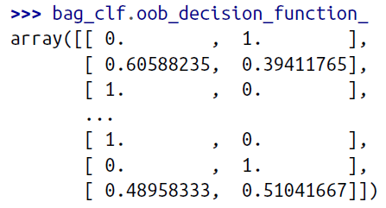
Out-of-Bag Evaluation
The oob decision function for each training instance is also available through the oob_decision_function_ variable. In this case (since the base estimator has a predict_proba() method) the decision function returns the class probabilities for each training instance. For example, the oob evaluation estimates that the second training instance has a 60.6% probability of belonging to the positive class (and 39.4% of belonging to the positive class):

Slide 23
Random Patches and Random Subspaces
The BaggingClassifier class supports sampling the features as well. This is controlled by two hyperparameters: max_features and bootstrap_features. They work the same way as max_samples and bootstrap, but for feature sampling instead of instance sampling. Thus, each predictor will be trained on a random subset of the input features.

Slide 24
Random Patches and Random Subspaces
This is particularly useful when you are dealing with high-dimensional inputs (such as images). Sampling both training instances and features is called the Random Patches method.7 Keeping all training instances (i.e., bootstrap=False and max_samples=1.0) but sampling features (i.e., bootstrap_features=True and/or max_features smaller than 1.0) is called the Random Subspaces method. Sampling features results in even more predictor diversity, trading a bit more bias for a lower variance.

Slide 25
Random Forests
As we have discussed, a Random Forest is an ensemble of Decision Trees, generally trained via the bagging method (or sometimes pasting), typically with max_samples set to the size of the training set. Instead of building a BaggingClassifier and passing it a DecisionTreeClassifier, you can instead use the RandomForestClassifier class, which is more convenient and optimized for Decision Trees. The following code trains a Random Forest classifier with 500 trees (each limited to maximum 16 nodes), using all available CPU cores:

Slide 26
Random Forests
from sklearn.ensemble import RandomForestClassifier
rnd_clf = RandomForestClassifier(n_estimators=500, max_leaf_nodes=16, n_jobs=-1)
rnd_clf.fit(X_train, y_train)
y_pred_rf = rnd_clf.predict(X_test)

Slide 27
Random Forests
The Random Forest algorithm introduces extra randomness when growing trees; instead of searching for the very best feature when splitting a node (see Chapter 6), it searches for the best feature among a random subset of features. This results in a greater tree diversity, which (once again) trades a higher bias for a lower variance, generally yielding an overall better model. The following BaggingClassifier is roughly equivalent to the previous RandomForestClassifier:
bag_clf = BaggingClassifier(
DecisionTreeClassifier(splitter="random", max_leaf_nodes=16),
n_estimators=500, max_samples=1.0, bootstrap=True, n_jobs=-1
)

Slide 28
Feature Importance
Lastly, if you look at a single Decision Tree, important features are likely to appear closer to the root of the tree, while unimportant features will often appear closer to the leaves (or not at all). It is therefore possible to get an estimate of a feature’s importance by computing the average depth at which it appears across all trees in the forest. Scikit-Learn computes this automatically for every feature after training. You can access the result using the feature_importances_ variable.

Slide 29
Feature Importance
>>> from sklearn.datasets import load_iris
>>> iris = load_iris()
>>> rnd_clf = RandomForestClassifier(n_estimators=500, n_jobs=-1)
>>> rnd_clf.fit(iris["data"], iris["target"])
>>> for name, score in zip(iris["feature_names"], rnd_clf.feature_importances_):
>>> print(name, score)
sepal length (cm) 0.112492250999
sepal width (cm) 0.0231192882825
petal length (cm) 0.441030464364
petal width (cm) 0.423357996355

Slide 30
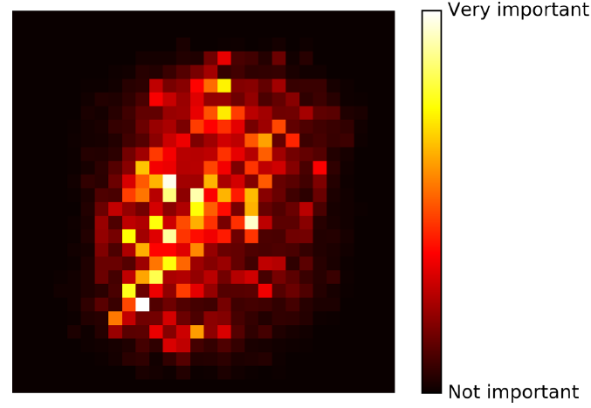
MNIST pixel importance (according to a Random Forest classifier)
>>> from sklearn.datasets import load_iris
>>> iris = load_iris()
>>> rnd_clf = RandomForestClassifier(n_estimators=500, n_jobs=-1)
>>> rnd_clf.fit(iris["data"], iris["target"])
>>> for name, score in zip(iris["feature_names"], rnd_clf.feature_importances_):
>>> print(name, score)
sepal length (cm) 0.112492250999
sepal width (cm) 0.0231192882825
petal length (cm) 0.441030464364
petal width (cm) 0.423357996355

Slide 31
Extra-Trees
When you are growing a tree in a Random Forest, at each node only a random subset of the features is considered for splitting (as discussed earlier). It is possible to make trees even more random by also using random thresholds for each feature rather than searching for the best possible thresholds (like regular Decision Trees do).
A forest of such extremely random trees is simply called an Extremely Randomized Trees ensemble12 (or Extra-Trees for short). Once again, this trades more bias for a lower variance. It also makes Extra-Trees much faster to train than regular Random Forests since finding the best possible threshold for each feature at every node is one of the most time-consuming tasks of growing a tree.

Slide 32
Boosting
Boosting (originally called hypothesis boosting) refers to any Ensemble method that can combine several weak learners into a strong learner. The general idea of most boosting methods is to train predictors sequentially, each trying to correct its predecessor. There are many boosting methods available, but by far the most popular are AdaBoost13 (short for Adaptive Boosting) and Gradient Boosting. Let’s start with AdaBoost.

Slide 33
AdaBoost
One way for a new predictor to correct its predecessor is to pay a bit more attention to the training instances that the predecessor underfitted. This results in new predictors focusing more and more on the hard cases. This is the technique used by AdaBoost.
For example, to build an AdaBoost classifier, a first base classifier (such as a Decision Tree) is trained and used to make predictions on the training set. The relative weight of misclassified training instances is then increased. A second classifier is trained using the updated weights and again it makes predictions on the training set, weights are updated, and so on.

Slide 34
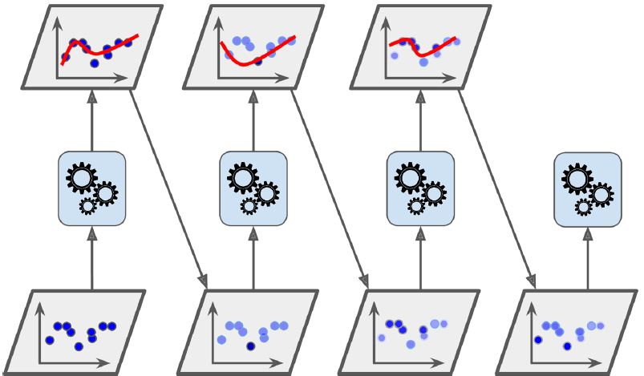
AdaBoost
One way for a new predictor to correct its predecessor is to pay a bit more attention to the training instances that the predecessor underfitted. This results in new predictors focusing more and more on the hard cases. This is the technique used by AdaBoost.
For example, to build an AdaBoost classifier, a first base classifier (such as a Decision Tree) is trained and used to make predictions on the training set. The relative weight of misclassified training instances is then increased. A second classifier is trained using the updated weights and again it makes predictions on the training set, weights are updated, and so on.

Slide 35
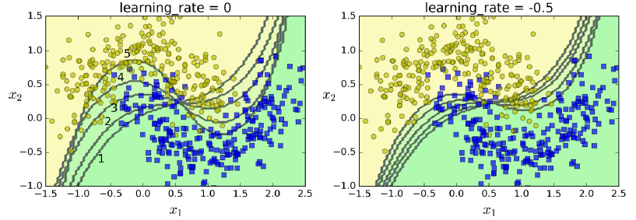
Decision boundaries of consecutive predictors

Slide 36
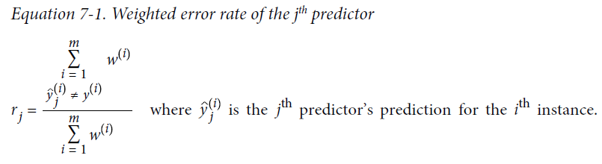
AdaBoost
Let’s take a closer look at the AdaBoost algorithm. Each instance weight w(i) is initially set to 1/m. A first predictor is trained and its weighted error rate r1 is computed on the training set; see Equation 7-1.

Slide 37
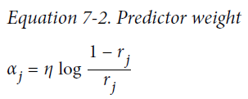
AdaBoost
The predictor’s weight αj is then computed using Equation 7-2, where η is the learning rate hyperparameter (defaults to 1). The more accurate the predictor is, the higher its weight will be. If it is just guessing randomly, then its weight will be close to zero. However, if it is most often wrong (i.e., less accurate than random guessing), then its weight will be negative.

Slide 38
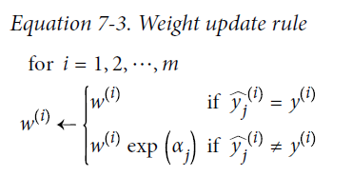
AdaBoost
Next the instance weights are updated using Equation 7-3: the misclassified instances are boosted.

Slide 39
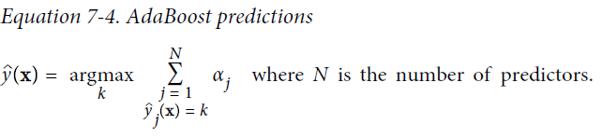
AdaBoost
Finally, a new predictor is trained using the updated weights, and the whole process is repeated (the new predictor’s weight is computed, the instance weights are updated, then another predictor is trained, and so on). The algorithm stops when the desired number of predictors is reached, or when a perfect predictor is found.
To make predictions, AdaBoost simply computes the predictions of all the predictors and weighs them using the predictor weights αj. The predicted class is the one that receives the majority of weighted votes (see Equation 7-4).

Slide 40
AdaBoost
from sklearn.ensemble import AdaBoostClassifier
ada_clf = AdaBoostClassifier(
DecisionTreeClassifier(max_depth=1), n_estimators=200,
algorithm="SAMME.R", learning_rate=0.5
)
ada_clf.fit(X_train, y_train)

Slide 41
Gradient Boosting
Another very popular Boosting algorithm is Gradient Boosting. Just like AdaBoost, Gradient Boosting works by sequentially adding predictors to an ensemble, each one correcting its predecessor. However, instead of tweaking the instance weights at every iteration like AdaBoost does, this method tries to fit the new predictor to the residual errors made by the previous predictor.

Slide 42
Gradient Boosting
Let’s go through a simple regression example using Decision Trees as the base predictors (of course Gradient Boosting also works great with regression tasks). This is called Gradient Tree Boosting, or Gradient Boosted Regression Trees (GBRT). First, let’s fit a DecisionTreeRegressor to the training set (for example, a noisy quadratic training set):

Slide 43
Gradient Boosting
from sklearn.tree import DecisionTreeRegressor
tree_reg1 = DecisionTreeRegressor(max_depth=2)
tree_reg1.fit(X, y)
y2 = y - tree_reg1.predict(X)
tree_reg2 = DecisionTreeRegressor(max_depth=2)
tree_reg2.fit(X, y2)
y3 = y2 - tree_reg2.predict(X)
tree_reg3 = DecisionTreeRegressor(max_depth=2)
tree_reg3.fit(X, y3)
y_pred = sum(tree.predict(X_new) for tree in (tree_reg1, tree_reg2, tree_reg3))

Slide 44
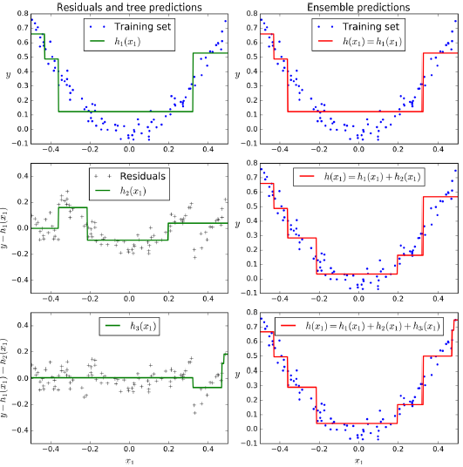
Gradient Boosting

Slide 45
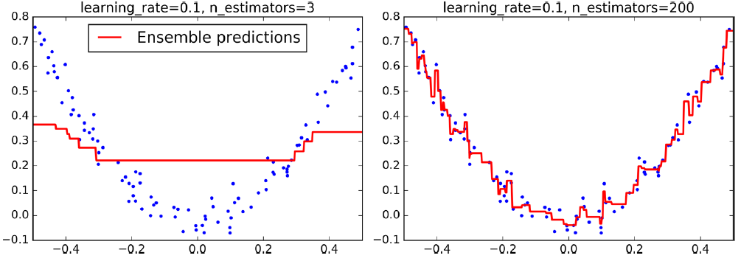
Gradient Boosting
from sklearn.ensemble import GradientBoostingRegressor
gbrt = GradientBoostingRegressor(max_depth=2, n_estimators=3, learning_rate=1.0)
gbrt.fit(X, y)

Slide 46
Gradient Boosting
import numpy as np
from sklearn.model_selection import train_test_split
from sklearn.metrics import mean_squared_error
X_train, X_val, y_train, y_val = train_test_split(X, y)
gbrt = GradientBoostingRegressor(max_depth=2, n_estimators=120)
gbrt.fit(X_train, y_train)
errors = [mean_squared_error(y_val, y_pred)
for y_pred in gbrt.staged_predict(X_val)]
bst_n_estimators = np.argmin(errors)
gbrt_best = GradientBoostingRegressor(max_depth=2,n_estimators=bst_n_estimators)
gbrt_best.fit(X_train, y_train)

Slide 47
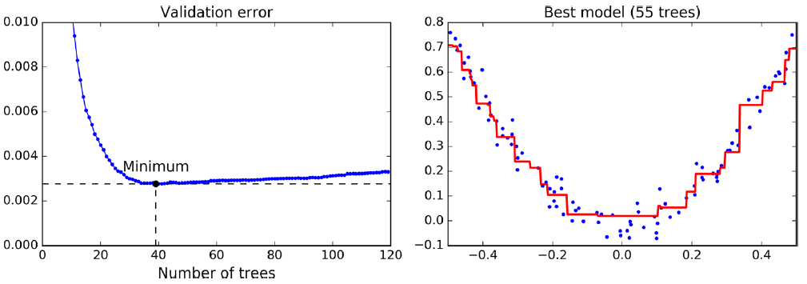
Tuning the number of trees using early stopping

Slide 48
Gradient Boosting
The GradientBoostingRegressor class also supports a subsample hyperparameter, which specifies the fraction of training instances to be used for training each tree. For example, if subsample=0.25, then each tree is trained on 25% of the training instances, selected randomly. As you can probably guess by now, this trades a higher bias for a lower variance. It also speeds up training considerably. This technique is called Stochastic Gradient Boosting.

Slide 49
Stacking
The last Ensemble method we will discuss in this chapter is called stacking (short for stacked generalization). It is based on a simple idea: instead of using trivial functions (such as hard voting) to aggregate the predictions of all predictors in an ensemble, why don’t we train a model to perform this aggregation? Figure 7-12 shows such an ensemble performing a regression task on a new instance. Each of the bottom three predictors predicts a different value (3.1, 2.7, and 2.9), and then the final predictor (called a blender, or a meta learner) takes these predictions as inputs and makes the final prediction (3.0).

Slide 50
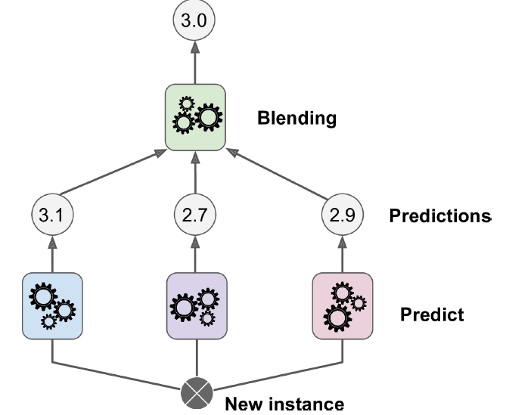
Stacking
The last Ensemble method we will discuss in this chapter is called stacking (short for stacked generalization). It is based on a simple idea: instead of using trivial functions (such as hard voting) to aggregate the predictions of all predictors in an ensemble, why don’t we train a model to perform this aggregation? Figure 7-12 shows such an ensemble performing a regression task on a new instance. Each of the bottom three predictors predicts a different value (3.1, 2.7, and 2.9), and then the final predictor (called a blender, or a meta learner) takes these predictions as inputs and makes the final prediction (3.0).

Slide 51
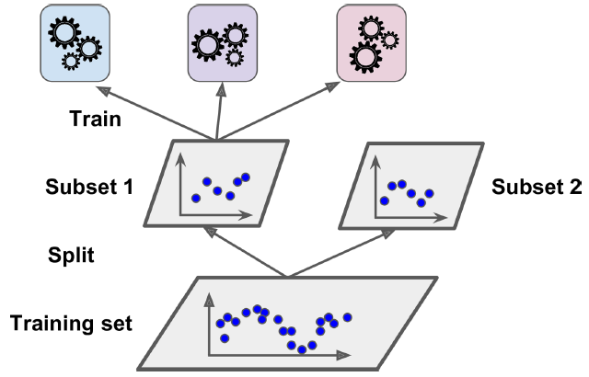
Stacking
To train the blender, a common approach is to use a hold-out set.19 Let’s see how it works. First, the training set is split in two subsets. The first subset is used to train the predictors in the first layer

Slide 52
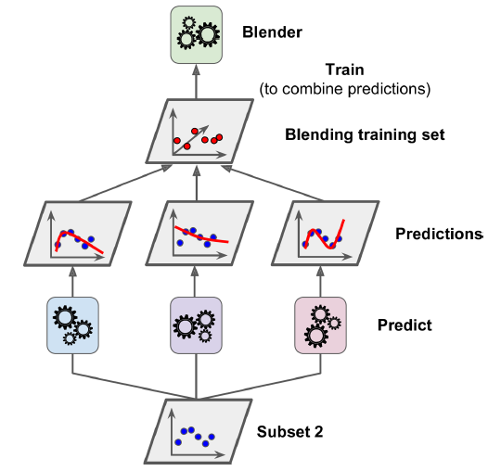
Stacking

Slide 53
Stacking
It is actually possible to train several different blenders this way (e.g., one using Linear Regression, another using Random Forest Regression, and so on): we get a whole layer of blenders. The trick is to split the training set into three subsets: the first one is used to train the first layer, the second one is used to create the training set used to train the second layer (using predictions made by the predictors of the first layer), and the third one is used to create the training set to train the third layer (using predictions made by the predictors of the second layer). Once this is done, we can make a prediction for a new instance by going through each layer sequentially, as shown in Figure 7-15.

Slide 54
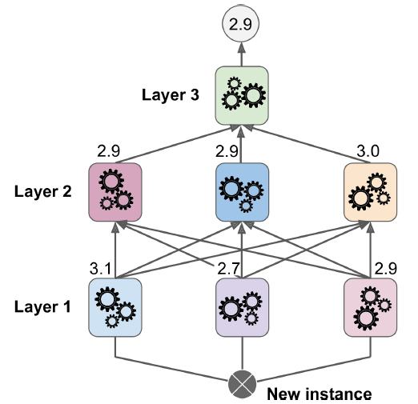
Stacking

