Slide 1
Hands-On Machine Learning with Scikit-Learn and TensorFlow
Concepts, Tools, and Techniques to Build Intelligent Systems

Slide 2
CHAPTER 8
Dimensionality Reduction
Many Machine Learning problems involve thousands or even millions of features for each training instance. Not only does this make training extremely slow, it can also make it much harder to find a good solution, as we will see. This problem is often referred to as the curse of dimensionality.

Slide 3
CHAPTER 8
Dimensionality Reduction
it is often possible to reduce the number of features considerably, turning an intractable problem into a tractable one. For example, consider the MNIST images: the pixels on the image borders are almost always white, so you could completely drop these pixels from the training set without losing much information.

Slide 4
CHAPTER 8
Dimensionality Reduction
In this chapter we will discuss the curse of dimensionality and get a sense of what goes on in high-dimensional space. Then, we will present the two main approaches to dimensionality reduction (projection and Manifold Learning), and we will go through three of the most popular dimensionality reduction techniques: PCA, Kernel PCA, and LLE.

Slide 5
The Curse of Dimensionality
We are so used to living in three dimensions1 that our intuition fails us when we try to imagine a high-dimensional space. Even a basic 4D hypercube is incredibly hard to picture in our mind (see Figure 8-1), let alone a 200-dimensional ellipsoid bent in a 1,000-dimensional space.

Slide 6
The Curse of Dimensionality
It turns out that many things behave very differently in high-dimensional space. For example, if you pick a random point in a unit square (a 1 × 1 square), it will have only about a 0.4% chance of being located less than 0.001 from a border (in other words, it is very unlikely that a random point will be “extreme” along any dimension). But in a 10,000-dimensional unit hypercube (a 1 × 1 × ⋯ × 1 cube, with ten thousand 1s), this probability is greater than 99.999999%. Most points in a high-dimensional hypercube are very close to the border.

Slide 7
The Curse of Dimensionality
Here is a more troublesome difference: if you pick two points randomly in a unit square, the distance between these two points will be, on average, roughly 0.52. If you pick two random points in a unit 3D cube, the average distance will be roughly 0.66. But what about two points picked randomly in a 1,000,000-dimensional hypercube?
Well, the average distance, believe it or not, will be about 408.25 (roughly sqrt(1000,000/6))

Slide 8
The Curse of Dimensionality
In theory, one solution to the curse of dimensionality could be to increase the size of the training set to reach a sufficient density of training instances. Unfortunately, in practice, the number of training instances required to reach a given density grows exponentially with the number of dimensions. With just 100 features (much less than in the MNIST problem), you would need more training instances than atoms in the observable universe in order for training instances to be within 0.1 of each other on average, assuming they were spread out uniformly across all dimensions.

Slide 9
Main Approaches for Dimensionality Reduction
Projection
In most real-world problems, training instances are not spread out uniformly across all dimensions. Many features are almost constant, while others are highly correlated (as discussed earlier for MNIST). As a result, all training instances actually lie within (or close to) a much lower-dimensional subspace of the high-dimensional space. This sounds very abstract, so let’s look at an example. In Figure 8-2 you can see a 3D dataset represented by the circles.

Slide 10
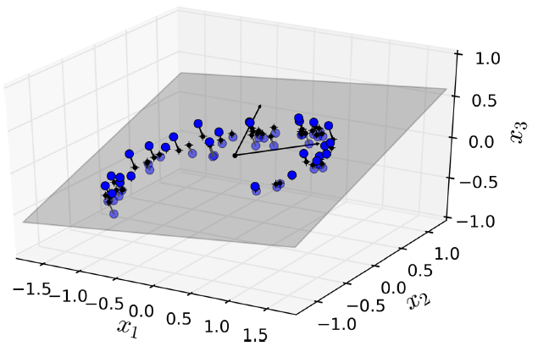
Main Approaches for Dimensionality Reduction
Projection
In most real-world problems, training instances are not spread out uniformly across all dimensions. Many features are almost constant, while others are highly correlated (as discussed earlier for MNIST). As a result, all training instances actually lie within (or close to) a much lower-dimensional subspace of the high-dimensional space. This sounds very abstract, so let’s look at an example. In Figure 8-2 you can see a 3D dataset represented by the circles.

Slide 11
Main Approaches for Dimensionality Reduction
Projection
Notice that all training instances lie close to a plane: this is a lower-dimensional (2D) subspace of the high-dimensional (3D) space. Now if we project every training instance perpendicularly onto this subspace (as represented by the short lines connecting the instances to the plane), we get the new 2D dataset shown in Figure 8-3. Ta-da! We have just reduced the dataset’s dimensionality from 3D to 2D. Note that the axes correspond to new features z1 and z2 (the coordinates of the projections on the plane).

Slide 12
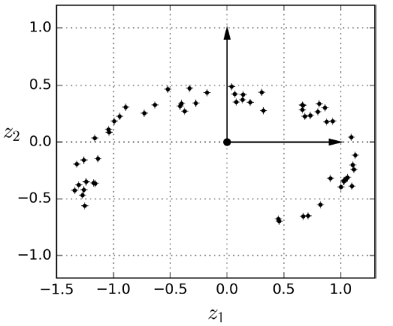
Main Approaches for Dimensionality Reduction
Projection

Slide 13
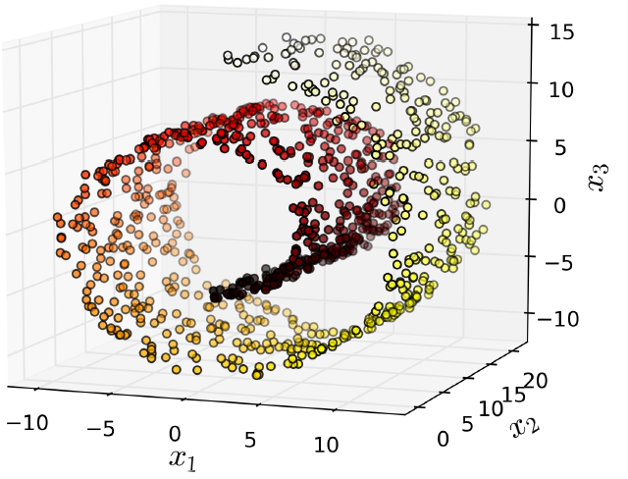
Main Approaches for Dimensionality Reduction
Projection
However, projection is not always the best approach to dimensionality reduction. In many cases the subspace may twist and turn, such as in the famous Swiss roll toy dataset represented in Figure 8-4.

Slide 14
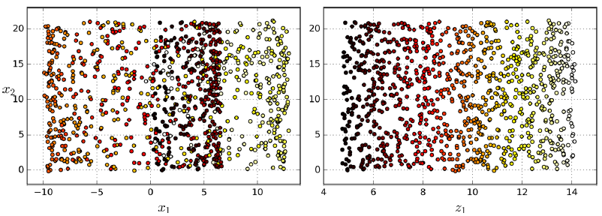
Main Approaches for Dimensionality Reduction
Projection
However, projection is not always the best approach to dimensionality reduction. In many cases the subspace may twist and turn, such as in the famous Swiss roll toy dataset represented in Figure 8-4.

Slide 15
Main Approaches for Dimensionality Reduction
Manifold Learning
The Swiss roll is an example of a 2D manifold. Put simply, a 2D manifold is a 2D shape that can be bent and twisted in a higher-dimensional space. More generally, a d-dimensional manifold is a part of an n-dimensional space (where d < n) that locally resembles a d-dimensional hyperplane. In the case of the Swiss roll, d = 2 and n = 3: it locally resembles a 2D plane, but it is rolled in the third dimension.

Slide 16
Main Approaches for Dimensionality Reduction
Manifold Learning
Many dimensionality reduction algorithms work by modeling the manifold on which the training instances lie; this is called Manifold Learning. It relies on the manifold assumption, also called the manifold hypothesis, which holds that most real-world high-dimensional datasets lie close to a much lower-dimensional manifold. This assumption is very often empirically observed.

Slide 17
Main Approaches for Dimensionality Reduction
Manifold Learning
The manifold assumption is often accompanied by another implicit assumption: that the task at hand (e.g., classification or regression) will be simpler if expressed in the lower-dimensional space of the manifold. For example, in the top row of Figure 8-6 the Swiss roll is split into two classes: in the 3D space (on the left), the decision boundary would be fairly complex, but in the 2D unrolled manifold space (on the right), the decision boundary is a simple straight line.

Slide 18
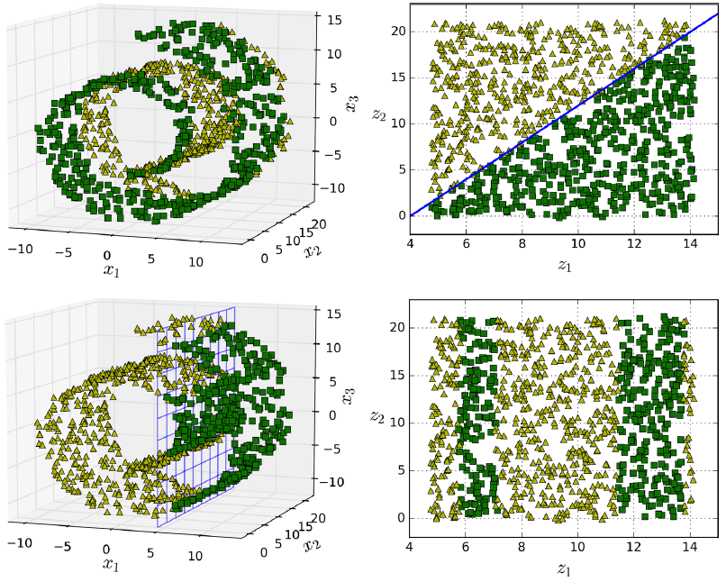
Main Approaches for Dimensionality Reduction
Manifold Learning

Slide 19
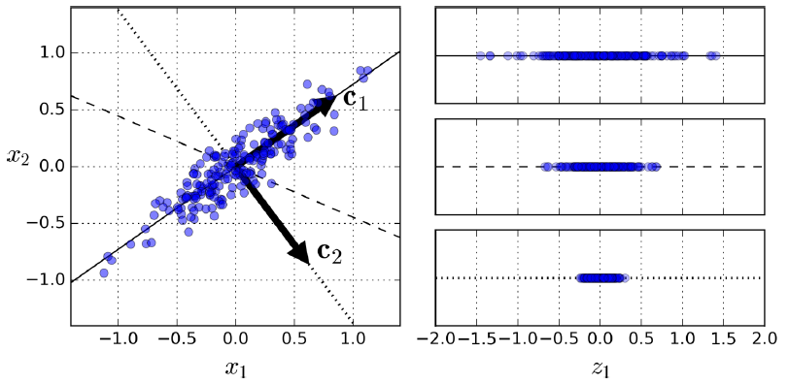
PCA
Principal Component Analysis (PCA) is by far the most popular dimensionality reduction algorithm. First it identifies the hyperplane that lies closest to the data, and then it projects the data onto it.

Slide 20
Principal Components
PCA identifies the axis that accounts for the largest amount of variance in the training set. In Figure 8-7, it is the solid line. It also finds a second axis, orthogonal to the first one, that accounts for the largest amount of remaining variance. In this 2D example there is no choice: it is the dotted line. If it were a higher-dimensional dataset, PCA would also find a third axis, orthogonal to both previous axes, and a fourth, a fifth, and so on—as many axes as the number of dimensions in the dataset.

Slide 21
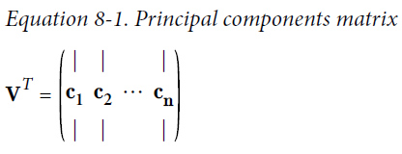
Principal Components
So how can you find the principal components of a training set? Luckily, there is a standard matrix factorization technique called Singular Value Decomposition (SVD) that can decompose the training set matrix X into the dot product of three matrices U ・ Σ ・ V^{T}, where V^{T} contains all the principal components that we are looking for.

Slide 22
Principal Components
X_centered = X - X.mean(axis=0)
U, s, V = np.linalg.svd(X_centered)
c1 = V.T[:, 0]
c2 = V.T[:, 1]

Slide 23
Projecting Down to d Dimensions
Once you have identified all the principal components, you can reduce the dimensionality of the dataset down to d dimensions by projecting it onto the hyperplane defined by the first d principal components. Selecting this hyperplane ensures that the projection will preserve as much variance as possible. For example, in Figure 8-2 the 3D dataset is projected down to the 2D plane defined by the first two principal components, preserving a large part of the dataset’s variance. As a result, the 2D projection looks very much like the original 3D dataset.

Slide 24
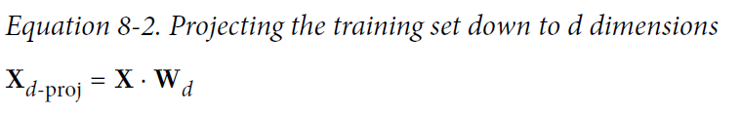
Projecting Down to d Dimensions
To project the training set onto the hyperplane, you can simply compute the dot product of the training set matrix X by the matrix W_{d}, defined as the matrix containing the first d principal components (i.e., the matrix composed of the first d columns of V^{T}), as shown in Equation 8-2.
W2 = V.T[:, :2]
X2D = X_centered.dot(W2)

Slide 25
Projecting Down to d Dimensions
Scikit-Learn’s PCA class implements PCA using SVD decomposition just like we did before. The following code applies PCA to reduce the dimensionality of the dataset down to two dimensions (note that it automatically takes care of centering the data):
from sklearn.decomposition import PCA
pca = PCA(n_components = 2)
X2D = pca.fit_transform(X)
the first principal component is equal to pca.components_.T[:, 0]).

Slide 26
Explained Variance Ratio
Another very useful piece of information is the explained variance ratio of each principal component, available via the explained_variance_ratio_ variable. It indicates the proportion of the dataset’s variance that lies along the axis of each principal component. For example, let’s look at the explained variance ratios of the first two components of the 3D dataset represented in Figure 8-2:
>>> print(pca.explained_variance_ratio_)
array([ 0.84248607, 0.14631839])

Slide 27
Choosing the Right Number of Dimensions
Instead of arbitrarily choosing the number of dimensions to reduce down to, it is generally preferable to choose the number of dimensions that add up to a sufficiently large portion of the variance (e.g., 95%).
pca = PCA()
pca.fit(X)
cumsum = np.cumsum(pca.explained_variance_ratio_)
d = np.argmax(cumsum >= 0.95) + 1

Slide 28
Choosing the Right Number of Dimensions
instead of specifying the number of principal components you want to preserve, you can set n_components to be a float between 0.0 and 1.0, indicating the ratio of variance you wish to preserve:
pca = PCA(n_components=0.95)
X_reduced = pca.fit_transform(X)

Slide 29
Choosing the Right Number of Dimensions
Yet another option is to plot the explained variance as a function of the number of dimensions (simply plot cumsum; see Figure 8-8). There will usually be an elbow in the curve, where the explained variance stops growing fast. You can think of this as the intrinsic dimensionality of the dataset. In this case, you can see that reducing the dimensionality down to about 100 dimensions wouldn’t lose too much explained variance.

Slide 30
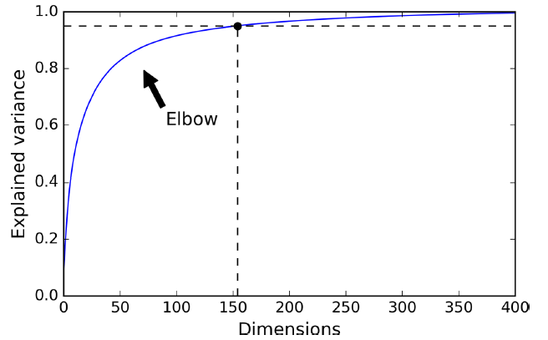
Choosing the Right Number of Dimensions
Yet another option is to plot the explained variance as a function of the number of dimensions (simply plot cumsum; see Figure 8-8). There will usually be an elbow in the curve, where the explained variance stops growing fast. You can think of this as the intrinsic dimensionality of the dataset. In this case, you can see that reducing the dimensionality down to about 100 dimensions wouldn’t lose too much explained variance.

Slide 31
PCA for Compression
Obviously after dimensionality reduction, the training set takes up much less space. For example, try applying PCA to the MNIST dataset while preserving 95% of its variance. You should find that each instance will have just over 150 features, instead of the original 784 features. So while most of the variance is preserved, the dataset is now less than 20% of its original size! This is a reasonable compression ratio, and you can see how this can speed up a classification algorithm (such as an SVM classifier) tremendously.

Slide 32
PCA for Compression
It is also possible to decompress the reduced dataset back to 784 dimensions by applying the inverse transformation of the PCA projection. Of course this won’t give you back the original data, since the projection lost a bit of information (within the 5% variance that was dropped), but it will likely be quite close to the original data. The mean squared distance between the original data and the reconstructed data (compressed and then decompressed) is called the reconstruction error.

Slide 33
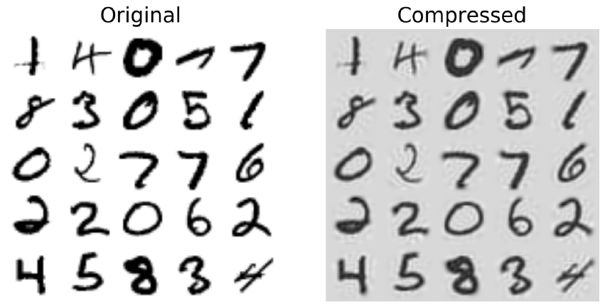
MNIST compression preserving 95% of the variance
pca = PCA(n_components = 154)
X_mnist_reduced = pca.fit_transform(X_mnist)
X_mnist_recovered = pca.inverse_transform(X_mnist_reduced)

Slide 34
Incremental PCA
One problem with the preceding implementation of PCA is that it requires the whole training set to fit in memory in order for the SVD algorithm to run. Fortunately, Incremental PCA (IPCA) algorithms have been developed: you can split the training set into mini-batches and feed an IPCA algorithm one mini-batch at a time. This is useful for large training sets, and also to apply PCA online (i.e., on the fly, as new instances arrive).

Slide 35
Incremental PCA
from sklearn.decomposition import IncrementalPCA
n_batches = 100
inc_pca = IncrementalPCA(n_components=154)
for X_batch in np.array_split(X_mnist, n_batches):
inc_pca.partial_fit(X_batch)
X_mnist_reduced = inc_pca.transform(X_mnist)
X_mm = np.memmap(filename, dtype="float32", mode="readonly", shape=(m, n))
batch_size = m // n_batches
inc_pca = IncrementalPCA(n_components=154, batch_size=batch_size)
inc_pca.fit(X_mm)

Slide 36
Randomized PCA
Scikit-Learn offers yet another option to perform PCA, called Randomized PCA. This is a stochastic algorithm that quickly finds an approximation of the first d principal components. Its computational complexity is O(m × d2) + O(d3), instead of O(m × n2) + O(n3), so it is dramatically faster than the previous algorithms when d is much smaller than n.
rnd_pca = PCA(n_components=154, svd_solver="randomized")
X_reduced = rnd_pca.fit_transform(X_mnist)

Slide 37
Kernel PCA
In Chapter 5 we discussed the kernel trick, a mathematical technique that implicitly maps instances into a very high-dimensional space (called the feature space), enabling nonlinear classification and regression with Support Vector Machines. Recall that a linear decision boundary in the high-dimensional feature space corresponds to a complex nonlinear decision boundary in the original space.
It turns out that the same trick can be applied to PCA, making it possible to perform complex nonlinear projections for dimensionality reduction. This is called Kernel PCA (kPCA). It is often good at preserving clusters of instances after projection, or sometimes even unrolling datasets that lie close to a twisted manifold.

Slide 38
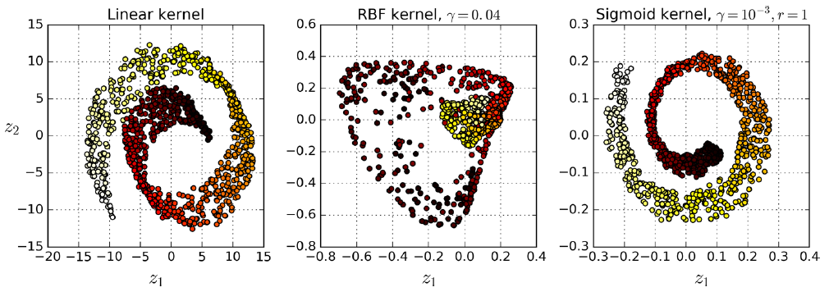
Kernel PCA
from sklearn.decomposition import KernelPCA
rbf_pca = KernelPCA(n_components = 2, kernel="rbf", gamma=0.04)
X_reduced = rbf_pca.fit_transform(X)

Slide 39
Selecting a Kernel and Tuning Hyperparameters
As kPCA is an unsupervised learning algorithm, there is no obvious performance measure to help you select the best kernel and hyperparameter values. However, dimensionality reduction is often a preparation step for a supervised learning task (e.g., classification), so you can simply use grid search to select the kernel and hyperparameters that lead to the best performance on that task.

Slide 40
from sklearn.model_selection import GridSearchCV
from sklearn.linear_model import LogisticRegression
from sklearn.pipeline import Pipeline
clf = Pipeline([
("kpca", KernelPCA(n_components=2)),
("log_reg", LogisticRegression())
])
param_grid = [{
"kpca__gamma": np.linspace(0.03, 0.05, 10),
"kpca__kernel": ["rbf", "sigmoid"]
}]
grid_search = GridSearchCV(clf, param_grid, cv=3)
grid_search.fit(X, y)
>>> print(grid_search.best_params_)
{'kpca__gamma': 0.043333333333333335, 'kpca__kernel': 'rbf'}

Slide 41
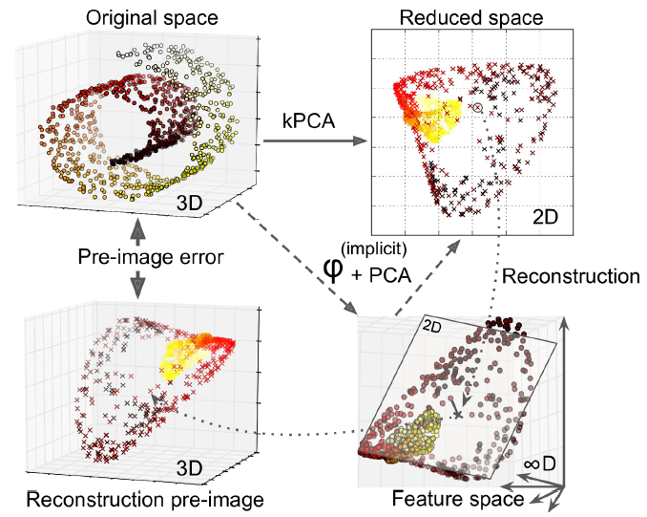
Kernel PCA and the reconstruction pre-image error

Slide 42
Kernel PCA and the reconstruction pre-image error
rbf_pca = KernelPCA(n_components = 2, kernel="rbf", gamma=0.0433,
fit_inverse_transform=True)
X_reduced = rbf_pca.fit_transform(X)
X_preimage = rbf_pca.inverse_transform(X_reduced)
>>> from sklearn.metrics import mean_squared_error
>>> mean_squared_error(X, X_preimage)
32.786308795766132

Slide 43
LLE
Locally Linear Embedding (LLE)8 is another very powerful nonlinear dimensionality reduction (NLDR) technique. It is a Manifold Learning technique that does not rely on projections like the previous algorithms. In a nutshell, LLE works by first measuring how each training instance linearly relates to its closest neighbors (c.n.), and then looking for a low-dimensional representation of the training set where these local relationships are best preserved (more details shortly). This makes it particularly good at unrolling twisted manifolds, especially when there is not too much noise.

Slide 44
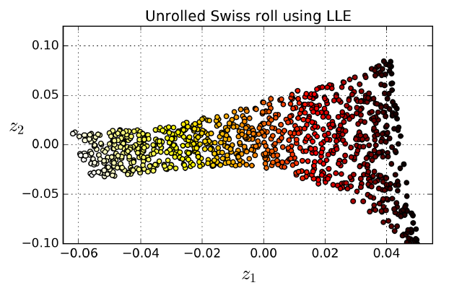
LLE
from sklearn.manifold import LocallyLinearEmbedding
lle = LocallyLinearEmbedding(n_components=2, n_neighbors=10)
X_reduced = lle.fit_transform(X)

Slide 45

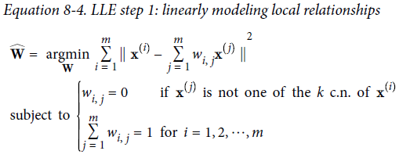
LLE
for each training instance x^{(i)}, the algorithm identifies its k closest neighbors (in the preceding code k = 10), then tries to reconstruct x^{(i)} as a linear function of these neighbors. More specifically, it finds the weights w_{i,j} such that the squared distance between x^{(i)} and is as small as possible, assuming w_{i,j} = 0 if x^{(j)} is not one of the k closest neighbors of x^{(i)}.

Slide 46

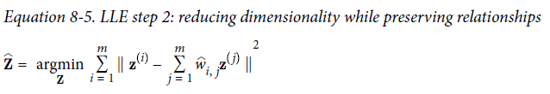
LLE
After this step, the weight matrix W encodes the local linear relationships between the training instances. Now the second step is to map the training instances into a d-dimensional space (where d < n) while preserving these local relationships as much as possible. If z^{(i)} is the image of x^{(i)} in this d-dimensional space, then we want the squared distance between z^{(i)} and to be as small as possible.

Slide 47
Other Dimensionality Reduction Techniques
Multidimensional Scaling (MDS) reduces dimensionality while trying to preserve the distances between the instances.
Isomap creates a graph by connecting each instance to its nearest neighbors, then reduces dimensionality while trying to preserve the geodesic distances between the instances.
t-Distributed Stochastic Neighbor Embedding (t-SNE) reduces dimensionality while trying to keep similar instances close and dissimilar instances apart.
Linear Discriminant Analysis (LDA) trains to learn the most discriminative axes between the classes, and these axes can then be used to project the data.

