Slide 1
Hands-On Machine Learning with Scikit-Learn and TensorFlow
Concepts, Tools, and Techniques to Build Intelligent Systems

Slide 2
CHAPTER 9
Up and Running with TensorFlow
TensorFlow is a powerful open source software library for numerical computation, particularly well suited and fine-tuned for large-scale Machine Learning. Its basic principle is simple: you first define in Python a graph of computations to perform (for example, the one in Figure 9-1), and then TensorFlow takes that graph and runs it efficiently using optimized C++ code.

Slide 3
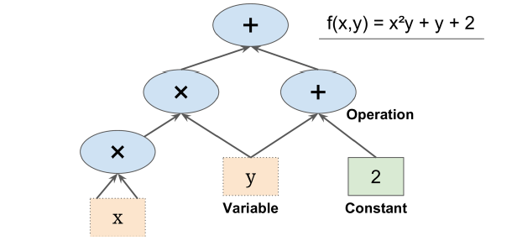
CHAPTER 9
Up and Running with TensorFlow
TensorFlow is a powerful open source software library for numerical computation, particularly well suited and fine-tuned for large-scale Machine Learning. Its basic principle is simple: you first define in Python a graph of computations to perform (for example, the one in Figure 9-1), and then TensorFlow takes that graph and runs it efficiently using optimized C++ code.

Slide 4
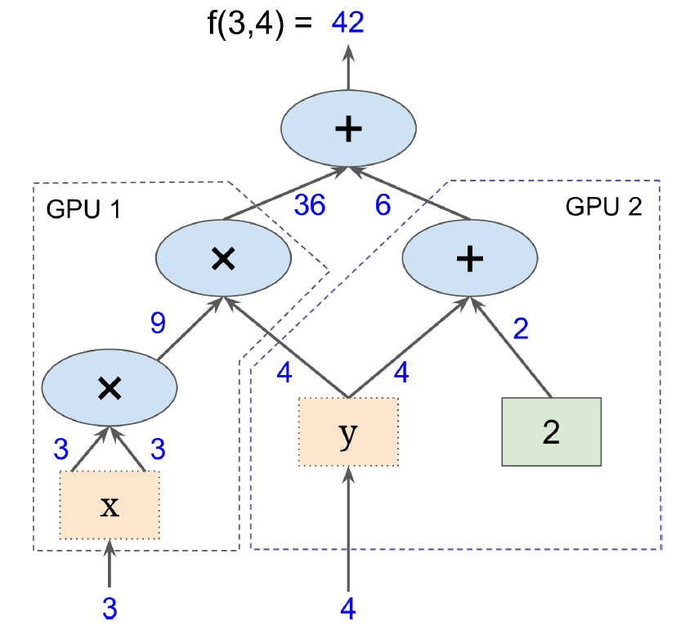
CHAPTER 9

Slide 5
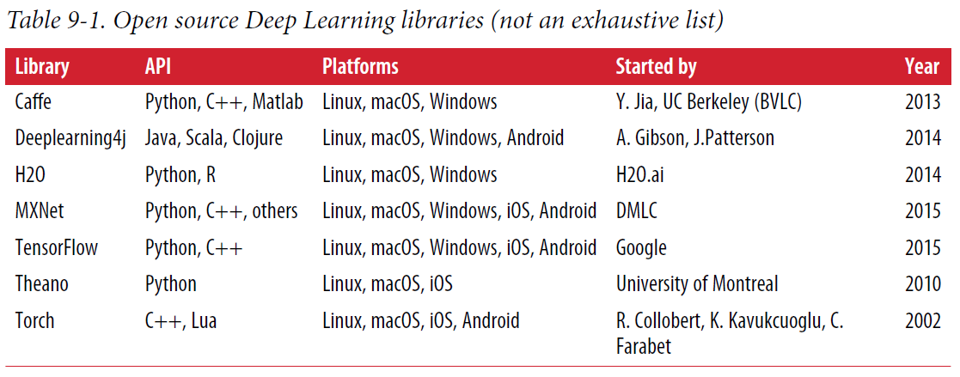
CHAPTER 9
Up and Running with TensorFlow

Slide 6
CHAPTER 9
Up and Running with TensorFlow
In this chapter, we will go through the basics of TensorFlow, from installation to creating, running, saving, and visualizing simple computational graphs. Mastering these basics is important before you build your first neural network (which we will do in the next chapter).

Slide 7
Creating Your First Graph and Running It in a Session
import tensorflow as tf
x = tf.Variable(3, name="x")
y = tf.Variable(4, name="y")
f = x*x*y + y + 2
>>> sess = tf.Session()
>>> sess.run(x.initializer)
>>> sess.run(y.initializer)
>>> result = sess.run(f)
>>> print(result)
42
>>> sess.close()
# a better way
with tf.Session() as sess:
x.initializer.run()
y.initializer.run()
result = f.eval()

Slide 8
Creating Your First Graph and Running It in a Session
init = tf.global_variables_initializer() # prepare an init node
with tf.Session() as sess:
init.run() # actually initialize all the variables
result = f.eval()
>>> sess = tf.InteractiveSession()
>>> init.run()
>>> result = f.eval()
>>> print(result)
42
>>> sess.close()

Slide 9
Creating Your First Graph and Running It in a Session
A TensorFlow program is typically split into two parts: the first part builds a computation graph (this is called the construction phase), and the second part runs it (this isthe execution phase). The construction phase typically builds a computation graph representing the ML model and the computations required to train it. The execution phase generally runs a loop that evaluates a training step repeatedly (for example, one step per mini-batch), gradually improving the model parameters.

Slide 10
Managing Graphs
>>> x1 = tf.Variable(1)
>>> x1.graph is tf.get_default_graph()
True
>>> graph = tf.Graph()
>>> with graph.as_default():
... x2 = tf.Variable(2)
...
>>> x2.graph is graph
True
>>> x2.graph is tf.get_default_graph()
False

Slide 11
Lifecycle of a Node Value
w = tf.constant(3)
x = w + 2
y = x + 5
z = x * 3
with tf.Session() as sess:
print(y.eval()) # 10
print(z.eval()) # 15
with tf.Session() as sess:
y_val, z_val = sess.run([y, z])
print(y_val) # 10
print(z_val) # 15

Slide 12
Lifecycle of a Node Value
All node values are dropped between graph runs, except variable values, which are maintained by the session across graph runs (queues and readers also maintain some state, as we will see in Chapter 12). A variable starts its life when its initializer is run, and it ends when the session is closed.
In single-process TensorFlow, multiple sessions do not share any state, even if they reuse the same graph (each session would have its own copy of every variable). In distributed TensorFlow (see Chapter 12), variable state is stored on the servers, not in the sessions, so multiple sessions can share the same variables.

Slide 13
Linear Regression with TensorFlow
TensorFlow operations (also called ops for short) can take any number of inputs and produce any number of outputs. For example, the addition and multiplication ops each take two inputs and produce one output. Constants and variables take no input (they are called source ops). The inputs and outputs are multidimensional arrays, called tensors (hence the name “tensor flow”). Just like NumPy arrays, tensors have a type and a shape. In fact, in the Python API tensors are simply represented by NumPy ndarrays. They typically contain floats, but you can also use them to carry strings (arbitrary byte arrays).

Slide 14
Linear Regression with TensorFlow
import numpy as np
from sklearn.datasets import fetch_california_housing
housing = fetch_california_housing()
m, n = housing.data.shape
housing_data_plus_bias = np.c_[np.ones((m, 1)), housing.data]
X = tf.constant(housing_data_plus_bias, dtype=tf.float32, name="X")
y = tf.constant(housing.target.reshape(-1, 1), dtype=tf.float32, name="y")
XT = tf.transpose(X)
theta = tf.matmul(tf.matmul(tf.matrix_inverse(tf.matmul(XT, X)), XT), y)
with tf.Session() as sess:
theta_value = theta.eval()

Slide 15
Implementing Gradient Descent
First we will do this by manually computing the gradients, then we will use TensorFlow’s autodiff feature to let TensorFlow compute the gradients automatically, and finally we will use a couple of TensorFlow’s out-of-the-box optimizers.
When using Gradient Descent, remember that it is important to first normalize the input feature vectors, or else training may be much slower. You can do this using TensorFlow, NumPy, Scikit-Learn’s StandardScaler, or any other solution you prefer.

Slide 16
n_epochs = 1000
learning_rate = 0.01
X = tf.constant(scaled_housing_data_plus_bias, dtype=tf.float32, name="X")
y = tf.constant(housing.target.reshape(-1, 1), dtype=tf.float32, name="y")
theta = tf.Variable(tf.random_uniform([n + 1, 1], -1.0, 1.0), name="theta")
y_pred = tf.matmul(X, theta, name="predictions")
error = y_pred - y
mse = tf.reduce_mean(tf.square(error), name="mse")
gradients = 2/m * tf.matmul(tf.transpose(X), error)
training_op = tf.assign(theta, theta - learning_rate * gradients)
init = tf.global_variables_initializer()
with tf.Session() as sess:
sess.run(init)
for epoch in range(n_epochs):
if epoch % 100 == 0:
print("Epoch", epoch, "MSE =", mse.eval())
sess.run(training_op)
best_theta = theta.eval()

Slide 17
Using autodiff
The preceding code works fine, but it requires mathematically deriving the gradients from the cost function (MSE). In the case of Linear Regression, it is reasonably easy, but if you had to do this with deep neural networks you would get quite a headache: it would be tedious and error-prone. You could use symbolic differentiation to automatically find the equations for the partial derivatives for you, Fortunately, TensorFlow can automatically and efficiently compute the gradients for you.
gradients = tf.gradients(mse, [theta])[0]

Slide 18
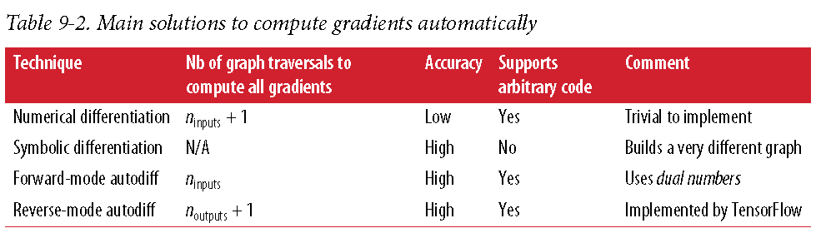
Using autodiff

Slide 19
Using an Optimizer
So TensorFlow computes the gradients for you. But it gets even easier: it also provides a number of optimizers out of the box, including a Gradient Descent optimizer.
optimizer = tf.train.GradientDescentOptimizer(learning_rate=learning_rate)
training_op = optimizer.minimize(mse)
optimizer = tf.train.MomentumOptimizer(learning_rate=learning_rate,
momentum=0.9)

Slide 20
Feeding Data to the Training Algorithm
Let’s try to modify the previous code to implement Mini-batch Gradient Descent. For this, we need a way to replace X and y at every iteration with the next mini-batch. The simplest way to do this is to use placeholder nodes. These nodes are special because they don’t actually perform any computation, they just output the data you tell them to output at runtime. They are typically used to pass the training data to TensorFlow during training. If you don’t specify a value at runtime for a placeholder, you get an exception.

Slide 21
Feeding Data to the Training Algorithm
>>> A = tf.placeholder(tf.float32, shape=(None, 3))
>>> B = A + 5
>>> with tf.Session() as sess:
... B_val_1 = B.eval(feed_dict={A: [[1, 2, 3]]})
... B_val_2 = B.eval(feed_dict={A: [[4, 5, 6], [7, 8, 9]]})
...
>>> print(B_val_1)
[[ 6. 7. 8.]]
>>> print(B_val_2)
[[ 9. 10. 11.]
[ 12. 13. 14.]]

Slide 22
Feeding Data to the Training Algorithm
To implement Mini-batch Gradient Descent, we only need to tweak the existing code slightly. First change the definition of X and y in the construction phase to make them placeholder nodes:
X = tf.placeholder(tf.float32, shape=(None, n + 1), name="X")
y = tf.placeholder(tf.float32, shape=(None, 1), name="y")
Then define the batch size and compute the total number of batches:
batch_size = 100
n_batches = int(np.ceil(m / batch_size))

Slide 23
Feeding Data to the Training Algorithm
Finally, in the execution phase, fetch the mini-batches one by one, then provide the value of X and y via the feed_dict parameter when evaluating a node that depends on either of them.
def fetch_batch(epoch, batch_index, batch_size):
[...] # load the data from disk
return X_batch, y_batch
with tf.Session() as sess:
sess.run(init)
for epoch in range(n_epochs):
for batch_index in range(n_batches):
X_batch, y_batch = fetch_batch(epoch, batch_index, batch_size)
sess.run(training_op, feed_dict={X: X_batch, y: y_batch})
best_theta = theta.eval()

Slide 24
Saving and Restoring Models
[...]
theta = tf.Variable(tf.random_uniform([n + 1, 1], -1.0, 1.0), name="theta")
[...]
init = tf.global_variables_initializer()
saver = tf.train.Saver()
with tf.Session() as sess:
sess.run(init)
for epoch in range(n_epochs):
if epoch % 100 == 0: # checkpoint every 100 epochs
save_path = saver.save(sess, "/tmp/my_model.ckpt")
sess.run(training_op)
best_theta = theta.eval()
save_path = saver.save(sess, "/tmp/my_model_final.ckpt")

Slide 25
Saving and Restoring Models
Restoring a model is just as easy: you create a Saver at the end of the construction phase just like before, but then at the beginning of the execution phase, instead of initializing the variables using the init node, call the restore() method:
with tf.Session() as sess:
saver.restore(sess, "/tmp/my_model_final.ckpt")
[...]
By default a Saver saves and restores all variables under their own name, but you can specify which variables to save or restore, For example, the following Saver will save or restore only the theta variable under the name weights:
saver = tf.train.Saver({"weights": theta})

Slide 26
Visualizing the Graph and Training Curves Using TensorBoard
TensorBoard will display nice interactive visualizations of training stats in your web browser (e.g., learning curves). You can also provide it the graph’s definition and it will give you a great interface to browse through it. This is very useful to identify errors in the graph, to find bottlenecks, and so on.
from datetime import datetime
now = datetime.utcnow().strftime("%Y%m%d%H%M%S")
root_logdir = "tf_logs"
logdir = "{}/run-{}/".format(root_logdir, now)
mse_summary = tf.summary.scalar('MSE', mse)
file_writer = tf.summary.FileWriter(logdir, tf.get_default_graph())

Slide 27
Visualizing the Graph and Training Curves Using TensorBoard
[...]
for batch_index in range(n_batches):
X_batch, y_batch = fetch_batch(epoch, batch_index, batch_size)
if batch_index % 10 == 0:
summary_str = mse_summary.eval(feed_dict={X: X_batch, y: y_batch})
step = epoch * n_batches + batch_index
file_writer.add_summary(summary_str, step)
sess.run(training_op, feed_dict={X: X_batch, y: y_batch})
[...]
Avoid logging training stats at every single training step, as this would significantly slow down training. Finally, you close the FileWriter at the end of the program:
file_writer.close()

Slide 28
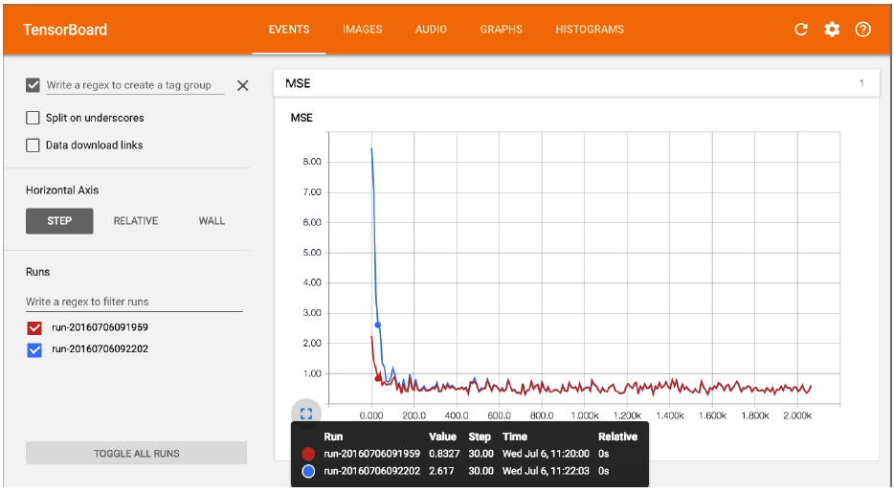
Visualizing the Graph and Training Curves Using TensorBoard
$ tensorboard --logdir tf_logs/
Starting TensorBoard on port 6006
(You can navigate to http://0.0.0.0:6006)

Slide 29
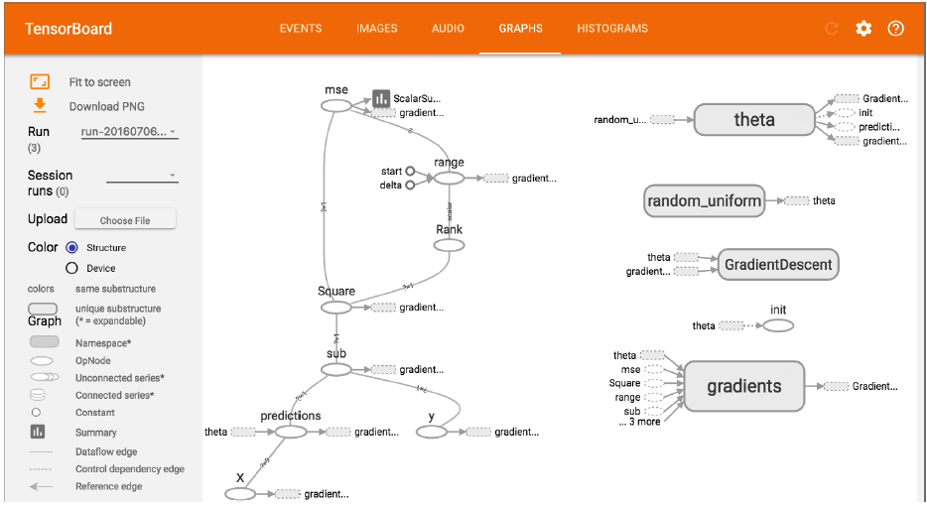
Visualizing the Graph and Training Curves Using TensorBoard
$ tensorboard --logdir tf_logs/
Starting TensorBoard on port 6006
(You can navigate to http://0.0.0.0:6006)

Slide 30
Name Scopes
When dealing with more complex models such as neural networks, the graph can easily become cluttered with thousands of nodes. To avoid this, you can create name scopes to group related nodes. For example, let’s modify the previous code to define the error and mse ops within a name scope called "loss":
with tf.name_scope("loss") as scope:
error = y_pred - y
mse = tf.reduce_mean(tf.square(error), name="mse")
The name of each op defined within the scope is now prefixed with "loss/":
>>> print(error.op.name)
loss/sub
>>> print(mse.op.name)
loss/mse

Slide 31
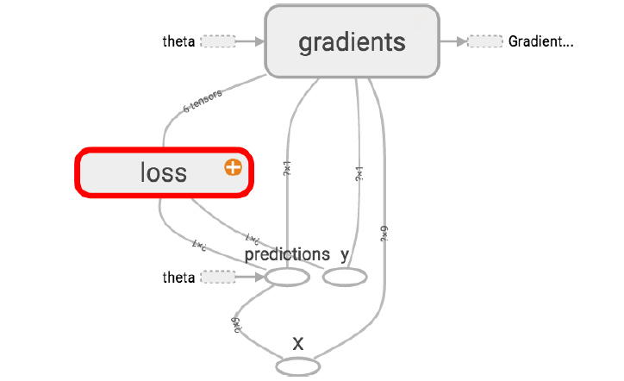
Name Scopes
In TensorBoard, the mse and error nodes now appear inside the loss namespace, which appears collapsed by default.

Slide 32
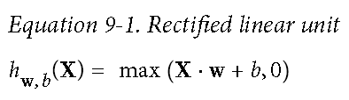
Modularity
Suppose you want to create a graph that adds the output of two rectified linear units (ReLU). A ReLU computes a linear function of the inputs, and outputs the result if it is positive, and 0 otherwise, as shown in Equation 9-1.

Slide 33
Modularity
n_features = 3
X = tf.placeholder(tf.float32, shape=(None, n_features), name="X")
w1 = tf.Variable(tf.random_normal((n_features, 1)), name="weights1")
w2 = tf.Variable(tf.random_normal((n_features, 1)), name="weights2")
b1 = tf.Variable(0.0, name="bias1")
b2 = tf.Variable(0.0, name="bias2")
z1 = tf.add(tf.matmul(X, w1), b1, name="z1")
z2 = tf.add(tf.matmul(X, w2), b2, name="z2")
relu1 = tf.maximum(z1, 0., name="relu1")
relu2 = tf.maximum(z1, 0., name="relu2")
output = tf.add(relu1, relu2, name="output")

Slide 34
Modularity
def relu(X):
w_shape = (int(X.get_shape()[1]), 1)
w = tf.Variable(tf.random_normal(w_shape), name="weights")
b = tf.Variable(0.0, name="bias")
z = tf.add(tf.matmul(X, w), b, name="z")
return tf.maximum(z, 0., name="relu")
n_features = 3
X = tf.placeholder(tf.float32, shape=(None, n_features), name="X")
relus = [relu(X) for i in range(5)]
output = tf.add_n(relus, name="output")

Slide 35
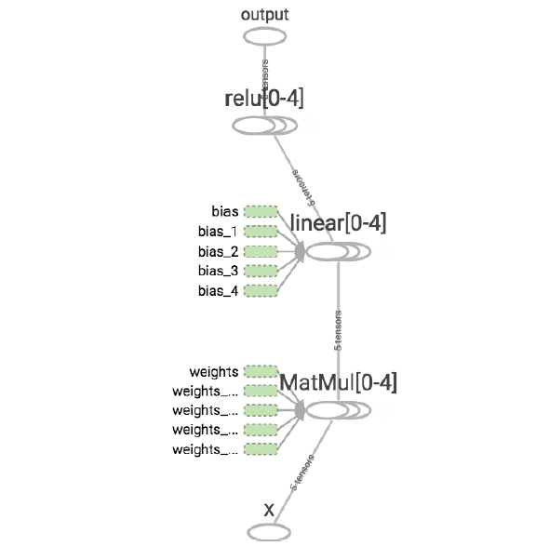
Modularity

Slide 36
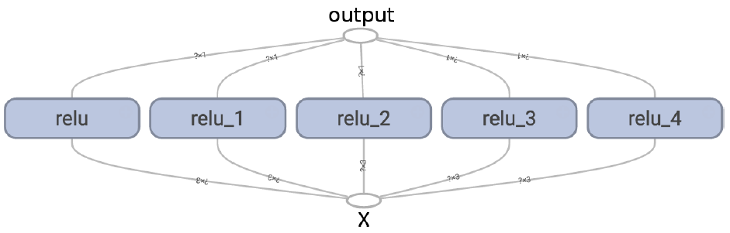
Modularity
Using name scopes, you can make the graph much clearer. Simply move all the content of the relu() function inside a name scope. Figure 9-7 shows the resulting graph. Notice that TensorFlow also gives the name scopes unique names by appending _1, _2, and so on.
def relu(X):
with tf.name_scope("relu"):
[...]

Slide 37
Sharing Variables
def relu(X, threshold):
with tf.name_scope("relu"):
[...]
return tf.maximum(z, threshold, name="max")
threshold = tf.Variable(0.0, name="threshold")
X = tf.placeholder(tf.float32, shape=(None, n_features), name="X")
relus = [relu(X, threshold) for i in range(5)]
output = tf.add_n(relus, name="output")
def relu(X): # Another method
with tf.name_scope("relu"):
if not hasattr(relu, "threshold"):
relu.threshold = tf.Variable(0.0, name="threshold")
[...]
return tf.maximum(z, relu.threshold, name="max")

Slide 38
Sharing Variables
with tf.variable_scope("relu"):
threshold = tf.get_variable("threshold", shape=(),initializer=tf.constant_initializer(0.0))
with tf.variable_scope("relu", reuse=True):
threshold = tf.get_variable("threshold")
with tf.variable_scope("relu") as scope:
scope.reuse_variables()
threshold = tf.get_variable("threshold")

Slide 39
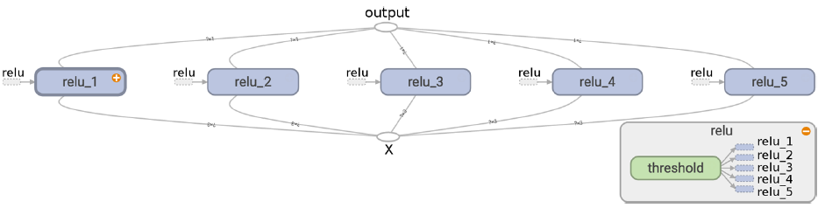
Sharing Variables
def relu(X):
with tf.variable_scope("relu", reuse=True):
threshold = tf.get_variable("threshold") # reuse existing variable
[...]
return tf.maximum(z, threshold, name="max")
X = tf.placeholder(tf.float32, shape=(None, n_features), name="X")
with tf.variable_scope("relu"): # create the variable
threshold = tf.get_variable("threshold", shape=(), initializer=tf.constant_initializer(0.0))
relus = [relu(X) for relu_index in range(5)]
output = tf.add_n(relus, name="output")

Slide 40
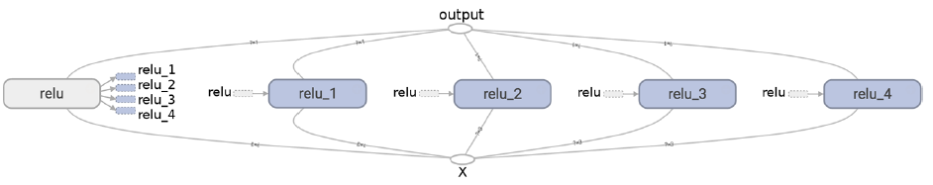
Sharing Variables
def relu(X):
threshold = tf.get_variable("threshold", shape=(), initializer=tf.constant_initializer(0.0))
[...]
return tf.maximum(z, threshold, name="max")
X = tf.placeholder(tf.float32, shape=(None, n_features), name="X")
relus = []
for relu_index in range(5):
with tf.variable_scope("relu", reuse=(relu_index >= 1)) as scope:
relus.append(relu(X))
output = tf.add_n(relus, name="output")

