Slide 1
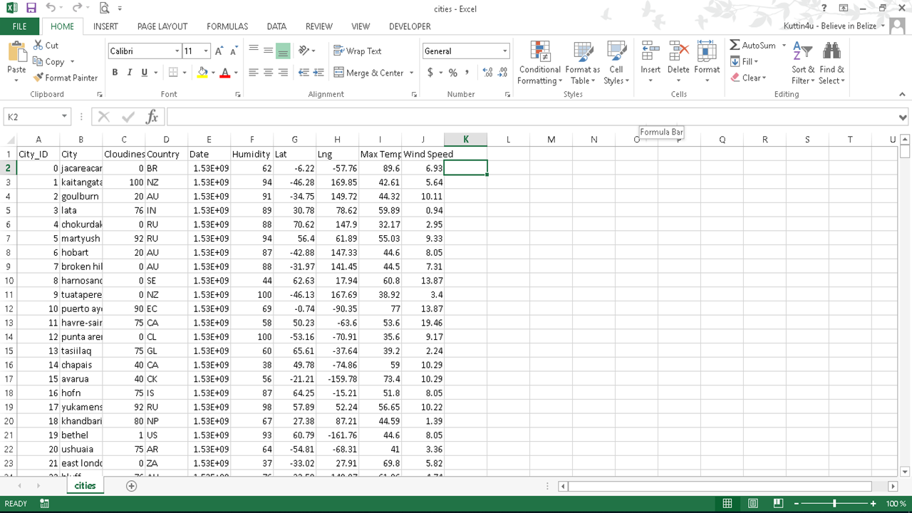
*Back 2 My Roots*

Slide 2
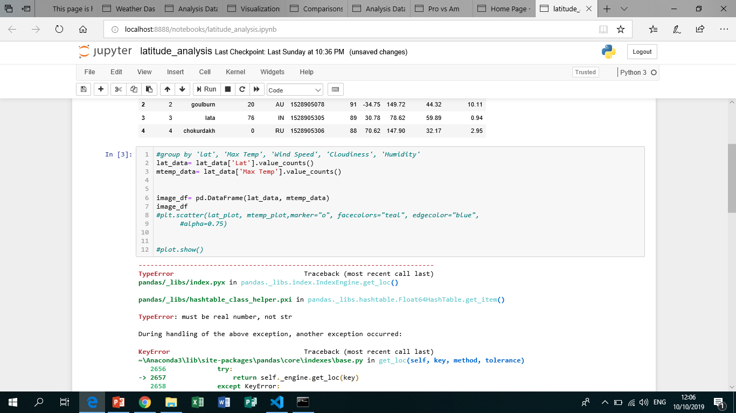
Still struggling..

Slide 3
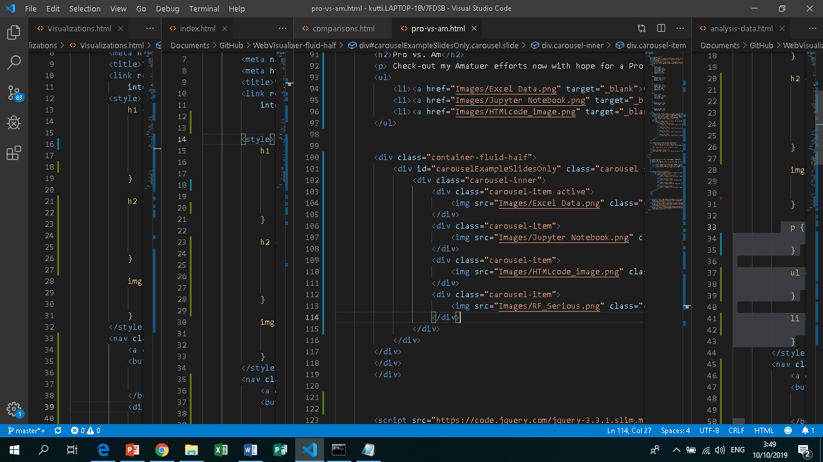
Got this!

Slide 4
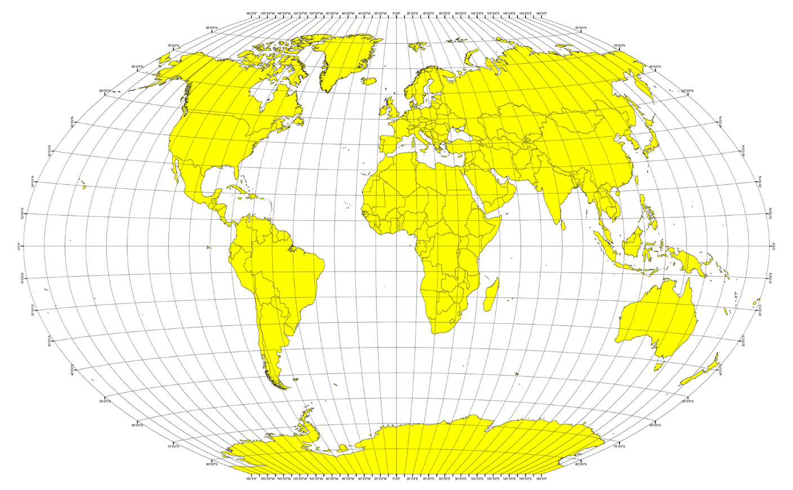
WebScraping CHALLENGE
Do What? My Brain Still thinking…:
R.F. Serious
I may not know
A Lot Bout Coding Languages But…
By GOD’s grace I’m committed to mastering what I can!

