Slide 1
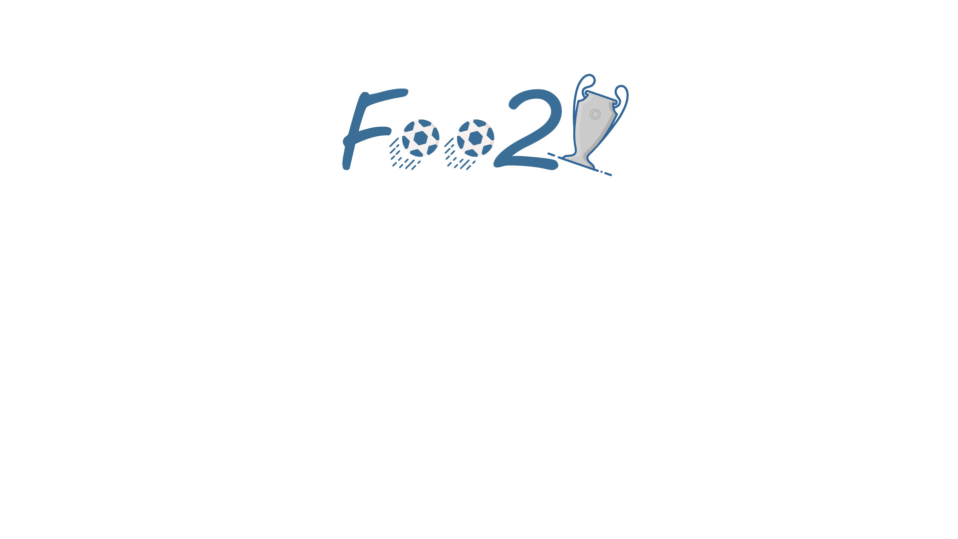
A Project By:
Jiwan Prasad Guragain (075BCT041)
Kiran Bhattarai (075BCT042)
Kushal Shrestha (075BCT045)
Completed as a Course requirement for
Object Oriented Programming (CT501)

Slide 2
Introduction
A 2-Dimensional Football Game,
Resembles the football game we used to play during our childhood in mobile phones (*Not the smartphones),
Played between 2 teams of 7 players each,
User will be able to control a player from the selected team.

Slide 3
Objectives
To become familiar with the basic concepts of Object Oriented Programming in C++,
To learn Graphics Programming using the SFML library,
To learn the basics of Game Development and Game Physics,
To Create an Interactive User Interface,

Slide 4
Description
Contains three basic objects in responses to the controls:
1. The Field,
2.The Ball,
3.Players
Contains three windows to interact with the uses:
1.Home Window,
2.Team Selection Window,
3.Game Window,

Slide 5
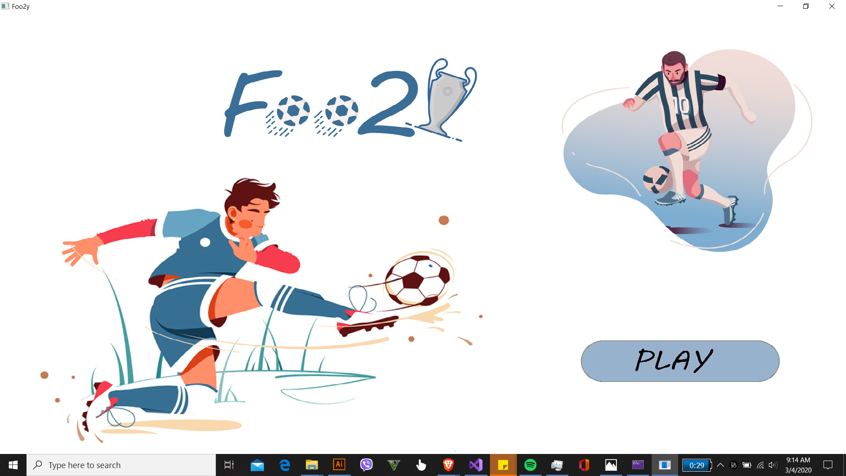
Home Window

Slide 6
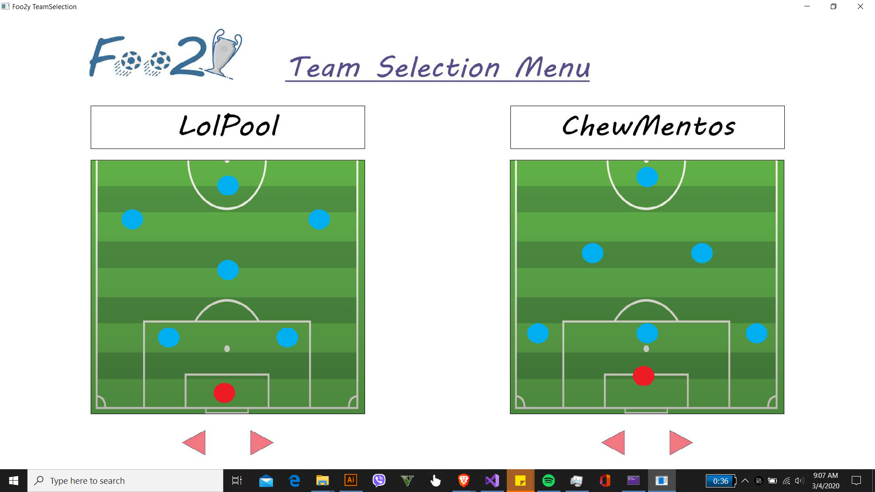
Team Selection Window

Slide 7
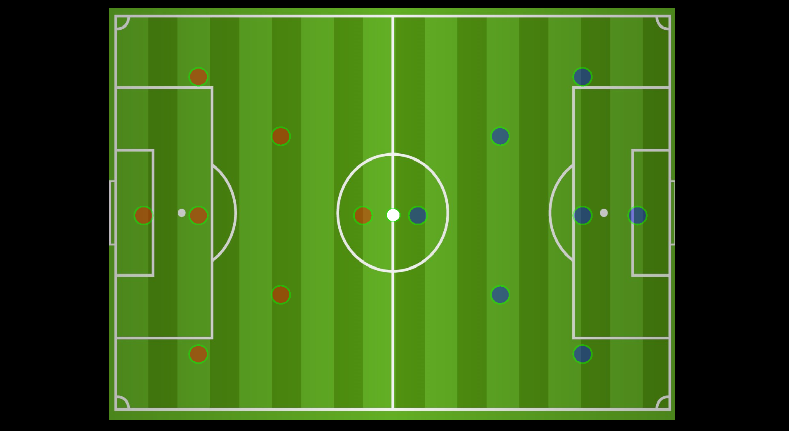
Game Window

Slide 8
Gameplay
1.User advances to the field window,
2.A player is selected by default which can be changed pressing the required key,
3.Player move towards the ball and towards the goal to score,
4.Opponent players try to intercept the ball and gain possession,
5.Other players of the player’s team move to take passes,
6.Passes are made by pressing the required keys
7.Game ends after a team scores certain number of goals.

Slide 9
Gameplay
Team-1’s player controls:
Movements: W,A,S,D
Change Player: C
Pass/Sprint:V
Shoot/Tackle:X
Team-2’s player controls:
Movements: Up,Down,Left,Right
Change Player: M
Pass/Sprint: <
Shoot/Tackle: N

Slide 10
Libraries and Classes
Libraries:
SFML Graphics library , for graphics handling around the program
Classes :
Player , for defining each player unit
Field , for setting the field backgrounds
Ball , for defining the ball and controlling its movements
Game , for hosting and controlling all game elements
Team , for creating teams and controlling gameplay
Mainmenu , for handling all the windows on the game

Slide 11

Platform Used

Slide 12
Limitations
Many features had to be left out so that we could complete the game on time.. The following features can be added to our project:
Features like Penalty,Fouls,Cards,etc are not available as of now,
The game can be extended for multiple players to play in LAN,
Modes of play like practice, tournament, match modes could be added,
Predefined teams and commentary can be added,
User Experience can be enhanced using 3D objects like spherical ball,
Game AI can be improved.

Slide 13
References
The Secrets of Object Oriented Programming in C++ by D.S. Baral and D. Baral
Object Oriented Programming With C++ by E Balagurusamy
https://www.sfml-dev.org
Robert Lafore, “Object Oriented Programming with C++”, Sams Publication
Photos from: https://www.dribbble.com
Icons from:https://www.flaticon.com

