Slide 1







CUSTOMER INTELLIGENCE
Predicting Customer Churn Before It Happens
Customer churn silently erodes revenue and stunts growth — but with the right signals, it's predictable and preventable.
Data-Driven Analysis
Explore behavioral patterns and usage signals across 250K+ customers
Machine Learning Models
XGBoost & Random Forest to identify at-risk customers with precision
Retention Strategies
Actionable, personalized interventions tiered by customer risk level
"The goal is not to react to churn — it's to predict and prevent it before the customer ever considers leaving."

Slide 2
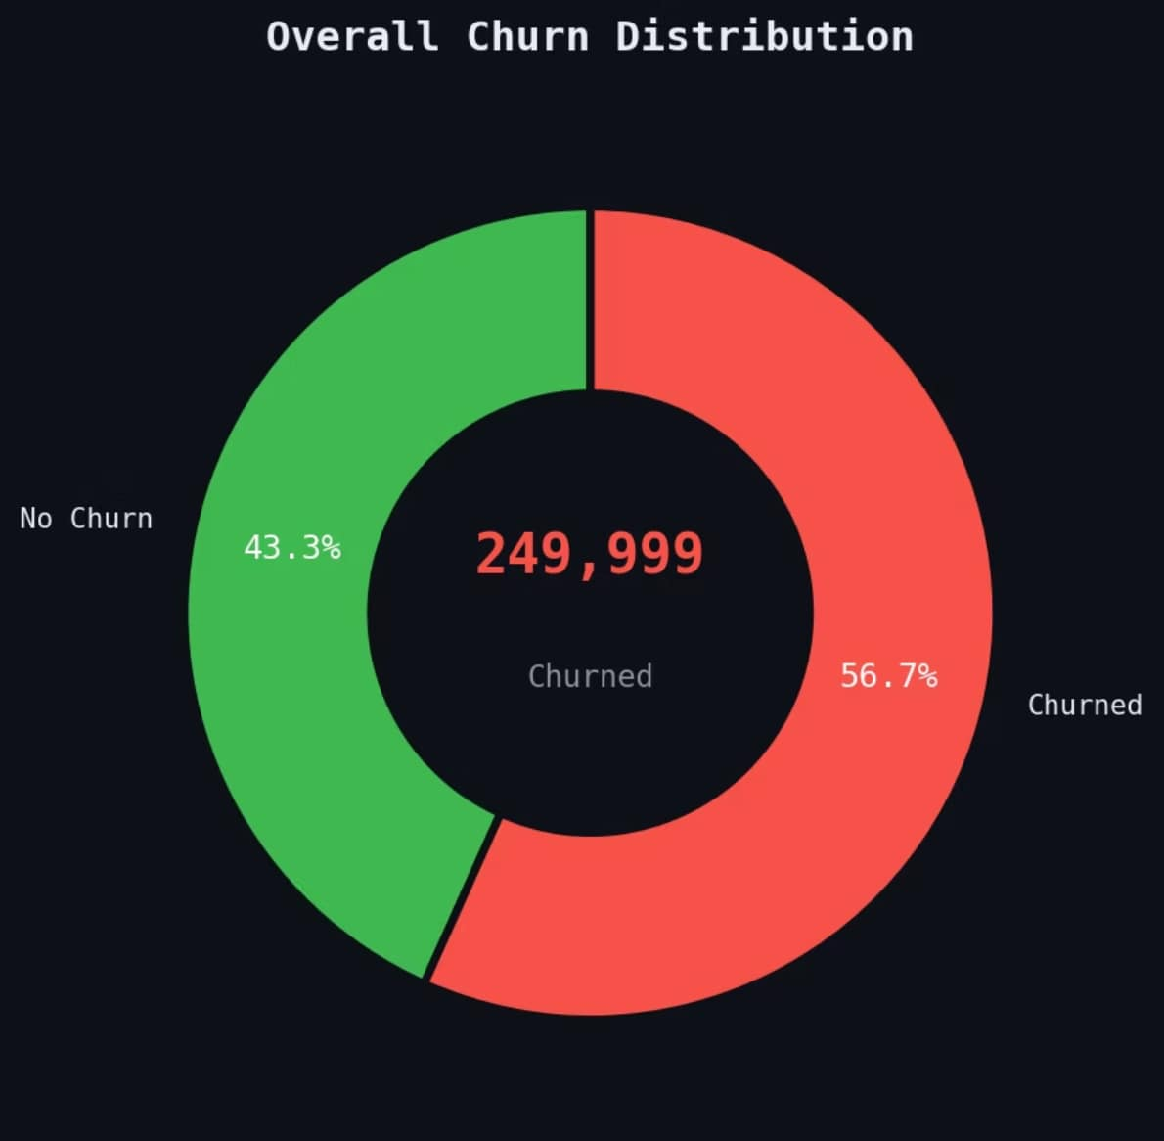
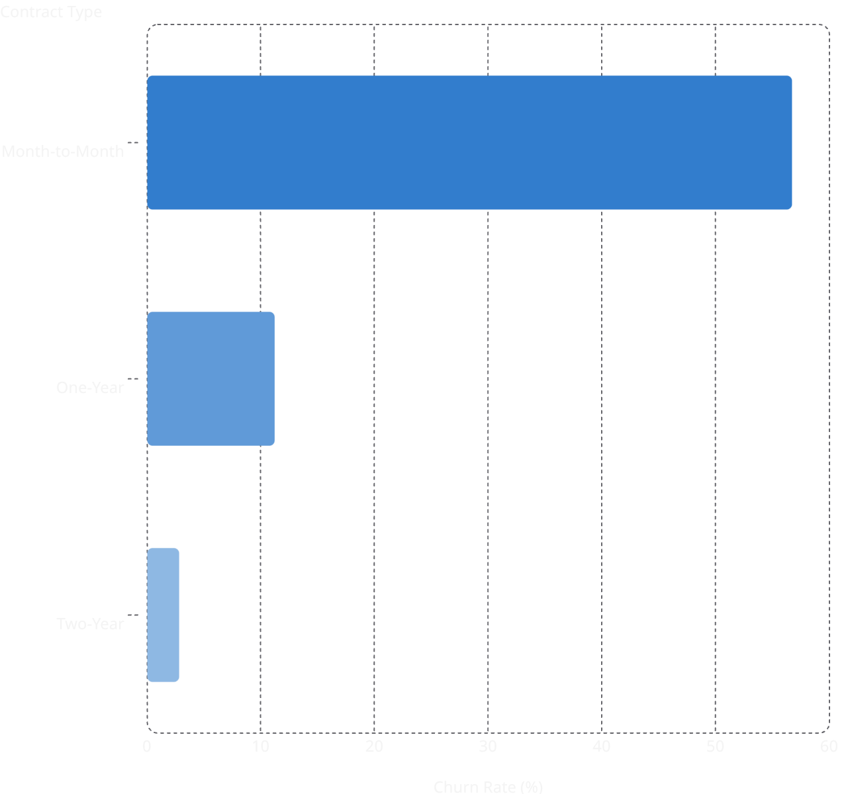

EXPLORATORY ANALYSIS
Understanding Customer Behavior
An analysis of 249,999 customers reveals a striking churn reality — and a clear opportunity for proactive intervention.
Overall Churn Distribution
Churn by Contract Type
💡 Key Insight: A significant portion of churn comes from month-to-month contracts — low-commitment customers are at the highest risk and should be prioritized in retention campaigns.

Slide 3
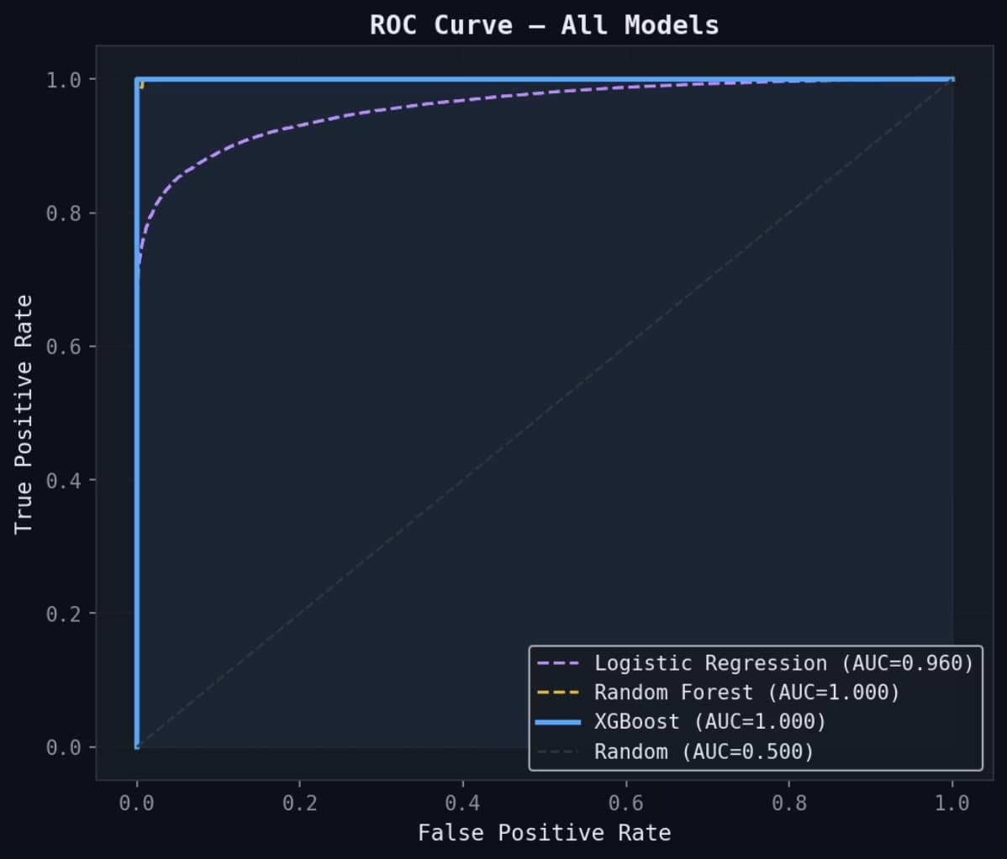
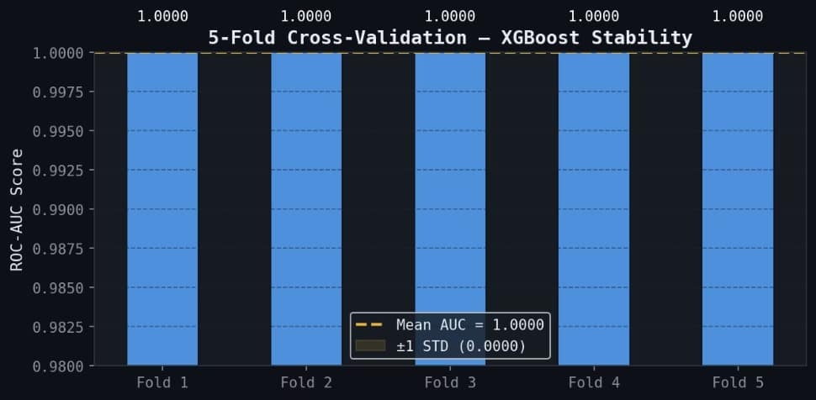

MODELING APPROACH
Building the Prediction Engine
A rigorous ML pipeline was built on real behavioral signals — engineered for precision, validated for stability.
Feature Engineering
Models Evaluated
Evaluation Metrics
Usage frequency & engagement depth
Tenure and contract lifecycle
Support interaction patterns
Billing & payment behavior
Logistic Regression (AUC = 0.960)
Random Forest (AUC = 1.000)
XGBoost (AUC = 1.000) ✅ Best
ROC-AUC Score
Recall & F1-Score
5-Fold Cross-Validation
Confusion Matrix Analysis
ROC Curve — All Models
5-Fold Cross-Validation Stability
XGBoost achieved a Mean AUC = 1.000 with near-zero variance across all 5 folds — confirming exceptional stability and generalization.

Slide 4
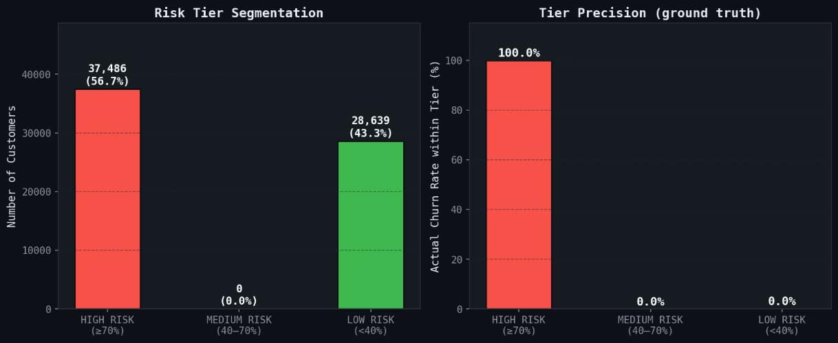
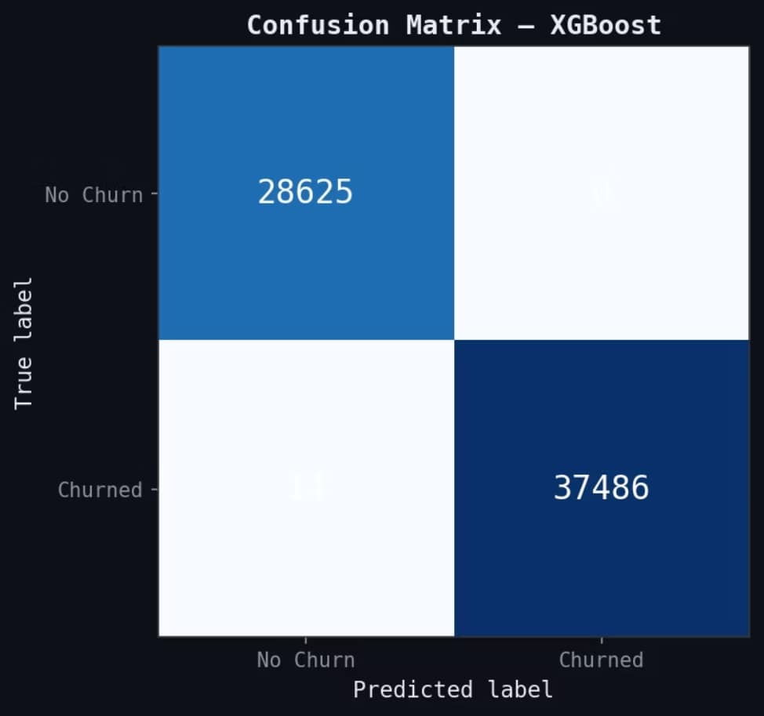

INTERPRETABILITY
Explaining Churn with AI
SHAP values decode the model's decisions — revealing what truly drives customers to leave, not just predicting that they will.
Risk Tier Segmentation & Precision
XGBoost Confusion Matrix
💡 Key Insight: Using SHAP, the model identified low engagement and short tenure as the top churn drivers. Customers are segmented into risk tiers so the business can prioritize retention efforts with 100% precision on High-Risk customers.
28,625
Correctly Retained
True negatives — customers correctly predicted to stay
37,486
Churn Caught
True positives — churned customers correctly identified

Slide 5





LIVE DEMO
Real-Time Churn Prediction Demo
See the model in action — predicting churn risk and generating retention recommendations in real time.
AI-Powered Churn Advisor
An intelligent assistant that evaluates customer profiles and flags risk in seconds
Real-Time Predictions
Input customer data live and receive an instant churn probability score
Personalized Retention Recommendations
Tailored actions suggested for each risk tier — from loyalty offers to proactive outreach
🚀 Switch to live demo now — Open Google Colab Notebook →

