Slide 1
✦ Ask AI Explorer ↗
Music Streaming Dataset Analysis
Understanding the Drivers of Track Popularity
Candidate: Kuwar Abhinav Aman | Data Analyst Technical Assessment
✦ Launch Interactive AI Data Explorer (10,058 Tracks) ↗
Click to query the complete dataset in real-time with zero-hallucination Pandas execution
Kuwar Abhinav Aman | Data Analyst Assessment

Slide 2
Executive Summary
✦ Ask AI Explorer ↗
Artist context matters more than energy alone.
01
Energy shows little to no overall association with popularity.
Across 9,637 tracks, there is no consistent relationship between energy level and popularity score.
02
The energy–popularity relationship changes substantially across genres.
In some genres (e.g. j-pop, k-pop), higher energy is associated with higher popularity. In others (e.g. emo, garage), the opposite pattern appears.
03
Superstar tracks show no meaningful regional concentration.
Superstar-tier artists are distributed proportionally across all five market regions.
Overall confidence: Moderate to High | Based on cleaned dataset of 10,058 tracks
Kuwar Abhinav Aman | Data Analyst Assessment

Slide 3
Data Quality & Cleaning
✦ Ask AI Explorer ↗
Issue
What We Did
Why
Inconsistent category casing
(e.g. 'Europe' vs 'EUROPE')
Standardised all category names
to consistent title case
Prevented the same group being
counted as two separate groups
250 non-numeric release years
(e.g. 'late 90s', 'unknown')
Treated as missing for
year-based analysis
Avoided inventing dates that
would distort temporal patterns
74 exact duplicate rows
Removed exact duplicates;
kept context-different entries
Same row appearing twice adds
no information
20 invalid popularity values
(negative or above 100)
Set to missing
Values outside documented
0–100 range are unreliable
4 negative track durations
Set to missing
Physical impossibility indicates
data-entry error
Cleaned dataset: 10,058 rows | 9,637 with valid popularity scores | Every exclusion has a documented rationale
Kuwar Abhinav Aman | Data Analyst Assessment

Slide 4
How the Analysis Worked
✦ Ask AI Explorer ↗
Step 1
Step 2
Step 3
Step 4
Step 5
Data
Clean
Outcome
Test
Interpret
→
→
→
→
10,132 tracks
across 114 genres
Standardise categories
and remove clear errors
Popularity score
(0–100 scale)
Energy/popularity
+ regional Superstar
Strength of evidence
+ limitations
Important: Association does not mean causation. All findings in this analysis describe observed relationships, not proven causes.
Hypotheses Tested
H1: Does energy relate to popularity? Does this vary by genre?
H2: Are Superstar artists concentrated in particular regions?
Kuwar Abhinav Aman | Data Analyst Assessment

Slide 5
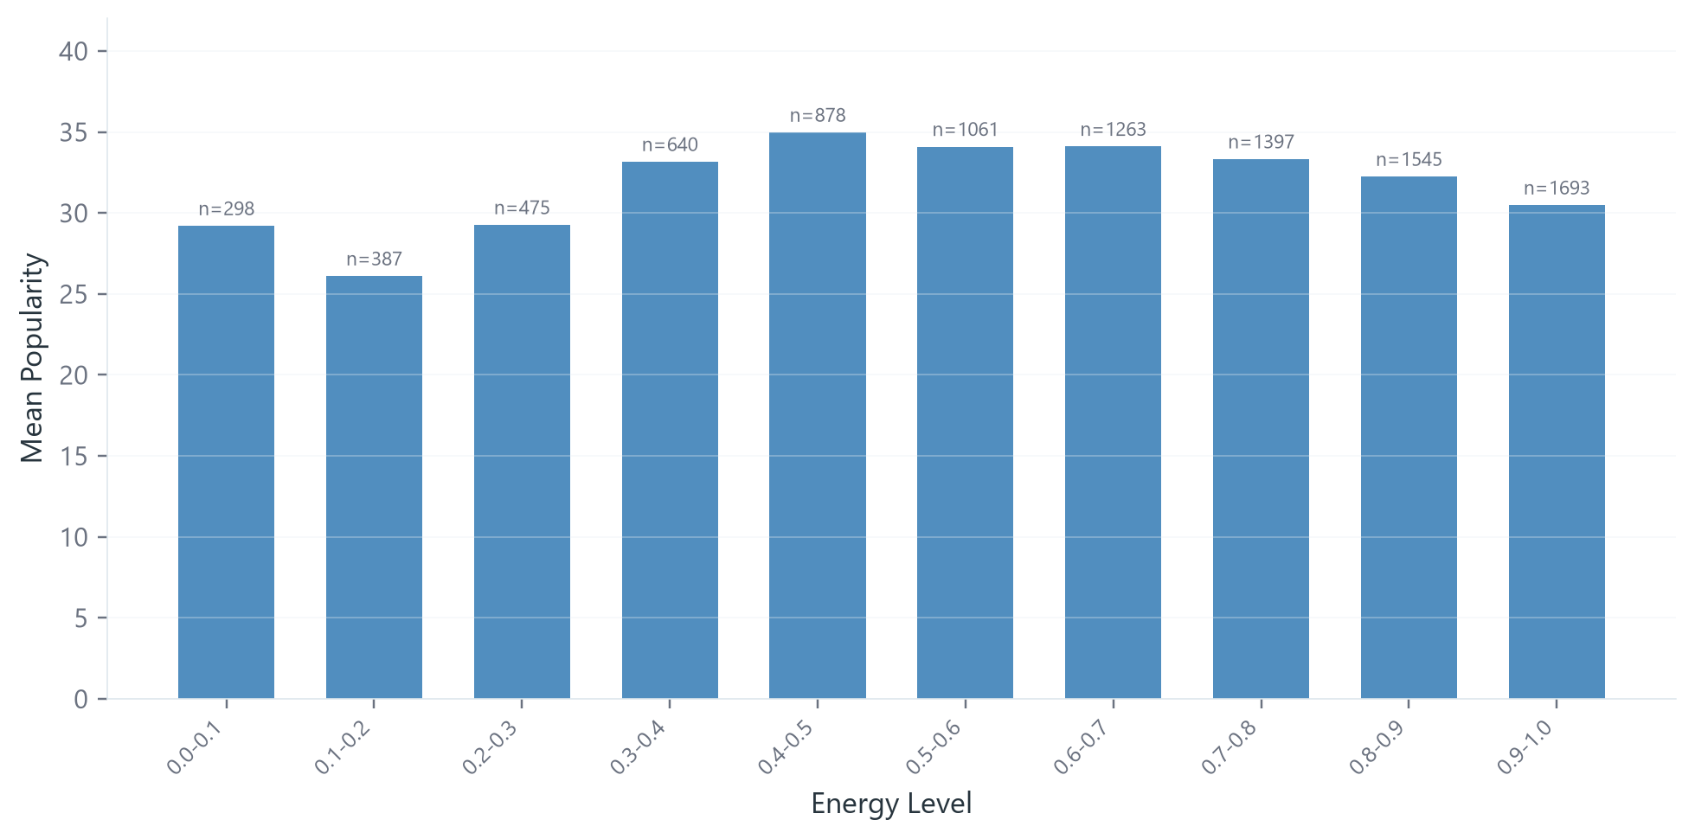
Energy has little to no overall association with popularity
✦ Ask AI Explorer ↗
Evidence
Correlation: r ≈ 0 (r = 0.0109)
p-value: 0.285 (not significant)
Sample: 9,637 tracks
Interpretation
Higher energy does not consistently correspond to higher popularity.
The relationship is neither statistically significant nor practically meaningful.
Mean popularity is remarkably flat across all energy levels (~26–35). Low-energy and high-energy tracks achieve similar popularity scores. However, the story changes when we look within individual genres.
Correlation measures the strength of association between two variables; it does not imply that one causes the other.
Kuwar Abhinav Aman | Data Analyst Assessment

Slide 6
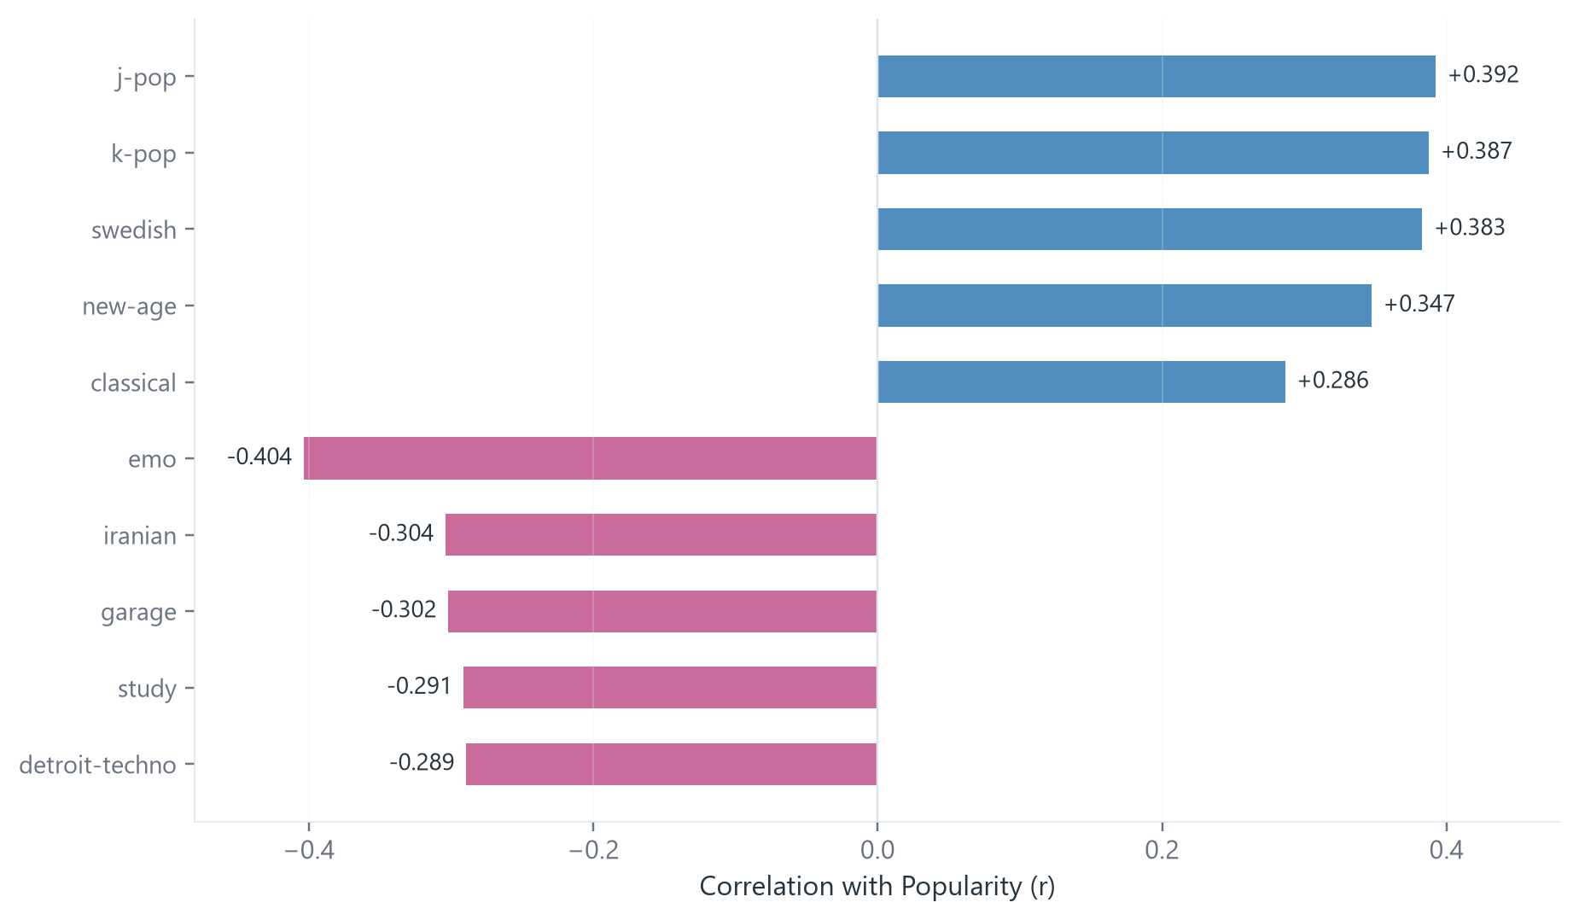
The overall result changes when we look within genres
✦ Ask AI Explorer ↗
What the data shows
Some genres show a positive relationship between energy and popularity, while others show the opposite.
Higher energy → higher popularity
j-pop (r = +0.392)
k-pop (r = +0.387)
swedish (r = +0.383)
new-age (r = +0.347)
Higher energy → lower popularity
study (r = -0.291)
garage (r = -0.302)
iranian (r = -0.304)
emo (r = -0.404)
24 of 114 genres show nominally significant correlations (p < 0.05); results are exploratory due to multiple testing. Genre context appears to be essential — the relationship between energy and popularity depends on the musical setting.
Exploratory analysis: testing 114 genres increases the chance of false positives. Individual genre results should be interpreted with caution.
Kuwar Abhinav Aman | Data Analyst Assessment

Slide 7
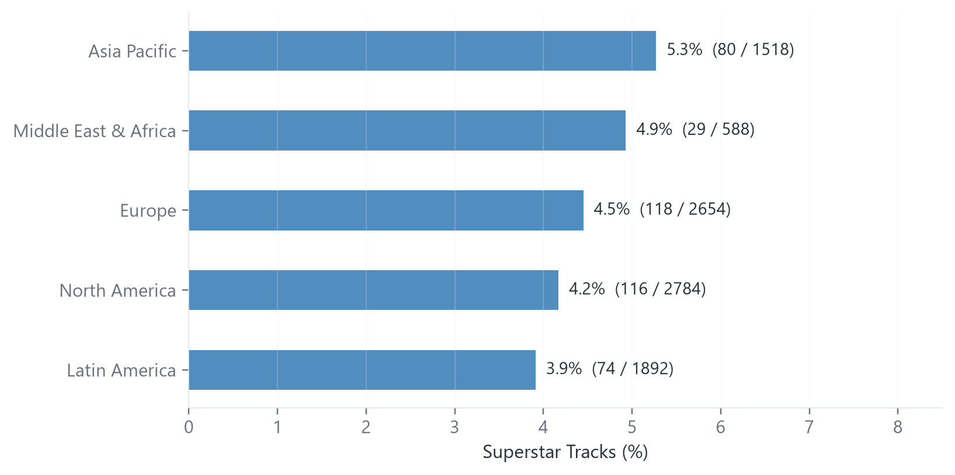
Superstar tracks are broadly proportional across regions
✦ Ask AI Explorer ↗
Evidence
Range across regions: 3.9% – 5.3%
p-value: 0.785 (not significant)
Effect size: Cramer’s V = 0.0168 (negligible)
Sample: 9,436 tracks
Interpretation
The regional differences are small and consistent with random variation.
No evidence of regional concentration. Superstar-tier artists appear across all five market regions at similar rates. The slight variation (3.9%–5.3%) is well within what we would expect from chance.
Note: Middle East & Africa has a smaller sample (588 tracks), which increases uncertainty for that region.
Sample: 9,436 tracks with complete popularity, market region, and artist tier data (622 tracks excluded due to missing values).
Kuwar Abhinav Aman | Data Analyst Assessment

Slide 8
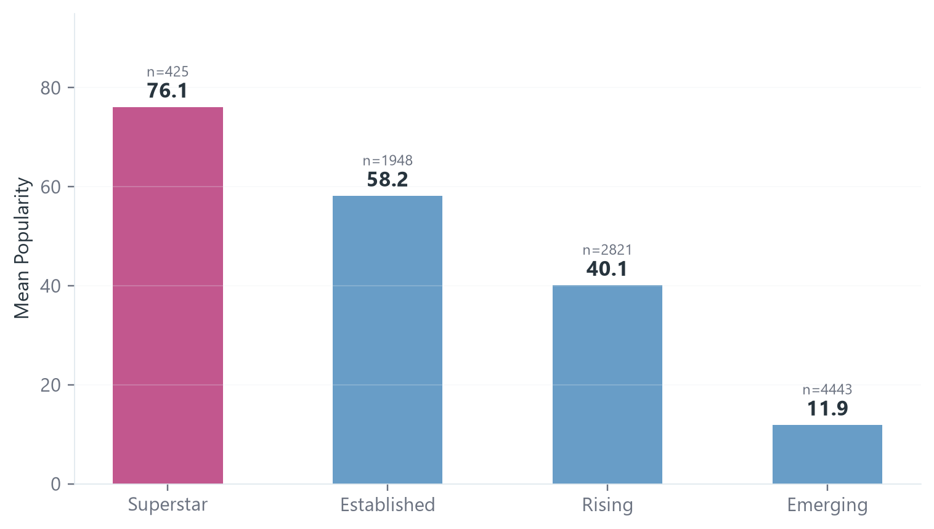
Conclusions, Confidence & Limitations
✦ Ask AI Explorer ↗
What the Data Suggests
• Artist tier shows the strongest observed association
among the variables examined (Superstar: 76.1 vs Emerging: 11.9).
• Energy alone has little overall association
with popularity.
• Genre context changes the energy–popularity
relationship.
• Superstar tracks show no meaningful
regional concentration.
How Confident Are We?
H1 overall (energy – popularity): HIGH
Large sample, clear null result.
H1 genre variation: MODERATE
Meaningful pattern, but ~80–90 tracks per genre
and multiple testing risk.
H2 regional distribution: HIGH
Large sample, p = 0.785, negligible effect size.
What We Cannot Claim
• We cannot establish causation from this data.
• Popularity is observational and snapshot-based.
• Genre, platform and playlist context may
independently influence results.
• Multiple genre tests require caution when
interpreting individual correlations.
The dataset suggests that artist-level context is more strongly associated with popularity than energy alone.
✦ Query 10,058 Rows Live on Web — Interactive AI Companion ↗
Kuwar Abhinav Aman | Data Analyst Assessment

