Slide 1
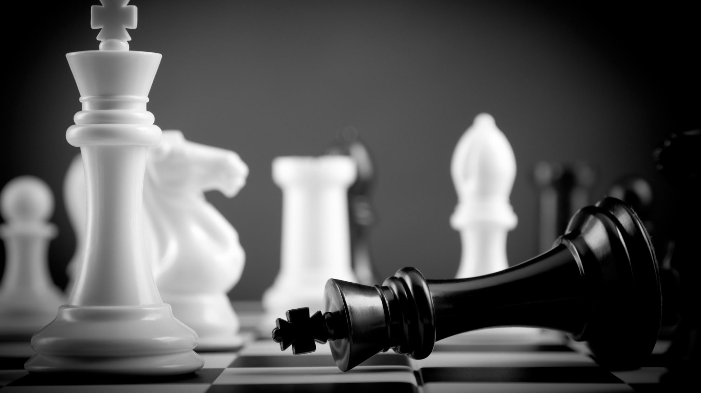
Development of a Chess AI
By Kuzey Cimen
Supervisors: Professor John Gan, Doctor David Richerby

Slide 2
Background and Project Goals
Background
My interest in the game of Chess
My interest in Artificial Intelligence
The state of Artificial Intelligence in the world
Project Goals
Train an AI player which was strong enough to beat an average chess player.
Implement a neural network
Create a presentable user interface

Slide 3
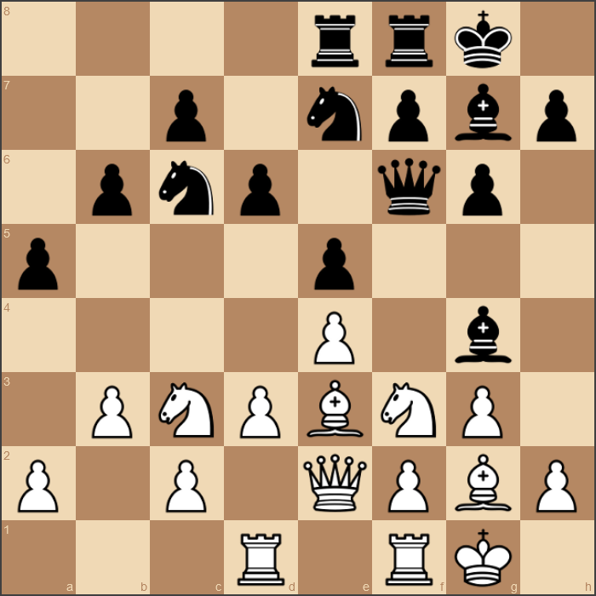
Methodology and Design
Programming Language
Chessboard Representation
User Interface
Data Flow
Algorithms
Methods of Increasing Playing Strength

Slide 4
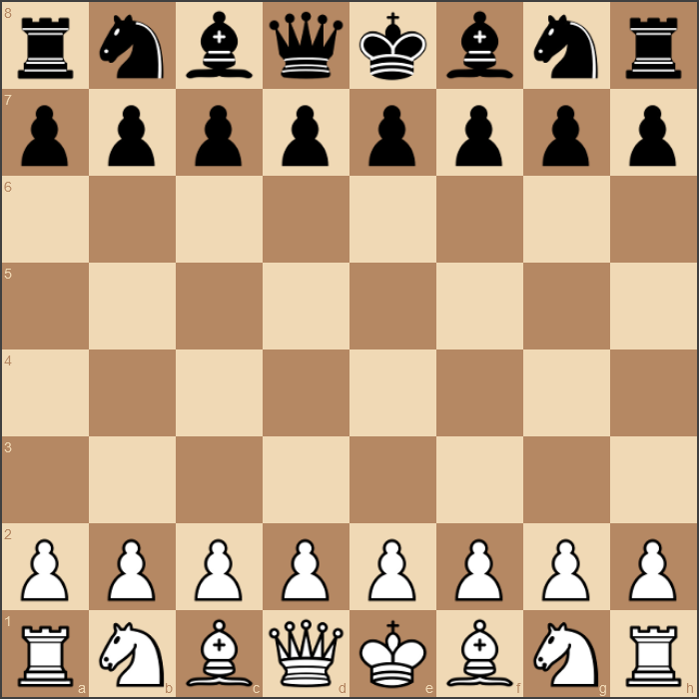
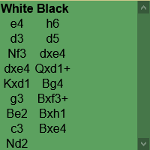
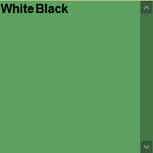
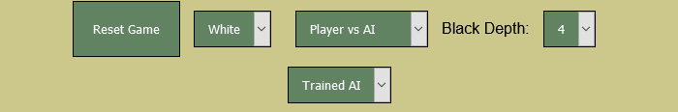
Implementation
Negamax
Alpha-beta Pruning
Iterative Deepening
Transposition Table
Neural Network
Platform
Online
Python-chess
Chessboard.js
Flask
Heroku

Slide 5
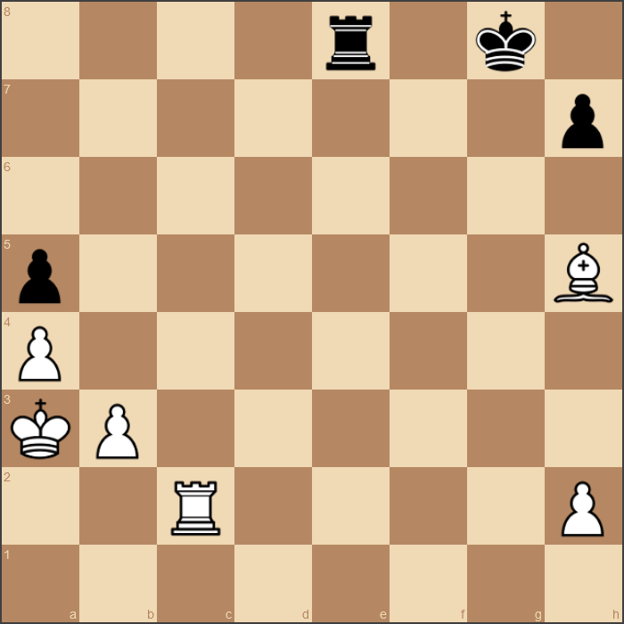
Testing and Results
Neural AI vs Default AI Player – 10 Games
9-1
Player vs Neural AI Player – 10 Games
2-8
Player vs Default AI Player – 10 Games
8-2

Slide 6
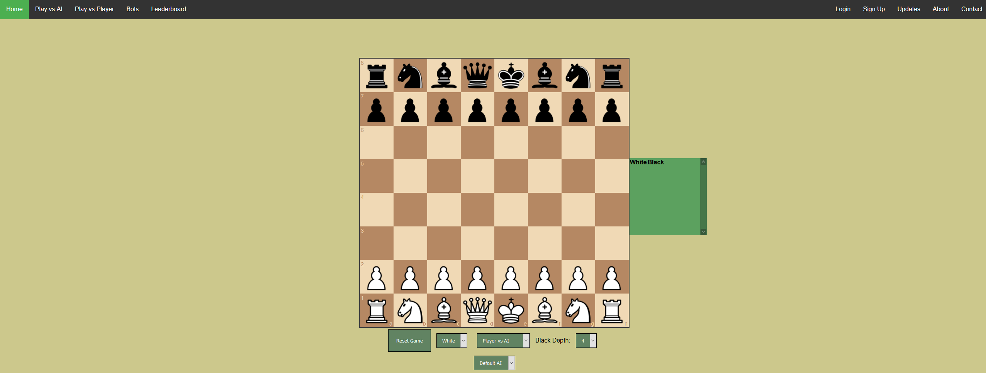
Technical Achievements
Neural Network
Machine Learning
Negamax
Website
Online Platform
AI vs AI
Player vs AI
Player vs Player

Slide 7
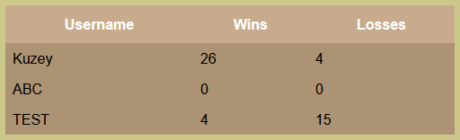
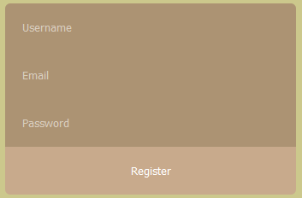
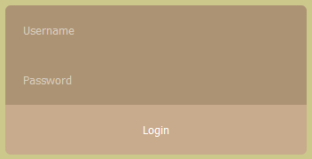
Future Work
User accounts
Save progress
Leaderboard
Competitiveness
Multiple Bots
Different ratings
Ranking System
Improve user gameplay

Slide 8
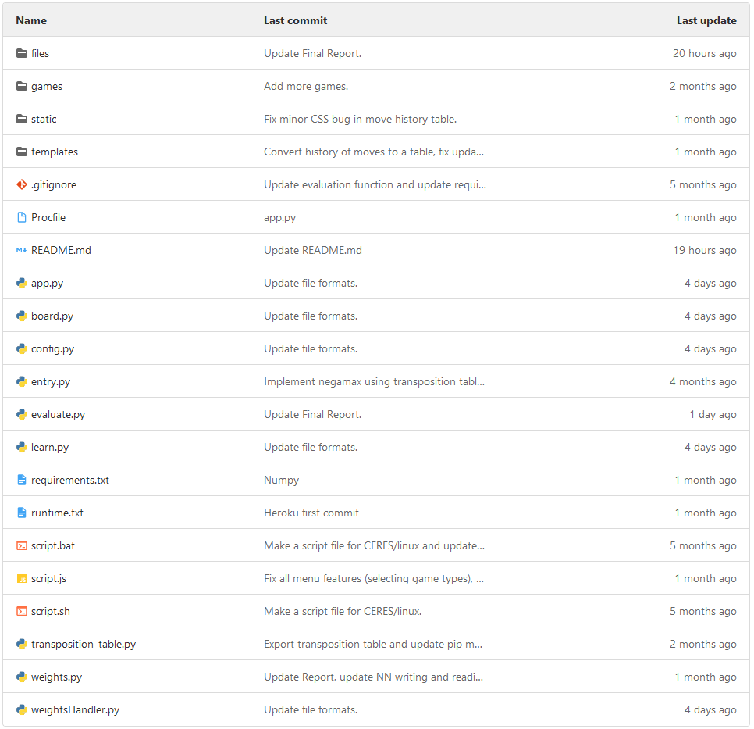

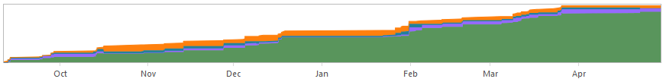
Jira and GitLab
Jira
Project Management
Planning
Time Management
GitLab
File Management
Organization
Record changes

Slide 9
Acknowledgement
University of Essex
Professor John Gan
Doctor David Richerby
Friends and Family
Online Sources
Python-chess
Chessboard.js
Flask
Heroku

