Slide 1


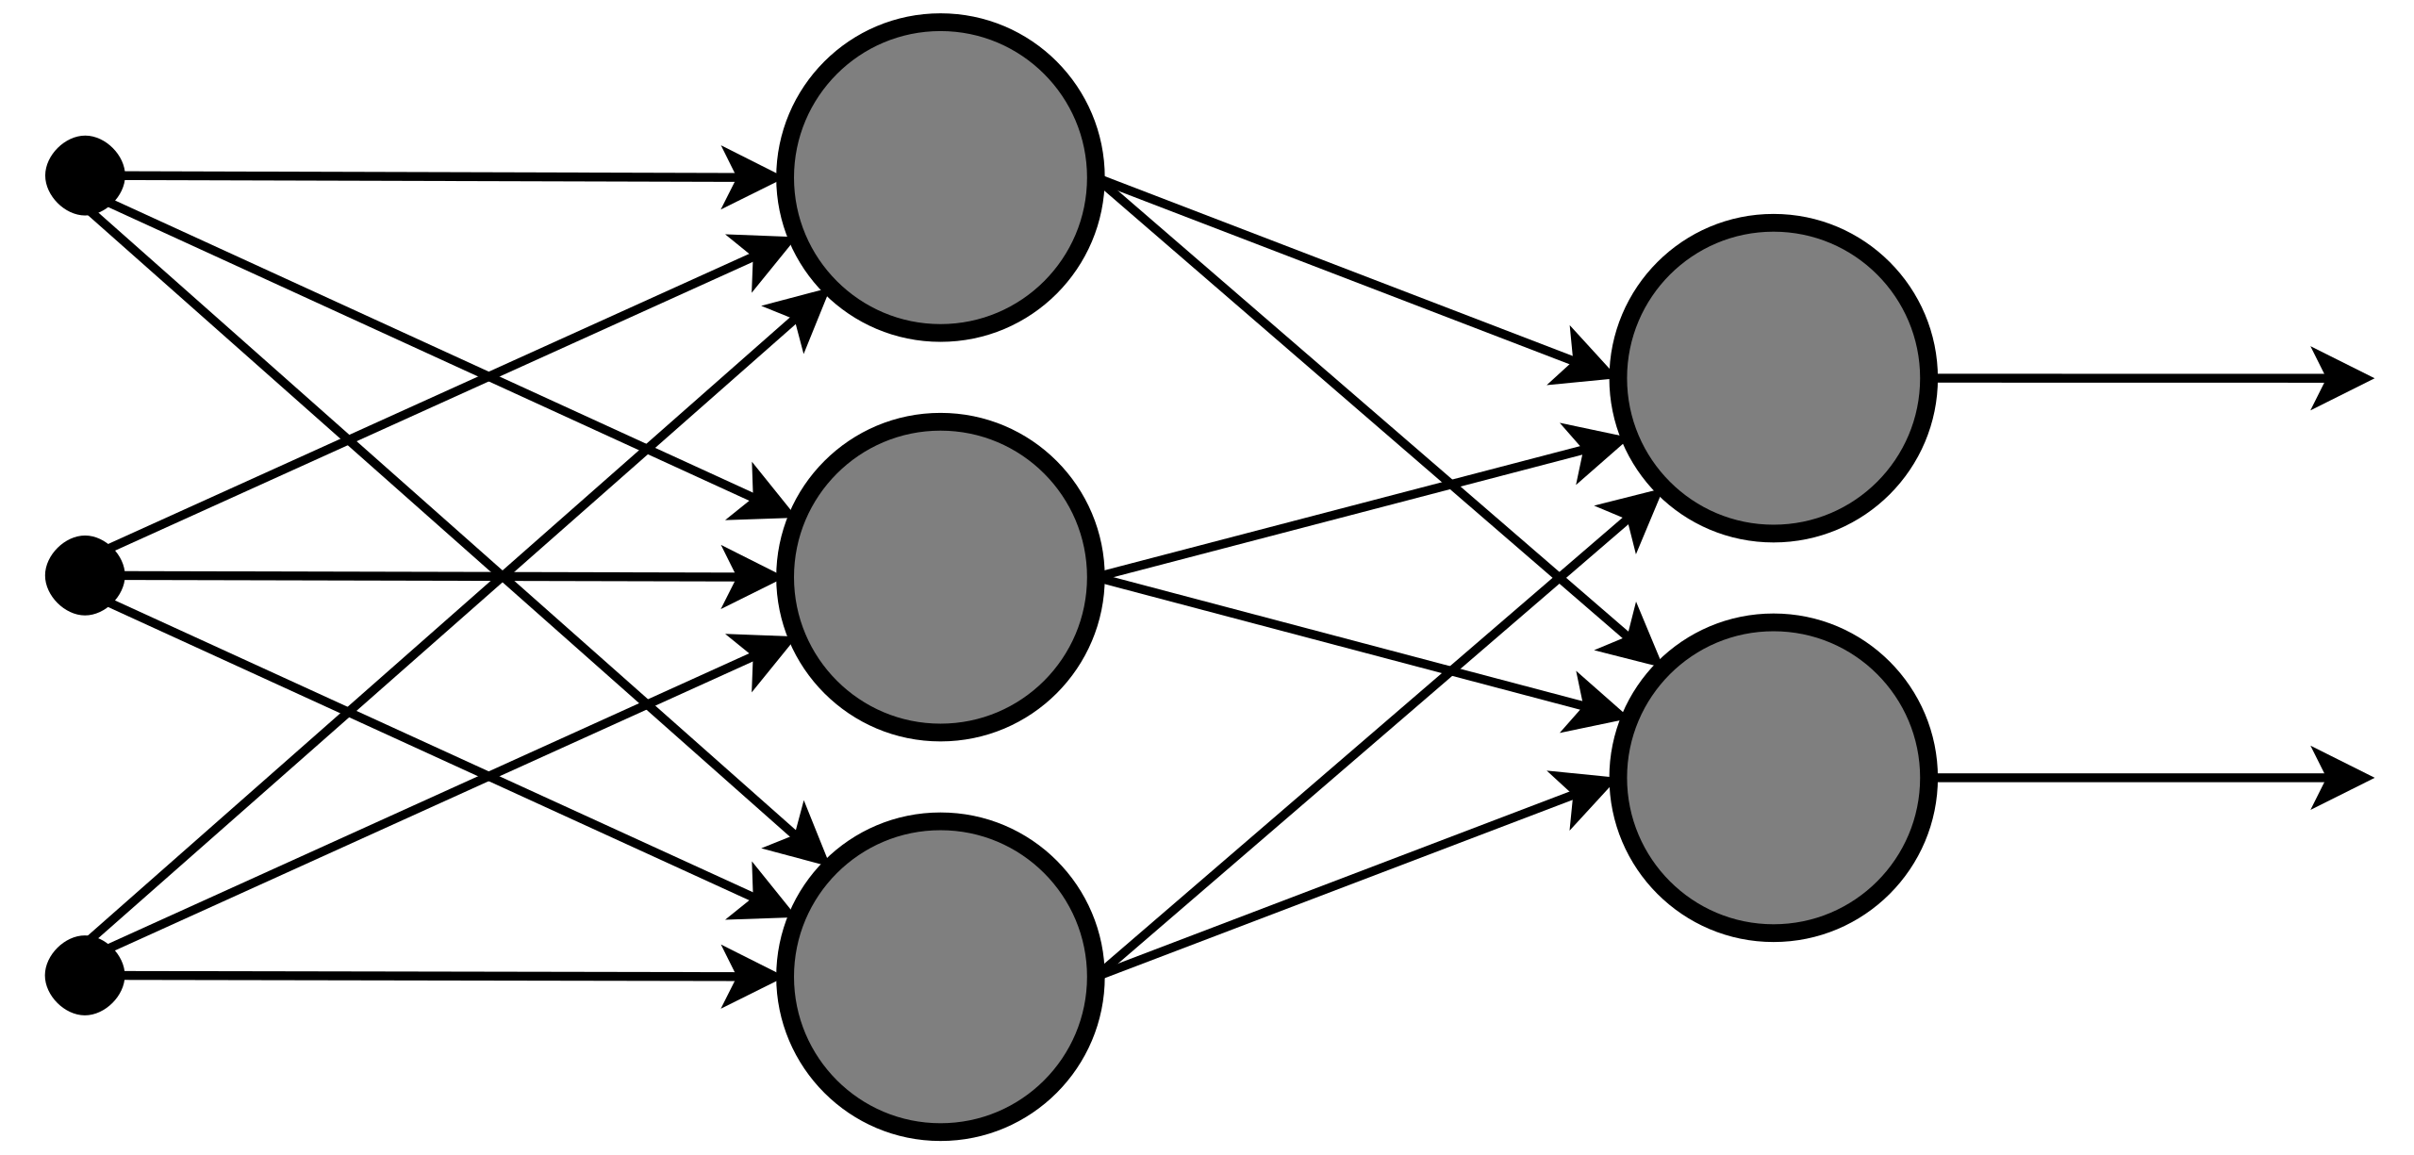
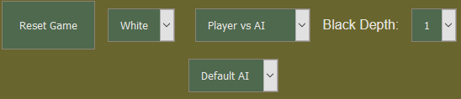
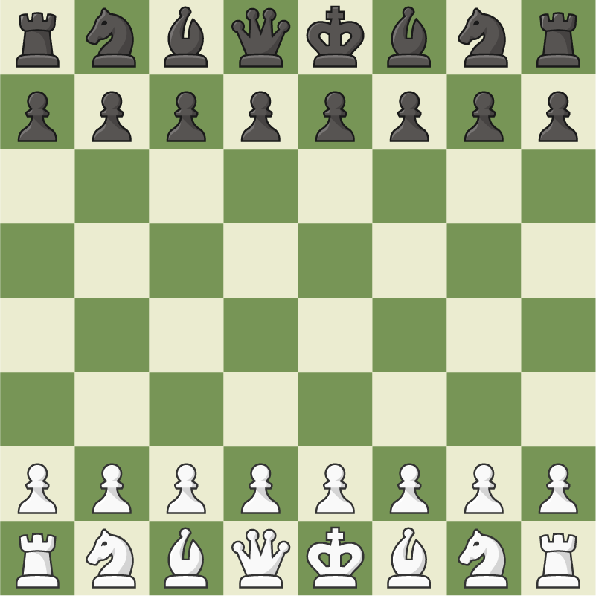
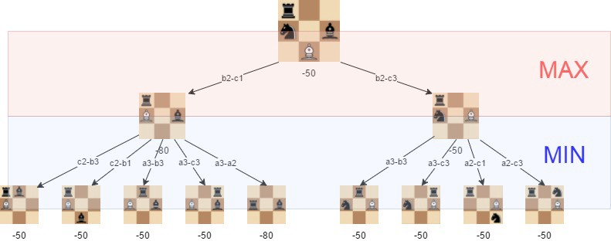
Chess AI with Neural Network
Kuzey Cimen – Supervisor: John Gan
Introduction
In this project, I am aiming to use a Neural Network to teach an AI player (Artificial Intelligence), from a database of super grandmaster (>2700 rating) games.
Methodology
The Trained AI player is taught from the database of chess games. The games are evaluated using a different version of Minimax, Negamax. Minimax is an algorithm that checks every possible move and decides which one is the best using an evaluation function. Negamax is a more efficient approach to minimax in the way that it uses iterative deepening depth first search as its search strategy.
The Trained AI uses the Neural Network to evaluate the board states. The Neural Network and the Negamax examines the move made from the current board state to the next board state, uses the evaluation function and exports the information to a file which is then used.
Input
Layer
Hidden Layer
Output
Layer
Project Goals
The main goal is to train an AI player until it was strong enough to beat an average player in a chess game.
The picture above is an Artificial Neural
Network
Implementation
In addition to the AI Player, I have also implemented a Transposition Table which remembers board states so that the algorithm does not have to evaluate it again.
I have made an online platform to play against the Negamax AI player or the Trained AI player, which uses a Neural Network. There is also an option to make the two AI players play against each other. In the website, there is a menu that the user can interact such as, depth of search, the AI player they want to play against, reset game and the colour they want to play. For the project structure, I am using JavaScript for the front-end and Python for the backend. To connect them both, I am using a framework called Flask.
Results
In the end, I achieved what I wanted.
All the features that I have talked about are available to play online at:
https://ce301-chess.herokuapp.com/
Conclusion
In the end, I am happy with where the project is heading and implemented most of the things I wanted. In the future, I would like to make a better User Interface, implement user accounts, a leaderboard and an online Player vs Player mode.

