Slide 1
RBL PRESENTATION

Slide 2
About Us:
NAME | ROLL NO
G.Sai Ashmit Reddy | 21951A3332
B.Karthik Varma | 21951A3312

Slide 3
Project name
Spam Detection Using Count vectorizer

Slide 4
Abstract:
1. Introduction to Spam Emails: - Definition and prevalence in digital communication. - Risks to individuals and organizations.
2. Machine Learning for Spam Detection: - Use of ML techniques for automatic classification. - Focus on distinguishing between spam and legitimate (ham) emails.
3. Integration and Deployment: - Incorporation of best-performing model into a spam detection system. - Real-time email classification as spam or ham.

Slide 5
4. System Maintenance and Validation: - Continuous monitoring and periodic retraining of models. - Testing and validation using diverse email samples. 5. Benefits of ML-Based Spam Detection: - Enhanced email security. - Reduced user inconvenience. - Improved productivity in email management.

Slide 6
Introduction:
Introduction to Email as a Communication Tool:
- Importance in personal and professional interactions.
- Increasing vulnerability to spam due to its widespread use.
2. Challenges Posed by Spam Emails:
- Inconvenience and information overload.
- Security risks like phishing and malware distribution.
3. Role of Machine Learning in Spam Detection: - Automated classification of emails into spam and legitimate (ham) categories. - Ability to learn from labeled data and predict classifications for new messages 4. CountVectorizer: - Converts text into numerical feature vectors. - Captures word frequencies to quantify email content.

Slide 7
5. Implementation of ML-Based Spam Detection System: - Dataset Preprocessing: - Removal of noise (e.g., stop words, punctuation). - Text normalization through stemming. 6. Model Selection and Training: - Utilization of supervised learning algorithms (e.g., Naïve Bayes, SVM, ensemble methods). - training on features generated by CountVectorizer. 7. System Performance and Adaptability: - High accuracy in classifying incoming emails. - Capability to adapt to evolving spamming techniques through continuous learning. 8. Benefits of ML-Based Approach:
- Enhanced effectiveness over traditional rule-based systems.
- Improved efficiency in detecting and filtering spam emails.

Slide 8
Methodology:
1. Dataset Collection: Collect a labeled dataset of SMS messages, classified as spam or non-spam (ham). The dataset should cover a wide range of spam messages and represent real-world scenarios. 2. Dataset Preprocessing: Clean the dataset by removing any noise, such as special characters, URLs, or phone numbers. Perform data normalization by converting all text to lowercase and removing unnecessary whitespace.Handle any class imbalance issues by applying techniques like oversampling or undersampling. 3. Text Representation: Convert the preprocessed SMS messages into numerical feature vectors. Common techniques include Count Vectorizer, TF-IDF, or word embeddings. Apply feature extraction methods such as n-grams or character-level encoding to capture relevant patterns in the text. 4. Model Selection and Training: Choose suitable ML algorithms for SMS spam detection, such as Naive Bayes, SVM, Random Forest, or Recurrent Neural Networks (RNNs). Split the dataset into training and testing sets, typically using a ratio such as 70:30 or 80:20, respectively. Train theselected ML models on the training data, utilizing thepreprocessed and represented features.

Slide 9
5.Hyperparameter Tuning: Perform hyperparameter optimization techniques, such as grid search or randomized search, to find the best combination of hyperparameters for each ML model. Fine-tune the models based on the evaluation results, aiming to improve their performance. 6. Deployment and Testing: Select the best-performing ML model based on the evaluation metrics. Integrate the chosen model into a spam detection system or application for real-time or batch processing of SMS messages. Perform thorough testing of the system using various types
of SMS messages to validate its effectiveness.
7. Monitoring and Maintenance: Continuously monitor the performance of the spam detection system and periodically retrain the model with new data to adapt to evolving spamming techniques.Stay updated with the latest research and advancements in SMS spam detection to improve the system’s efficiency over time.

Slide 10
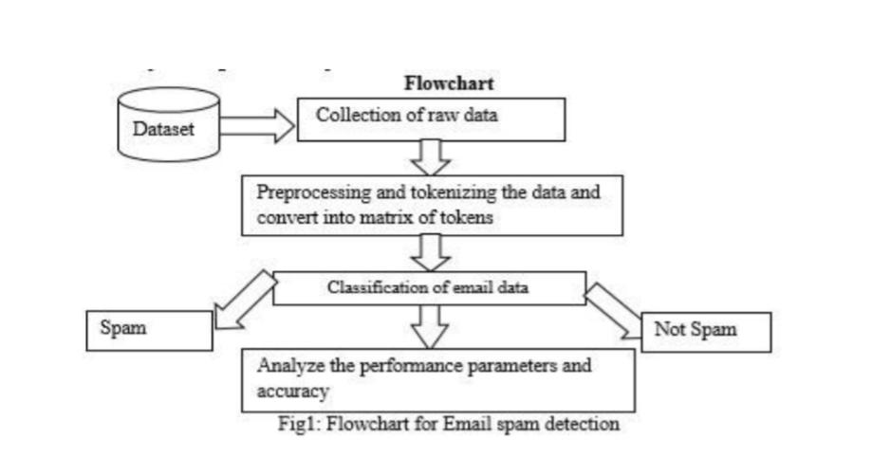
By following this methodology, an ML-based SMS spam detection system can accurately identify and filter out spam messages, improving user experience and reducing the impact of unwanted SMS communications

Slide 11
Algorithm:
1.Load and preprocess the labeled dataset of spam and non-spam emails. 2. Split the dataset into training and testing sets.
3. Apply a text representation technique (e.g., CountVectorizer) to convert emails into numerical feature vectors.
4. Perform additional preprocessing (e.g., removing stop words, stemming) on the feature vectors. 5. Select an ML algorithm (e.g., Naive Bayes, SVM) for training. 6. Train the ML model on the preprocessed training data as shown in fig.2. 7. Evaluate the model using appropriate metrics on the testing data. 8. Perform hyper parameter optimization to fine-tune the model’s performance. 9. Select the best-performing model based on evaluation results. 10. Integrate the chosen model into the spam detection system or application for real-time or batch processing.

Slide 12
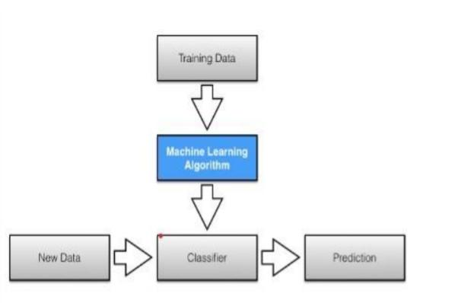
11. Continuously monitor the system’s performance and periodically retrain the model with updated data. 12. Test the system extensively with various types of emails to validate its performance and effectiveness. 13. Maintain and update the system regularly to adapt to evolving spamming techniques.

Slide 13
Explanation about Technology used algorithms:
Countvectorizer: Simply creates a Bag of words. In Bag of words, all the words in the Vocabulary go along columns and documents go along rows. Each row depicts one message. Then we are simply splitting our data into training and testing data. Multinomial Naive Bayes Algorithm: Multinomial Naive Bayes algorithm is a probabilistic learning method that is mostly used in Natural Language Processing (NLP). The algorithm is based on the Bayes theorem and Predicts the tag of a text such as a piece of email or newspaper article. It calculates the Probability of each tag for a given sample and then gives the tag with the highest probability as output. Bayes theorem, formulated by Thomas Bayes, calculates the probability of an event occurring based on the prior knowledge of conditions related to an event. It is based on the following formula:
P(A|B) = P(A) * P(B|A)/P(B)
Where we are calculating the probability of class A when predictor B is already provided. P(B) = prior probability of B P(A) = prior probability of class A P(B|A) = occurrence of predictor B given class A probability

Slide 14
Explanation about system considered / data taken / real time system you are working for the project
1. Input: The input to the system is an email or a collection of emails that need to be classified as either spam or non-spam (ham). 2. Preprocessing Module: This module is responsible for cleaning and preparing the input data before feeding it into the ML model. It includes steps such as removing noise (HTML tags, special characters), tokenization, removing stop words, and performing stemming or lemmatization. 3. Feature Extraction: In this step, the preprocessed email text is transformed into numerical feature vectors using techniques like CountVectorizer, TF-IDF, or word embeddings. This allows the ML model to understand and analyze the text. 4. Machine Learning Model: The ML model is trained on a labeled dataset of spam and non-spam emails using supervised learning algorithms such as Naïve Bayes, Support Vector Machines (SVM), Random Forest, or Gradient Boosting. The model learns patterns and characteristics of spam emails from the training data. 5. Model Evaluation: The trained model is evaluated using a separate testing dataset to measure its performance. Evaluation metrics such as accuracy, precision, recall, F1-score, and ROC curve are calculated to assess the model’s effectiveness in spam detection. 6. Hyperparameter Tuning: Hyperparameters of the ML model are optimized to improve its performance. Techniques like grid search or randomized search are commonly used to find the best combination of hyperparameters.

Slide 15
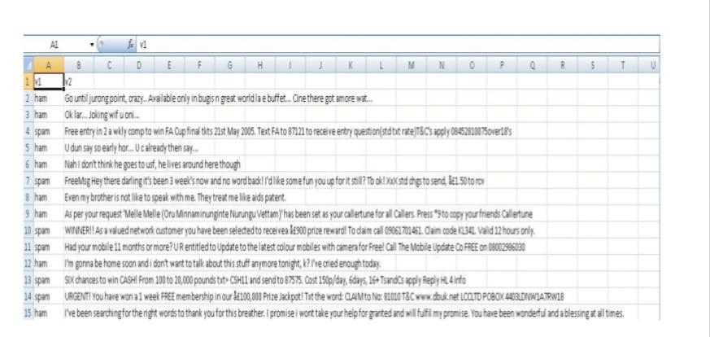
DATA TAKEN:
One of the primary methods for spam mail detection is email filtering. It Involves categorize incoming emails into spam and non –spam, Machine Learning algorithm can be trained to filter out spam mails based on them Content and metadata as shown in fig.3.

Slide 16
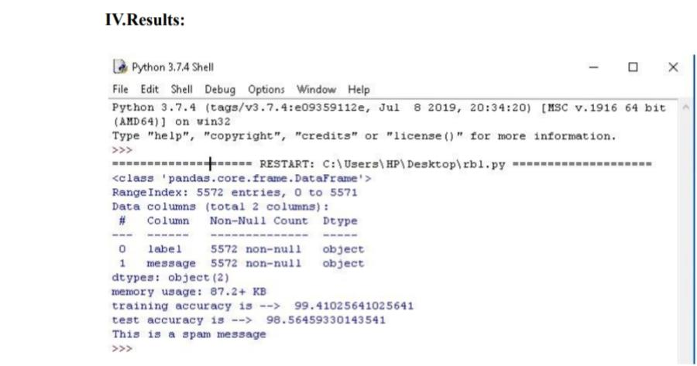
Results:

Slide 17
Conclusion:
We presented a comprehensive methodology for developing an effective machine learning based
SMS spam detection system. Our approach begins with the collection of a labelled dataset
representing real-world scenarios, followed by rigorous preprocessing to ensure data cleanliness and
balance. We utilized advanced text representation techniques such as Count Vectorizer, TF-IDF, and
word embeddings to capture relevant patterns in the text.
Various machine learning algorithms, including Naïve Bayes, SVM, Random Forest, and RNNs, were evaluated using metrics like accuracy, precision, recall, and F1-score. Hyperparameter tuning was performed to optimize model performance. The best-performing model was integrated into a spam detection system and extensively tested for real-time or batch processing. Continuous monitoring and periodic retraining with new data ensure the system adapts to evolving spamming techniques, maintaining its effectiveness over time. This iterative methodology demonstrates that an ML-based spam detection system can significantly improve user experience by accurately filtering out unwanted messages

Slide 18
Thank you

