Slide 1
Steps
Lets take example of settings for sharedpreferences
Create a menu file , add it to the current activity through which u want to navigate from
Inside onOptionItemselected, handle opening of new activity i.e settingsactivity
Create a xml folder in app , inside it create a resource file.
Create a checkboxpreference let’s say
Add summaryon , summaryoff situ , name , id , title, key
Add compile 'com.android.support:preference-v7:25.1.0' in build.gradle
Create a new java file , lets sey settingsFragment , extends PreferenceFragmentCompat from import android.support.v7.preference.PreferenceFragmentCompat;
Override methods , inside method addPreferencesFromResource pass , newly creaed xml file
Inside activity_settings , add a fragment layout with android:name value to SEttingsFragment class.
Add , theme in style file to ensure all works. <item name="preferenceTheme">@style/PreferenceFragment</item>

Slide 2
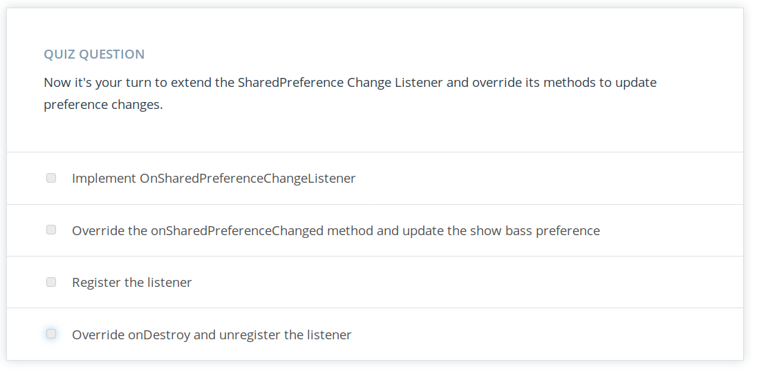

Slide 3
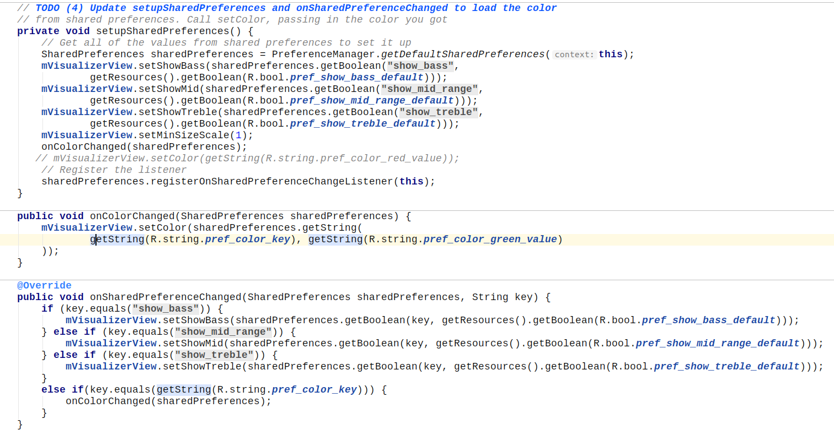

Slide 4
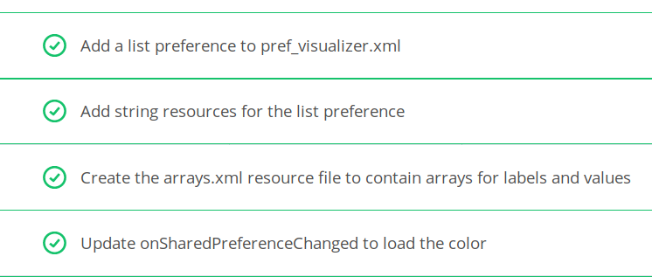
List Preference

Slide 5
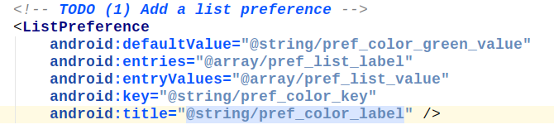
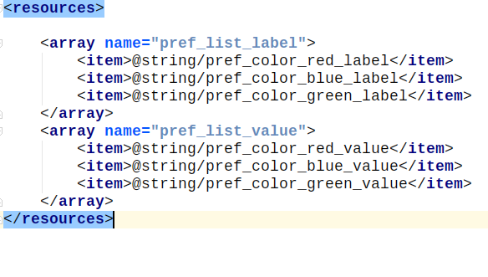

Slide 6
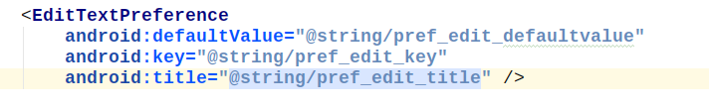
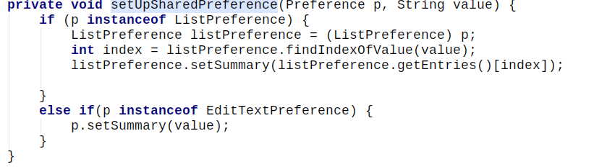
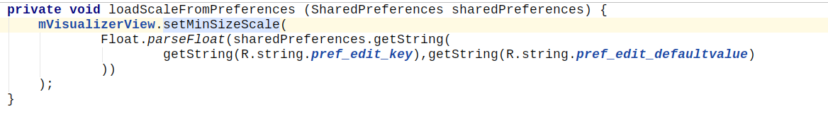
Edit Preference
Set it in xml file. For ex :
Set summary of edit text
Inside onsharedpreferendechanged, set summary in fragment
Inside activity where it need to display changes, call it in on create
Inside activity , onsharedpreferencechanged, set scale again by checking.

Slide 7
Handling edit text preference input
https://classroom.udacity.com/courses/ud851/lessons/1392b674-18b6-4636-b36b-da7d37a319e3/concepts/7156d056-641e-491c-9b86-49f5310de0b0

Slide 8
What settings are necessary ?
https://material.io/guidelines/patterns/settings.html

Slide 9
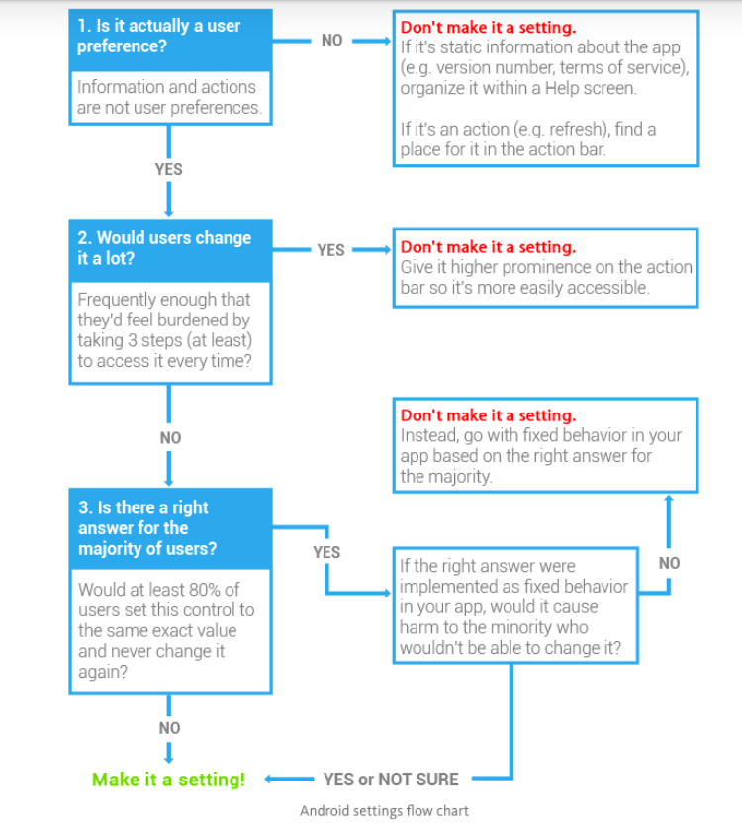

Slide 10
Press back with setting parent
https://developer.android.com/training/implementing-navigation/ancestral.html

