Slide 1

Analyzing MARL algorithms in dynamic environment: Evaluating performance with an additional unknown element
Author: Kevin VANDERVAEREN
Promoter:Yannick MOLINGHEN
Supervisor:Tom LENAERTS
ULB – DI

Slide 2
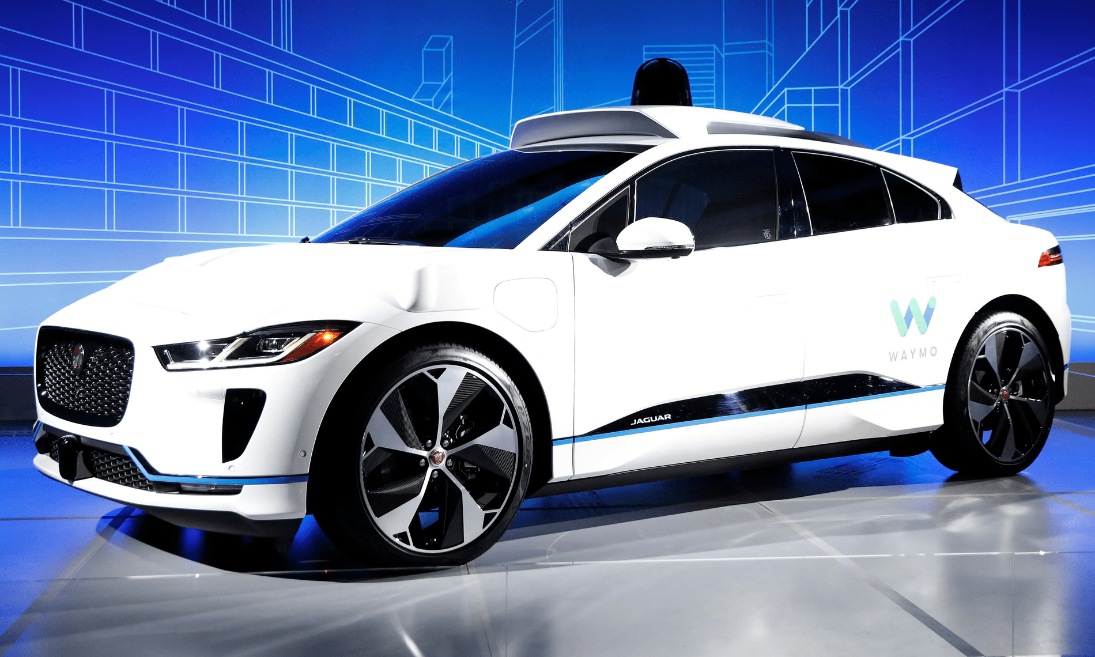
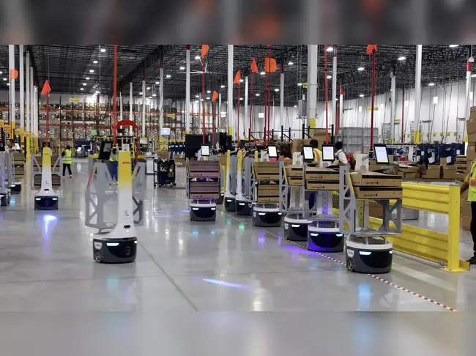
Introduction
Artificial Intelligence (AI) systems are increasingly used in autonomous decision-making

Slide 3
Introduction
Artificial Intelligence (AI) systems are increasingly used in autonomous decision-making
performance degrades with certain elements composing the environment

Slide 4
Introduction
Artificial Intelligence (AI) systems are increasingly used in autonomous decision-making
performance degrades with certain elements composing the environment
This preparatory work will investigate one of factor that impact the robustness of multi-agents reinforcement algorithm (MARL) through the Laser learning Envirement

Slide 5
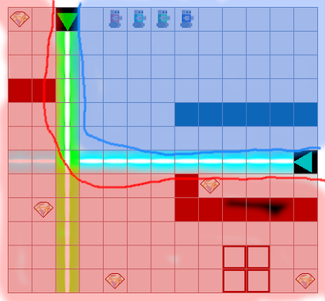
Problem Statement
MARL work well for cooperative multi-agents system while maintaining acceptable* horizontal scaling.
Some problem appear when specific obstacle appear causing agent to lock on a subset of the state space (aka state space bottleneck)

Slide 6
Problem Statement
MARL work well for cooperative multi-agents system while maintaining acceptable* horizontal scaling.
Some problem appear when specific obstacle appear causing agent to lock on a subset of the state space (aka state space bottleneck)
Goal:
  Try to reproduce state space bottleneck using a lift and lever in the LLE.

Slide 7
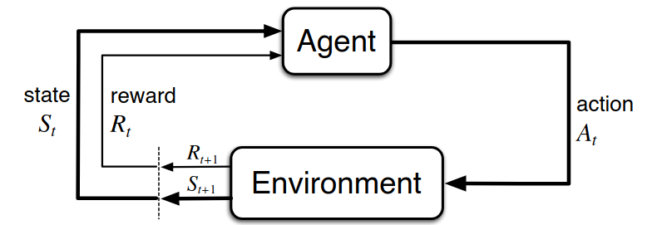
What is RL ?

Slide 8
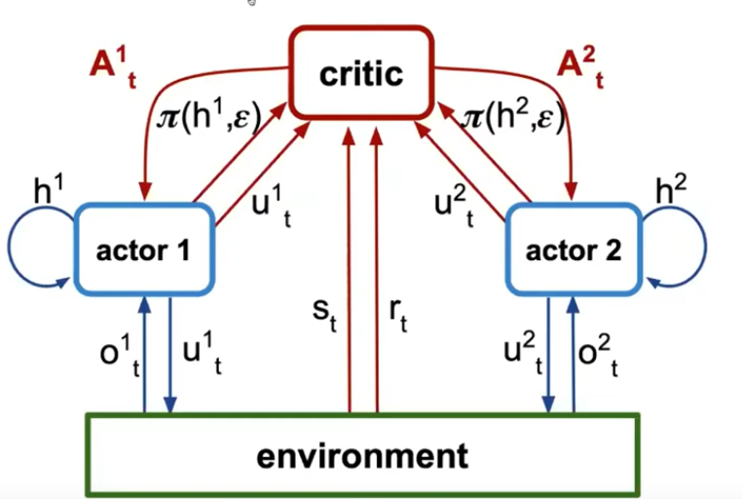
Centralize Training
Decentralize Execution
(CTDE)

Slide 9
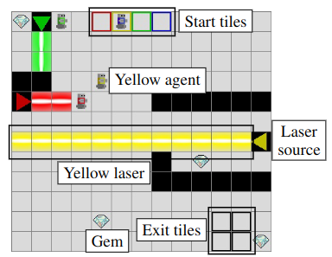
Environment
A 2D grid-based environment inspired by Oxen
Cooperative:
  Collect gems
  Avoid laser
  Reaching exit points
Designed to test MARL algorithm under coordination and cooperative setting.

Slide 10
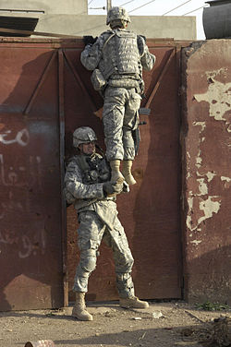
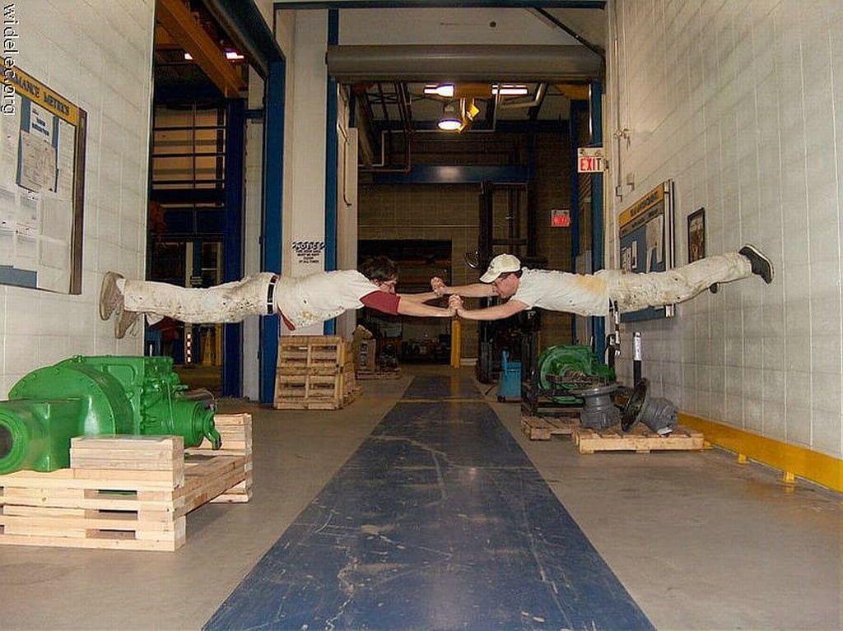
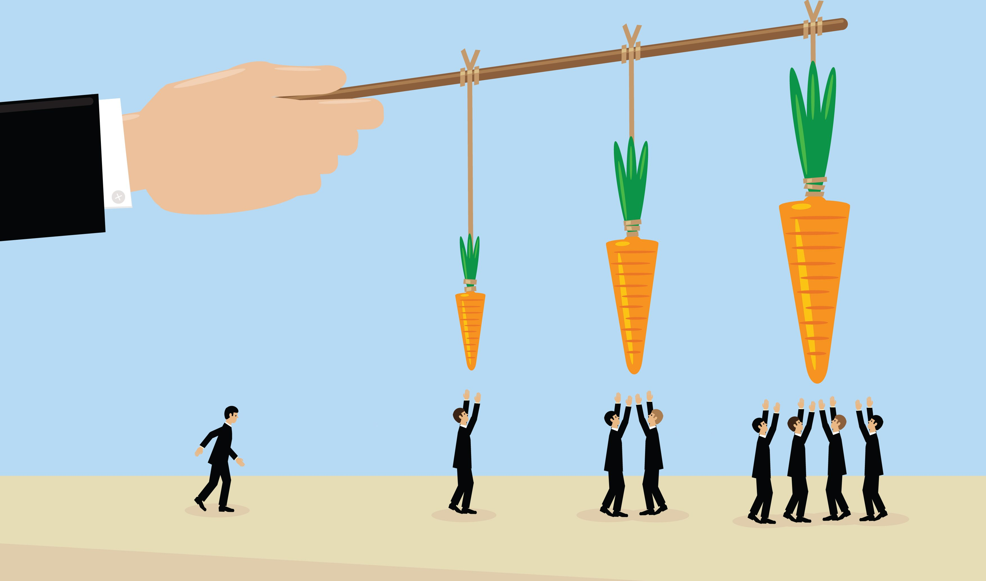
Particularity
Perfect Coordination
Zero-Incentive
Interdependence

Slide 11
Lifts and Levers
Lift:
  New tile type allowing vertical navigation in the environment.
  Lets agents access different layers of the grid.
Lever:
  Interactive tile that activates or deactivates lifts.
  Requires coordination among agents to enable passage.
Impact:
  Adds new strategic challenges and increases environment complexity.
  Purpose: Observe if any element can create a state space bottleneck if following the idea of Interdependence and zero-insensitive.

Slide 12
Research Questions
How does adding lifts to existing lasers influence bottleneck formation and evolution in LLE?
  What bottlenecks occur when only lasers are present?
  How do lifts modify bottleneck dynamics?
  How do MARL algorithms adapt to the modified environment?

Slide 13
Contributions
Enrich LLE toolkit for future experiment.
Extend multi-agent environments for MARL research.
Provide insights into robustness and bottleneck dynamics.

Slide 14
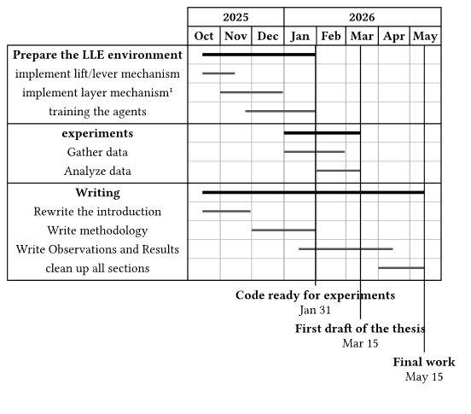
Time plan

Slide 15
Thank you !

