Slide 1
Methods of Artificial Intelligence for positional games
Student: Kochurkin Ivan (ICS-104)

Slide 2
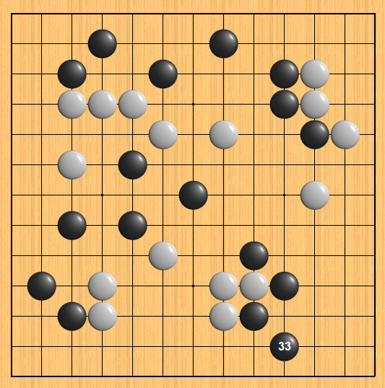
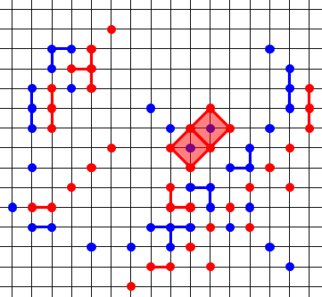
Introduction
“Go”
“Dots”
Go: capturing the territory.
Dots: capturing the dots.

Slide 3
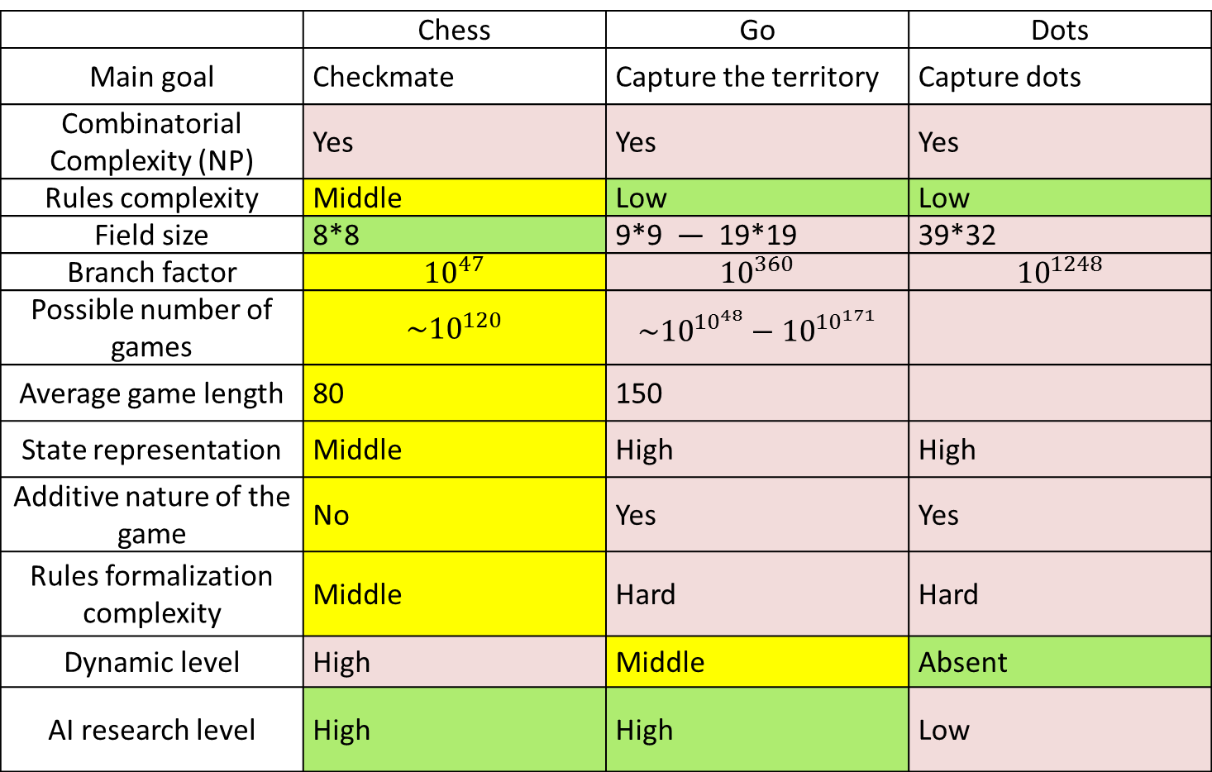
Analysis of Chess, Go and Dots
 | Chess | Go | Dots
Main goal | Checkmate | Capture the territory | Capture dots
Combinatorial Complexity (NP) | Yes | Yes | Yes
Rules complexity | Middle | Low | Low
Field size | 8*8 | 9*9 — 19*19 | 39*32
Branch factor | $${10}^{47}$$ | $${10}^{360}$$ | $${10}^{1248}$$
Possible number of games | $${\sim 10}^{120}$$ | $${\sim 10}^{{10}^{48}}−{10}^{{10}^{171}}$$
Average game length | 80 | 150
State representation | Middle | High | High
Additive nature of the game | No | Yes | Yes
Rules formalization complexity | Middle | Hard | Hard
Dynamic level | High | Middle | Absent
AI research level | High | High | Low

Slide 4
Tree Search
Minimax
MTD-f
Alpha-Beta
Negascout
Advantages:
Easy to implement.
Predictability of results.
Disadvantages:
Huge branch factor.
Hard to create efficient evaluation function.
Hard to create efficient moves generator.
Hard to realize efficient parallel algorithm.

Slide 5
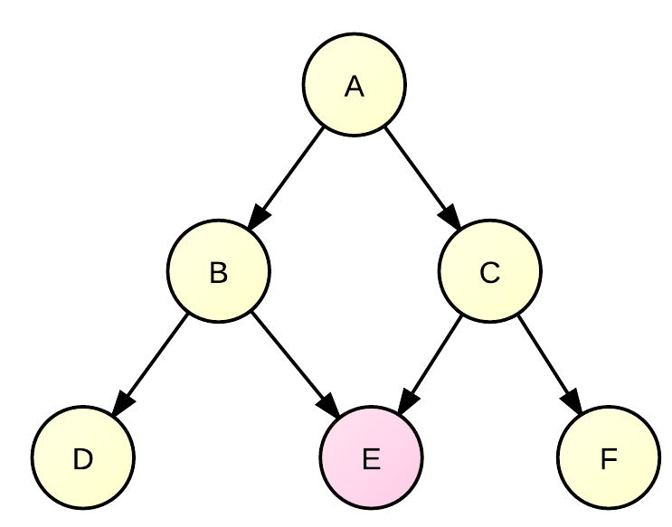
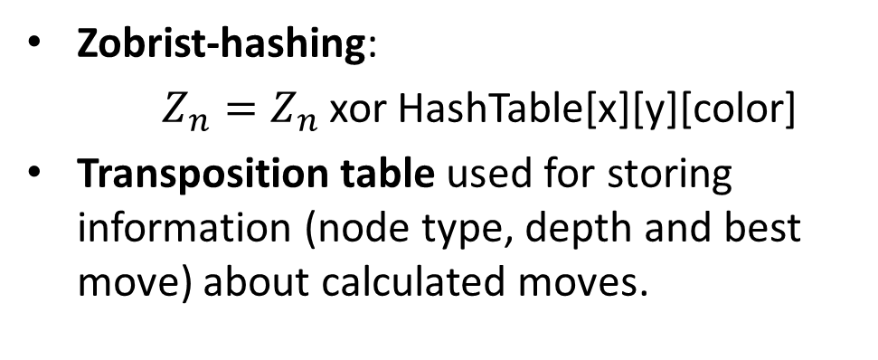
Caching and hashing
Zobrist-hashing:
$Z_{n}=Z_{n}$ xor HashTable[x][y][color]
Transposition table used for storing information (node type, depth and best move) about calculated moves.
Advantages of caching:
Game search tree collision minimization. Best for iterative algorithms.
Caching can be used not only for sequence of putted stones or dots but for group of stones and dots too.
Caching can be used in further calculations.
Disadvantages of caching:
Hard to determine errors.
Hard to realize tree parallel search algorithms with caching.

Slide 6
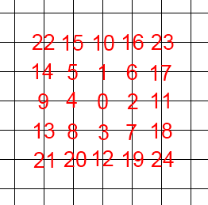
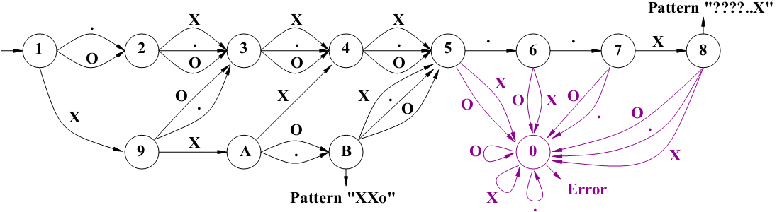
Knowledge-based systems
Pattern matching
Pattern recognition
Advantages:
High performance.
Global search.
Disadvantages:
Many experts or professional players are required for building knowledge base.
Hard to formalize expert knowledge.
Much time is required for building knowledge base.
Impossibility for deep search.

Slide 7
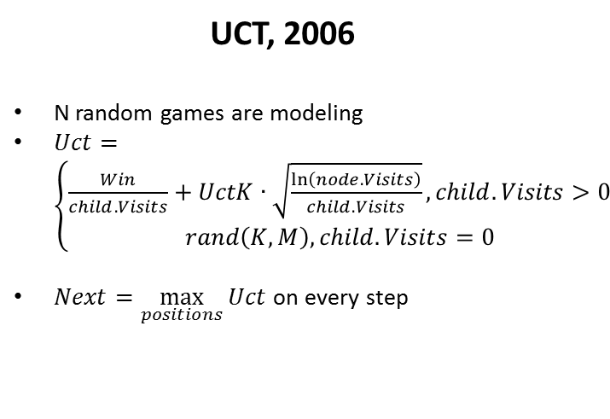
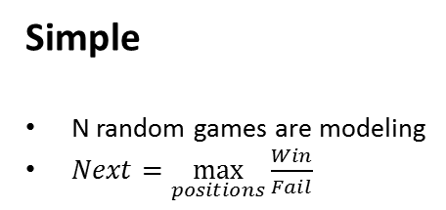
Monte-Carlo Methods
Simple
N random games are modeling
$Next=\max_{positions}{\frac{Win}{Fail}}$
UCT, 2006
N random games are modeling
$Uct=\left\{\begin{aligned}\frac{Win}{child.Visits}+UctK∙\sqrt{\frac{\ln\left(node.Visits\right)}{child.Visits}},child.Visits>0 \\ rand\left(K, M\right),child.Visits=0\end{aligned}\right.$
$Next=\max_{positions}{Uct}$ on every step
Advantages:
Easy to implement.
Simple to realize parallel algorithm.
Strategically search.
Many high-level go engines are using UCT.
Disadvantages:
Large computational resources are reqired for a good game.
Best results for small fields.

Slide 8

Current researches and conclusions
Hash table size efficiency. Optimal size is: ~$2^{20}$ elements.
Method UCT shows best results than Alpha-beta search for game “Dots”. The main problem of UCT is case of cascade attack-defense moves sequences (also called «ladder»).

Slide 9
Further plan of works and ideas
Tree search:
Modeling sequence of moves with one color and finding preliminary alpha-beta bounds, which further can be used in traditional tree search algorithms (Alpha-Beta or Negascout).
Modeling of cascade attack-defense moves sequences. It can help to solve some problems with UCT method.
Knowledge-based systems:
Pattern knowledge base for dots.
Pattern recognition in dots with DFA.
Monte-Carlo methods:
Calculating not all move sequence until the end, but calculating local sectors (such as groups connections).
«Smart» move generator (with patterns).
Research UCT method with different parameters.
General:
Try to develop method of dividing set of dots on disjoint trajectories.
Realize and explore all methods with combination of each other and different parameters.

