Slide 1
Score following
Student: Kochurkin Ivan (ICS-94)

Slide 2
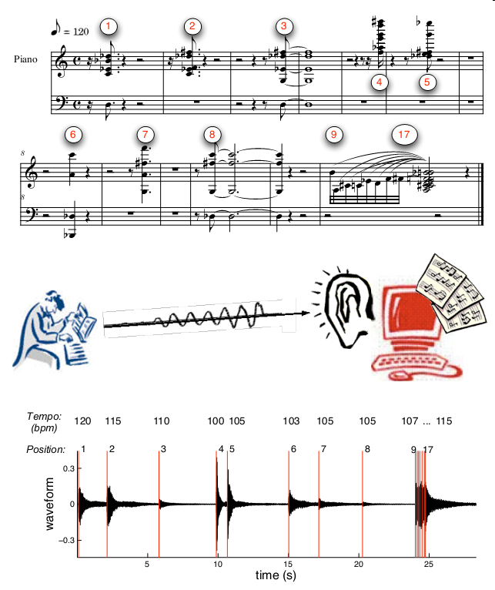
Main goal:
Developing system which would automatically listening to a live music and tracking position in the score
Importance:
Computer live assistant to musician
The way to automatic accompaniment

Slide 3
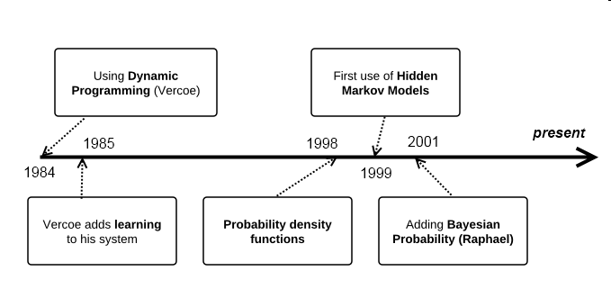
Research intro score following: a timeline

Slide 4
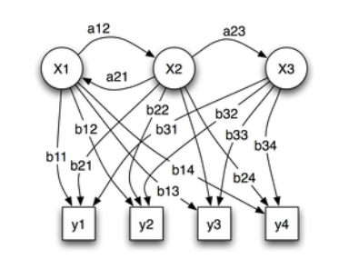
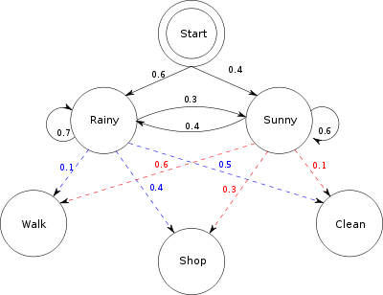
A Hidden Markov Model is a way of modeling real-world scenarios
x — states
y — possible observations
a — state transition probabilities
b — output probabilities

Slide 5

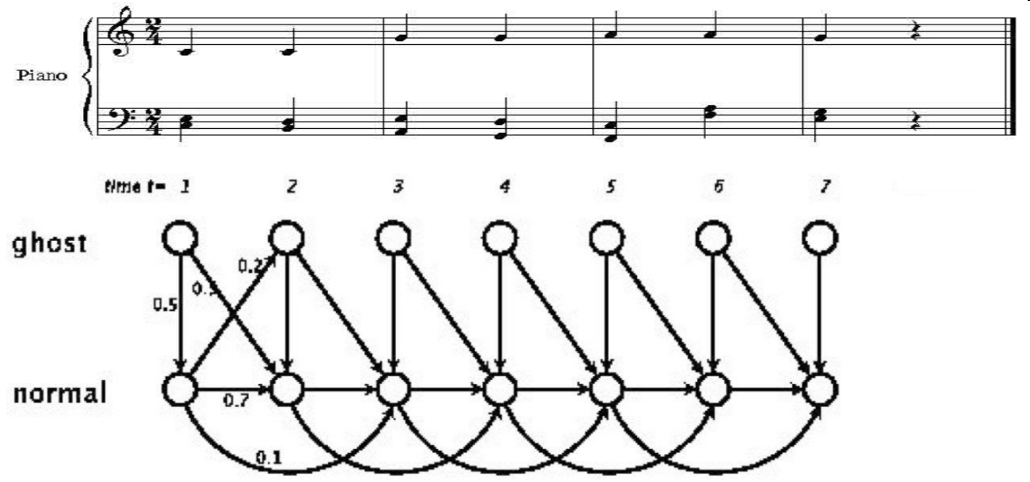
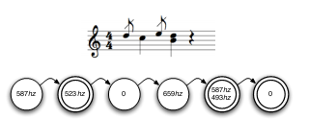
Score following can be done using a HMM
A music score can be divided into a sequence of events, such as
Notes, Beats, Cadences, Phrases, Chords, etc
Looking at the sequence
Matching that sequence

Slide 6
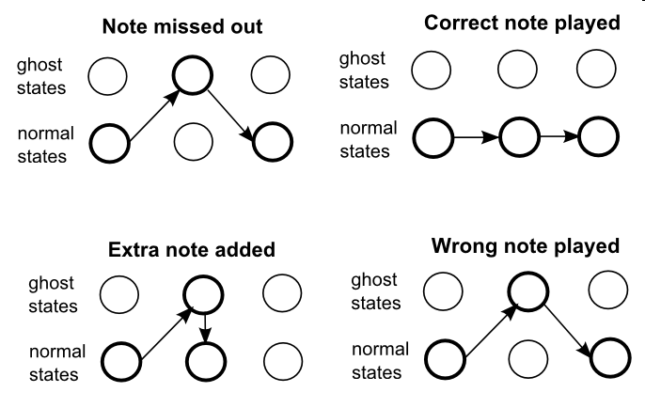
Normal and Ghost states

Slide 7
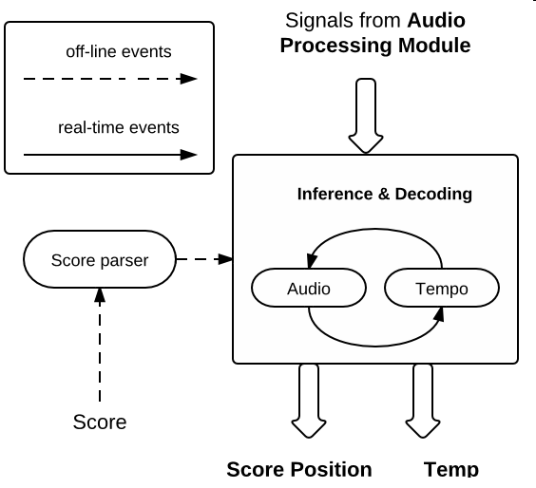
General Architecture

Slide 8
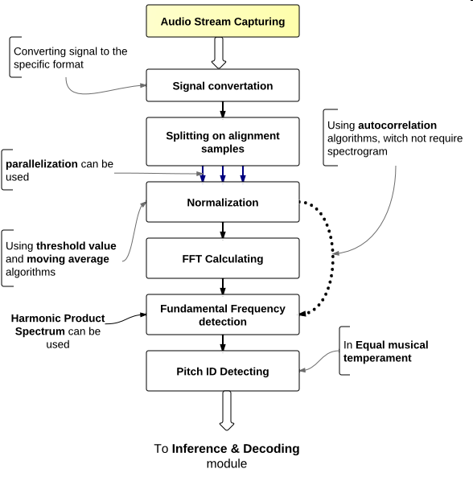
Audio processing module

Slide 9
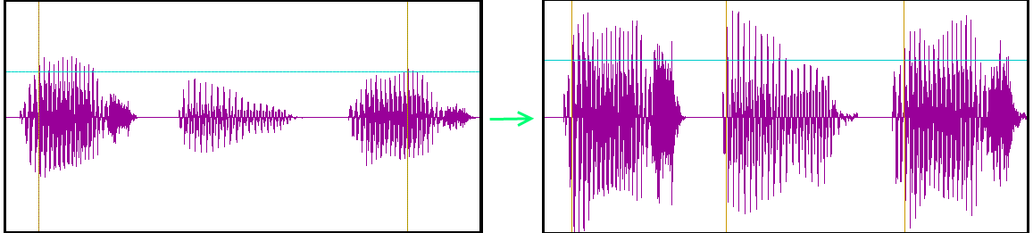

Signal normalization

Slide 10
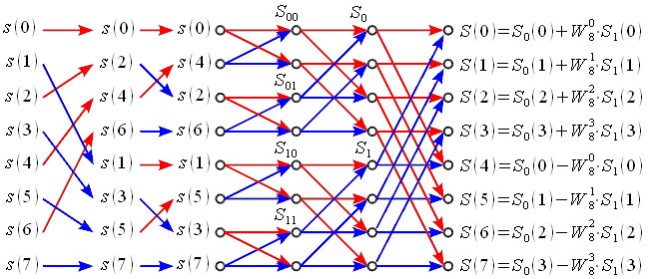
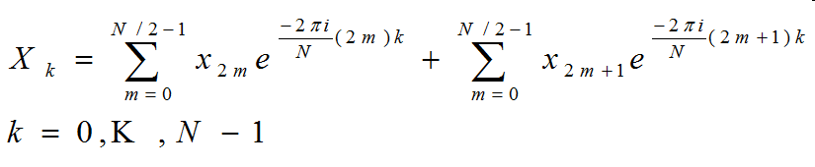
FFT

Slide 11
Summary
Today you’ve heard about:
Score following researches and problems
Score following can be implemented
using Hidden Markov Models (HMMs) to track what state a performer is in
Score following related algorithms
Score following system architecture

