Slide 1
Big Data Analytics
Assignment - 4
Abhishek Agarwal - 2016126
Kaustav Vats - 2016048

Slide 2
Learnings
Learnt how to apply PageRank algorithm
Various applications of PageRank
Shortcomings of PageRank
HITS algorithm and its applications
Learned about usage of graphFrames library and various api calls for graph like problems. Learned how to create graph and run various algorithms on the graph.
In this assignment, we learned how we can implement the HITS algorithm using Map-Reduce APIs present in the apache storm.
Most importantly we learned about, how various graph problems can be solved using libraries like GraphFrame, Networkx, etc.

Slide 3
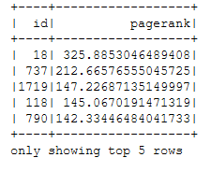
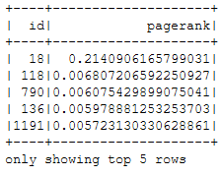
Results - 1
PageRank Results
SimRank Results

Slide 4
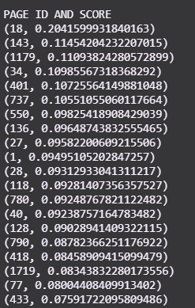
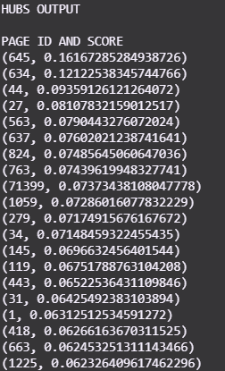
Results - 2 (HITS algorithm results)
Left
Top 20 result of HITS algorithm with ID and Authority Score in decreasing order.
Right
Top 20 result of HITS algorithm with ID and Hubs Score in decreasing order.
Top 5 Most trusted users are - 18, 143, 1179, 34, 401.

Slide 5
Challenges
Took some time to implement and understand all the resources mentioned online. Implementation of HITS algorithm using Map-Reduce.

Slide 6
References
https://graphframes.github.io/graphframes/docs/_site/api/python/graphframes.lib.html
HITS Algorithm Reference - https://raw.githubusercontent.com/jaimeps/hits-algorithm/master/spark/hits_spark.py

