Slide 1
Prairie Plot
Oak Savanna Plot
Temperate Forest
Plot Pair
AM- associated Vegetation
EcM- associated Vegetation
Grasses
Trees

Slide 2
Site | Latitude | Longitude | Soil Description | Mycorrhizal Setting | Common Plant Species | pH | Soil Water Content (%)
Prairie | 45°26ʹ N 45°24ʹ N 45°23ʹ N | 93°11ʹ W 93°12ʹ W 93°10ʹ W | Outwash derived entisols with a fine sand texture. | AM | Agropyron repens, Calamagrostis Canadensis, Poa pratensis, Andropogon gerardi, and Schiacharium scoparium | 4.84 ± 0.02 | 13.4 ± 0.3 (VWC)
 |  |  |  | EcM | Helianthemum bicknellii | 4.97 ± 0.04 | 12.7 ± 0.3 (VWC)
Oak Savanna | 45°41’ N | 93°18’ W |  | AM | Poa spp. Ambrosia sp. Agropyron sp. | 5.25 ± 0.03 | 10.1 ± 0.5
 |  |  |  | AM | Poa sp., Ambrosia sp., and Agropyron sp. | 5.25 ± 0.03 | 10.1 ± 0.5 (GWC)
 |  |  |  | EcM | Quercus ellipsoidalis Quercus macrocarpa | 4.34 ± 0.04 | 11.1 ± 0.4 (GWC)
Temperate Forest | 39°05ʹ N | 86°28ʹ W | Sandstone derived inceptisols with a silty loam texture | AM | Acer saccharum, Liriodendron tulipifera, Prunus serotina and Sassafras albidu | 4.66 ± 0.1 | 8.44 ± 0.4 (VWC)
 |  |  |  | EcM | Quercus rubra. Quercus velutina, Quercus alba Carya glabra and Fagus grandifolia | 3.42 ± 0.02 | 5.16 ± 0.4 (GWC)

Slide 3
Table 2: ANOVA results for Mass Remaining
 | Prairie |  |  |  | Oak Savanna |  |  |  | Temperate Forest
Fixed Effect Terms | Num DF | Den DF | F | P | Num DF | Den DF | F | P | Num DF | Den DF | F | P
Mycorrhizal Association | 1 | 47 | 0.681 | 0.413 | 1 | 29 | 0.098 | 0.756 | 1 | 68 | 1.18 | 0.281
Necromass Species | 1 | 45 | 20.3 | <0.001 | 1 | 29 | 53.0 | <0.001 | 1 | 62 | 125 | <0.001
Incubation Period | 1 | 16 | 54.3 | <0.001 | 3 | 29 | 32.5 | <0.001 | 2 | 64 | 51.3 | <0.001
Soil Moisture | - | - | - | - |  | 29 | 0.783 | 0.385 | 1 | 60 | 1.65 | 0.204
Myc Assoc x Necro Sp | 1 | 45 | 0.25 | 0.620 | 1 | 29 | 0.000 | 0.998 | 1 | 62 | 0.210 | 0.649
Myc Assoc x Incub Period | 1 | 47 | 0.010 | 0.923 | 3 | 29 | 0.223 | 0.879 | 2 | 63 | 0.336 | 0.716
Necro Sp x Incub Period | 1 | 45 | 0.125 | 0.730 | 3 | 29 | 2.672 | 0.066 | 2 | 62 | 17.3 | <0.001
Myc Assoc x Necro Sp x Incub Period | 1 | 45 | 0.195 | 0.661 | 3 | 29 | 1.232 | 0.315 | 2 | 62 | 0.61 | 0.546

Slide 4
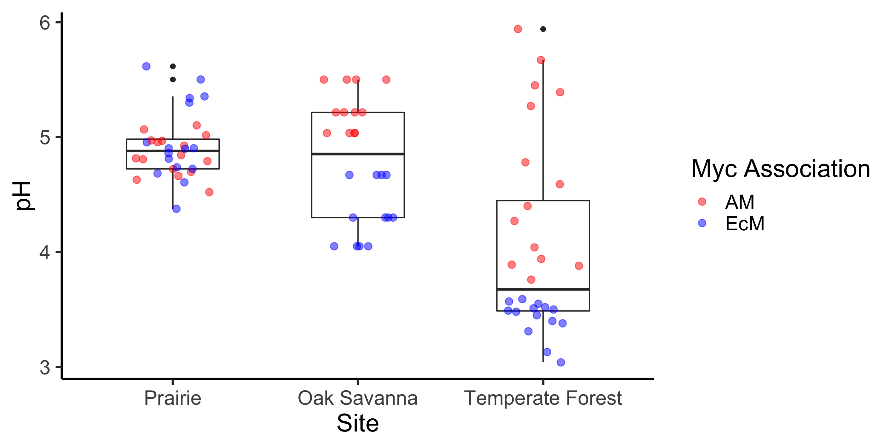

Slide 5
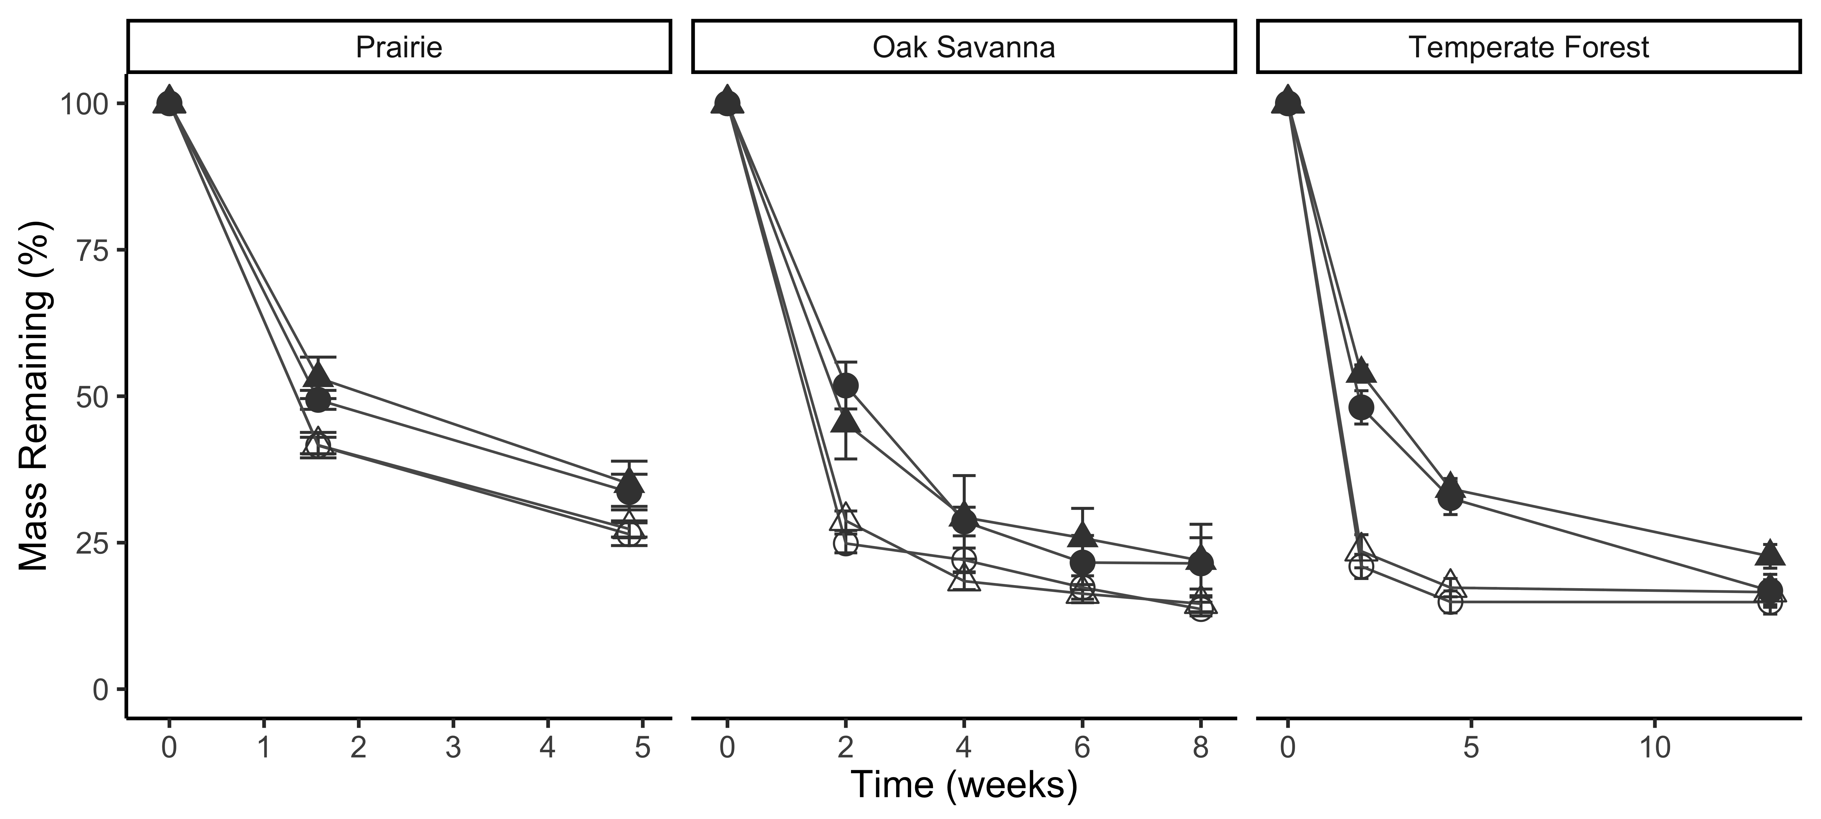


Mass Remaining by Site- Excluding Prairie Experiment 1
M. bicolor – AM veg
M. bicolor – EcM veg
M. elongata – AM veg
M. elongata – EcM veg
*
*
*
*

Slide 6
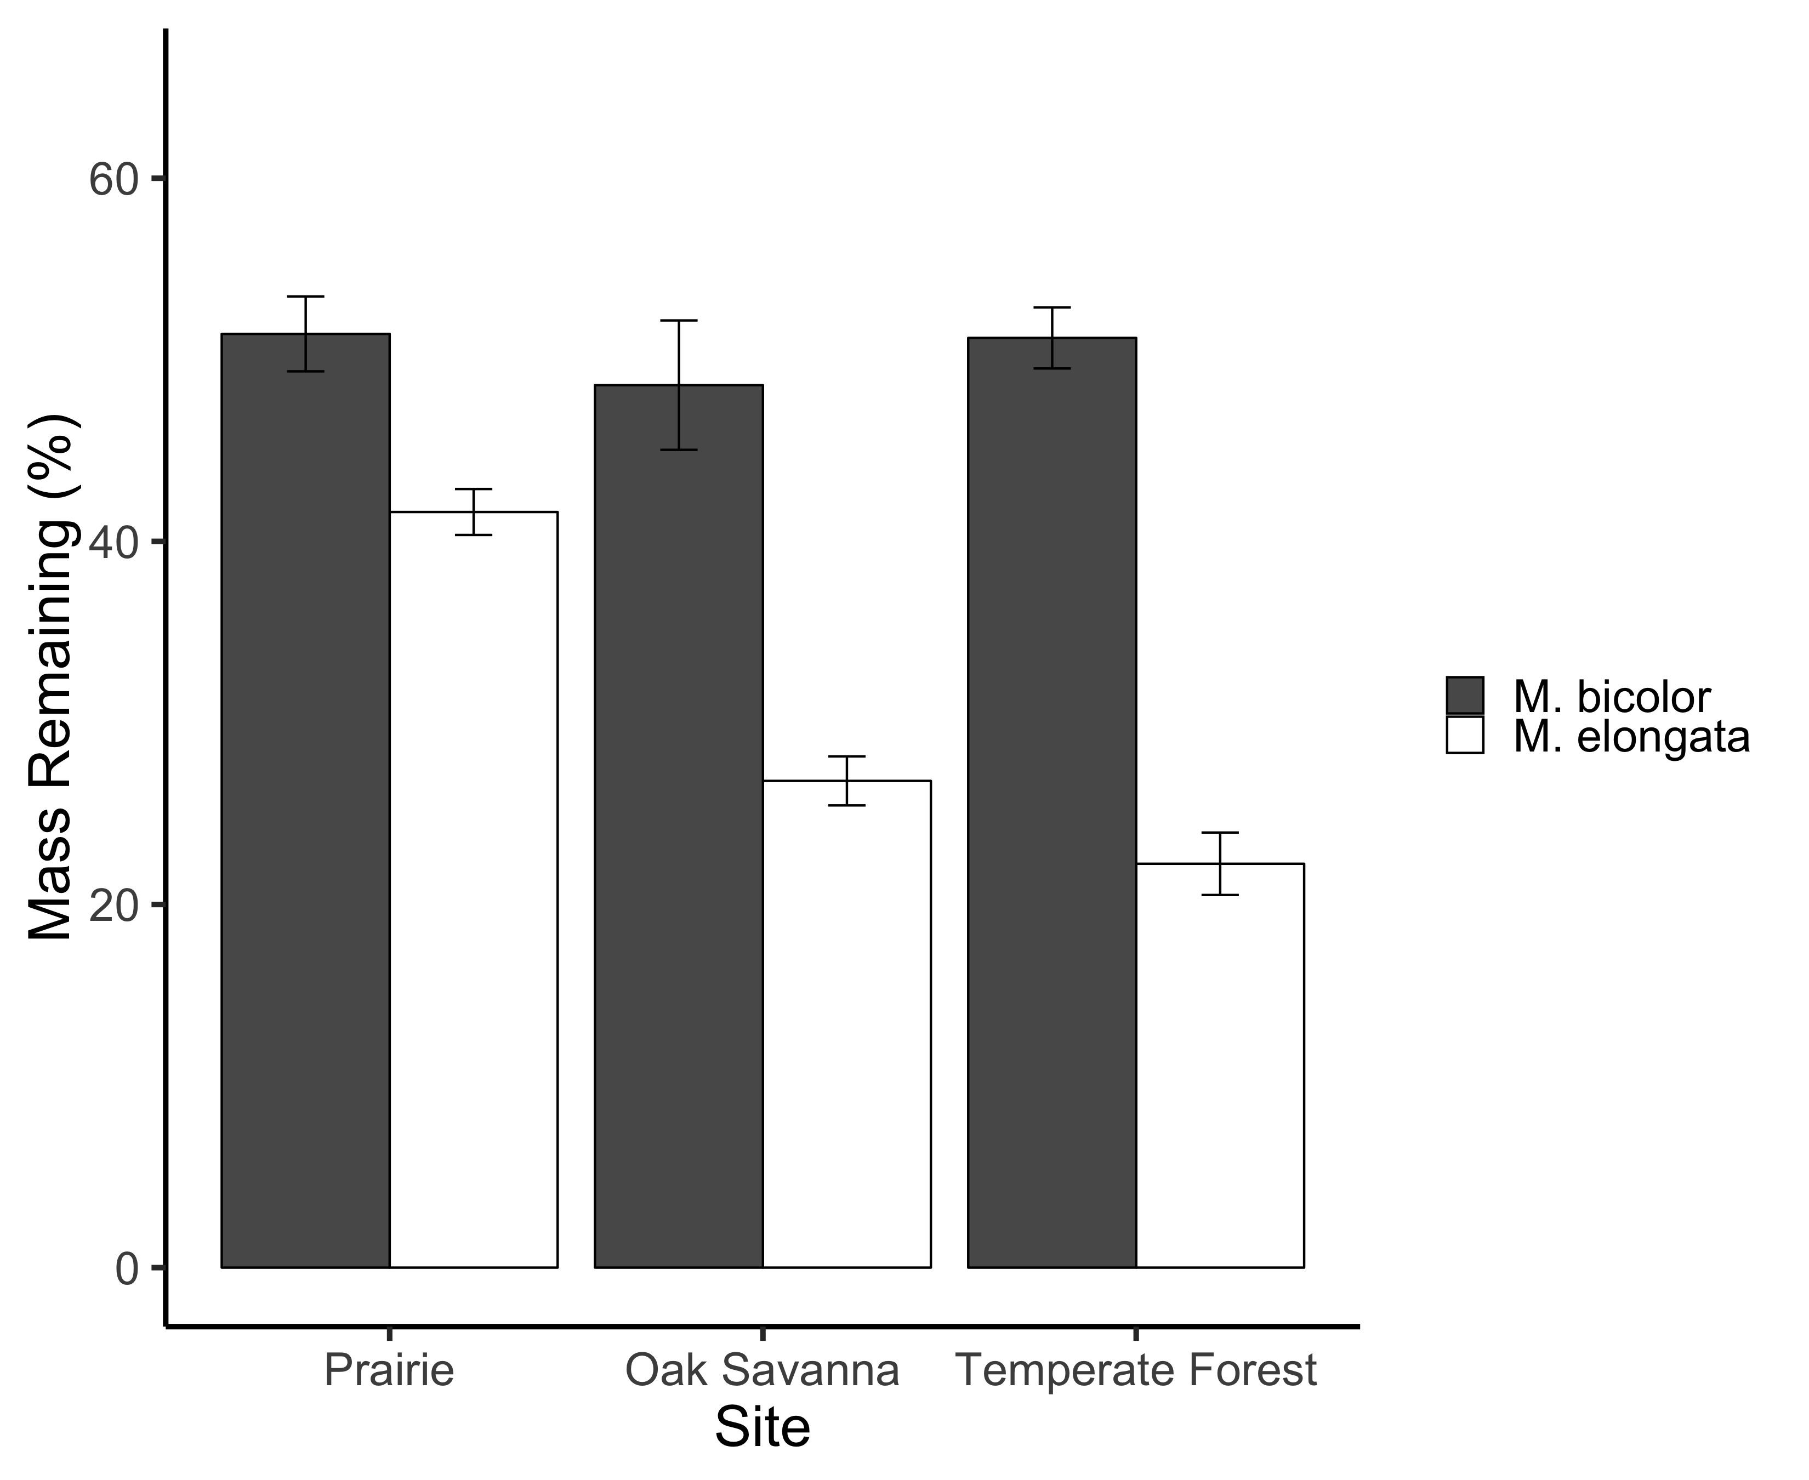

Slide 7
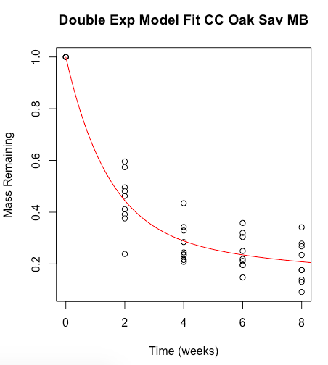
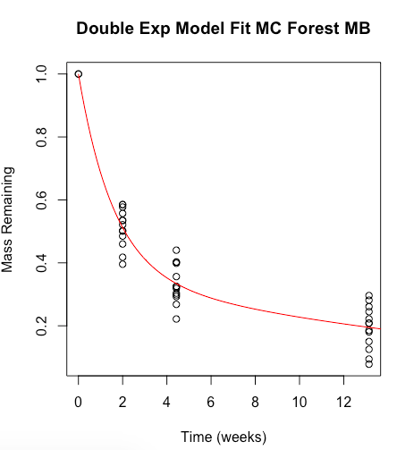
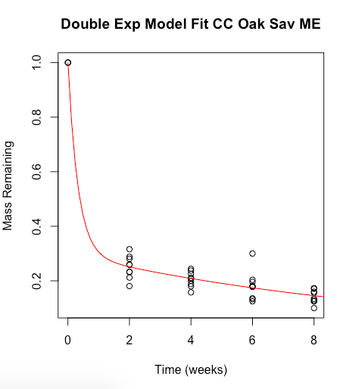
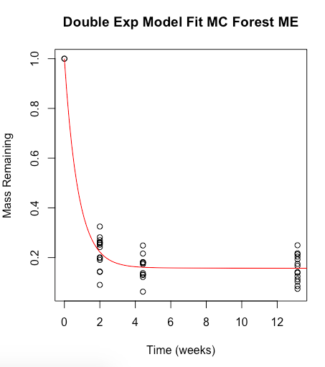
Oak Savanna
Temperate Forest
K¹ = 0.68 ± 0.26
K¹ = 0.63 ± 0.13
K² = 0.042 ± 0.09
K² = 0.047 ± 0.02
M. bicolor
M. bicolor
Mass Remaining
K¹ = 3.07 ± 9.14
K¹ = 1.29 ± 0.20
K² = 0.090 ± 0.03
K² = 0.0009 ± 0.016
M. elongata
M. elongata
Time (weeks)

Slide 8
Site | Fungal Necromass Species | K¹ (weeks) | K² (weeks)
Oak Savanna | M. elongata | 3.07 ± 9.14 | 0.090 ± 0.03
 | M. bicolor | 0.68 ± 0.26 | 0.042 ± 0.09
Temperate Forest | M. elongata | 1.29 ± 0.20 | 0.0009 ± 0.016
 | M. bicolor | 0.63 ± 0.13 | 0.047 ± 0.02

