Slide 1
Spring Boot
Spring Boot makes it easy to create stand-alone, production-grade Spring based Applications that you can "just run".

Slide 2
Spring Boot
Spring Boot makes it easy to create stand-alone, production-grade Spring based Applications that you can "just run".
Spring Boot take an opinionated view of the Spring platform and third-party libraries so you can get started with minimum fuss.
Most Spring Boot applications need minimal Spring configuration.

Slide 3
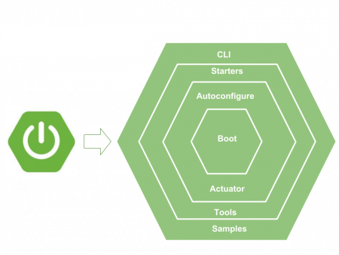
Spring Boot
Spring Boot is a Spring framework module which provides RAD (Rapid Application Development) feature to the Spring framework.
It is highly dependent on the starter templates feature which is very powerful and works flawlessly.

Slide 4
Spring Boot - Features
Create stand-alone Spring applications
Embed Tomcat, Jetty or Undertow directly (no need to deploy WAR files)
Provide opinionated 'starter' dependencies to simplify your build configuration
Automatically configure Spring and 3rd party libraries whenever possible
Provide production-ready features such as metrics, health checks, and externalized configuration
Absolutely no code generation and no requirement for XML configuration

Slide 5
What is spring-boot-starter-parent dependency?
The spring-boot-starter-parent dependency is the parent POM providing dependency and plugin management for Spring Boot-based applications.
It contains the default versions of Java to use, the default versions of dependencies that Spring Boot uses, and the default configuration of the Maven plugins.

Slide 6
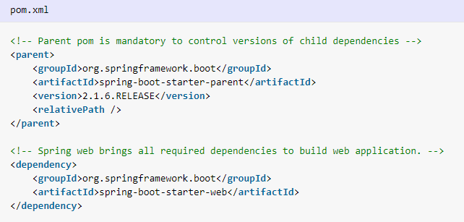
Starter Template

Slide 7
Starter Template
With the exponential increase in number of libraries and their dependencies, dependency management was becoming very complex task which required good amount of technical expertise to do it correctly.
With the introduction of String boot starter templates, you can get a lot of help in identifying the correct dependencies to use in project if you want to use any popular library into your project.

Slide 8
Starter Template
Spring Boot comes with over 50+ different starter modules, which provide ready-to-use integration libraries for many different frameworks
Such as database connections that are both relational and NoSQL, web services, social network integration, monitoring libraries, logging, template rendering, and the list just keeps going on.

Slide 9
How starter template work?
Spring Boot starters are templates that contain a collection of all the relevant transitive dependencies that are needed to start a particular functionality.
Each starter has a special file, which contains the list of all the provided dependencies Spring provides.
These files can be found inside pom.xml files in respective starter module. e.g.
The spring-boot-starter-data-jpa starter

Slide 10
How starter template work?
This tells us that by including spring-boot-starter-data-jpa in our build as a dependency, we will automatically get spring-orm, hibernate-entity-manager and spring-data-jpa.
These libraries will provide us all basic things to start writing JPA/DAO code .

Slide 11
Popular templates and their transitive dependencies
Name | Description
spring-boot-starter | Core starter, including auto-configuration support, logging
spring-boot-starter-aop | Starter for aspect-oriented programming with Spring AOP and AspectJ
spring-boot-starter-data-jdbc | Starter for using Spring Data JDBC
spring-boot-starter-data-jpa | Starter for using Spring Data JPA with Hibernate
spring-boot-starter-security | Starter for using Spring Security
spring-boot-starter-test | Starter for testing Spring Boot applications with libraries including JUnit, Hamcrest and Mockito
spring-boot-starter-validation | Starter for using Java Bean Validation with Hibernate Validator
spring-boot-starter-web | Starter for building web, including RESTful, applications using Spring MVC. Uses Tomcat as the default embedded container

Slide 12
@SpringBootApplication
Spring boot is mostly about auto-configuration.
This auto-configuration is done by component scanning i.e. finding all classes in classspath for @Component annotation.
It also involve scanning of @Configuration annotation and initialize some extra beans.
@SpringBootApplication annotation enable all able things in one step. It enables the three features:
@EnableAutoConfiguration : enable auto-configuration mechanism
@ComponentScan : enable @Component scan
@SpringBootConfiguration : register extra beans in the context

Slide 13
Spring Boot Autoconfiguration
Autoconfiguration is enabled with @EnableAutoConfiguration annotation.
Spring boot auto configuration scans the classpath, finds the libraries in the classpath.
And then attempt to guess the best configuration for them, and finally configure all such beans.

Slide 14
Spring Boot Autoconfiguration
Auto-configuration tries to be as intelligent as possible and will back-away as you define more of your own configuration.
Spring boot auto-configuration logic is implemented in spring-boot-autoconfigure.jar
Behind the scene, this automatic start, load and wire are based on the conditional matches.

Slide 15
Auto-configuration Classes
The following auto-configuration classes are from the spring-boot-autoconfigure module
https://docs.spring.io/spring-boot/docs/current/reference/html/appendix-auto-configuration-classes.html

Slide 16
Externalized Configuration
Spring Boot lets you externalize your configuration so that you can work with the same application code in different environments.
You can use properties files, YAML files, environment variables, and command-line arguments to externalize configuration.
Property values can be injected directly into your beans by using the @Value annotation, accessed through Spring’s Environment abstraction, or be bound to structured objects through @ConfigurationProperties.

Slide 17
@ConfigurationProperties
@ConfigurationProperties allows to map the entire Properties and Yaml files into an object easily.
By default, the annotation reads from the application.properties file.
The source file can be changed with @PropertySource annotation.

Slide 18
Accessing Command Line Properties
By default, SpringApplication converts any command line option arguments (that is, arguments starting with --, such as --server.port=9000) to a property and adds them to the Spring Environment.
As mentioned previously, command line properties always take precedence over other property sources.
--jas.teamLeader="New Team Lead"

Slide 19
Application Property Files
SpringApplication loads properties from application.properties files in the following locations and adds them to the Spring Environment
A /config subdirectory of the current directory
The current directory
A classpath /config package
The classpath root

Slide 20
PropertySource Abstraction
A PropertySource is a simple abstraction over any source of key-value pairs
Spring’s StandardEnvironment is configured with two PropertySource objects
one representing the set of JVM system properties (System.getProperties())
one representing the set of system environment variables (System.getenv()).

Slide 21
@PropertySource Annotation
The @PropertySource annotation provides a convenient and declarative mechanism for adding a PropertySource to Spring’s Environment.

Slide 22
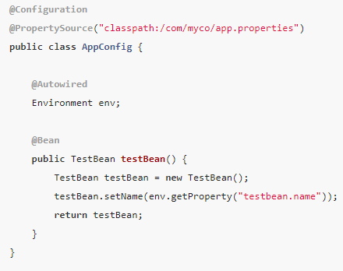
@PropertySource Annotation
Given a file called app.properties that contains the key-value pair testbean.name=myTestBean the following @Configuration class uses @PropertySource in such a way that a call to testBean.getName() returns myTestBean

Slide 23
Using the ApplicationRunner or CommandLineRunner
If you need to run some specific code once the SpringApplication has started, you can implement the ApplicationRunner or CommandLineRunner interfaces.
Both interfaces work in the same way and offer a single run method, which is called just before SpringApplication.run(…​) completes.

Slide 24
Using the ApplicationRunner or CommandLineRunner
The CommandLineRunner interfaces provides access to application arguments as a string array.
The ApplicationRunner uses the ApplicationArguments interface

Slide 25
Accessing Application Arguments
If you need to access the application arguments that were passed to SpringApplication.run(…​), you can inject a org.springframework.boot.ApplicationArguments bean.
The ApplicationArguments interface provides access to both the raw String[] arguments as well as parsed option and non-option arguments

Slide 26
Accessing Application Arguments
ApplicationArguments distinguish between option arguments and non-option arguments.
Option arguments are the one we can use via the Spring Boot property handling (starting with -- like --app.name=Myapp) .
They can also contain multiple values per option either by passing in a comma-separated list or using the argument multiple times.
Non-option arguments are all others we pass at the command line, except VM parameters.

Slide 27
Accessing Application Arguments
Non-option arguments are reteieved via getNonOptionArgs() as a List of Strings.
For option arguments, we can receive the option name via getOptionNames and the actual values via getOptionValues, which will return a List of Strings.

