Slide 1
Web Services

Slide 2
Web Services
Any piece of software that makes itself available over the internet via a standard protocol or messaging system.
Available over the internet.
Uses a standardized messaging system.
It’s not tied to any operating system or programming language.
It’s self-describing via a common grammar.
It’s discoverable via a simple find mechanism.

Slide 3
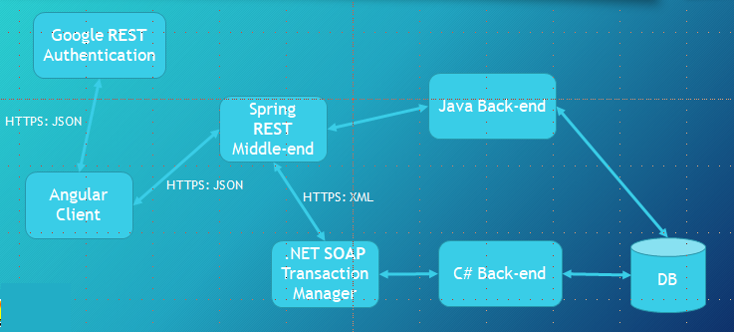
Architecture Example

Slide 4
Why do we use them?
Interoperability.
Make applications platform and technology independent.
Standardized media types.
XML, JSON, HTML.
Low cost of communication and delivery.
HTTP, HTTPS (REST).
HTTP, HTTPS, FTP and SMTP (SOAP).
Code reusability.
Connect other technologies to your existing one.
Distributed business applications.
Make your business system decoupled.

Slide 5
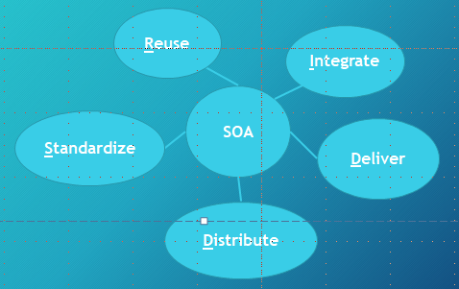
Service Oriented Architecture (SOA)
Web services are an implementation of SOA.

Slide 6
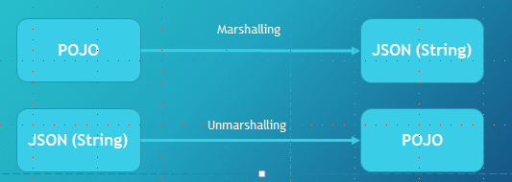
Marshalling
Process of transforming an object into a compatible version to be transmitted through the network.

Slide 7
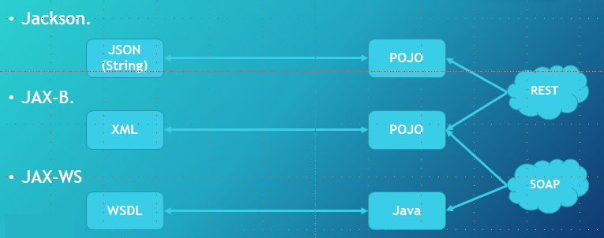
JAX-B, JAX-WS, Jackson

Slide 8
Representational State Transfer (REST)
Web Service that follows the Service Oriented Architecture standard and uses HTTP as its main protocol.
Introduced by Roy Fielding in the 2000s.
It supports JSON and XML for data transmission (representational).
Everything is considered a resource (state).
Objects are transmitted with the use of HTTP methods (transfer).
Endpoints are classified by URIs, which provide the resources.

Slide 9
HTTP Methods
POST
Used to create a new resource. (Most used.)
GET
Read only operations on resources.
DELETE
Removal of resources.
PUT
Used to update a resource.
OPTIONS
Used to get supported operations on a resource.
HEAD
Used to send and get only head messages.
PATCH
Used to partially update a resource to consume less bandwidth.

Slide 10
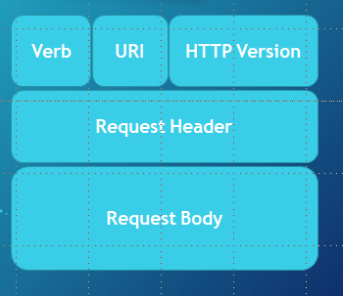
REST Message - Request
HTTP Request
Verb
Indicates the executing HTTP method.
URI
Specifies the endpoint where resource is located.
HTTP Version.
Request Header
META-DATA (information) of the Request as key-value pairs such as: format supported by client, browser type, etc.
Request Body
Message content or resource representation.

Slide 11
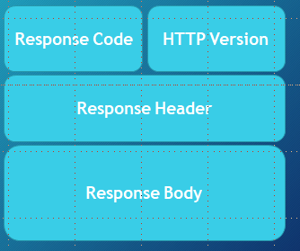
REST Message - Response
HTTP Response
Response Code
200 (OK), 403 (Forbidden), 404 (Not Found), 500 (Internal Error), etc.
HTTP Version.
Response Header
META-DATA for the Response such as: content length, content type, date, etc.
Response Body
Resource representation.

Slide 12
Spring REST
Spring’s solution for RESTful web services.
Included as part of MVC.
Change @Controller for @RestController.
Once you do so: @ResponseBody is not needed anymore.
If your controller method returns an object is going to implicitly be marshalled.
Jackson or JAX-B marshalling tool still needs to be provided as a Maven dependency.

Slide 13
REST: Exception Handling (Spring)
Response Entity
new ResponseEntity<Customer>(HttpStatus.NOT_FOUND).
@ResponseStatus
On top of a custom exception.
@ResponseStatus(value=HttpStatus.NOT_FOUND, reason=“Message”).
@ExceptionHandler
On top of a method that is going to handle the exception.
@ExceptionHandler(CustomException.class).
It can also be done globally in a separate class which uses @ControllerAdvice

Slide 14
@RestController
The @RestController annotation was introduced in Spring 4.0 to simplify the creation of RESTful web services.
It's a convenience annotation that combines @Controller and @ResponseBody –
Eliminates the need to annotate every request handling method of the controller class with the @ResponseBody annotation.

Slide 15
@RequestBody
@RequestBody annotation binds request body to method parameters.
The process of serialization/deserialization is performed by HttpMessageConverter.

Slide 16
@ResponseBody
@ResponseBody is a Spring annotation which binds a method return value to the web response body.
It is not interpreted as a view name.
It uses HTTP Message converters to convert the return value to HTTP response body, based on the content-type in the request HTTP header.

Slide 17
ResponseEntity
ResponseEntity represents the whole HTTP response: status code, headers, and body.
As a result, we can use it to fully configure the HTTP response.
ResponseEntity represents an HTTP response, including headers, body, and status.
While @ResponseBody puts the return value into the body of the response, ResponseEntity also allows us to add headers and status code.

Slide 18
@RequestParams
@RequestParams extract values from the query string, @PathVariables extract values from the URI path

Slide 19
@ControllerAdvice
@ControllerAdvice is an annotation provided by Spring allowing you to write global code that can be applied to a wide range of controllers
By default, @ControllerAdvice will apply to all classes that use the @Controller annotation (which extends to classes using @RestController).

Slide 20
@ExceptionHandler
@ExceptionHandler allows you to define a method that, as the name suggests, handles exceptions.
If you weren’t using @ControllerAdvice , the code for handling these exceptions would be in the controllers themselves,
which could add quite a bit of duplication and clutter to the class and leading to it not being as “clean”.
Using @ControllerAdvice along with @ExceptionHandler provides global (and more specific) error handling
so you don’t need to remember to implement them yourself or extend another class every time.

Slide 21
@CrossOrigin
CORS (Cross-origin resource sharing) allows a webpage to request additional resources into browser from other domains
e.g. fonts, CSS or static images from CDN.
CORS helps in serving web content from multiple domains into browsers

Slide 22
Spring Security

Slide 23
Spring Security Model
Spring Security defines a framework for security
Implemented using Servlet filters in the background
Two methods of securing a Web app: declarative and programmatic

Slide 24
Spring Security with Servlet Filters
Servlet Filters are used to pre-process / post-process web requests
Servlet Filters can route web requests based on security logic
Spring provides a bulk of security functionality with servlet filters

Slide 25
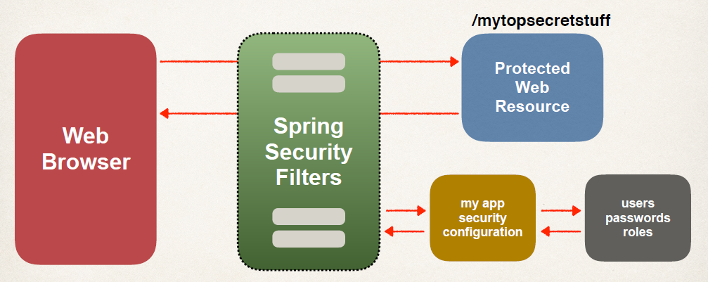
Spring Security Overview

Slide 26
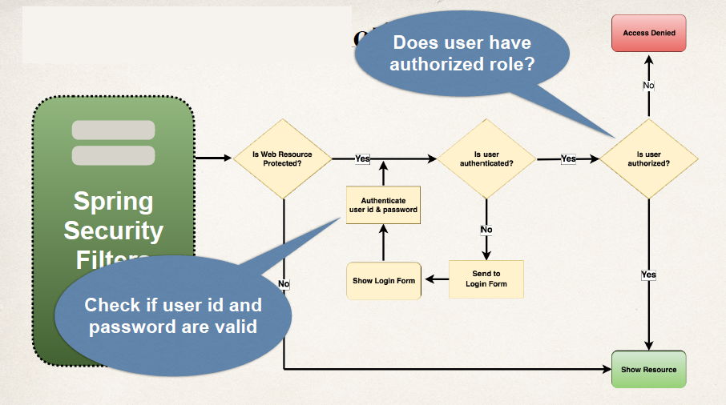
Spring Security in Action

Slide 27
Security Concepts
Authentication
Check user id and password with credentials stored in app / db
Authorization
Check to see if user has an authorized role

Slide 28
Declarative Security
Define application’s security constraints in configuration
All Java config (@Configuration, no xml)
Spring XML config
Provides separation of concerns between application code and security

Slide 29
Programmatic Security
Spring Security provides an API for custom application coding
Provides greater customization for specific app requirements

Slide 30
Different Login Methods
HTTP Basic Authentication
Default login form
Spring Security provides a default login form
Custom login form
your own look-and-feel, HTML + CSS

Slide 31
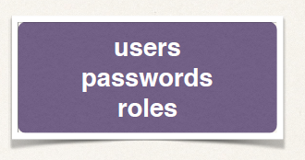
Authentication and Authorization
In-memory
JDBC
LDAP
Custom / Pluggable
others …

Slide 32
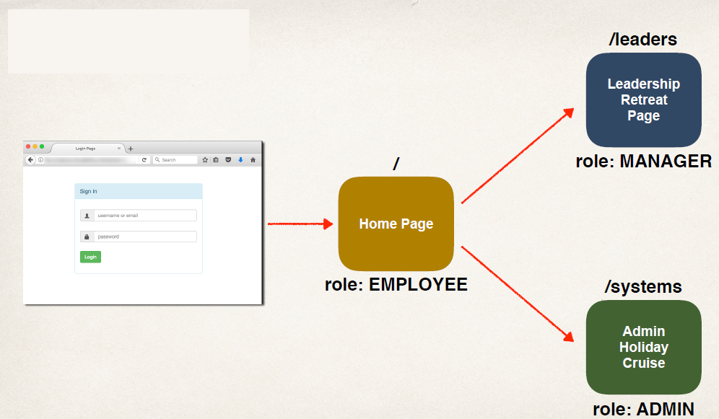
Our Example

Slide 33
Scheduling
To schedule job in spring boot application to run periodically, spring boot provides @EnableScheduling and @Scheduled annotations.
Add @EnableScheduling annotation to your spring boot application class.
@EnableScheduling is a Spring Context module annotation.
It internally imports the SchedulingConfiguration via the @Import(SchedulingConfiguration.class) instruction

Slide 34
Scheduling
Scheduling a Task with Fixed Rate
Scheduling a Task with Fixed Delay
Scheduling a Task With Fixed Rate and Initial Delay
Scheduling a Task using Cron Expression

