Slide 1
Hibernate Overview

Slide 2
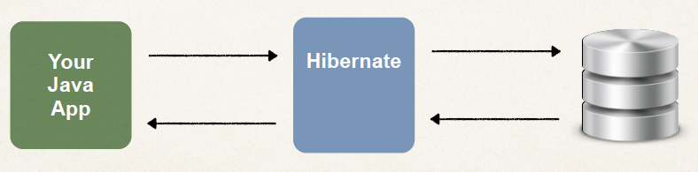
What is Hibernate?
A framework for persisting / saving Java objects in a database
www.hibernate.org

Slide 3
Benefits of Hibernate
Hibernate handles all of the low-level SQL
Minimizes the amount of JDBC code you have to develop
Hibernate provides the Object-to-Relational Mapping (ORM)

Slide 4
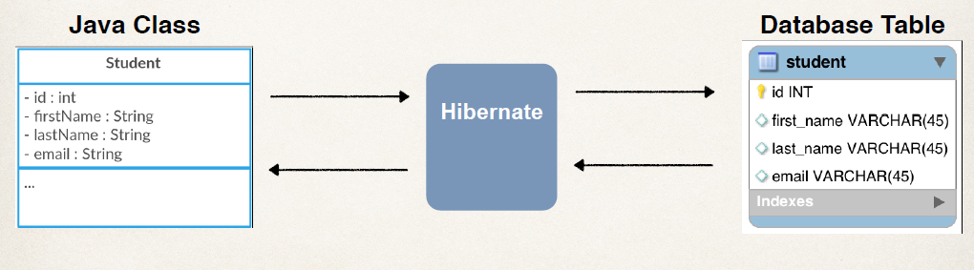
Object-To-Relational Mapping (ORM)
The developer defines mapping between Java class and database table

Slide 5
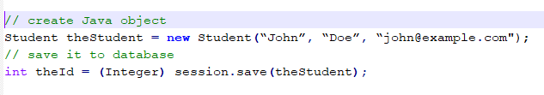
Saving a Java Object with Hibernate

Slide 6
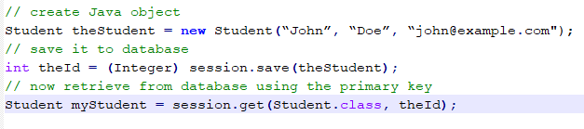
Retrieving a Java Object with Hibernate

Slide 7
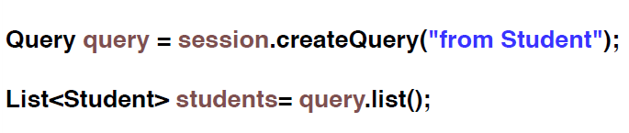
Querying for Java Objects

Slide 8
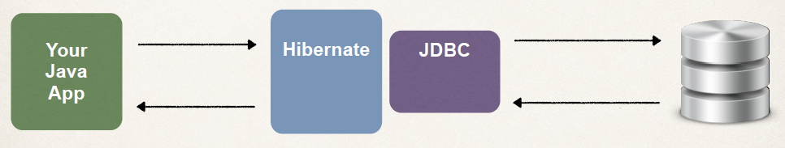
Hibernate and JDBC
Hibernate uses JDBC for all database communications

Slide 9
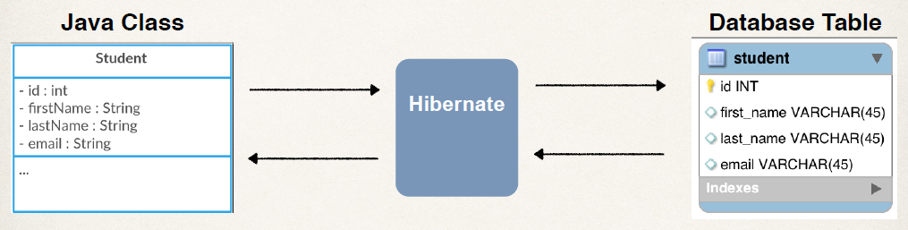
Object-to-Relational Mapping (ORM)

Slide 10
Two Options for Mapping
Option 1: XML config file (legacy)
Option 2: Java Annotations (modern, preferred)

Slide 11
Java Annotations
Step 1: Map class to database table
Step 2: Map fields to database columns

Slide 12
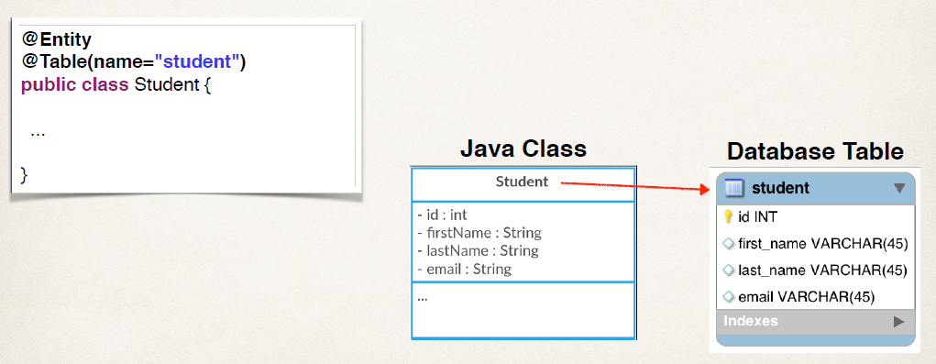
Map class to database table

Slide 13
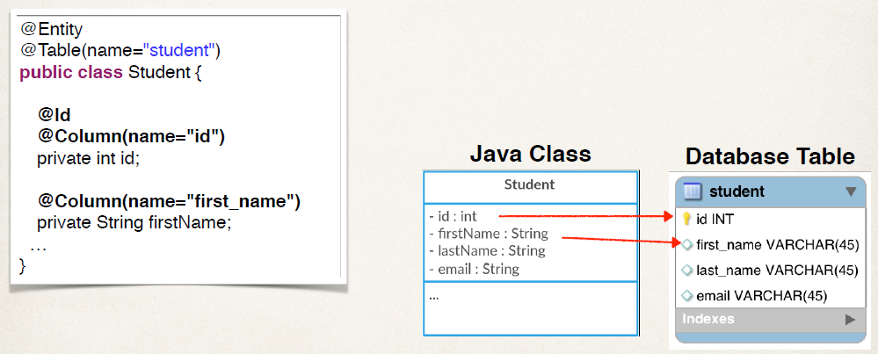
Map fields to database columns

Slide 14
Two Key Players
Interface | Description
SessionFactory | Reads the hibernate config file Creates Session objects Heavy-weight object Only create once in your app
Session | Wraps a JDBC connection Main object used to save/retrieve objects Short-lived object Retrieved from SessionFactory

