Slide 1
Spring AOP

Slide 2
Spring AOP – Introduction
Spring AOP enables Aspect-Oriented Programming in spring applications.
In AOP, aspects enable the modularization of concerns such as transaction management, logging or security that cut across multiple types and objects (often termed crosscutting concerns).
AOP provides the way to dynamically add the cross-cutting concern before, after or around the actual logic using simple pluggable configurations.

Slide 3
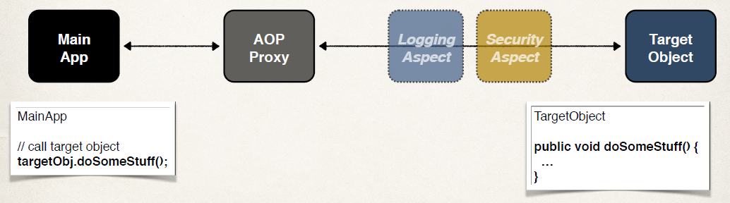
Spring AOP Proxy
Apply the Proxy design pattern

Slide 4
Spring AOP Proxy
A proxy is a well-used design pattern.
A proxy is an object that looks like another object, but adds special functionality behind the scene.
Spring AOP is proxy-based. AOP proxy is an object created by the AOP framework in order to implement the aspect contracts in runtime.
Spring AOP defaults to using standard JDK dynamic proxies for AOP proxies.
This enables any interface (or set of interfaces) to be proxied. Spring AOP can also use CGLIB proxies.

Slide 5
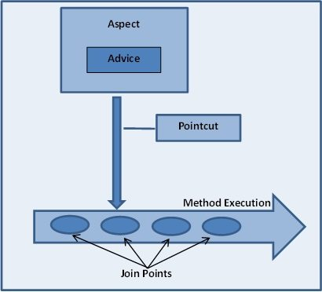
What is Aspect, advice, joinpoint and pointcut

Slide 6
Aspect
a modularization of a concern that cuts across multiple classes. Transaction management is a good example of a crosscutting concern in J2EE applications.
In Spring AOP, aspects are implemented using regular classes (the schema-based approach) or regular classes annotated with the @Aspect annotation (the @AspectJ style).

Slide 7
Join point
a point during the execution of a program, such as the execution of a method or the handling of an exception.
In Spring AOP, a join point always represents a method execution.

Slide 8
Advice
action taken by an aspect at a particular join point. Different types of advice include "around," "before" and "after" advice.

Slide 9
Advice Types
Before advice: run before the method
After finally advice: run after the method (finally)
After returning advice: run after the method (success execution)
After throwing advice: run after method (if exception thrown)
Around advice: run before and after method

Slide 10
Pointcut
A Pointcut is a predicate that helps match an Advice to be applied by an Aspect at a particular JoinPoint.
The Advice is often associated with a Pointcut expression and runs at any Joinpoint matched by the Pointcut.
A predicate expression for where advice should be applied

Slide 11
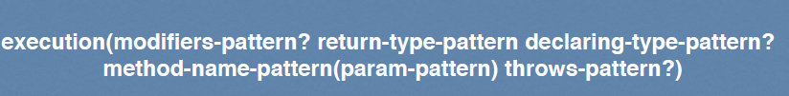
Pointcut Expression Language
The pattern is optional if it has “?”
Patterns can use wildcards

Slide 12
Pointcut Expression Examples
Match on method names
Match only addAccount() method in AccountDAO class
@Before("execution(public void com.jasdhir.aopdemo.dao.AccountDAO.addAccount())")
Match any addAccount() method in any class
@Before("execution(public void addAccount())")
Match on method names (using wildcards)
@Before("execution(public void add*())”)
Use wildcards on modifier and return type
@Before(“execution(* * processCreditCard*())”)

Slide 13
Parameter Pattern Wildcards
() - matches a method with no arguments
(*) - matches a method with one argument of any type
(..) - matches a method with 0 or more arguments of any type
@Before("execution(* addAccount())")
@Before("execution(* addAccount(com.jasdhir.aopdemo.Account))")
@Before("execution(* addAccount(..))”)

Slide 14
Match on Package
@Before("execution(* com.jasdhir.aopdemo.dao.*.*(..))")

Slide 15
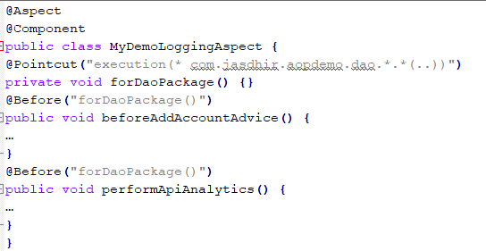
reuse a pointcut expression
Create a pointcut declaration once
Apply it to multiple advices @Pointcut("execution(* com.jasdhir.aopdemo.dao.*.*(..))")
private void forDaoPackage() {}

Slide 16
Combining Pointcut Expressions
Combine pointcut expressions using logic operators
AND (&&)
OR (||)
NOT (!)

Slide 17
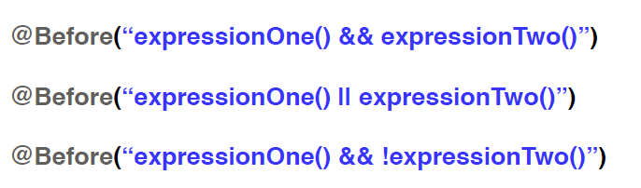
Combining Pointcut Expressions
Works like an “if” statement
Execution happens only if it evaluates to true

Slide 18
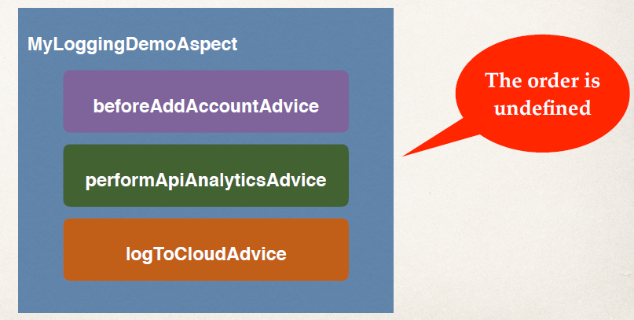
How to control the order of advices being applied?

Slide 19
To Control Order
Refactor: Place advices in separate Aspects
Control order on Aspects using the @Order annotation
Guarantees order of when Aspects are applied

Slide 20
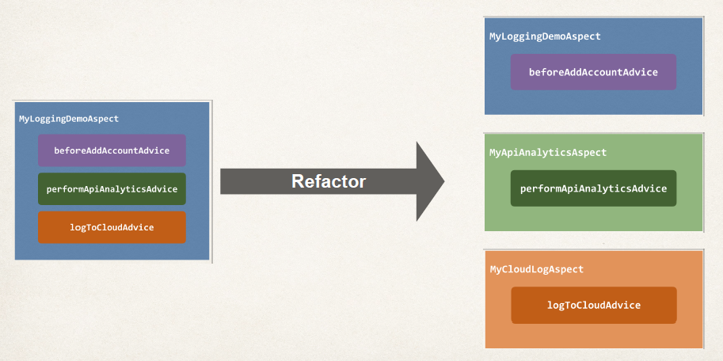
Refactor: Place advices in separate Aspects

Slide 21
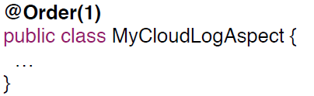
Add @Order annotation
Control order on Aspects using the @Order annotation
Guarantees order of when Aspects are applied
Lower numbers have higher precedence

Slide 22
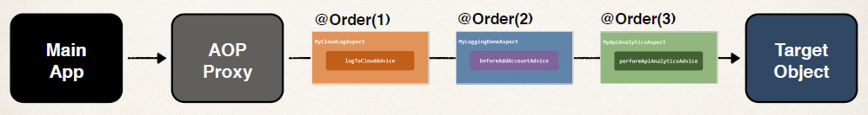
@Order
We want the following order:
MyCloudLogAspect
MyLoggingDemoAspect
MyApiAnalyticsAspect

Slide 23
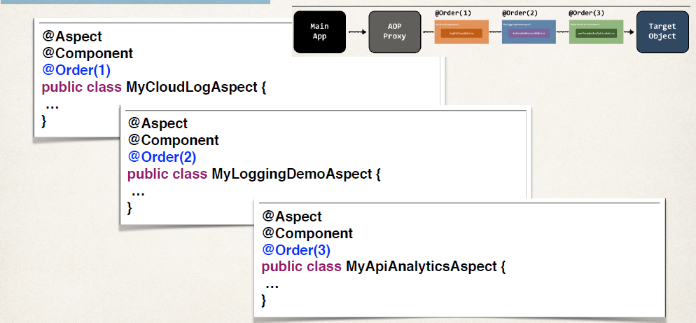
@Order annotation

Slide 24
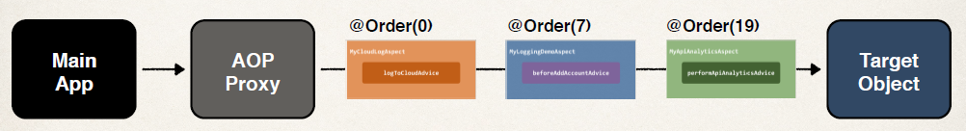
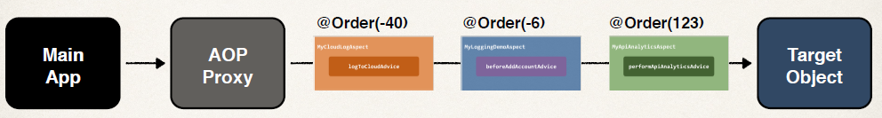
@Order annotation
Lower numbers have higher precedence
Range: Integer.MIN_VALUE to Integer.MAX_VALUE
Negative numbers are allowed
Does not have to be consecutive

Slide 25
Weaving
Weaving is the process of applying aspects to a target object to create a new proxied object.
The aspects are woven into the target object at the specified join points.
Different types of weaving
Compile-time, load-time or run-time

Slide 26
Types of advice
Before advice: Advice that executes before a join point, but which does not have the ability to prevent execution flow proceeding to the join point (unless it throws an exception).
After returning advice: Advice to be executed after a join point completes normally: for example, if a method returns without throwing an exception.

Slide 27
Types of advice
After throwing advice: Advice to be executed if a method exits by throwing an exception.
After (finally) advice: Advice to be executed regardless of the means by which a join point exits (normal or exceptional return).

Slide 28
Types of advice
Around advice: Advice that surrounds a join point such as a method invocation. This is the most powerful kind of advice. Around advice can perform custom behavior before and after the method invocation. It is also responsible for choosing whether to proceed to the join point or to shortcut the advised method execution by returning its own return value or throwing an exception.

Slide 29
Spring - MVC Framework
Framework for building web applications in Java
Based on Model-View-Controller design pattern
Leverages features of the Core Spring Framework (IoC, DI)

Slide 30
Components of a Spring MVC Application
A set of web pages to layout UI components
A collection of Spring beans (controllers, services, etc…)
Spring configuration (XML, Annotations or Java)

Slide 31
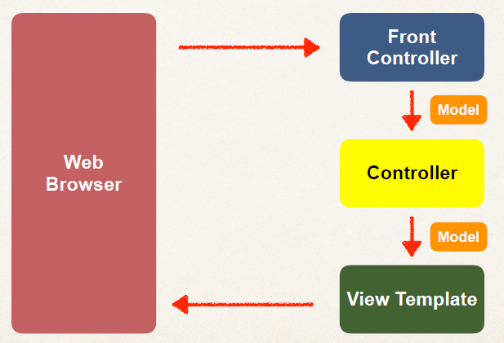
Spring MVC

Slide 32
Spring MVC Front Controller
Front controller known as DispatcherServlet
Part of the Spring Framework
Already developed by Spring Dev Team

Slide 33
Controller
Code created by developer
Contains your business logic
Handle the request
Store/retrieve data (db, web service…)
Place data in model
Send to appropriate view template

Slide 34
Model
Model: contains your data
Store/retrieve data via backend systems
database, web service, etc…
Use a Spring bean if you like
Place your data in the model
Data can be any Java object/collection

Slide 35
View Template
Spring MVC is flexible
Supports many view templates
Most common is JSP + JSTL
Developer creates a page
Displays data

Slide 36
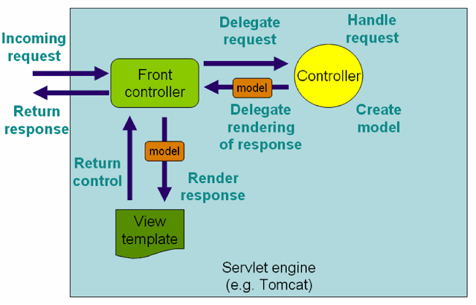
Spring MVC work Flow

Slide 37
Spring MVC work Flow
The client sends an HTTP request to a specific URL
DispatcherServlet of Spring MVC receives the request
It passes the request to a specific controller depending on the URL requested using @Controller and @RequestMapping annotations.
Spring MVC Controller then returns a logical view name and model to DispatcherServlet.
DispatcherServlet consults view resolvers until actual View is determined to render the output
DispatcherServlet contacts the chosen view (like Thymeleaf, Freemarker, JSP) with model data and it renders the output depending on the model data
The rendered output is returned to the client as a response

Slide 38
Spring MVC Using XML Configuration
In spring MVC all requests go through DispatcherServlet which acts as a front controller.
You need to configure DispatcherServlet in web.xml with the Servlet mapping for the URL pattern to indicate the URLs served by the DispatcherServlet.

Slide 39
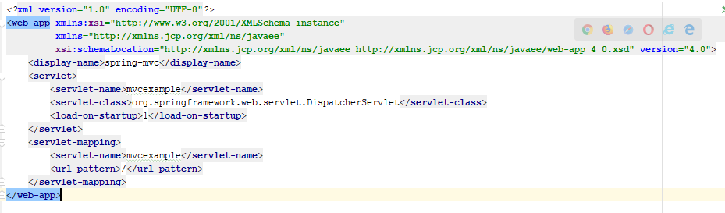
web.xml

Slide 40
Configuration file for Spring Web MVC
Here <servlet-name> is important because DispatcherServlet tries to load the Spring application context from the XML file whose name is <servlet-name>-servlet.xml.
For example here name is mvcexample so DispatcherServlet will look for the xml named mvcexample-servlet.xml in WEB-INF directory.
So you need to create mvcexample-servlet.xml file

Slide 41
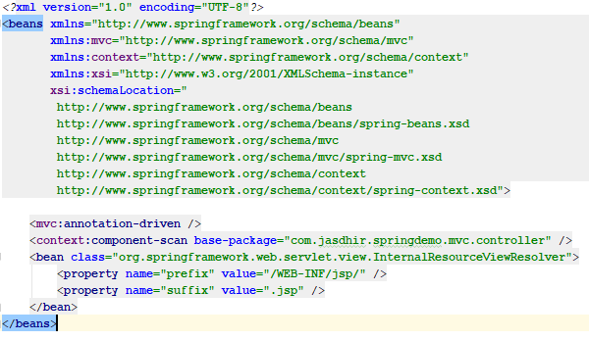
mvcexample-servlet.xml

Slide 42
InternalResourceViewResolver
The InternalResourceViewResolver is an implementation of ViewResolver
In the Spring MVC framework which resolves logical view names like "hello" to internal physical resources like Servlet and JSP files e.g. jsp files placed under the WEB-INF folder.
It is a subclass of UrlBasedViewResolver, which uses "prefix" and "suffix" to convert a logical view name returned from the Spring controller to map to actual, physical views.

Slide 43
Spring MVC Using Java Configuration
To enable Spring MVC support through a Java configuration class, all we have to do is add the @EnableWebMvc annotation
This will set up the basic support we need for an MVC project, such as registering controllers and mappings, type converters, validation support, message converters and exception handling.
If we want to customize this configuration, we need to implement the WebMvcConfigurer interface

Slide 44
WebMvcConfigurer
Defines callback methods to customize the Java-based configuration for Spring MVC enabled via @EnableWebMvc.
@EnableWebMvc-annotated configuration classes may implement this interface to be called back and given a chance to customize the default configuration.

Slide 45
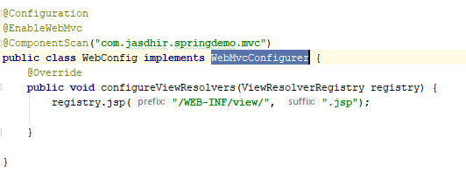
WebMvcConfigurer

Slide 46
AbstractAnnotationConfigDispatcherServletInitializer
WebApplicationInitializer to register a DispatcherServlet and use Java-based Spring configuration.
Implementations are required to implement:
getRootConfigClasses() -- for "root" application context (non-web infrastructure) configuration.
getServletConfigClasses() -- for DispatcherServlet application context (Spring MVC infrastructure) configuration.
getServletMappings() - Specify the servlet mapping(s) for the DispatcherServlet — for example "/", "/app", etc.

Slide 47
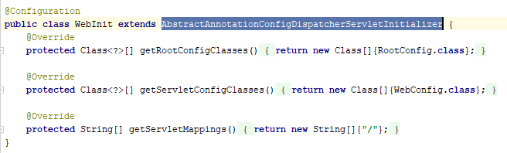
AbstractAnnotationConfigDispatcherServletInitializer

Slide 48
The Need for Validation
Check the user input form for
required fields
valid numbers in a range
valid format (postal code)
custom business rule

Slide 49
Java’s Standard Bean Validation API
Java has a standard Bean Validation API
Defines a metadata model and API for entity validation
Not tied to either the web tier or the persistence tier
Available for server-side apps and also client-side JavaFX/Swing apps

Slide 50
Bean Validation Features
Validation Feature
required
validate length
validate numbers
validate with regular expressions
custom validation

Slide 51
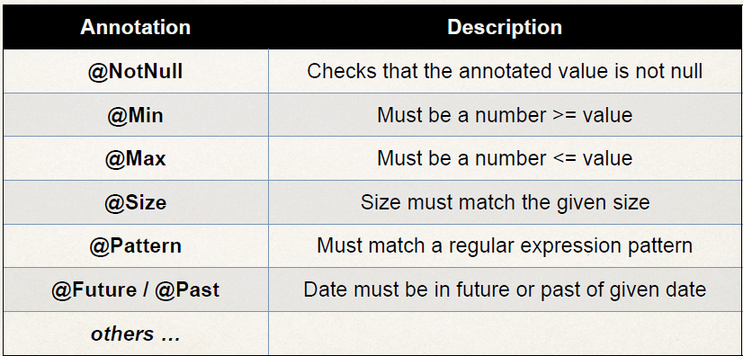
Validation Annotations

