Slide 1
JDBC

Slide 2
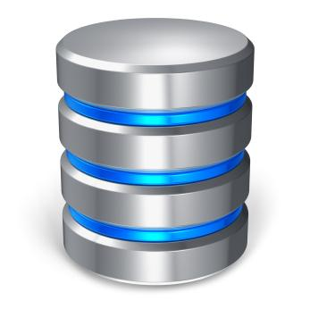

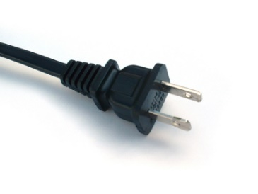
Intro to JDBC
Java Database Connectivity
Standard framework for handling tabular/relational data
Located in java.sql package

Slide 3
Establishing a Connection
The first thing to do is establish a connection with the DBMS
This involves two steps:
Loading the driver
Making the connection

Slide 4



Loading Drivers
Loading a driver is very simple
One line of code
You also need the respective JAR file in your build
Drivers can be easily downloaded online

Slide 5
Connection Object
To make the driver connect to the database:
One line of code
What’s my URL?
Every vendor is different

Slide 6
Statement
Once connected, you can execute SQL statements
A Statement object wraps and executes SQL (including DDL, DML, etc.)
For a SELECT statement, the method to use is executeQuery
To INSERT or UPDATE, use executeUpdate
Review other methods of the Statement Interface

Slide 7
PreparedStatement
Precompiled SQL statement
Reduce execution time for repetitious SQL statements
Parameterized inputs using ‘?’ placeholders
Easier to read
Database reserved characters automatically escaped
SQL Injection prevention
pstmt.method(Placeholder position, value to insert)

Slide 8
CallableStatement
Used to call the stored procedure from the database.

Slide 9
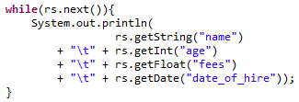
ResultSet
Object that wraps the rows returned by the query
Return type of a query
Loop over the ResultSet to inspect each row
Select each column by “column_name” or column_index
At end of loop, ResultSet points to the next row

