Slide 1
Spring Overview

Slide 2
Spring in a Nutshell
Very popular framework for building Java applications.
Initially a simpler and lightweight alternative to J2EE.
Provides a large number of helper classes … makes things easier

Slide 3
What About J2EE???
Client Side
Presentation
Server Side
Presentation
Server Side
Business Logic
Database

Slide 4
What About Java EE???
J2EE 1.2 1999
Servlets
JSP
J2EE 1.3
2001
EJB
CMP
EJB
JMS
RMI
JCA
J2EE 1.4 2003
JavaEE 6 2009
Web Services
JavaEE 5 2006
Ease of Use
EJB3
JPA
JSF
JAXB
JAX-WS
Ease of Use
JAX-RS
CDI
Bean – Validation
JavaEE 7 2013
JMS 2
Batch TX
Concurrency
Web Sockets

Slide 5
EJB v1 and v2 - Complexity
Early version of EJB (v1 and v2) were extremely complex!!!
Multiple deployment descriptors
Multiple interfaces
Poor Performance of Entity Beans

Slide 6
J2EE Development without EJB
Rod Johnson
Founder of Spring
J2EE Development without EJB, Wrox Press
Java Development with the Spring Framework, Wrox Press

Slide 7
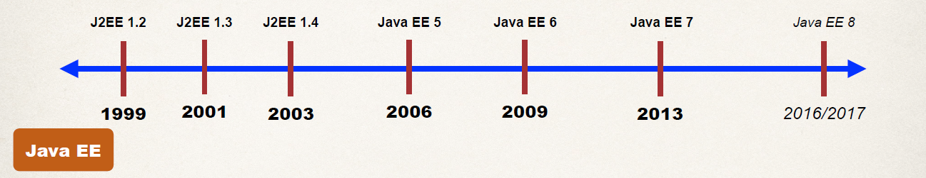
Release Timeline

Slide 8
What’s New in Spring 5
Updated minimum requirements for Java 8 or higher
Deprecated legacy integration for: Tiles, Velocity, Portlet, Guava etc
Upgraded Spring MVC to use new versions of Servlet API 4.0
Added new reactive programming framework: Spring WebFlux

Slide 9
What about Spring 4 ???
Some of you may have projects at your job that are still using Spring 4
No worries,
Spring 5 just added new features …
But core Spring 4 features are still the same :-)

Slide 10
Why Spring?
Simplify Java Enterprise Development
Spring Website – Official
https://spring.io/

Slide 11
Goals of Spring
Lightweight development with Java POJOs (Plain-Old-Java-Objects)
Dependency injection to promote loose coupling
Declarative programming with Aspect-Oriented-Programming (AOP)
Minimize boilerplate Java code

Slide 12
Spring Architecture
The Spring Framework consists of features organized into about 20 modules.
These modules are grouped into
Core Container
Data Access/Integration
Web
AOP (Aspect Oriented Programming)
Instrumentation
Test.

Slide 13
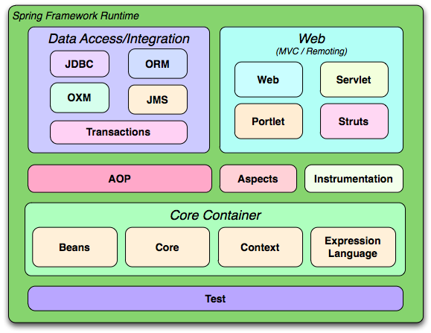
Spring Architecture

Slide 14
Coding Scenario
App should be configurable
Easily change the coach for another sport
Track and Field, Hockey, Cricket, Tennis, Gymnastics etc …
getDailyWorkout()
MyApp
BaseballCoach

Slide 15
Coding Scenario
MyApp.java: main method
BaseballCoach.java
Coach.java
TrackCoach.java

Slide 16
Inversion of Control (IoC)
The approach of outsourcing the construction and management of objects.

Slide 17
Inversion of Control (IoC)
Obtain a Coach Object
MyApp
Object Factory
configuration
BaseballCoach
TrackCoach
TennisCoach

Slide 18
Inversion of Control (IoC)
Obtain a Coach Object
MyApp
Spring
Object Factory
configuration
BaseballCoach
TrackCoach
TennisCoach

Slide 19
Spring Container
Primary functions
Create and manage objects (Inversion of Control)
Inject object’s dependencies (Dependency Injection)
Spring
Object Factory

Slide 20
Configuring Spring Container
XML configuration file (legacy, but most legacy apps still use this)
Java Annotations
Java Source Code

Slide 21
Spring Development Process
Configure your Spring Beans
Create a Spring Container
Retrieve Beans from Spring Container

Slide 22
Configure your Spring Beans
<beans …>
<bean id="myCoach" class="com.jasdhir.springdemo.BaseballCoach"> </bean> </beans>

Slide 23
Create a Spring Container
Spring container is generically known as ApplicationContext
Specialized implementations
ClassPathXmlApplicationContext
AnnotationConfigApplicationContext
GenericWebApplicationContext

Slide 24
Create a Spring Container
ClassPathXmlApplicationContext context = new ClassPathXmlApplicationContext("applicationContext.xml");

Slide 25
Retrieve Beans from Container
// retrieve bean from spring container
Coach theCoach = context.getBean("myCoach", Coach.class);
<bean id="myCoach" class="com.jasdhir.springdemo.BaseballCoach"> </bean>

Slide 26
Spring Dependency Injection
The dependency inversion principle.
The client delegates to calls to another object the responsibility of providing its
dependencies.

Slide 27



Spring Dependency Injection (Car Factory)
Obtain a Car Object
Spring
Car Factory
Dependencies

Slide 28
Spring Container
Primary functions
Create and manage objects (Inversion of Control)
Inject object’s dependencies (Dependency Injection)

Slide 29
Example
Our Coach already provides daily workouts
Now will also provide daily fortunes
New helper: FortuneService
This is a dependency
Coach
FortuneService

Slide 30
Injection Types
There are many types of injection with Spring
The two most common
Constructor Injection
Setter Injection

Slide 31
Constructor Injection

Slide 32
Setter Injection

Slide 33
Injecting Literal Values

Slide 34
Injecting Values from Properties File

Slide 35
Bean Scopes
Scope refers to the lifecycle of a bean
How long does the bean live?
How many instances are created?
How is the bean shared?

Slide 36
Default Scope: Singleton
Spring Container creates only one instance of the bean, by default
It is cached in memory
All requests for the bean
will return a SHARED reference to the SAME bean

Slide 37
Default Scope: Singleton
<beans … >
<bean id="myCoach"
class="com.jasdhir.springdemo.TrackCoach">
…
</bean>
</beans>

Slide 38
Default Scope: Singleton
Spring
Coach theCoach = context.getBean("myCoach", Coach.class);
...
Coach alphaCoach = context.getBean("myCoach", Coach.class);
TrackCoach

Slide 39
Explicitly Specify Bean Scope
<beans … >
<bean id="myCoach"
class="com.jasdhir.springdemo.TrackCoach"
scope="singleton">
…
</bean>
</beans>

Slide 40
Spring Bean Scopes
Scope | Description
singleton | (Default) Scopes a single bean definition to a single object instance for each Spring IoC container.
prototype | Scopes a single bean definition to any number of object instances.
request | Scopes a single bean definition to the lifecycle of a single HTTP request. That is, each HTTP request has its own instance of a bean created off the back of a single bean definition. Only valid in the context of a web-aware Spring ApplicationContext.
session | Scopes a single bean definition to the lifecycle of an HTTP Session. Only valid in the context of a web-aware Spring ApplicationContext.
application | Scopes a single bean definition to the lifecycle of a ServletContext. Only valid in the context of a web-aware Spring ApplicationContext.
websocket | Scopes a single bean definition to the lifecycle of a WebSocket. Only valid in the context of a web-aware Spring ApplicationContext.

Slide 41
Prototype Scope
<beans … >
<bean id="myCoach"
class="com.jasdhir.springdemo.TrackCoach"
scope="prototype">
…
</bean>
</beans>

Slide 42
Prototype Scope
Spring
Coach theCoach = context.getBean("myCoach", Coach.class);
...
Coach alphaCoach = context.getBean("myCoach", Coach.class);
TrackCoach
TrackCoach

Slide 43
Bean Lifecycle
Container Started
Bean
Instantiated
Dependencies
Injected
Internal Spring
Processing
Bean Is Ready For Use
Container Is Shutdown
Your Custom
Init Method
STOP
Your Custom
Destroy Method

Slide 44
Bean Lifecycle
Instantiate
Populate properties
setBeanName
setBeanFactory
pre-init PostProcessor
afterPropertiesSet
custom init
post-init PostProcessor
in use
Destroy
custom destroy

Slide 45
Bean Lifecycle Methods
You can add custom code during bean initialization
Calling custom business logic methods
Setting up handles to resources (db, sockets, file etc)
You can add custom code during bean destruction
Calling custom business logic method
Clean up handles to resources (db, sockets, files etc)

Slide 46
Init: method configuration
<beans … >
<bean id="myCoach"
class="com.jasdhir.springdemo.TrackCoach"
init-method="doMyStartupStuff">
…
</bean>
</beans>

Slide 47
Destroy: method configuration
<beans … >
<bean id="myCoach"
class="com.jasdhir.springdemo.TrackCoach"
init-method="doMyStartupStuff"
destroy-method="doMyCleanupStuff">
…
</bean>
</beans>

Slide 48
Spring Configuration with Annotations
What are Java Annotations?
Special labels/markers added to Java classes
Provide meta-data about the class
Processed at compile time or run-time for special processing

Slide 49
Why Spring Configuration with Annotations?
XML configuration can be verbose
Configure your Spring beans with Annotations
Annotations minimizes the XML configuration

Slide 50
Spring – Stereotype annotations
With @Component, @Repository, @Service and @Controller annotations in place and automatic component scanning enabled, Spring will automatically import the beans into the container and inject to dependencies.
These annotations are called Stereotype annotations as well.

Slide 51
@Component annotation
The @Component annotation marks a java class as a bean so the component-scanning mechanism of spring can pick it up and pull it into the application context.

Slide 52
@Repository annotation
The @Repository annotation is a specialization of the @Component annotation with similar use and functionality.
In addition to importing the DAOs into the DI container, it also makes the unchecked exceptions (thrown from DAO methods) eligible for translation into Spring DataAccessException.

Slide 53
@Service annotation
The @Service annotation is also a specialization of the component annotation.
Its good to use @Service over @Component in service-layer classes because it specifies intent better.

Slide 54
@Controller annotation
@Controller annotation marks a class as a Spring Web MVC controller.

Slide 55
Scanning for Component Classes
Spring will scan your Java classes for special annotations
Automatically register the beans in the Spring container

Slide 56
Development Process
Enable component scanning in Spring config file
Add the @Component Annotation to your Java classes
Retrieve bean from Spring container

Slide 57
Step 1: Enable component scanning in Spring config file
<beans … >
<context:component-scan
base-package="com.jasdhir.springdemo" />
</beans>

Slide 58
Step 2: Add the @Component Annotation to your Java classes
@Component("thatAnnotatedCoach")
public class TennisCoach implements Coach {
@Override
public String getDailyWorkout() {
return "Practice your backhand volley";
}
}

Slide 59
Step 3: Retrieve bean from Spring container
Coach theCoach =
context.getBean(" thatAnnotatedCoach ", Coach.class);

Slide 60
Spring also supports Default Bean IDs
Default bean id:
the class name, make first letter lower-case
Class Name
Default Bean Id
TennisCoach
tennisCoach

Slide 61
Spring Dependency Injection with Annotations and Autowiring
What is Spring AutoWiring?
For dependency injection, Spring can use auto wiring
Spring will look for a class that matches the property
matches by type: class or interface
Spring will inject it automatically … hence it is autowired
Configure the dependency injection with @Autowired Annotation

Slide 62
Autowiring Injection Types
Constructor Injection
Setter Injection
Field Injections

Slide 63
Constructor Injection
Inject dependencies by calling constructor on your class

Slide 64
Setter Injection
Inject dependencies by calling setter method(s) on your class

Slide 65
Method Injection
Inject dependencies by calling ANY method on your class

Slide 66
Field Injections
Inject dependencies by setting field values on your class directly
Accomplished by using Java Reflection

Slide 67
Multiple FortuneService Implementations
FortuneService
RESTFortuneService
HappyFortuneService
RandomFortuneService
DatabaseFortuneService

Slide 68
Be specific! - @Qualifier
@Component
public class TennisCoach implements Coach {
@Autowired
@Qualifier("happyFortuneService")
private FortuneService fortuneService;
...
}

Slide 69
Injection Types
Can apply @Qualifier annotation to
Constructor injection
Setter injection methods
Field injection

Slide 70
Bean Scopes with Annotations
@Component
@Scope("singleton")
public class TennisCoach implements Coach {
...
}
@Component
@Scope("prototype")
public class TennisCoach implements Coach {
...
}

Slide 71
Bean Lifecycle Methods - Annotations
Define your methods for init and destroy
Add annotations:
@PostConstruct and @PreDestroy

Slide 72
Init: method configuration
@Component
public class TennisCoach implements Coach {
@PostConstruct
public void doMyStartupStuff() { … }
...
}

Slide 73
Destroy: method configuration
@Component
public class TennisCoach implements Coach {
@PreDestroy
public void doMyCleanupStuff() { … }
...
}

Slide 74
Spring Configuration with Java Code
Instead of configuring Spring container using XML
Configure the Spring container with Java code

Slide 75
Development Process
Create a Java class and annotate as @Configuration
Add component scanning support: @ComponentScan (optional)
Read Spring Java configuration class
AnnotationConfigApplicationContext context =
new AnnotationConfigApplicationContext(SomeConfig.class);
Retrieve bean from Spring container
Coach theCoach = context.getBean("tennisCoach", Coach.class);

