Slide 1
Spring AOP

Slide 2
Spring AOP – Introduction
Spring AOP enables Aspect-Oriented Programming in spring applications.
In AOP, aspects enable the modularization of concerns such as transaction management, logging or security that cut across multiple types and objects (often termed crosscutting concerns).
AOP provides the way to dynamically add the cross-cutting concern before, after or around the actual logic using simple pluggable configurations.

Slide 3
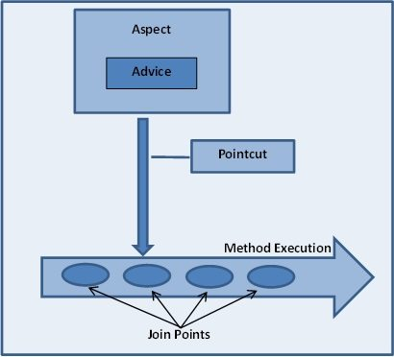
What is Aspect, advice, joinpoint and pointcut

Slide 4
Aspect
a modularization of a concern that cuts across multiple classes. Transaction management is a good example of a crosscutting concern in J2EE applications.
In Spring AOP, aspects are implemented using regular classes (the schema-based approach) or regular classes annotated with the @Aspect annotation (the @AspectJ style).

Slide 5
Join point
a point during the execution of a program, such as the execution of a method or the handling of an exception.
In Spring AOP, a join point always represents a method execution.

Slide 6
Advice
action taken by an aspect at a particular join point. Different types of advice include "around," "before" and "after" advice.

Slide 7
Pointcut
Pointcut is expressions that are matched with join points to determine whether advice needs to be executed or not.
Pointcut uses different kinds of expressions that are matched with the join points and Spring framework uses the AspectJ pointcut expression language.
The concept of join points as matched by pointcut expressions is central to AOP, and Spring uses the AspectJ pointcut expression language by default.

Slide 8
Types of advice
Before advice: Advice that executes before a join point, but which does not have the ability to prevent execution flow proceeding to the join point (unless it throws an exception).
After returning advice: Advice to be executed after a join point completes normally: for example, if a method returns without throwing an exception.

Slide 9
Types of advice
After throwing advice: Advice to be executed if a method exits by throwing an exception.
After (finally) advice: Advice to be executed regardless of the means by which a join point exits (normal or exceptional return).

Slide 10
Types of advice
Around advice: Advice that surrounds a join point such as a method invocation. This is the most powerful kind of advice. Around advice can perform custom behavior before and after the method invocation. It is also responsible for choosing whether to proceed to the join point or to shortcut the advised method execution by returning its own return value or throwing an exception.

Slide 11
Spring - MVC Framework
Framework for building web applications in Java
Based on Model-View-Controller design pattern
Leverages features of the Core Spring Framework (IoC, DI)

Slide 12
Components of a Spring MVC Application
A set of web pages to layout UI components
A collection of Spring beans (controllers, services, etc…)
Spring configuration (XML, Annotations or Java)

Slide 13
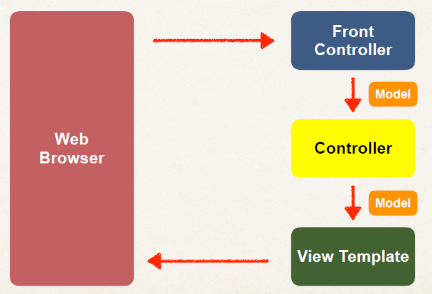
Spring MVC

Slide 14
Spring MVC Front Controller
Front controller known as DispatcherServlet
Part of the Spring Framework
Already developed by Spring Dev Team

Slide 15
Controller
Code created by developer
Contains your business logic
Handle the request
Store/retrieve data (db, web service…)
Place data in model
Send to appropriate view template

Slide 16
Model
Model: contains your data
Store/retrieve data via backend systems
database, web service, etc…
Use a Spring bean if you like
Place your data in the model
Data can be any Java object/collection

Slide 17
View Template
Spring MVC is flexible
Supports many view templates
Most common is JSP + JSTL
Developer creates a page
Displays data

Slide 18
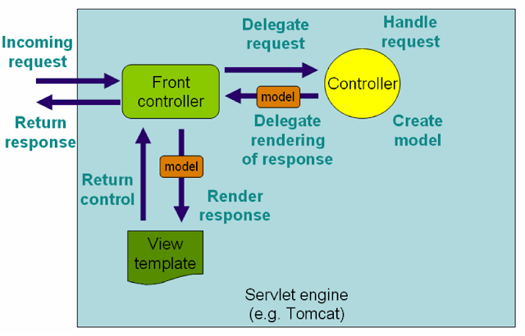
Spring MVC work Flow

Slide 19
Spring MVC work Flow
The client sends an HTTP request to a specific URL
DispatcherServlet of Spring MVC receives the request
It passes the request to a specific controller depending on the URL requested using @Controller and @RequestMapping annotations.
Spring MVC Controller then returns a logical view name and model to DispatcherServlet.
DispatcherServlet consults view resolvers until actual View is determined to render the output
DispatcherServlet contacts the chosen view (like Thymeleaf, Freemarker, JSP) with model data and it renders the output depending on the model data
The rendered output is returned to the client as a response

Slide 20
The Need for Validation
Check the user input form for
required fields
valid numbers in a range
valid format (postal code)
custom business rule

Slide 21
Java’s Standard Bean Validation API
Java has a standard Bean Validation API
Defines a metadata model and API for entity validation
Not tied to either the web tier or the persistence tier
Available for server-side apps and also client-side JavaFX/Swing apps

Slide 22
Bean Validation Features
Validation Feature
required
validate length
validate numbers
validate with regular expressions
custom validation

Slide 23
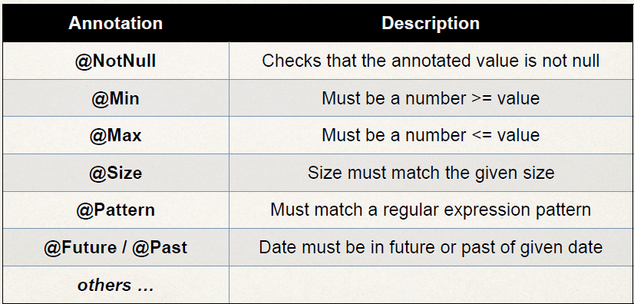
Validation Annotations

