Slide 1

By: Kevin Vélez Salazar
magIA Juvenil

Slide 2
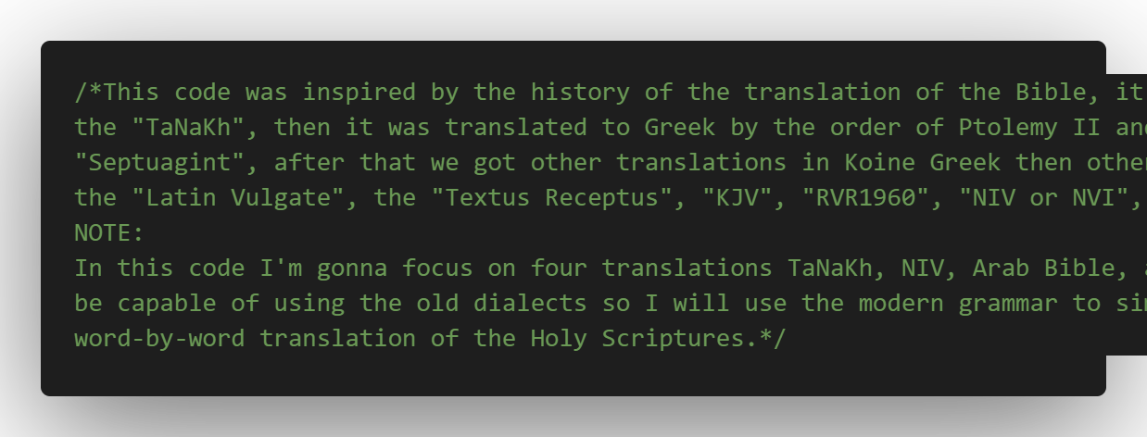
Azure Translator “Going back to my roots”

Slide 3
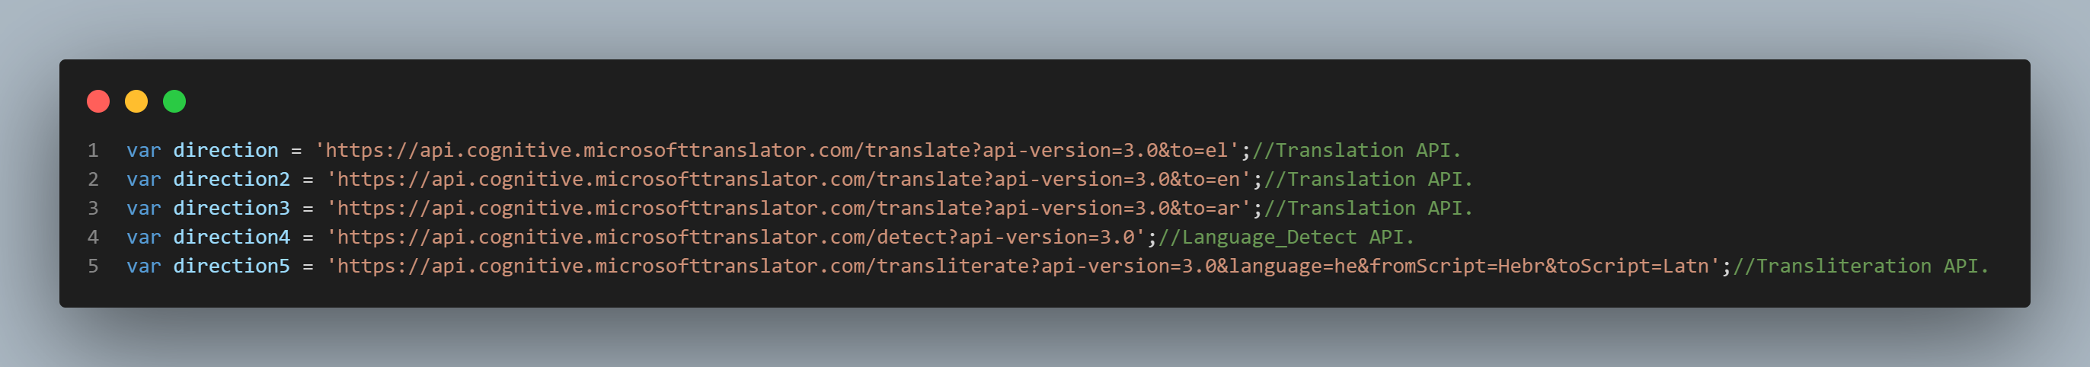
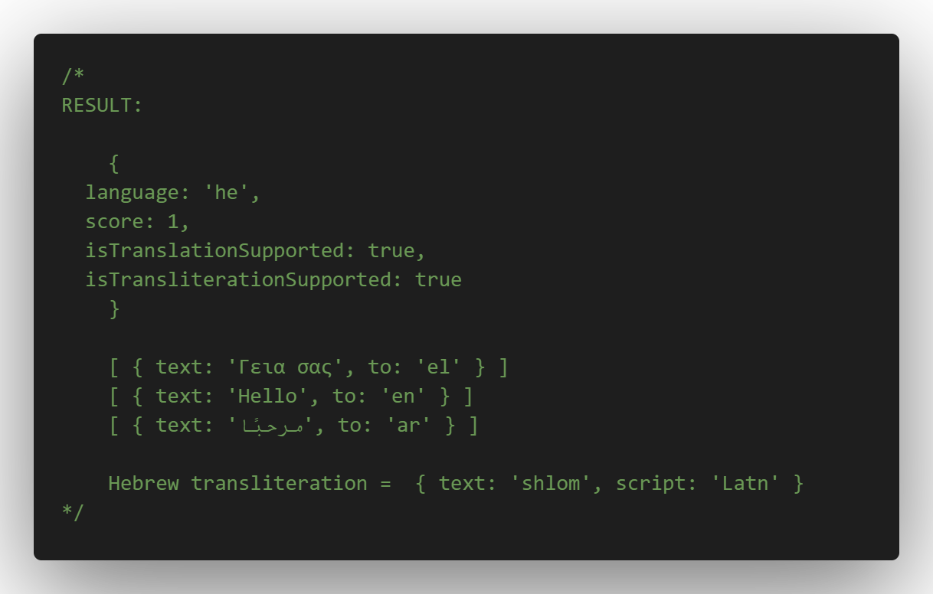

Slide 4

GOALS:
I used the bible book as an inspiration to code this program because I’m passionate about languages and how they change as time passes by.
I want other people to engage with my passion and allow them to know the story behind their bibles and how they are usually underrated.
I will also provide my code so that others can use it an improve it, this project is totally (OPEN SOURCE).

Slide 5


acknowledgements
I wanted to take some time to thank Microsoft because they made this project possible by the deploying of services from Azure.
Finally I wanted to thank intevolution for their time and all of the knowledge that they instilled on us.

