Slide 1
Text Summarization Using Keras With Sequential Model
-Karan Verma(306611284)

Slide 2


Slide 3
PROBLEM
We had to build a model that could generate news articles given a set of previous articles (in our case 3 articles ) as our training data and build a nearly 200 word article using the new article to be uploaded

Slide 4
BASIC TO BE USED
NEURON
NEURAL NETWORK
ACTIVATION FUNCTION

Slide 5
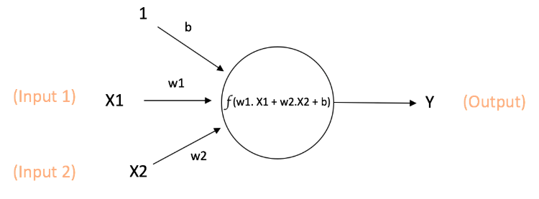
NEURON

Slide 6
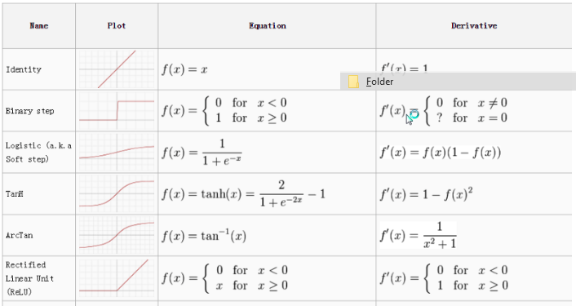
ACTIVATION FUNCTION

Slide 7
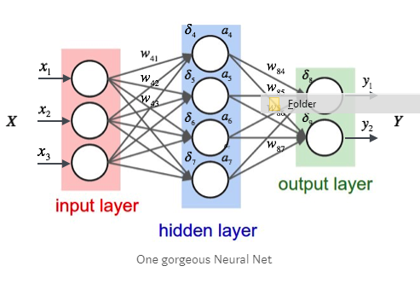
NEURAL NETWORK

Slide 8
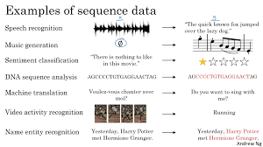
SEQUENCE MODEL

Slide 9
RECURRENT NEURAL NETWORK - WHY??
A regular neural network will not consider features across different position of text
Input , output are of different lengths

Slide 10
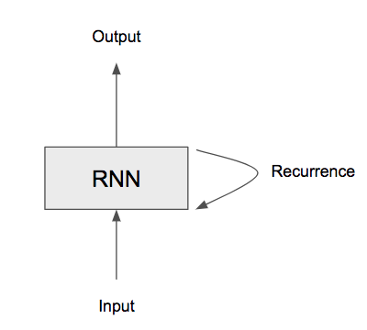
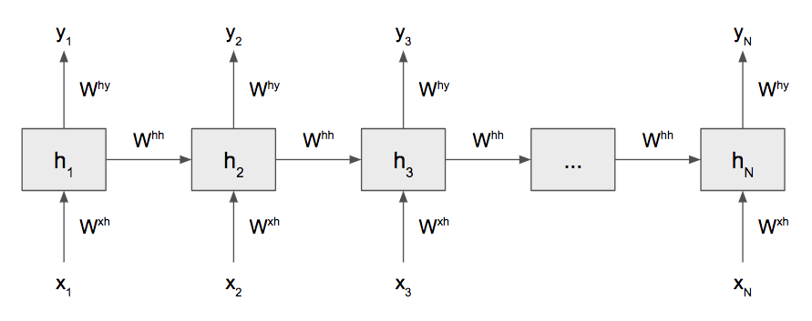
RECURRENT NEURAL NETWORK - WHAT

Slide 11

LSTM (Loss of Short Term Memory)

Slide 12
LSTM(Long Short Term Memory) – Why?
RNN’s suffer the problem of vanishing gradient , since at each step of backpropagation gradient is multiplied to something , it eventually withers out .

Slide 13
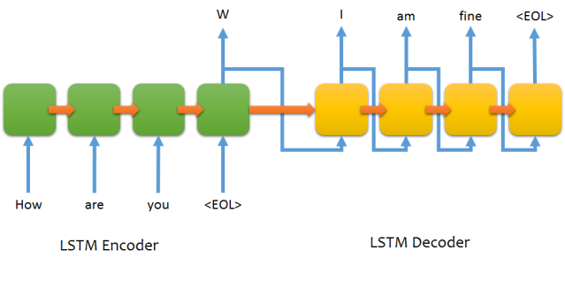
ENCODER - DECODER

Slide 14


Slide 15
Attention Mechanism – Why
One of the major drawbacks is Encoder-Decoder doesn’t work too well with long sentences . Hence context starts withering out
E.g : I will watch T.V
I will be going to watch the T.V

Slide 16
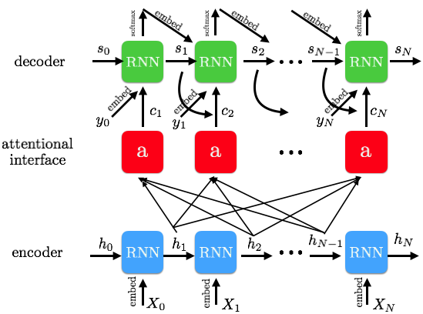
Attention Mechanism – What

Slide 17
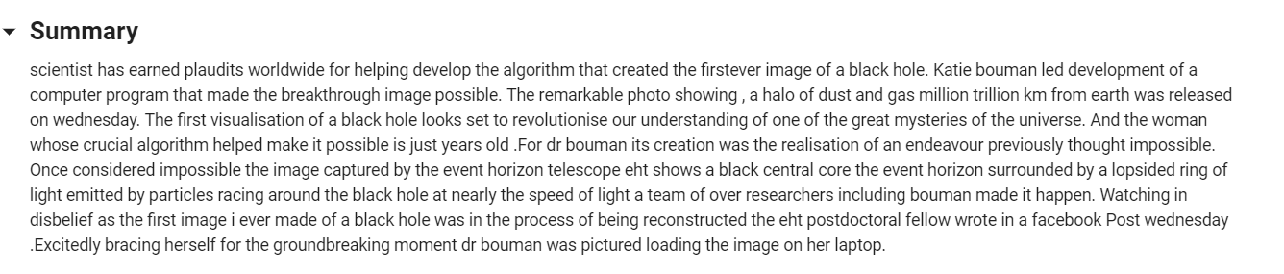
OUR OUTPUT

Slide 18
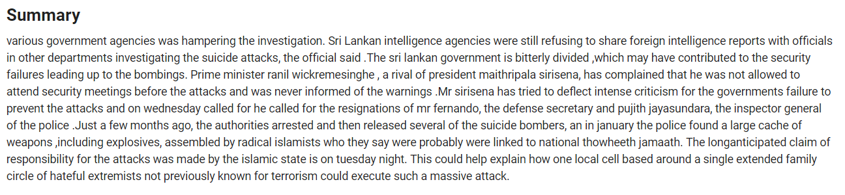
OUR OUTPUT

Slide 19
FUTURE WORK
Include other characters of punctuation
Heading , Sub heading

Slide 20
THANK YOU
ANY QUESTIONS??
EMAIL ME AT:-
Kverma@calstatela.edu

