Slide 1
UK Electricity Consumption Forecasting
Ayush Yadav
(MDS202315)
Kalyani Gohokar
(MDS202330)
Time Series Analysis
Instructor: Dr. M. R. Srinivasan

Slide 2
Objective
The main objective of this project is to develop predictive models for forecasting the demand for electricity in the United Kingdom using time series analysis.
Specifically, we aim to:
Analyse historical electricity consumption data to identify patterns like trend and seasonality.
Build forecasting models using SARIMA, Holt-Winters, and Long Short-Term Memory (LSTM) to capture the underlying structure of the time series data.
Conduct a comparative analysis of these models to determine their strengths, weaknesses, and suitability for electricity demand forecasting.
Evaluate the models' performance in predicting future electricity demand.

Slide 3
Dataset
The dataset contains information on electricity demand in the United Kingdom since 2009, gathered by the National Grid ESO.
The dataset contains weekly data for columns like National Demand, Transaction System Demand, and England & Wales Demand. All values are measured in Mega Watts (MW).
We use the National Demand (ND) values for our study.
Settlement Date | ND | TSD | EWD
2009-01-11 | 15046759 | … | …
2009-01-18 | 14080079 | … | …
2009-01-25 | 14237170 | … | …
2009-02-01 | 14246472 | … | …
: | : | : | :

Slide 4
Data Pre-processing
Feature Selection: Out of the available features, only National Demand (ND) was considered, and the rest were discarded.
Transformation:
Log Transformation: This transformation reduces variance and stabilises the time series, making it easier for the models to capture trends and seasonality.
Min-Max Scaling: This transformation was done specifically for the LSTM model. It rescales the values between 0 and 1, suitable for deep learning models.
Train-Test Split: The data from 2009-21 was taken for training (approx. 82%). And the data for 2022-24 was taken for testing the model.

Slide 5
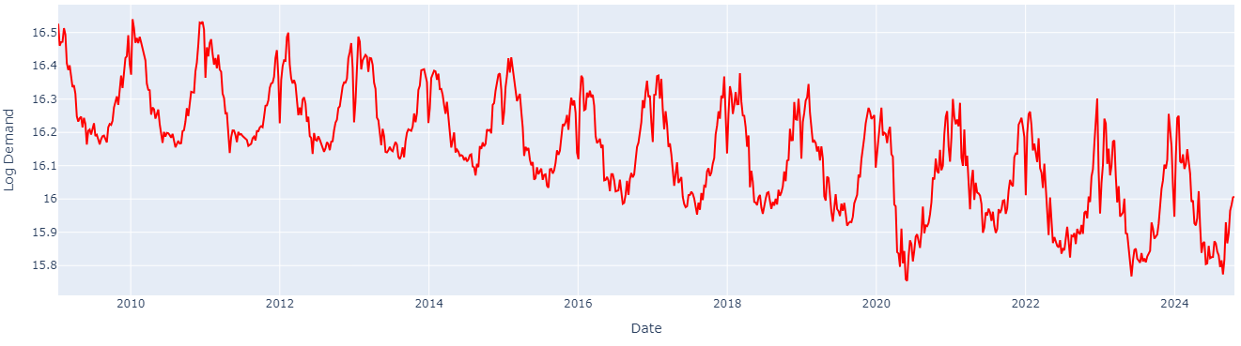
Dataset
Key observations:
Downwards trend.
Clear seasonal (yearly) fluctuations.
No significant noise/outliers.

Slide 6
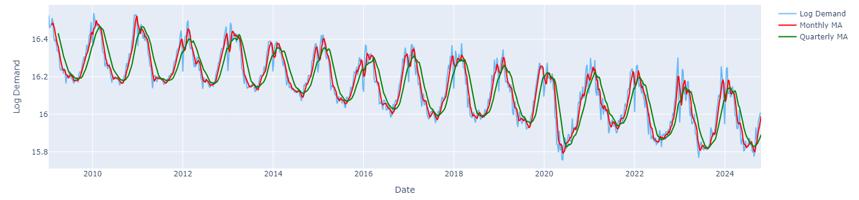
Moving Averages Smoothing
Monthly MA: The monthly moving average was used to capture short-term fluctuations and trends. It effectively smooths out weekly variations in the data while retaining more responsive changes in demand.
3-Month MA: The quarterly moving average, with a larger time window, is better at identifying mid-range term trends by smoothing out more of the short-term fluctuations.

Slide 7
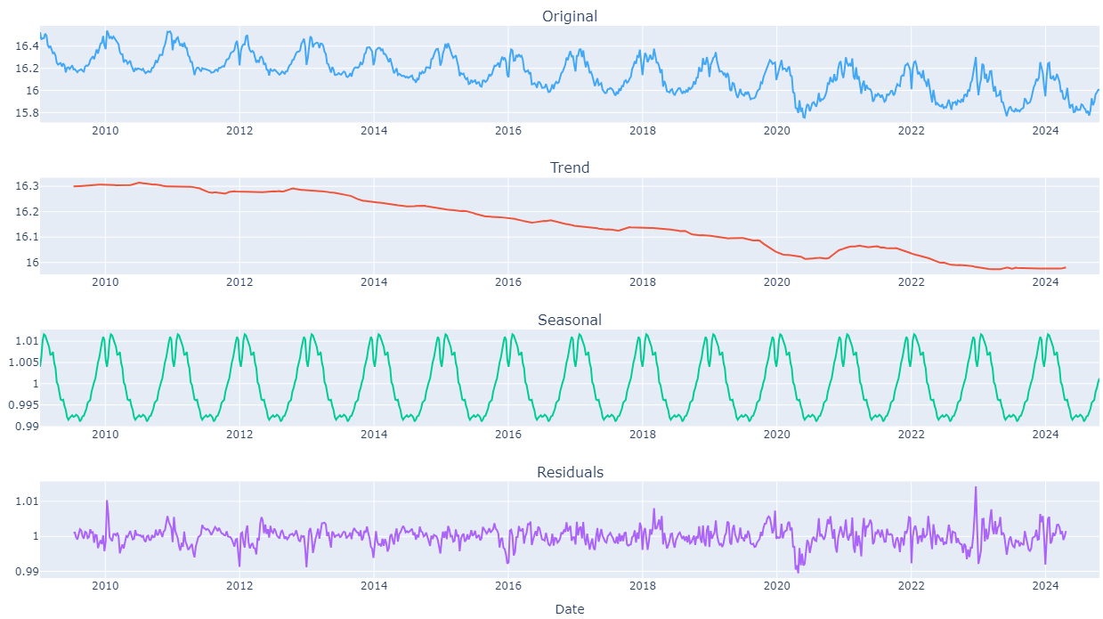
Seasonal Decomposition

Slide 8
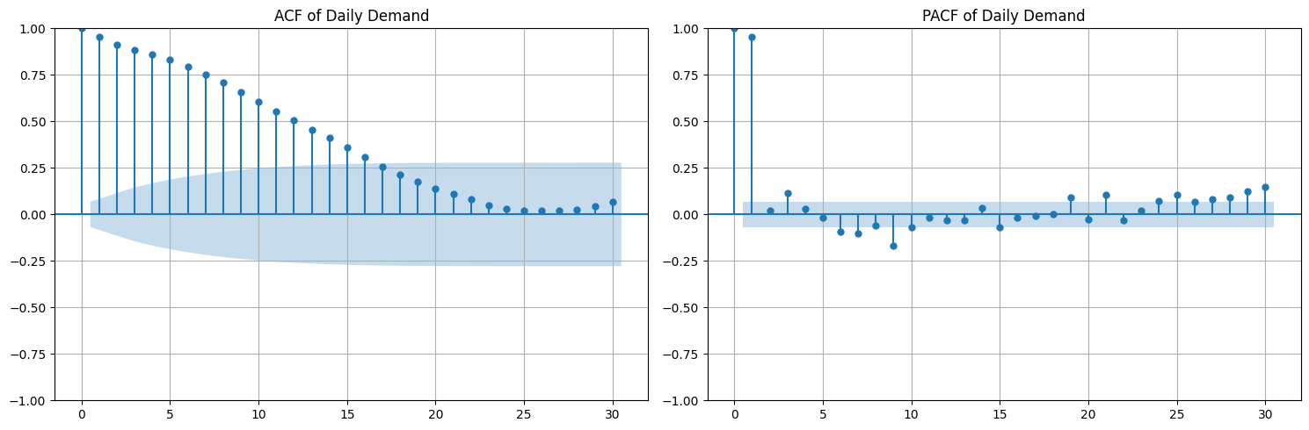
ACF and PACF (before differencing)
TIME SERIES IS CLEARLY NON-STATIONARY !

Slide 9
Stationarity Check
ADF Test
KPSS Test
Tests the presence of unit root in a time series.
Null Hypothesis: The time series has a unit root (series is non-stationary).
Inference – If p-value ≤ 0.05, we reject H₀, i.e., the time series is stationary.
Observation
ADF Statistic: -4.129
P-value: 0.0009
Result: STATIONARY
Tests whether a given time series is stationary around a mean or linear trend.
Null Hypothesis: The time series is stationary around a mean (or a trend).
Inference – If p-value ≤ 0.05, we reject H₀, i.e., the time series is non-stationary.
Observation
KPSS Statistic: 2.924
P-value: 0.01
Result: NON-STATIONARY

Slide 10
Why ADF fails?
ADF test looks for a unit root in the time series, the presence of which indicates that the time series exhibits a random walk behaviour, which makes the series non-stationary.
The ADF Statistic is very sensitive to strong seasonal patterns.
Seasonality tends to repeat over specific periods, which is contrary to the random walk behaviour.
This leads to incorrect conclusions.

Slide 11
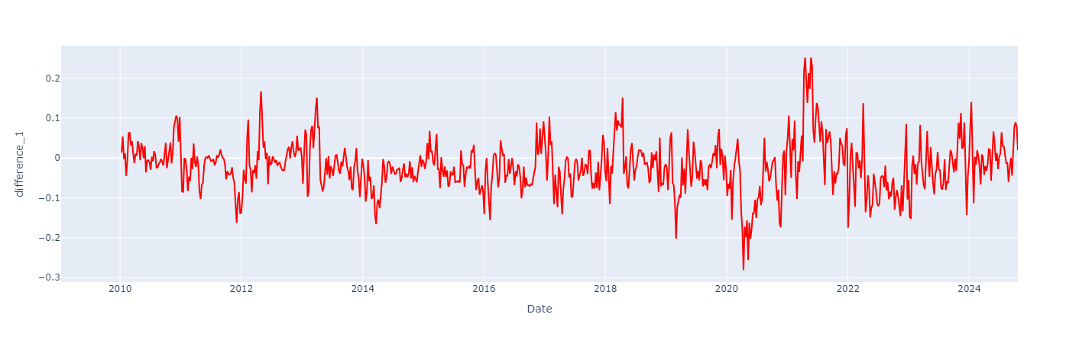
After Differencing

Slide 12
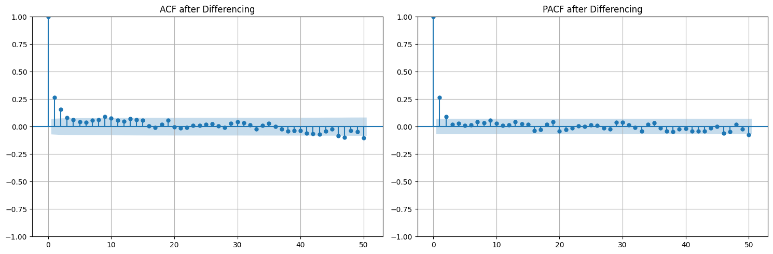
After Differencing
KPSS Test
Test Statistic: 0.112
P-value: 0.1
Inference: STATIONARY

Slide 13
SARIMA Model
The SARIMA (Seasonal Autoregressive Integrated Moving Average) model is an extension of the ARIMA model that explicitly accounts for seasonality in time series data.
SARIMA combines the Auto-Regressive (AR), Moving Average (MA), and differencing components of the ARIMA model, with seasonal counterparts for each of these components, allowing it to model both trend and seasonality.
Represented as ARIMA(p,d,q)(P,D,Q)[M], where,
(p,d,q): AR, differencing, and MA components of ARIMA
(p,d,q): AR, differencing, and MA components for Seasonality.
M: Period of Seasonality.
Optimization: Use grid search on values for (p,d,q,P,Q) and select the model with the lease AIC (Akaike Information Criteria.

Slide 14
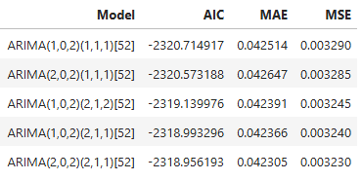
SARIMA Results

Slide 15
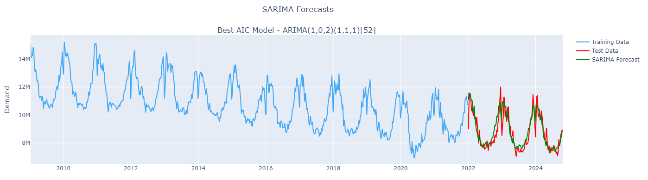
SARIMA Results

Slide 16
SARIMA Advantages & Disadvantages
Advantages
Disadvantages
SARIMA explicitly models both seasonality and trend using differencing, making it effective for seasonal time series.
It is grounded in statistical theory, providing confidence intervals for forecasts, which are useful for uncertainty quantification.
SARIMA performs well with stationary and seasonal data, particularly when the dataset is relatively small.
Can’t handle multiple seasonal patterns within the same time series.
Selecting the correct combination of parameters (p, d, q, P, D, Q) can be challenging and time-consuming.
SARIMA cannot model complex non-linear patterns.
Risk of overfitting.

Slide 17
Holt-Winters Model
The Holt-Winters model, also known as Exponential Smoothing is a popular forecasting technique and is used when the data exhibits both trend and seasonality.
This model captures the level, trend, and the seasonality in the data.
Model Description:
Trend: Additive (the trend is fairly constant over time)
Seasonality: Additive (the seasonal fluctuations are constant and do not shrink/grow with the level)
Seasonal Periods: 52

Slide 18
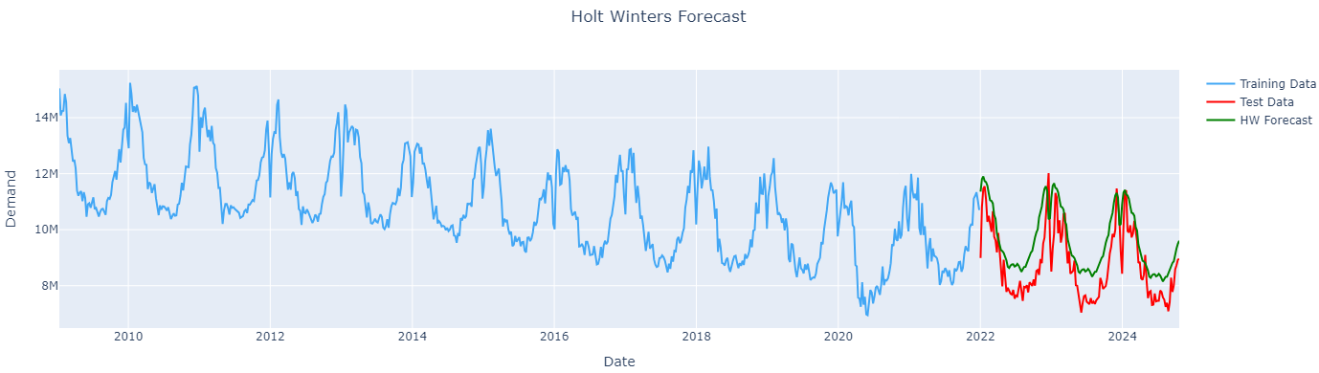
Holt-Winters Results
Performance Metrics
AIC: -4420.09
MSE: 0.013
MAE: 0.101

Slide 19
Holt-Winters Advantages & Disadvantages
Advantages
Disadvantages
Holt-Winters explicitly accounts for both trend and seasonal components, making it suitable for periodic data.
Easy to implement and computationally efficient, even for large datasets.
Supports both additive and multiplicative seasonality, providing flexibility.
Cannot handle dynamic or changing seasonal patterns effectively
If seasonality is weak or non-existent, Holt-Winters may perform worse than simpler methods like ARIMA or single exponential smoothing.
Holt-Winters cannot handle multiple seasonalities.

Slide 20
Long Short-Term Memory (LSTM) Model
LSTM is a specialized deep learning model used for modelling sequential data like text, time series, signal, etc.
LSTM memory cell is a system of gates which control flow of information.
Forget Gate: Controls which information is discarded from current cell state.
Input Gate: Controls what new data should be added to the current cell state.
Output Gate: Controls the information output to the next layer, based on current cell state.
This gated architecture helps the LSTM selectively remember and forget, making it especially effective for forecasting when the data exhibits intricate patterns such as long-term dependencies, trends, and seasonality.

Slide 21
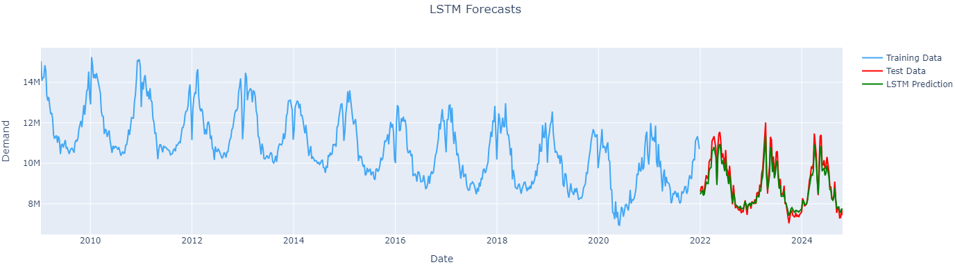
LSTM Results
Performance Metrics
MSE: 0.0009
MAE: 0.026

Slide 22
LSTM Advantages & Disadvantages
Advantages
Disadvantages
LSTMs can model intricate patterns and relationships in time series data, such as long-term dependencies and interactions.
Unlike statistical methods, LSTMs do not require the data to be stationary or seasonally adjusted.
LSTMs can handle multivariate time series and integrate additional external features, making them suitable for complex forecasting tasks.
LSTMs are resource-intensive and require significant computational power and time for training, especially on large datasets.
Deep learning models like LSTMs need large amounts of data to generalize well, which might not always be available.
Tuning the architecture (e.g., number of layers, units, learning rate) and preventing overfitting can be time-consuming.

Slide 23
Results’ Comparison
Model | MAE | MSE
ARIMA(1,0,2)(1,1,1)[52] | 0.0425 | 0.0032
Holt Winters | 0.1013 | 0.013
LSTM | 0.0258 | 0.0009

