Slide 1
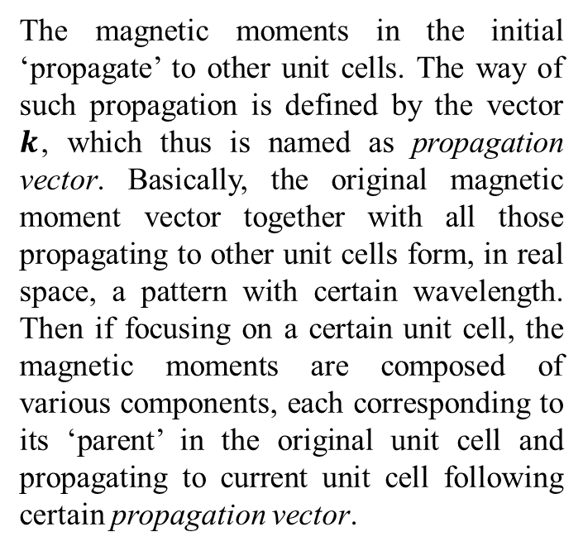
Propagation vector
The magnetic moments in the initial ‘propagate’ to other unit cells. The way of such propagation is defined by the vector $k$, which thus is named as propagation vector. Basically, the original magnetic moment vector together with all those propagating to other unit cells form, in real space, a pattern with certain wavelength. Then if focusing on a certain unit cell, the magnetic moments are composed of various components, each corresponding to its ‘parent’ in the original unit cell and propagating to current unit cell following certain propagation vector.
Ferromagnetic component
Net magnetic moment
Antiferromagnetic component

Slide 2
Propagation vector
The propagation vectors for FM and AFM components here are given as:
, where
is the unit vector along
Following the propagation vectors given above, the two components propagate from initial unit cell to the neighboring unit cell to the right (see the illustration in previous slide) as follows:
propagation
propagation

Slide 3
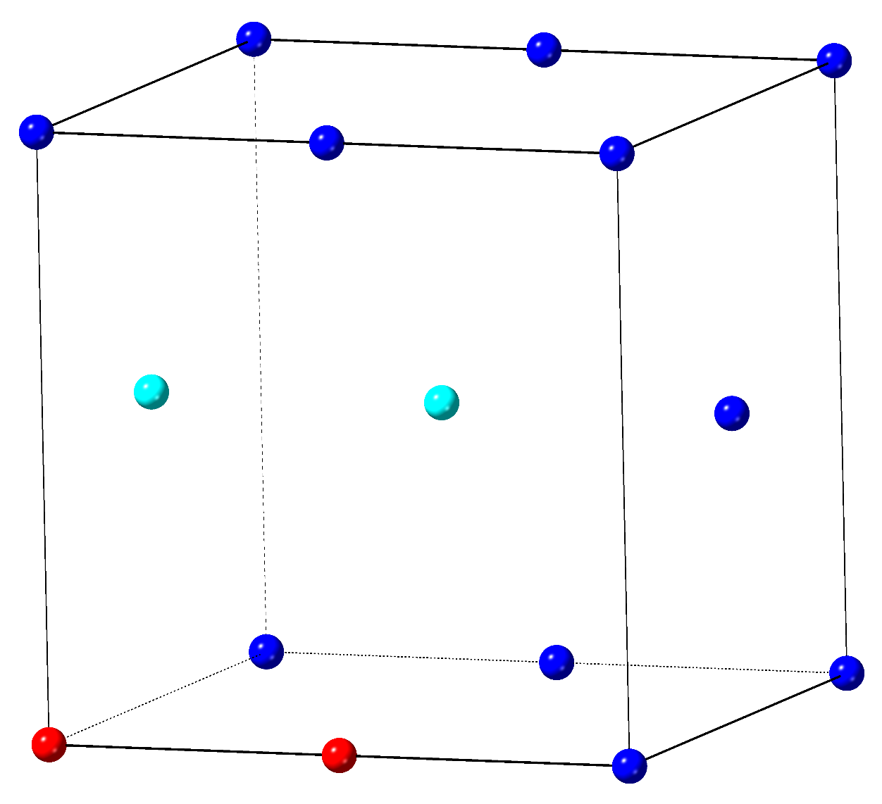
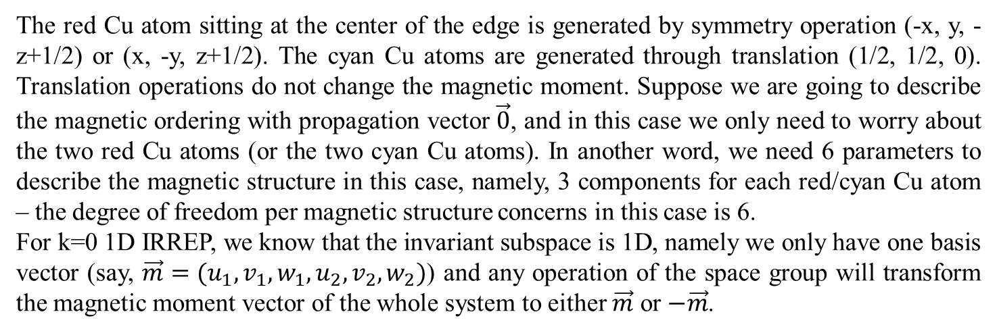
IRREP and Basis vectors
Consider a structure with space group symmetry of C2/c. Suppose we have a Cu atom sitting at the origin (0, 0, 0) and the structure will look at this:
The red Cu atom sitting at the center of the edge is generated by symmetry operation (-x, y, -z+1/2) or (x, -y, z+1/2). The cyan Cu atoms are generated through translation (1/2, 1/2, 0). Translation operations do not change the magnetic moment. Suppose we are going to describe the magnetic ordering with propagation vector $\vec{0}$, and in this case we only need to worry about the two red Cu atoms (or the two cyan Cu atoms). In another word, we need 6 parameters to describe the magnetic structure in this case, namely, 3 components for each red/cyan Cu atom – the degree of freedom per magnetic structure concerns in this case is 6.
For k=0 1D IRREP, we know that the invariant subspace is 1D, namely we only have one basis vector (say, $\vec{m}=(u_{1}, v_{1}, w_{1},u_{2},v_{2},w_{2})$) and any operation of the space group will transform the magnetic moment vector of the whole system to either $\vec{m}$ or $−\vec{m}$.

Slide 4
IRREP and Basis vectors
Now we are going to look at how we can build up the basis vector for describing the magnetic structure. Here following are the four operations contained in the space group:
(x, y, z)
(-x, y, -z+1/2)
(-x, -y, -z)
(x, -y, z+1/2)
Identity
Rotation + Translation
Inversion
Mirror + Translation
The special members here concerning magnetic moment are inversion and mirror operations, i.e. the way that inversion and mirror operates on magnetic moments (which are axial vectors) is different from the situation where they operate on polar vectors, as shown below:
Magnetic moment
Inversion center
Mirror plane

Slide 5

IRREP and Basis vectors
We start from the magnetic moment (u, v, w) of Cu atom sitting at (0, 0, 0) and operate each operator of the space group (first, consider none of the members is primed) on it:
(x, y, z)
(-x, y, -z+1/2)
(-x, -y, -z)
(x, -y, z+1/2)
Identity
Rotation + Translation
Inversion
Mirror + Translation
(u, v, w)
(u, v, w)
(-u, v, -w)
(u, v, w)
(-u, v, -w)‡
Cu atom sitting at (0, 0, 0)
Cu atom sitting at (0, 0, 1/2)
‡ Here in this case, the mirror plane is perpendicular to the y-axis therefore the mirror reflection does not change the y component but inverse both the x and y component. Refer to the illustration at the bottom right corner in previous slide.

Slide 6
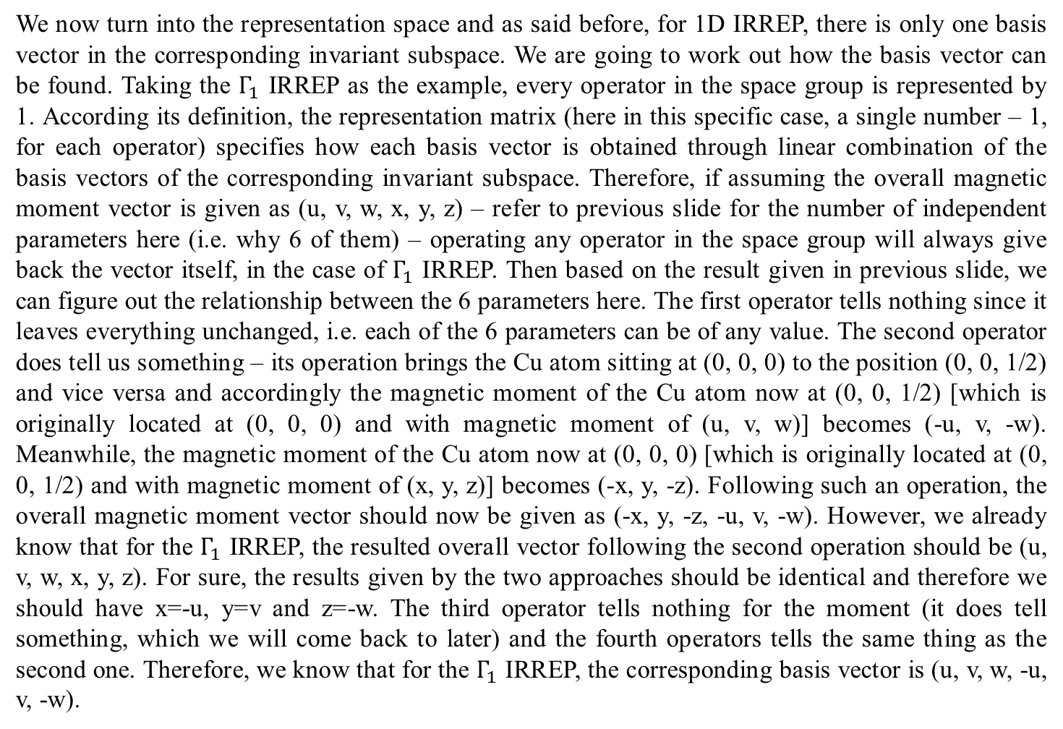
IRREP and Basis vectors
We now turn into the representation space and as said before, for 1D IRREP, there is only one basis vector in the corresponding invariant subspace. We are going to work out how the basis vector can be found. Taking the $Γ_{1}$ IRREP as the example, every operator in the space group is represented by 1. According its definition, the representation matrix (here in this specific case, a single number – 1, for each operator) specifies how each basis vector is obtained through linear combination of the basis vectors of the corresponding invariant subspace. Therefore, if assuming the overall magnetic moment vector is given as (u, v, w, x, y, z) – refer to previous slide for the number of independent parameters here (i.e. why 6 of them) – operating any operator in the space group will always give back the vector itself, in the case of $Γ_{1}$ IRREP. Then based on the result given in previous slide, we can figure out the relationship between the 6 parameters here. The first operator tells nothing since it leaves everything unchanged, i.e. each of the 6 parameters can be of any value. The second operator does tell us something – its operation brings the Cu atom sitting at (0, 0, 0) to the position (0, 0, 1/2) and vice versa and accordingly the magnetic moment of the Cu atom now at (0, 0, 1/2) [which is originally located at (0, 0, 0) and with magnetic moment of (u, v, w)] becomes (-u, v, -w). Meanwhile, the magnetic moment of the Cu atom now at (0, 0, 0) [which is originally located at (0, 0, 1/2) and with magnetic moment of (x, y, z)] becomes (-x, y, -z). Following such an operation, the overall magnetic moment vector should now be given as (-x, y, -z, -u, v, -w). However, we already know that for the $Γ_{1}$ IRREP, the resulted overall vector following the second operation should be (u, v, w, x, y, z). For sure, the results given by the two approaches should be identical and therefore we should have x=-u, y=v and z=-w. The third operator tells nothing for the moment (it does tell something, which we will come back to later) and the fourth operators tells the same thing as the second one. Therefore, we know that for the $Γ_{1}$ IRREP, the corresponding basis vector is (u, v, w, -u, v, -w).

Slide 7
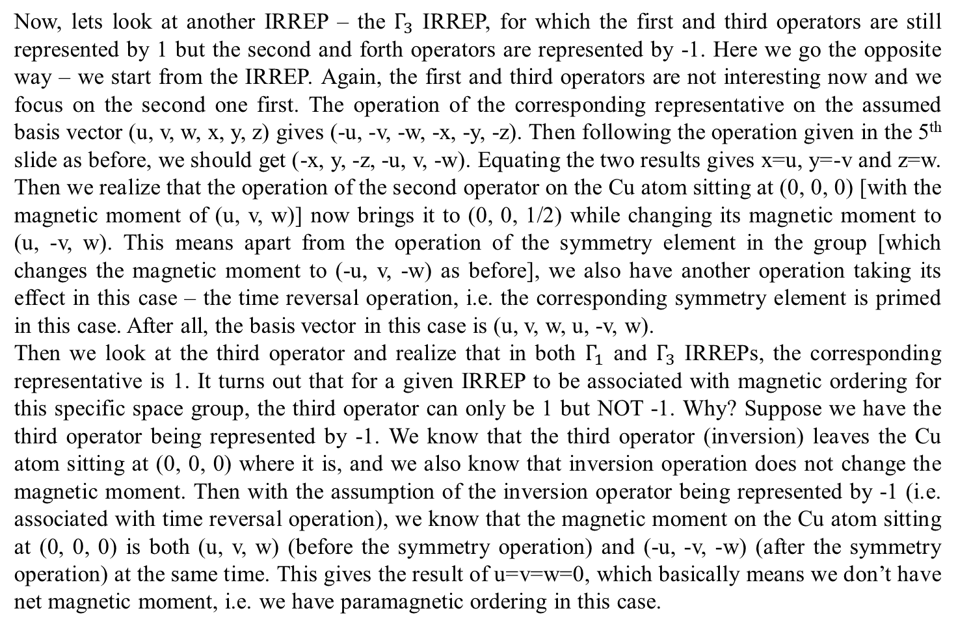
IRREP and Basis vectors
Now, lets look at another IRREP – the $Γ_{3}$ IRREP, for which the first and third operators are still represented by 1 but the second and forth operators are represented by -1. Here we go the opposite way – we start from the IRREP. Again, the first and third operators are not interesting now and we focus on the second one first. The operation of the corresponding representative on the assumed basis vector (u, v, w, x, y, z) gives (-u, -v, -w, -x, -y, -z). Then following the operation given in the 5th slide as before, we should get (-x, y, -z, -u, v, -w). Equating the two results gives x=u, y=-v and z=w. Then we realize that the operation of the second operator on the Cu atom sitting at (0, 0, 0) [with the magnetic moment of (u, v, w)] now brings it to (0, 0, 1/2) while changing its magnetic moment to (u, -v, w). This means apart from the operation of the symmetry element in the group [which changes the magnetic moment to (-u, v, -w) as before], we also have another operation taking its effect in this case – the time reversal operation, i.e. the corresponding symmetry element is primed in this case. After all, the basis vector in this case is (u, v, w, u, -v, w).
Then we look at the third operator and realize that in both $Γ_{1}$ and $Γ_{3}$ IRREPs, the corresponding representative is 1. It turns out that for a given IRREP to be associated with magnetic ordering for this specific space group, the third operator can only be 1 but NOT -1. Why? Suppose we have the third operator being represented by -1. We know that the third operator (inversion) leaves the Cu atom sitting at (0, 0, 0) where it is, and we also know that inversion operation does not change the magnetic moment. Then with the assumption of the inversion operator being represented by -1 (i.e. associated with time reversal operation), we know that the magnetic moment on the Cu atom sitting at (0, 0, 0) is both (u, v, w) (before the symmetry operation) and (-u, -v, -w) (after the symmetry operation) at the same time. This gives the result of u=v=w=0, which basically means we don’t have net magnetic moment, i.e. we have paramagnetic ordering in this case.

