Slide 1
Exchange Interaction Summary
Yuanpeng Zhang
SNS, ORNL
May10, 2018

Slide 2
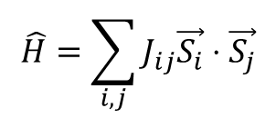


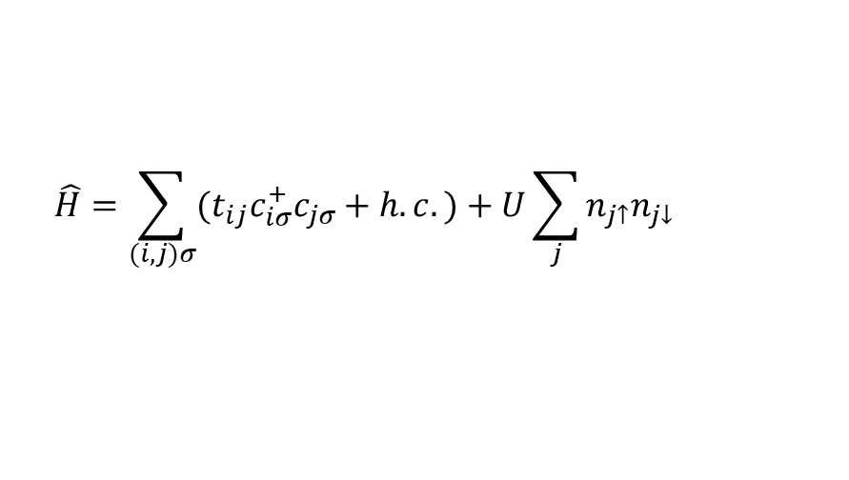
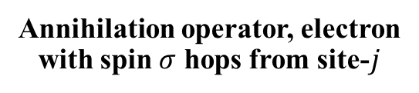

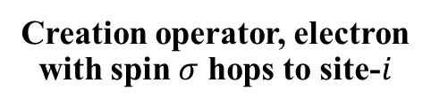
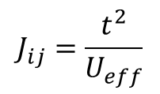
Single-band Hubbard Model
$$\hat{H}=\sum_{(i,j)σ}{{(t}_{ij}c_{iσ}^{+}c_{jσ}+h.c.)+U\sum_{j}{n_{j↑}n_{j↓}}}$$
$$c_{iσ}^{+}$$
Creation operator, electron
with spin $σ$ hops to site-$i$
On-site Coulomb repulsion
$$c_{jσ}$$
Annihilation operator, electron
with spin $σ$ hops from site-$j$
Energy term unfavorable
for electrons hopping
$$t_{ij}$$
Transfer integral
Specifically casted in the framework
of Anderson (1959) [1] superexchange model
Energy term favoring
electrons hopping
Also assuming the Heisenberg limit (t << U) [2]
$$\hat{H}=\sum_{i,j}{J_{ij}\vec{S_{i}}}⋅\vec{S_{j}}$$
$$J_{ij}=\frac{t^{2}}{U_{eff}}$$
, where
[1] P. W. Anderson. Phys. Rev., 115, 2 (1959).
[2] S. Lebernegg, et al. Phys. Rev. B, 87, 155111 (2013).

Slide 3
More Notes
The Anderson superexchange model is one of the most famous models concerning the superexchange interaction. The model is built up in the basis of the ligand wavefunctions, and as pointed out in R. White’s book (Click Me! Refer to Page-61), there does exist models beyond Anderson’s approach – those in the basis of molecular orbitals. In fact, the formulation derived from both approaches is quite similar – refer to the equation-(2.100) in R. White’s book. Specifically, the denominator in the second term of equation-(2.100) in R. White’s book is quite similar to the corresponding term in (5.25) of M. Suzuki’s lecture notes. What’s worth mentioning is that in the molecular orbitals based approach, the numerator term is explained as the energy difference between the molecular orbitals – for details, refer to the Fig. 1 and expression-(9) in R. Hoffmann’s paper.
Beyond the single-band Hubbard model, we could also have the so-called multiple-bands model. The difference here is that in the single-band model, if taking the Anderson superexchange as an example, only the mixing between single bands (e.g. p- and d- bands) is considered. However, for the multiple-bands model, the mixing takes into account multiple bands at the same time. Without going into details, we could have, for example, the three-band Emery model [1], the Floquet model [2], etc.
[1] H. Eskes, et al. Phys. Rev. B, 48, 9788-9798 (1993).
[2] R. Mikhaylovskiy, et al. Nat. Commun., 6, 8190 (2015).

