Slide 1
Where to find data at SNS/HFIR?

Slide 2
What is data?
Raw data
Collection of neutron scattering events (time of flight, wallclock time, sample log, detector positions, …)
Usually saved in a hdf5 format using a NeXus format (*.nxs.h5)
Reduced data
Transformed data into something that has some physical meaning or some intermediate format that other programs used by the community can understand
Can be ASCII/ NeXus hdf5/ image/any other format

Slide 3
Where are my files?
Home folder – only you have access by default
/SNS/users/<username>
Raw data file
Organized by instrument and proposal
/SNS/<instrument>/IPTS-<12345>/nexus
/SNS/users/<username>/data/SNS/<instrument>/IPTS-<12345>/nexus
Instrument files
/SNS/<instrument>/shared
Reduced data files
/SNS/<instrument>/IPTS-<12345>/shared
/SNS/<instrument>/IPTS-<12345>/shared/autoreduce

Slide 4
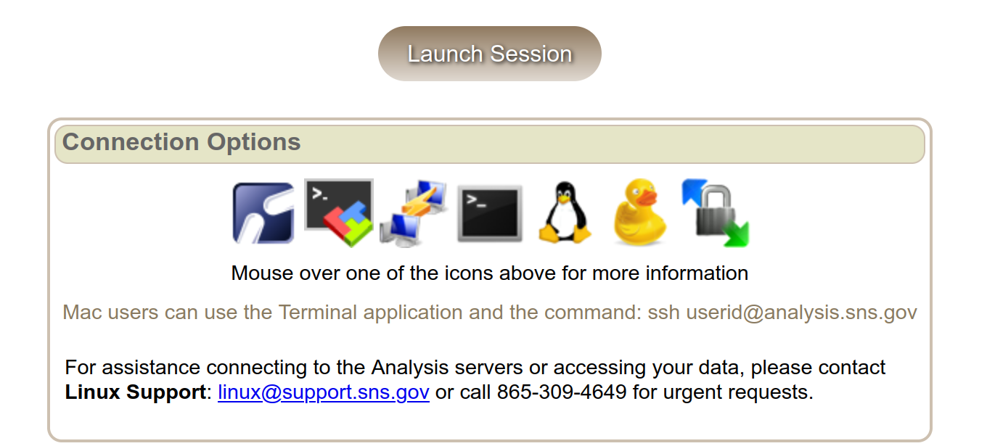
How to get the data?
Secure file transfer protocol
From a terminal sftp or scp
GUIs for Windows, MacOS
https://analysis.sns.gov/

Slide 5
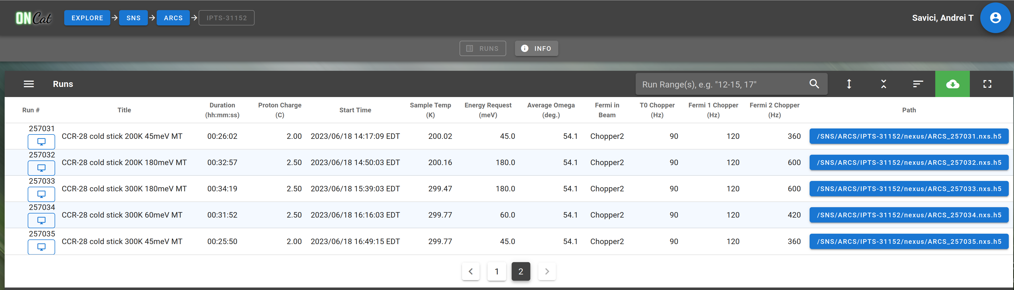
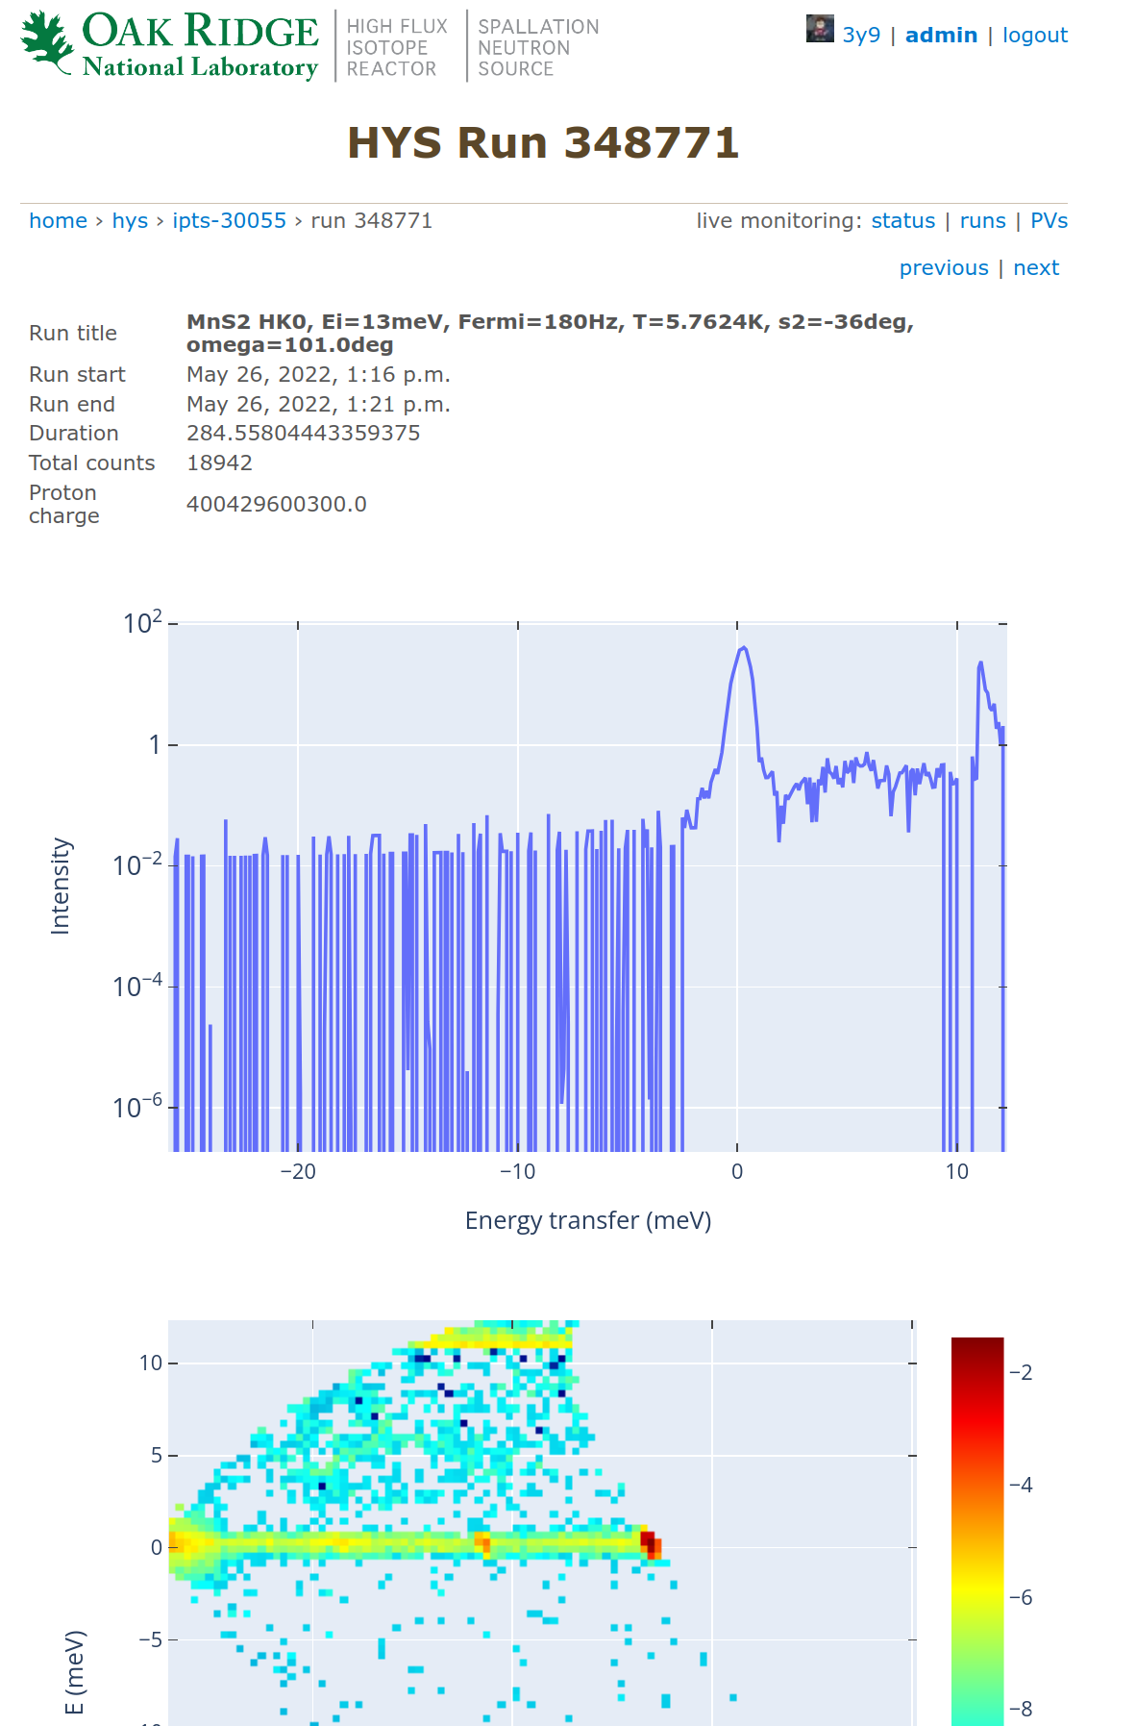
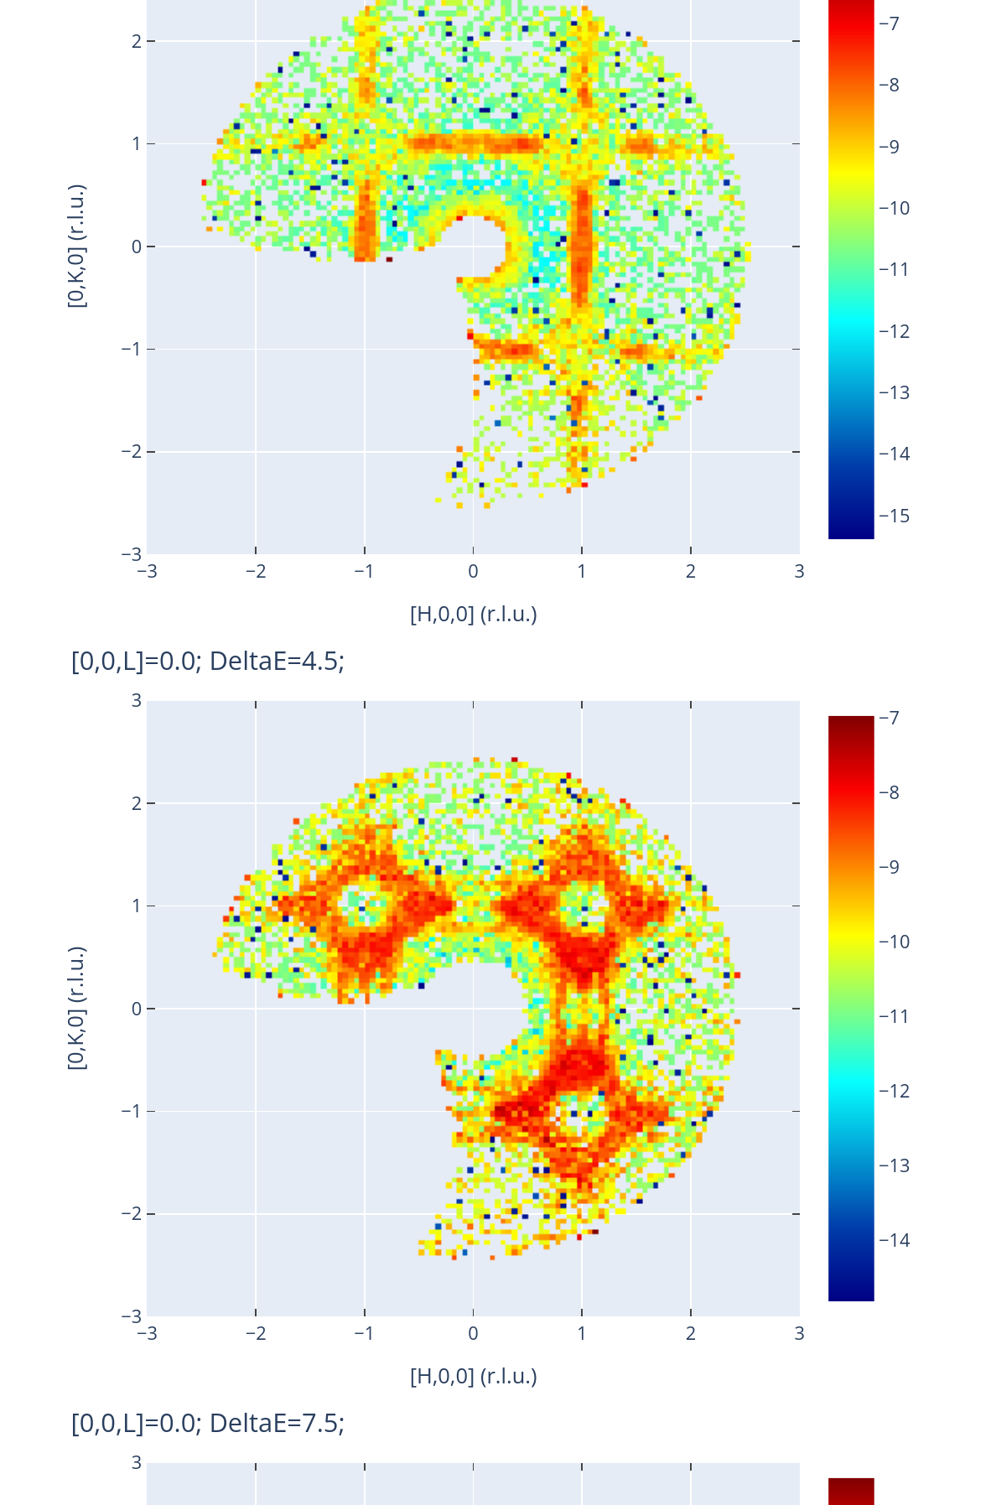
Organize and track data
https://oncat.ornl.gov
https://monitor.sns.gov

