Slide 1
Površinska elektromiografija visoke gustoće (HDsEMG)
Kvirin Polondak
Mentor: prof. dr. sc. Mario Cifrek

Slide 2
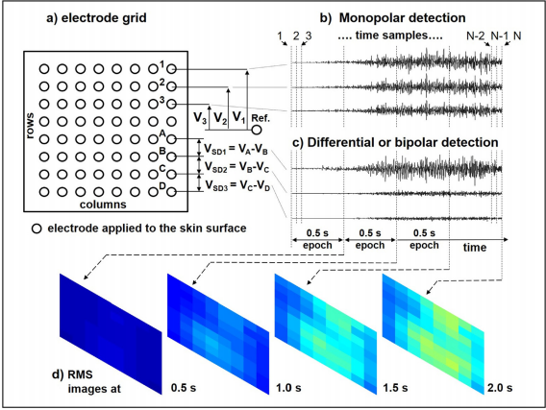
HDsEMG
Polje elektroda
Monopolarna detekcija
Diferencijalna detekcija

Slide 3
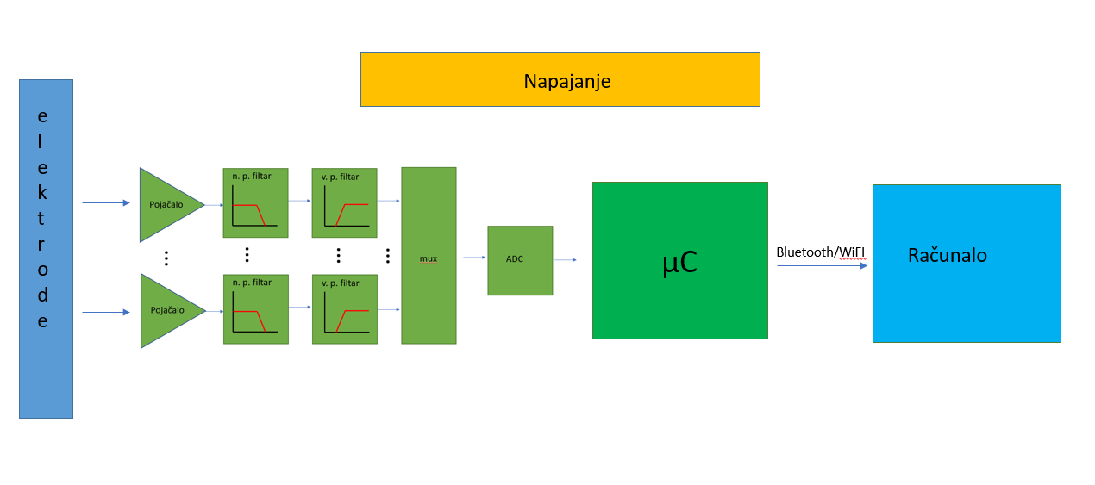
Blok shema

Slide 4
Zahtjevi
Mala veličina uređaja (2x2 cm do 4x4 cm)
Mala potrošnja
Nosivo
Skalabilno rješenje
16 kanalna implementacija

Slide 5
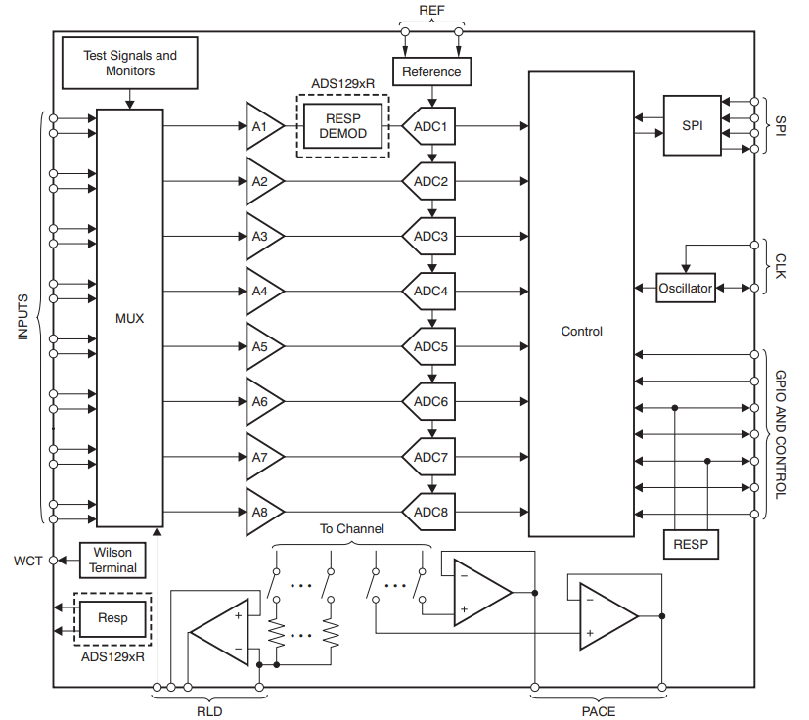
ADS1298

Slide 6
Karakteristike ADS1298 i usporedba s ADS1xxx
 | ADS1198 | ADS1298 | ADS1299
Broj kanala | 8 | 8 | 8
Rezolucija ADC-a | 16 bit | 24 bit | 24 bit
Potrošnja | 8.2 mW normal mode | 8.8 mW HR mode | 39 mW normal mode
 | 4 mW Standby mode | 6 mW LP mode | 5.1 mW standby mode
 | 20 μW Power down | - | 10 μW Power-down
Input Bias Current | 200pA | 200 pA | 300 pA
Data Rate | 125SPS to 8kSPS | 250 SPS to 32 kSPS | 250 SPS to 16 kSPS
CMRR | -105dB | -115dB | -110dB
Programabilno pojačanje: | 1, 2, 3, 4, 6, 8, or 12 | 1, 2, 3, 4, 6, 8, or 12 | 1, 2, 4, 6, 8, 12, or 24

Slide 7
Napajanje: | Analog: 2.7 V to 5.25 V | AVDD = 2.7 V to 5.25V | Analog:4.7 V to 5.25 V
 | Digital: 1.65 V to 3.6 V | DVDD = 1.65 V to 3.6 V | Digital:1.8 V to 3.6 V
Ulazni šum: | 12 μVPP (150HzBW, G = 6) | 4 μVPP (150Hz BW, G = 6) | 1 μVPP (70-HzBW)
Ostale karakteristike | Built-In RightLegDriveAmplifier,Lead-Off Detection, WCT,TestSignals | Built-in Right Leg Drive Amplifier, Lead-off detection; Wilson center terminal, pace detection, test signals | Built-In RightLegDriveAmplifier,Lead-Off Detection, WCT,TestSignals
Komunikacija | SPI™-Compatible Serial Interface | SPI™-Compatible Serial Interface | SPI™-Compatible Serial Interface
Kućište | 8 mm×8 mm,64-ball BGA and 10 mm×10 mm TQFP-64 | 8 mm×8 mm,64-ball BGA and 10 mm×10 mm TQFP-64 | 10 mm×10 mm TQFP-64
Cijena | 23,52 € | 36,39 € | 48,91 €

Slide 8
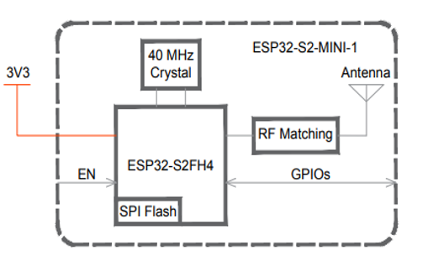
ESP32-S2-MINI-1
Veličina modula (15.40±0.15)×(20.00±0.15)×(2.40±0.15) mm.
Wi­Fi
Relativno lako dostupan i često korišten

Slide 9
Zaključak
Kao rezultat ovog projekta nastao je nacrt rješenja za implementaciju koja će biti nastavak projekta
Tokom projektiranja prototipa uređaja obavljati će se mjerenja na evaluation boardu kako bi uređaj bio što kvalitetnije projektiran

Slide 10
Literatura
[1] R. Merlettia , S. Muceli, Journal of Electromyography and Kinesiology, 2019
[2] ADS129x Low-Power, 8-Channel, 24-Bit Analog Front-End for Biopotential Measurements datasheet (Rev. K), 2015
[3] ADS1298ECGFE-PDK, ADS1198ECGFE-PDK (Rev. D), 2016
[4] esp32-s2-mini-1_esp32-s2-mini-1u_datasheet

