Slide 1
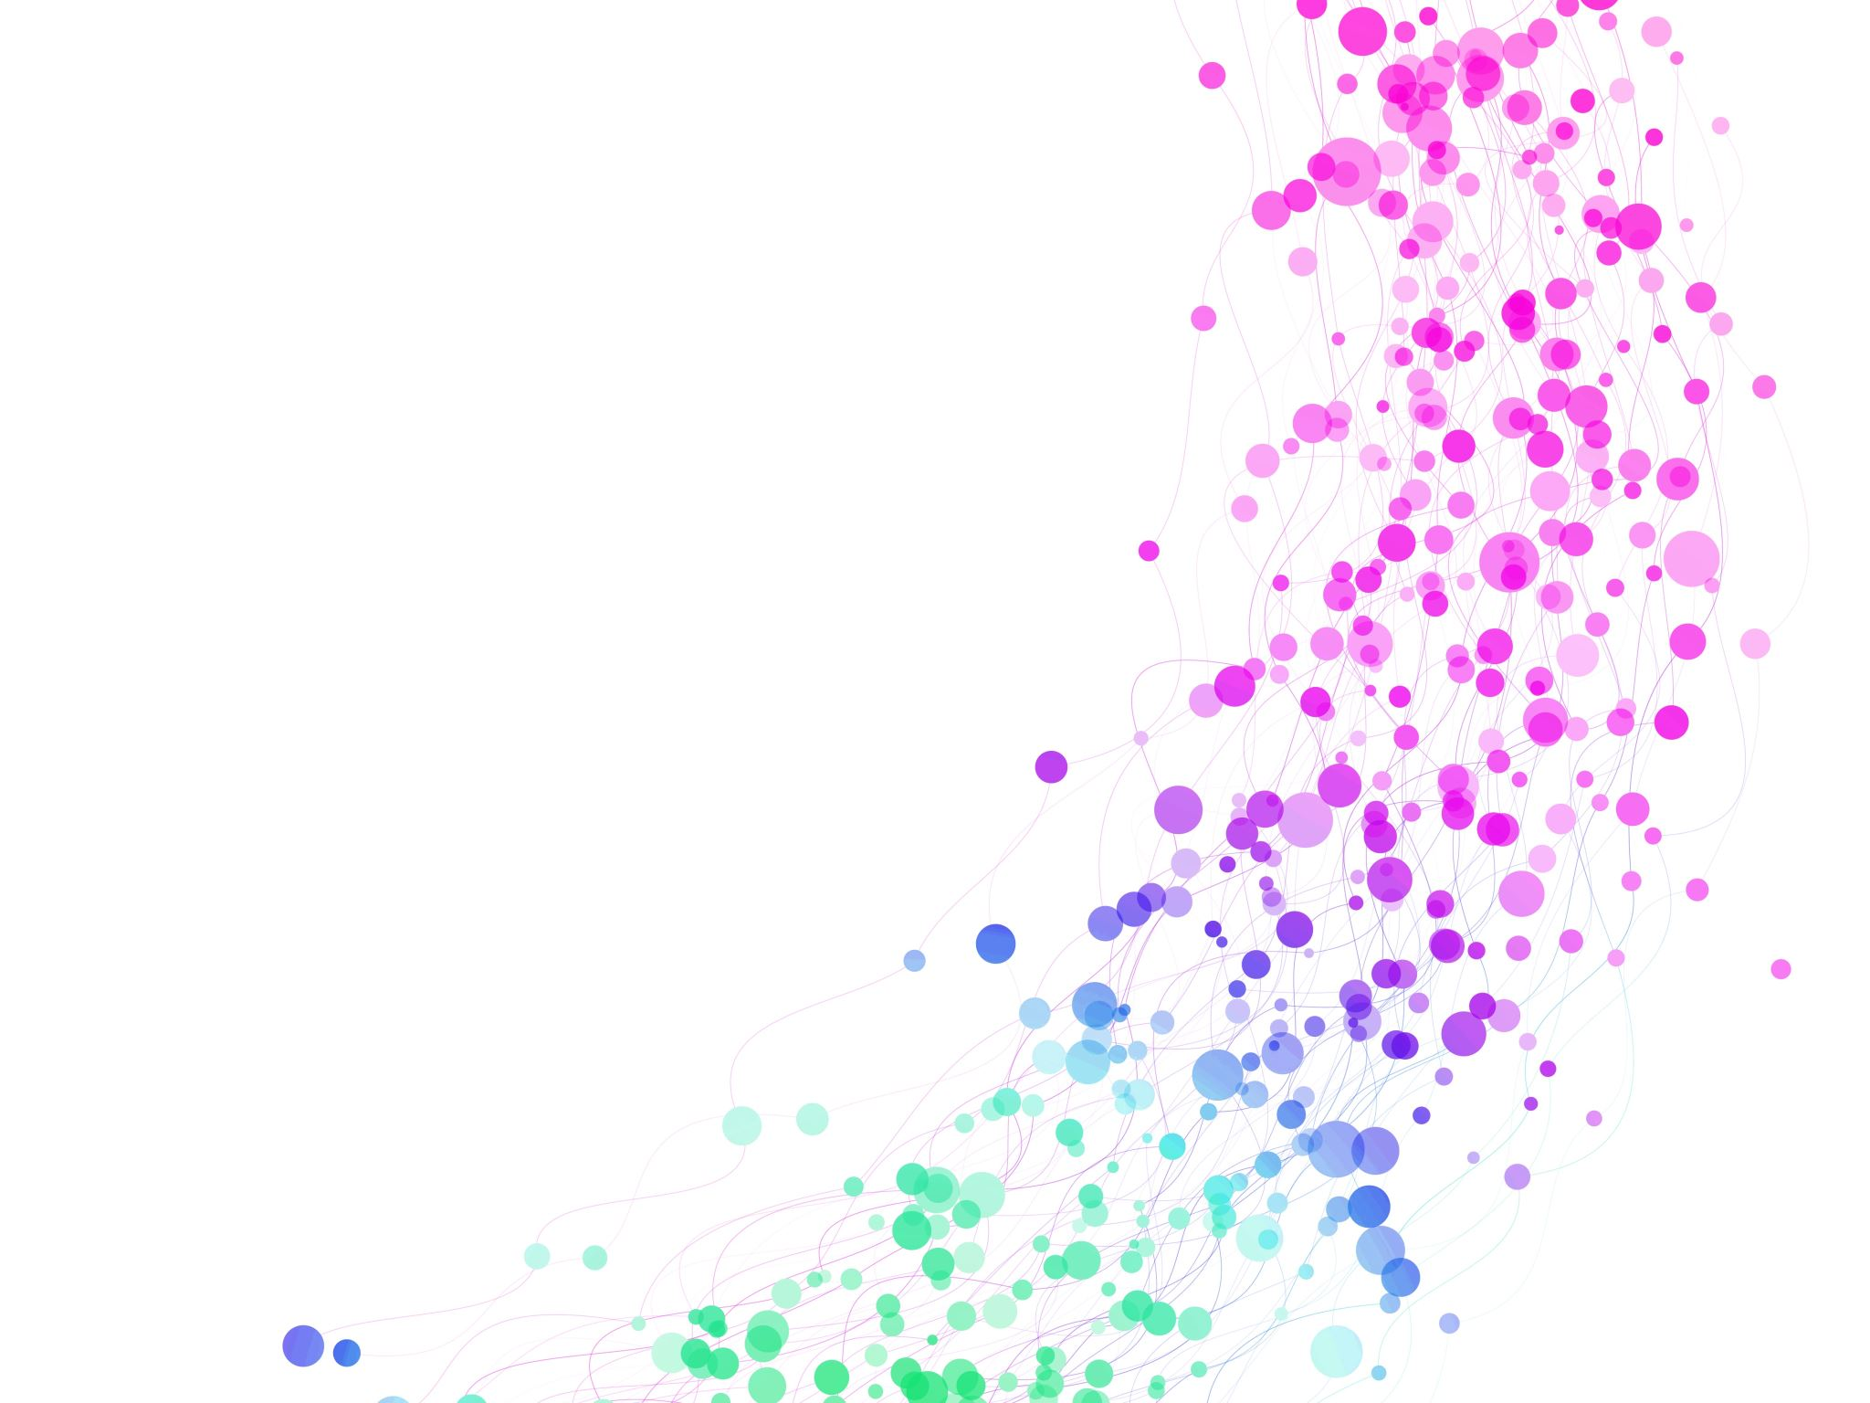
Introduction
Shopping app TrendSprint

Slide 2
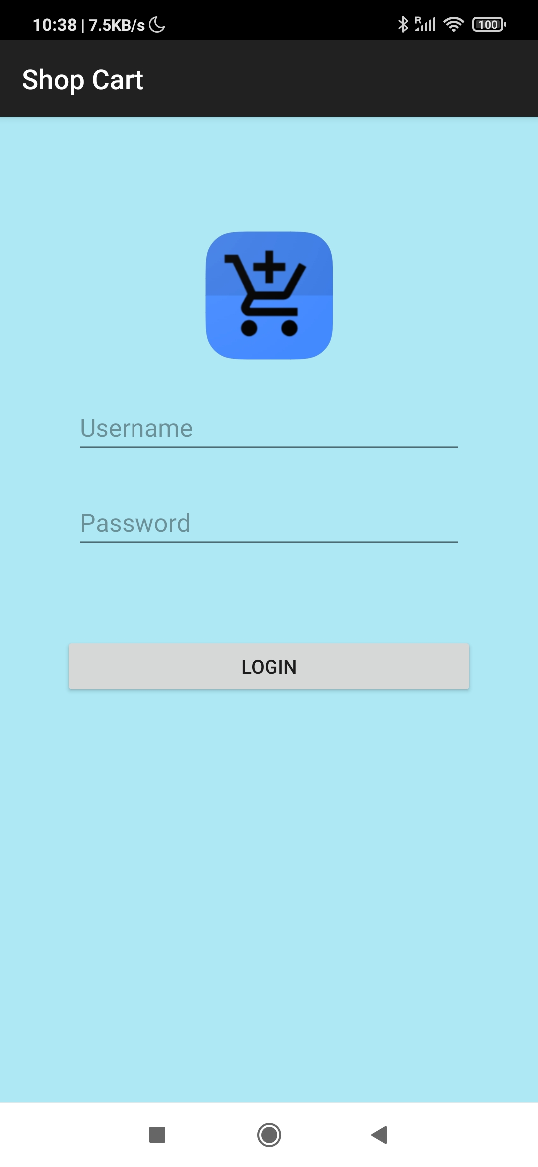
Login Screen
Introduction to the app's login functionality.
Brief explanation of the single-user login with username and password.
Mention of data validation on the login screen.

Slide 3
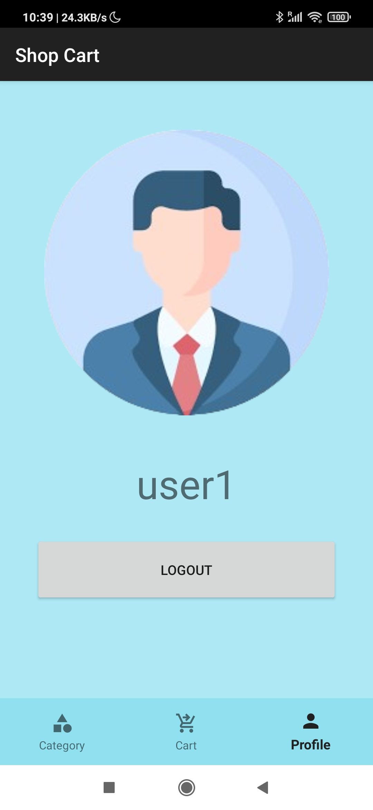
Profile View
Introduction to the profile view.
Mention of user-specific information and settings.
Integration of Hilt and Dagger for Dependency Injection to enhance functionality.

Slide 4
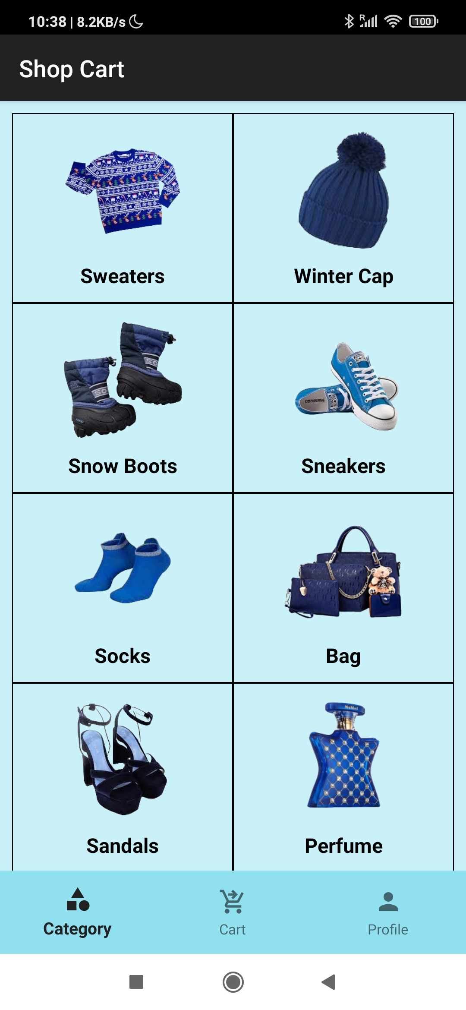
Category View
Overview of the category view for Thanksgiving shopping.
List of categories users can browse (sweaters, winter cap, snow boots, sneakers, variety of socks, bag, sandals, perfume, Christmas gifts for friends).
Visual representation of the category view.

Slide 5
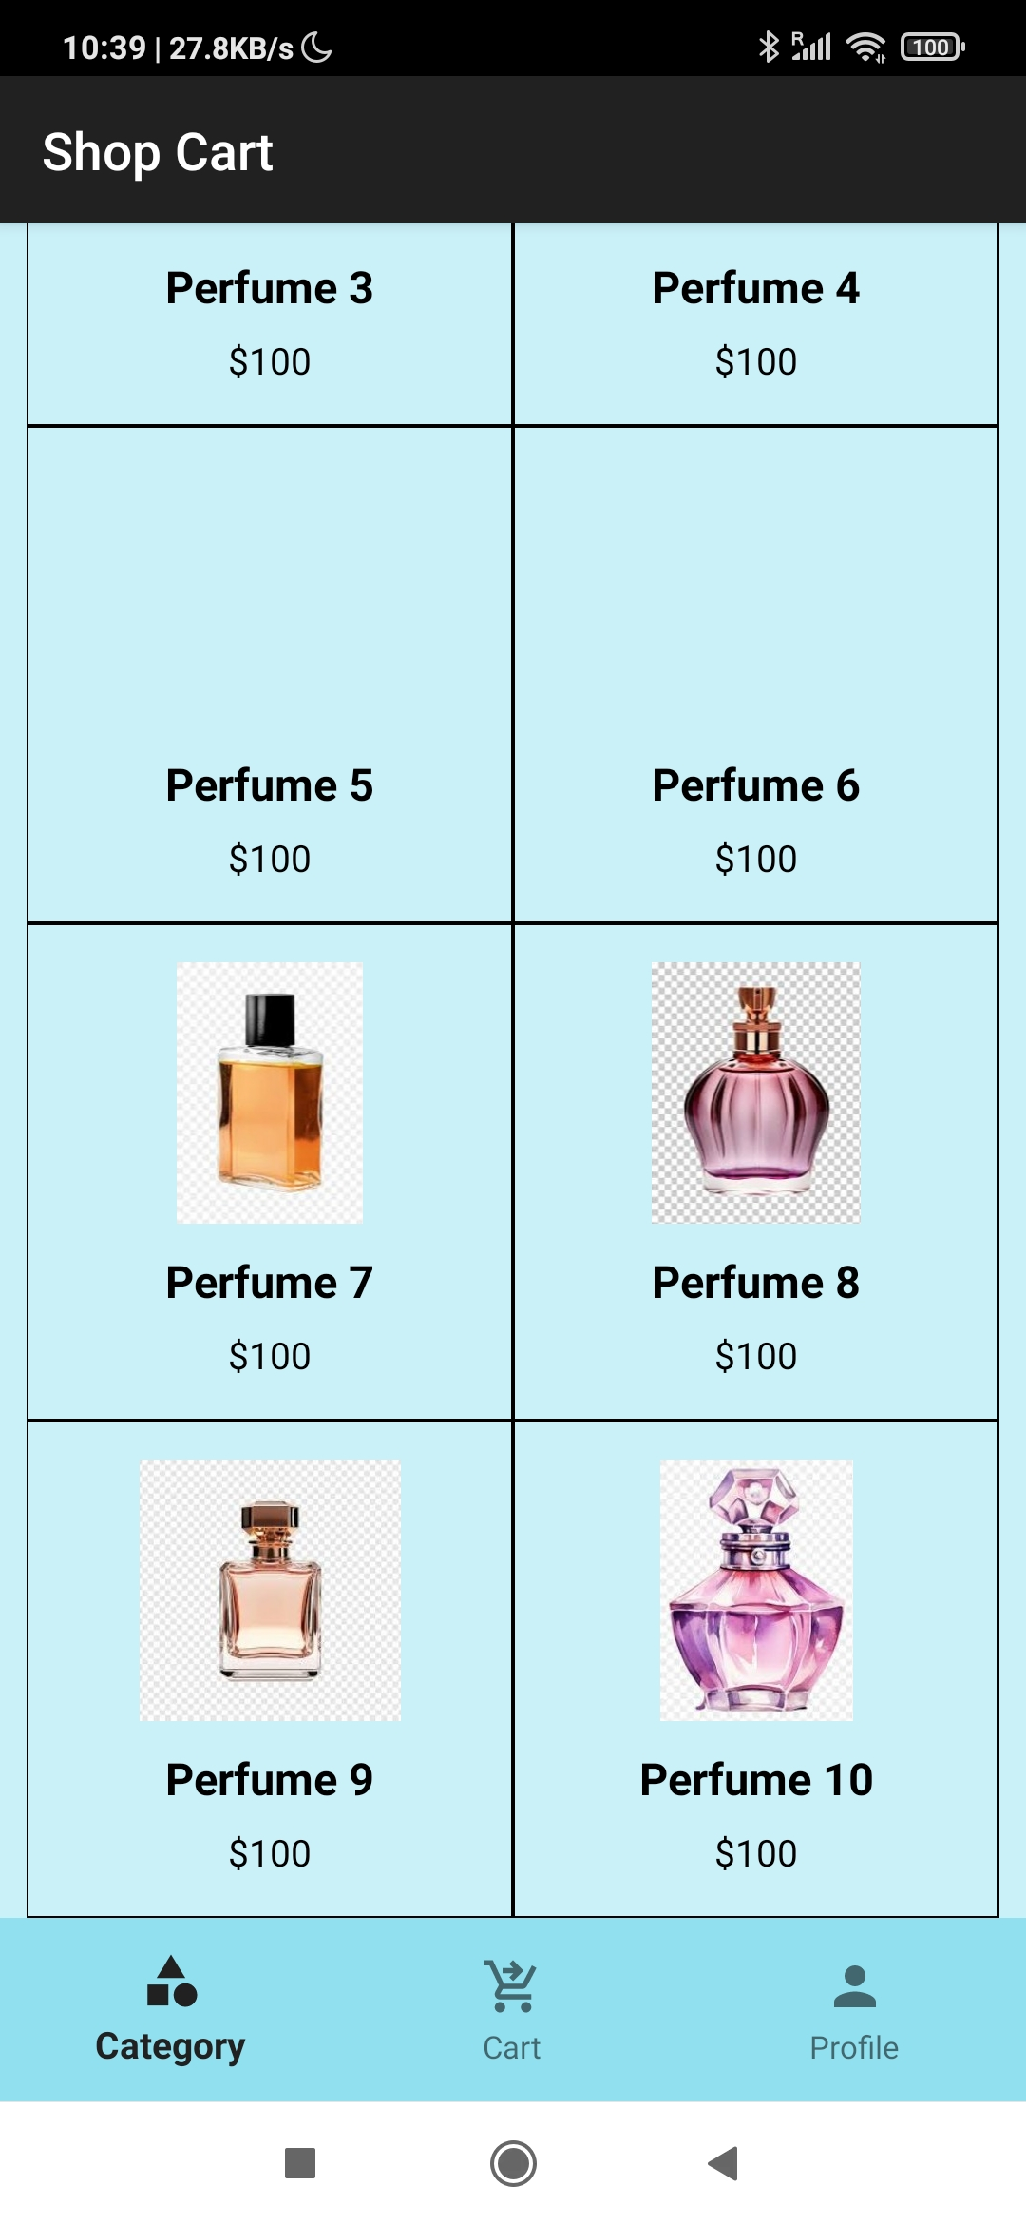
Items View
Introduction to the items view within each category.
Mention of the Recycler view for displaying items.
Visual representation of items displayed in a visually appealing manner.

Slide 6
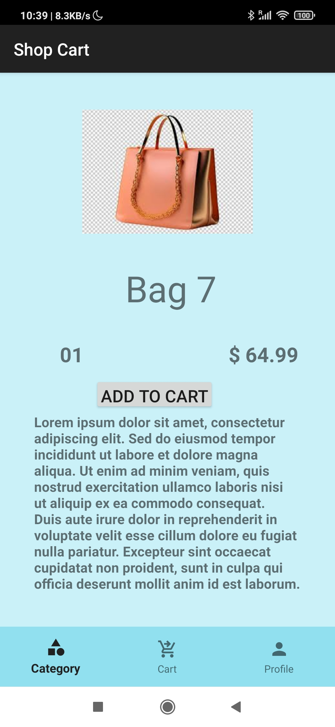
Item Details View
Explanation of the item details view when a specific item is selected.
Inclusion of interactive UI elements for viewing details.
Mention of Jetpack Compose for creating an engaging UI.

Slide 7
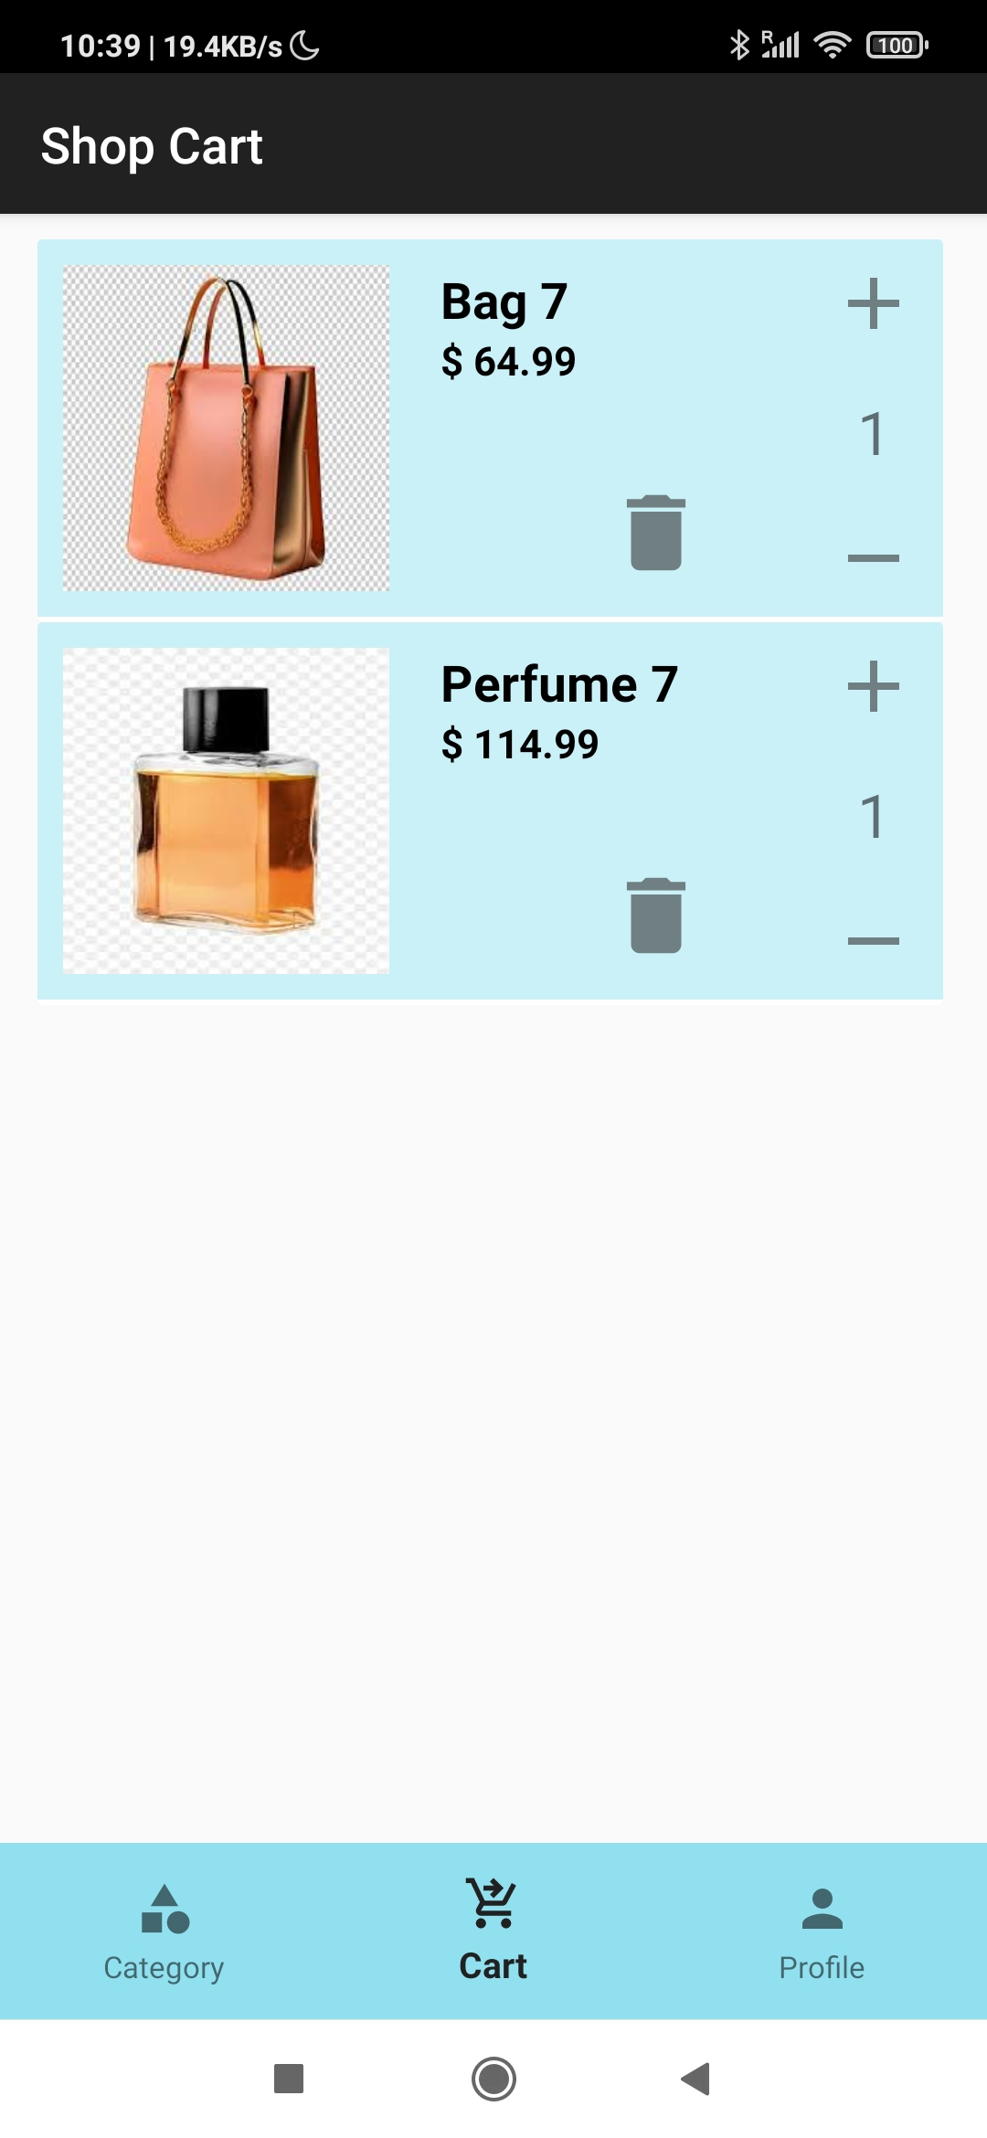
Cart View
Overview of the cart view for managing selected items.
Explanation of the ease of adding and deleting items from the cart.
Visual representation of the cart and its functionalities.

