Slide 1
Copy Quote and Copy Line Items Functionality
23-Sep-2019

Slide 2

Version History
Version | Version Date | Revised By | Reviewed By | Approved by | Reason For change
0.1(Draft) | 09/09/2019 | Sandip/Sanjivani |  |  | First draft.
0.2 | 13/09/2019 | Sandip/Sanjivani |  |  | Changes as per internal review
0.3 | 16/09/2019 | Sandip/Sanjivani |  |  | Allow to change configuration parameter in line item grid.
0.4 | 19/09/2019 | Sandip/Sanjivani |  |  | Draft for review
0.5 | 23/09/2019 | Sandip/Sanjivani |  |  | Review comments provided by Dimas, Joan incorporated
0.6 | 10/12/2019 | Sandip |  |  | Deal Pricing Review Non Standard/Bespoke scenario and Sales Engineer journey

Slide 3
Assumptions, Risks and Dependencies
S.No | Date | Assumption | Status | Stakeholders
1
S.No | Date | Risks | Status | Stakeholders
1
S.No | Date | Dependencies | Status | Stakeholders
1

Slide 4
Key Design Decisions
S.No | Date | Design Decision | Stakeholders
1 | 13/09/2019 | Copy quote option available inside quote to create new quote for selected line items. | Piyush, Luca, Joan, Dimas
2 | 13/09/2019 | Config parameters line contract term, bandwidth and resiliency options allow to change in line item grid to update configuration pre technical approval. | Piyush, Luca, Joan, Dimas
3 | 13/09/2019 | For Quote refresh, rules related to pricing will be same as Copy Quote functionality. Copy Quote changes to pricing rules should also be implemented for Quote refresh.
4. | 13/09/2019 | Post Copy quote, new quote is created and guided message to be shown in new quote for expired connectivity options and restrict user to submit to commercial approval. | Piyush, Luca, Joan, Dimas
5 | 13/09/2019 | In case of overall quote expiry or any one of the connectivity options(non-onnet) are expired user should restrict to submit to commercial approval. | Piyush, Luca, Joan, Dimas

Slide 5
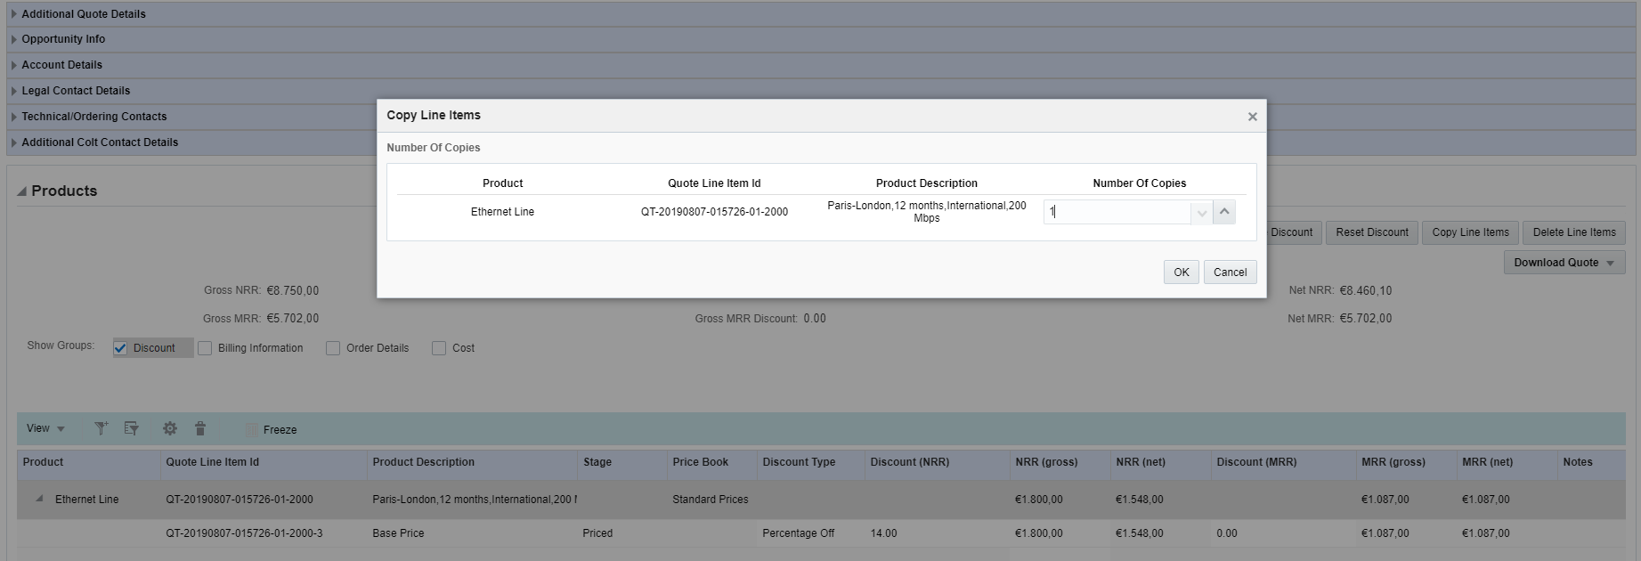
Product and product description display in copy line items.
Add product and product description column in copy line item.

Slide 6

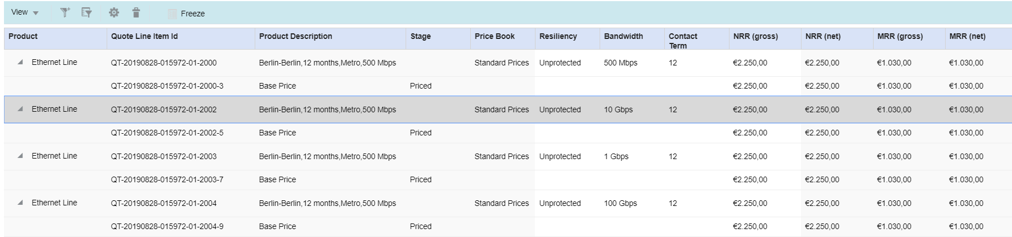
CPQ - Copy Quote within Quote
Solution Approach
Introduce Copy Quote option in standard quote and price lookup quote.
For selected line item system will create new quote and redirect user to newly created standard quote.
Generating new quote by selecting Single or multiple line item, Quote generation logic would be same as multi-quote.
New quote created using Copy quote action will be created against the same opportunity of the original quote unlike multi-quote where new opportunity gets created.
Copy quote functionality is available only for Sales, Quoting Team and Sales Engineer.
Copy quote cannot be performed on Locked quote.
The stage of new quote created using “Copy Quote” action will be explain in further slides.
Copy quote functionality for different Quote stages is covered in further slides.
Quote Type | Copy quote functionality available
Standard | Yes
Price lookup | Yes
Container | No
Multi-Quote | No
Quote Status | Copy quote functionality available
Inprogress | Yes
Expired | Yes
Closed | No

Slide 7
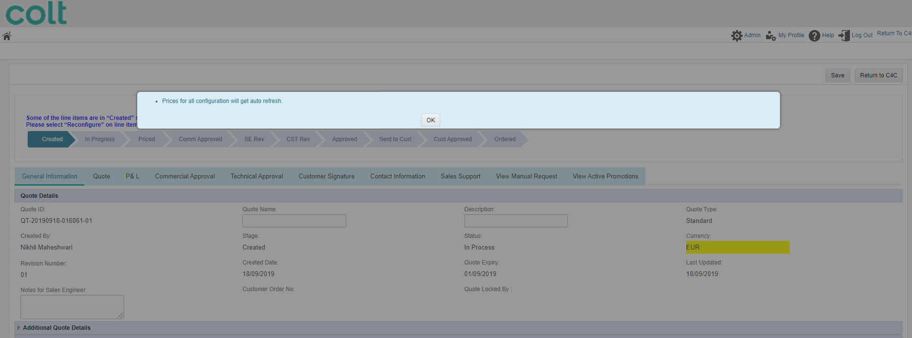
CPQ - Copy Quote within Quote
In Copied quote system show guided message with OK option. On click on OK, system will get updated prices for configuration automatically if required.
Note: Message provided below is example. Exact wording of the message to be agreed.
Guided message will be available base on stage of the original quote and validity of line item from configuration.
If configuration is expired then message would be – Configuration and Prices are automatically copied if they are expired and for updated price, use reconfigure option.
If configuration is valid then message would be – Configuration and Prices are automatically refreshed with updated price if they are not expired i.e. are valid.
If configuration is waiting prices then message would be - When awaiting pricing information from third party/BCP team, configuration is copied with stage as Created, offnet/eXplore requests for price information are not copied.
Configuration and Prices are automatically copied if they are expired and for updated price, use reconfigure option.
Configuration and Prices are automatically refreshed with updated price if they are not expired i.e. are valid.
When awaiting pricing information from third party/BCP team, configuration is copied with stage as Created, offnet/eXplore requests for price information are not copied.
.
Ok

Slide 8
CPQ – Copy Quote within quote and Copy line item
 | Can attributes to be updated in line(Pre technical approval) |  |  | Actions
Line Stage | Contract Term | Resiliency | Bandwidth | Copy Quote within CPQ | Copy Line item(BAU)
Created | Yes | Yes | Yes | Created | Created
To Be priced | Yes | Yes | Yes | To be priced | To be priced
Waiting for third party | No | No | No | Warning message User need to raise a new request with third party/BCP to get information for the copied line item. Stage Created Note1 | Stage is Waiting for third party/ Waiting for BCP On going request are valid for copied line items as well and appear in View Manual request tab as well.
Waiting for BCP | No | No | No
Estimated | Yes | Yes | Yes | Estimated | Estimated
Rejected by PPT | No | No | No | To be priced | To be priced
Waiting for portfolio pricing | No | No | No | To be priced(for unlock quote) Note2 | To be priced(for unlock quote) Note2
Priced | Yes | Yes | Yes | Priced | Priced
Bespoke Identified | Yes | Yes | Yes | Created(All Bespoke elements and costs identified by Sales Engineers will be retained .But the line items will move to Bespoke Identified only when Sales Engineer logs in again reconfigures and saves the configuration ) | Bespoke Identified
Non Standard | Yes | Yes | Yes | Created(All Non Standard and costs identified by Sales Engineers will be retained .But the line items will move to Non Standard only when Sales Engineer logs in again reconfigures and saves the configuration ) | Non Standard
Note1: Message provided below is example. Exact wording of the message to be agreed.
When awaiting pricing information from third party/BCP team, configuration is copied with stage as Created, offnet/eXplore requests for price information are not copied.
Note2:When the quote is pending with PPT team, Quote is locked for Sales user. Copy quote cannot be performed on Locked quote..

Slide 9
Copy Quote in CPQ and C4C
 |  |  | Actions
 | Quote stage | Copy Line item(BAU) | Copy Quote inside Quote | Copy quote in C4C and CPQ outside of Quote(BAU) | Copied Quote stage
Commercial Approval | Created | Yes | Yes | Yes | Created
 | To Be priced | Yes | Yes | Yes | To be priced
 | Waiting for third party | Stage is Waiting for third party/ Waiting for BCP On going request are valid for copied line items as well. | Warning message User need to raise a new request with third party/BCP to get information for the copied line item. Stage Created | Warning message. User need to raise a new request with third party/BCP to get information for the copied line item. Stage Created | Created
 | Waiting for BCP
 | Estimated | Yes | Yes | Yes | Estimated
 | Deal pricing review required | Yes | Yes | Yes | Created
 | Rejected by PPT Note1 | No | Yes | Yes | To be priced
 | Waiting for portfolio pricing | No | Yes(for unlock quote) | Yes | To be priced
 | Portfolio pricing review | No | Yes(for unlock quote) | Yes | To be priced
 | Priced | Yes | Yes | Yes | Priced
 | Deal Pricing Review(Priced) | No | Yes | Yes | Priced
 | Deal Pricing Review(Non Standard/Bespoke Indetified) | No | Yes | Yes | Created
 | Commercially Approved (Deal pricing approval) | No | Yes | Yes | Priced
 | Commercially Approved (Self approval) | No | Yes | Yes | Priced
 | Commercially Approved (Bespoke/Non-Standard) | No | Yes | Yes | Created
 | Approval Denied | No | Yes | Yes | Priced
Technical Approval Note2 | SE Technical Review | No | Yes(for unlock quote) | Yes | Priced
 | CST Technical Review | No | Yes(for unlock quote) | Yes | Priced
 | Approved | No | Yes | Yes | Priced
 | Sent to Customer | No | Yes | Yes | Priced
 | Accepted by Customer | No | Yes | Yes | Priced

Slide 10
Quote stage : Deal pricing review required – Copy Quote action
Product | Original Quote |  | Action | Copied Quote
Wave | Quote stage | Deal pricing review required | Copy Quote | Quote stage | Created
 | Base price | Non-standard |  | Base price | Created
 | Feature | Priced |  | Feature | Priced
Ethernet | Quote stage | Deal pricing review required | Copy Quote | Quote stage | Created
 | Base price | Priced |  | Base price | Priced
 | Feature-bespoke | Bespoke identified |  | Feature-bespoke | Created
Note - All Bespoke elements and costs identified by Sales Engineers will be retained .But the line items will move to Bespoke Identified only when Sales Engineer logs in again and saves the configuration .

Slide 11
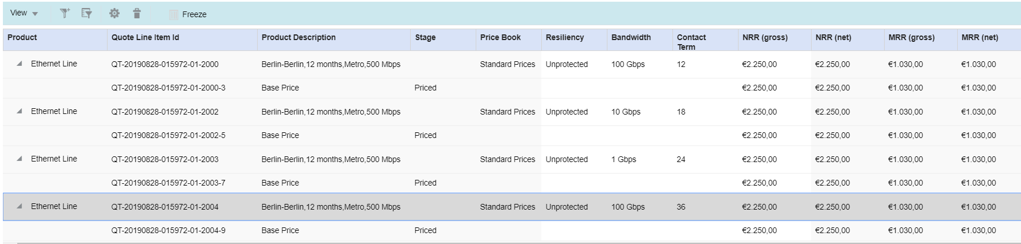
Update Configuration - Options to change config parameters
Resiliency , Bandwidth and contract term allow to change in line item grid.
As per existing functionality, Resiliency / Bandwidth will be drop down list and contract term will free text.
For selected line items on click on Update configuration system update configuration and recalculate the prices.
User entered configuration is not valid, system will move line item to created stage. No pop-up message presented to the user. User need to manually reconfigure. Guided message will be presented at the top. This is existing functionality.
System allow to check config parameters till Price stage.

Slide 12
Revise Commercial
 | Field Name | Is update allowed in line item grid
Revise Commercial pre technical Review | Contract Term | Y
 | Resiliency | Y
 | Bandwidth | Y
Revise Commercial post technical Review | Contract Term | Y
 | Resiliency | N
 | Bandwidth | N

Slide 13
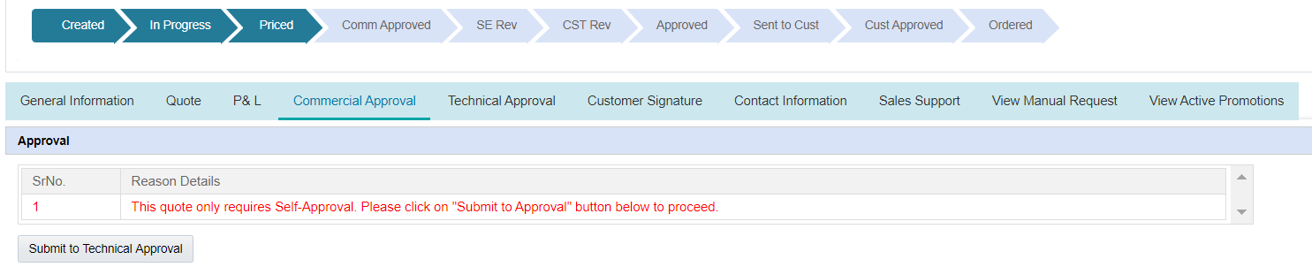
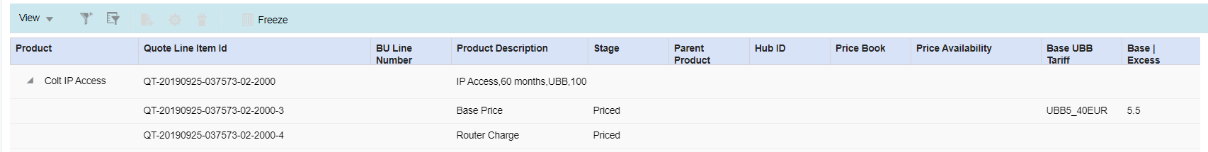
Expired non-onnet configuration
CPQ must NOT allow a user to submit a quote for customer acceptance if its expiry date is in the past of any one of the line item. Any such quote must be revised first to get prices/costs refreshed/revalidated before it can progress further for any kind of governance or customer acceptance process/activity
On click on Submit to Technical Approval message would be One of the configuration is expired, so please reconfigure and get it price before submitting for approval.
Same message would be available as guided message on top in case of configuration expired.
Notes:
OK. Maybe to include and example here about how the journey would be in this case?

Slide 14
Quote Refresh
For Quote refresh, rules related to pricing will be same as Copy Quote functionality.
Copy Quote changes to pricing rules should also be implemented for Quote refresh.

Slide 15
Copy Quote and Copy Line item Summary
 | Current implementation | New functionality
Copy Quote option (Inside Quote) | Not available | Introduce Copy Quote option in standard quote and price lookup quote inside Quote. For selected line item system will create new quote and redirect user to newly created standard quote. Guided message to be shown in new quote for expired connectivity options and restrict user to submit to commercial approval.
Guided Message |  | In case of non onnet configuration expiry system will show guided message.
On-net | Configuration and Prices are automatically copied and using “Refresh All Prices” to get updated prices. | Clicking Refresh All action manually is not required to get updated prices. System show guided message with OK option. On click on OK, system will get updated prices for configuration automatically in case of change in price
Non-Onnet (Expired) | “Non – Onnet” configurations (Manual and Automated) will be removed. User will have to manually reconfigure all line items with the non on-net configurations. | Configuration is automatically copied with prices. System will show guided message asking user to reconfigure manually to get the updated prices.
Non-Onnet (Valid) | “Non – Onnet” configurations (Manual and Automated) will be removed. User will have to manually reconfigure all line items with the non on-net configurations. | Configuration is automatically copied with prices.
Pricing exception scenarios | Pricing exception scenarios corrected by portfolio pricing will be mark as To Be Priced. | System will retain the prices in copied quote and mark line item in Priced.
Awaiting pricing information from third party/BCP team | Configuration is copied with stage as Created, offnet/eXplore requests for price information are not copied. | Copy Quote – No Change. Copy Line item - On going request are valid for copied line items as well and appear in View Manual request tab as well
Copy Line item popup | Quote Line item id and Number of Copies presented in Copy Line Item window | Addiionally product and product description will be presented in Copy Line item window
Contract term, bandwidth and resiliency | Cannot be changed pre technical approval. | Can be changed in line item grid pre technical approval.
Quote refresh – rules related to pricing | Same as existing Copy Quote pricing rules | Copy Quote changes to pricing rules will be implemented for Quote refresh.

