Slide 1
PROJECT TITLE Secure data hiding using steganography
CAPSTONE PROJECT
Student Name : Keerthivasan E
College Name & Department : Vellore Institute of Technology

Slide 2
OUTLINE
Problem Statement
Technology used
Wow factor
End users
Result
Conclusion
Git-hub Link
Future scope

Slide 3
Problem Statement
With rising cyber threats, securing sensitive data is crucial. Traditional encryption methods can attract attention, making data a target. Steganography offers a way to hide data within images, audio, or text, ensuring discreet transmission. The challenge is to develop an efficient and undetectable method for embedding and extracting hidden information while maintaining file integrity and quality.

Slide 4
Technology used
LSB (Least Significant Bit) Substitution – Modifies the least significant bits of pixel values to embed data without noticeable changes.DCT (Discrete Cosine Transform) – Hides data in the frequency domain of images, commonly used in JPEG compression.DWT (Discrete Wavelet Transform) – Embeds data in wavelet coefficients, offering better resistance to compression and scaling.PVD (Pixel Value Differencing) – Uses differences between adjacent pixel values to determine how much data can be hidden.F5 Algorithm – An advanced steganography method that reduces detectability by minimizing changes in the image histogram.Adaptive Steganography – Dynamically selects embedding regions based on image complexity to improve security and undetectability.Deep Learning-based Steganography – Uses neural networks to enhance hiding and extraction processes, making detection harder.

Slide 5
Wow factors
The WOW (Wavelet Obtained Weights) steganography technique enhances security by embedding data in less detectable regions of an image. It uses human visual system (HVS) principles and wavelet transforms to minimize distortion, making hidden data harder to detect by steganalysis tools.
Key Features of WOW Steganography:
Adaptive Embedding – Prioritizes complex regions (edges, textures) to reduce visual artifacts.
Reduced Detectability – More resistant to modern steganalysis techniques like SCA (Subtractive Clustering Attack).
Preserves Image Quality – Uses perceptual weighting to maintain high visual fidelity.

Slide 6
End users
Cybersecurity Experts – Use steganography for secure data transmission and anti-forensics.
Journalists & Activists – Hide sensitive information to evade censorship or surveillance.
Military & Intelligence Agencies – Secure covert communication and classified data.
Forensic Analysts – Detect and analyze hidden data in criminal investigations.
Corporate Sector – Protect intellectual property and confidential documents.
Hackers & Ethical Hackers – Use for penetration testing or, in unethical cases, for covert data
exfiltration.

Slide 7
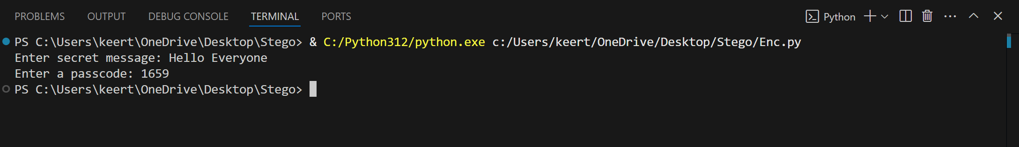
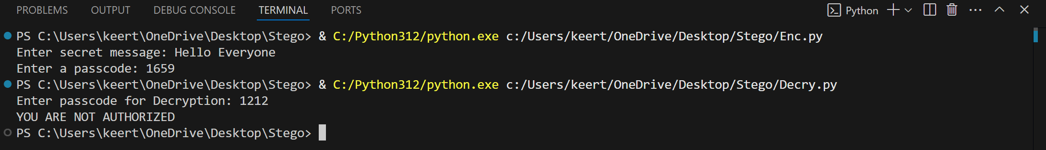
Results

Slide 8



Slide 9


Slide 10
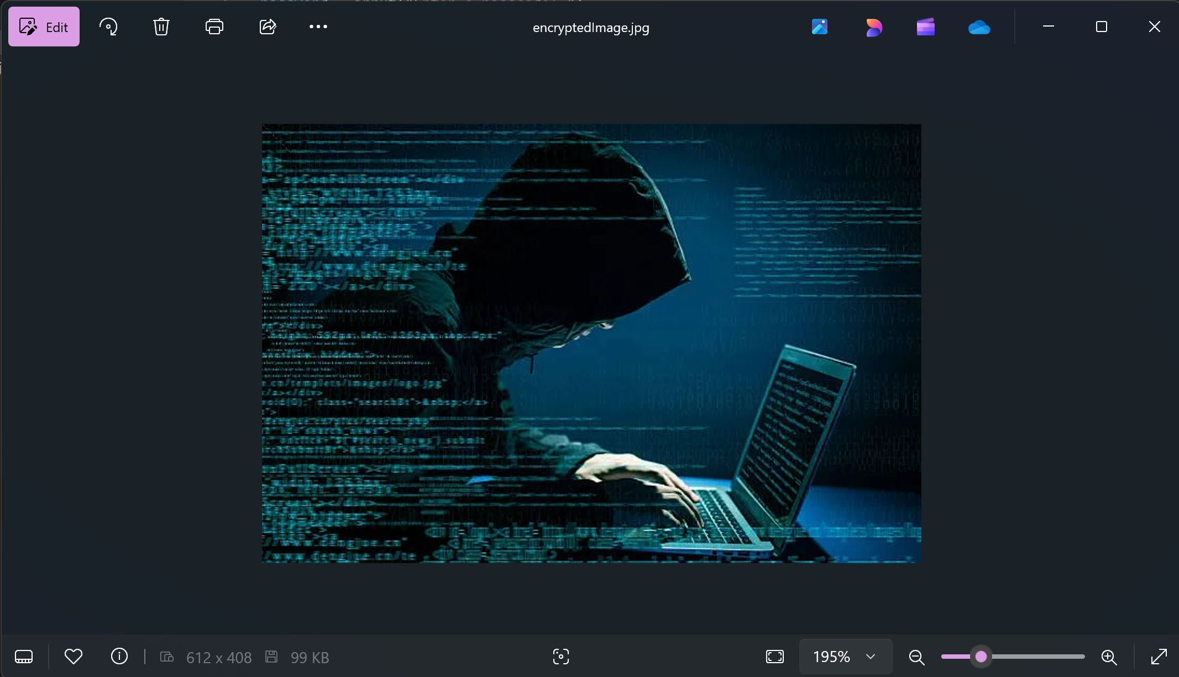

Slide 11
Conclusion
In an era of rising cyber threats, image steganography provides a powerful method for secure data hiding and transmission. By embedding information within images using techniques like LSB, DCT, DWT, and WOW, we can ensure confidentiality while maintaining image integrity. This approach is crucial for cybersecurity, journalism, military applications, and corporate security. While steganography enhances secrecy, it must be combined with encryption for maximum security against detection and attacks. Future advancements in AI-driven steganography will further strengthen its effectiveness and resistance to steganalysis.

Slide 12
GitHub Link

Slide 13
Future scope(optional)
The future scope of this project includes enhancing encryption techniques using advanced cryptographic methods, integrating AI-driven security features, and improving efficiency in message extraction. Expanding support for different image formats, cloud-based secure decryption, and multi-factor authentication can further strengthen security. Real-time decryption applications in cybersecurity and secure communications are promising.

Slide 14
THANK YOU

