Slide 1
Investigation of Unauthorized Transactions Caused by
Compromised Fintech Customer Accounts
NuePay | Incident Investigation Track
Abigail Kwablah | September 2026

Slide 2
Organization & Incident
NuePay
What Happened
Fictional mobile peer-to-peer payment fintech, ~1,200 active customers.
Customers send and receive funds directly through the NuePay app.
SMS phishing message impersonating NuePay: “Your account is locked. Verify now.”
3 customers submitted credentials on a fake login page.
Attacker authenticated with password only, no OTP, from one external IP/device.
Funds transferred from all 3 accounts to a single external account within minutes of login.

Slide 3
Objectives & Scope
Objectives
Scope
Reconstruct the phishing vector and how it induced credential disclosure
Trace the attack path from credential theft to unauthorized transactions
Analyze authentication and transaction evidence
Assess the weaknesses that enabled compromise
Confirm the activity is externally driven, not insider
Recommend practical containment and remediation controls
In scope: the 3 compromised accounts, the campaign window, phishing-to-transfer chain, related authentication and transaction logs.
Out of scope: broader NuePay infrastructure, unrelated customers, a full security architecture redesign.

Slide 4
Investigation Approach
1
2
3
4
5
6
Collect
evidence
Correlate
logs
Determine
root cause
Assess
impact
Define
response
Verify with
AI
Two authentication and transaction log files (25 and 14 events) served as the sole evidence base, cross-referenced at every stage.

Slide 5
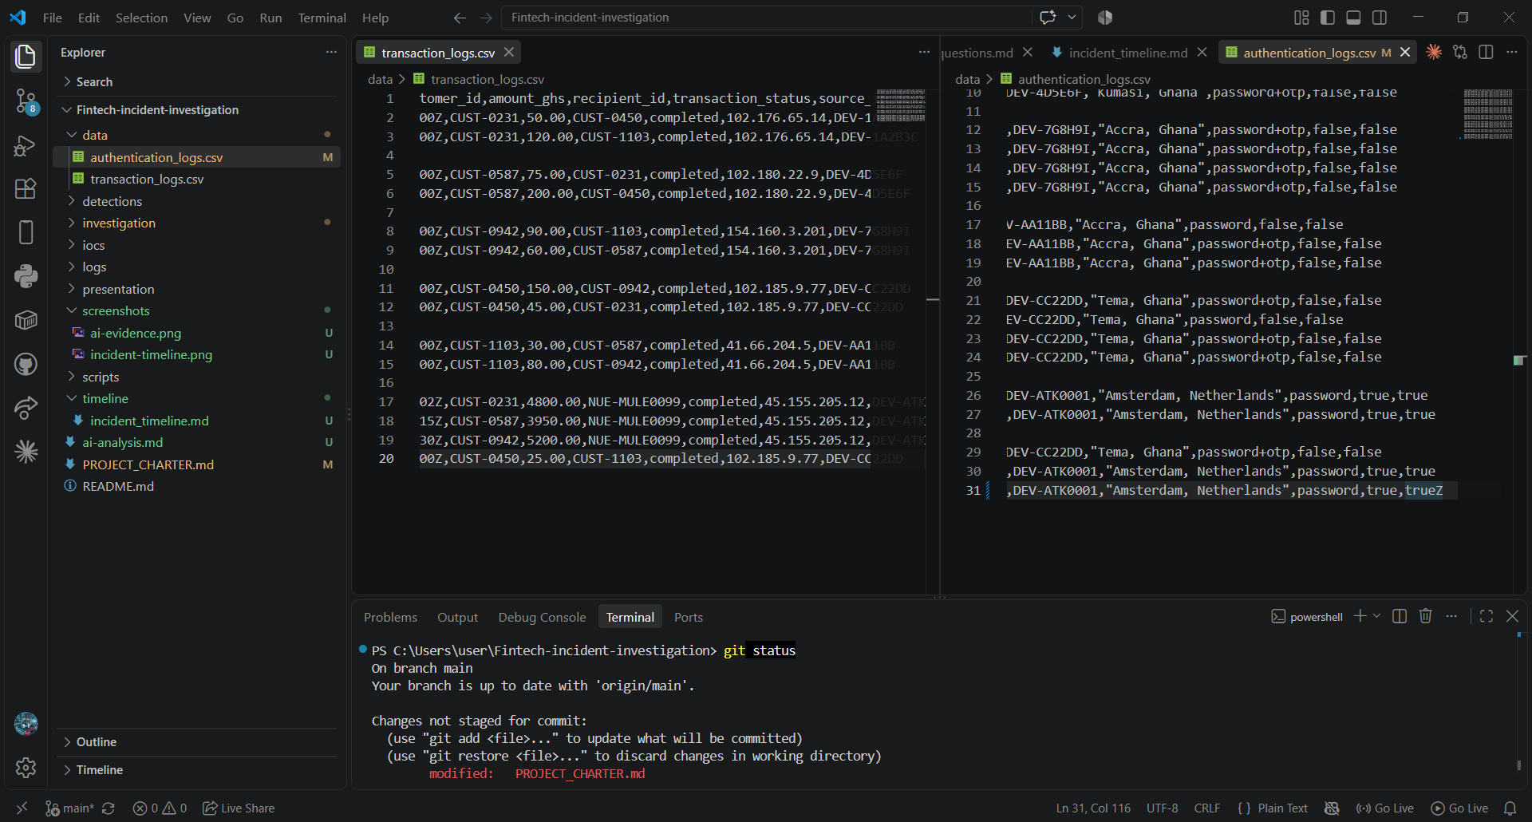
Key Findings
3 accounts compromised (CUST-0231, CUST-0587, CUST-0942) via SMS phishing
All attacker logins used password only; every legitimate login used password+otp
Single external IP/device (Amsterdam) accessed all 3 accounts within a 5-hour window
Each login was followed by a transfer within ~2 minutes, to one shared external account
Login-to-transaction correlation, from investigation evidence

Slide 6
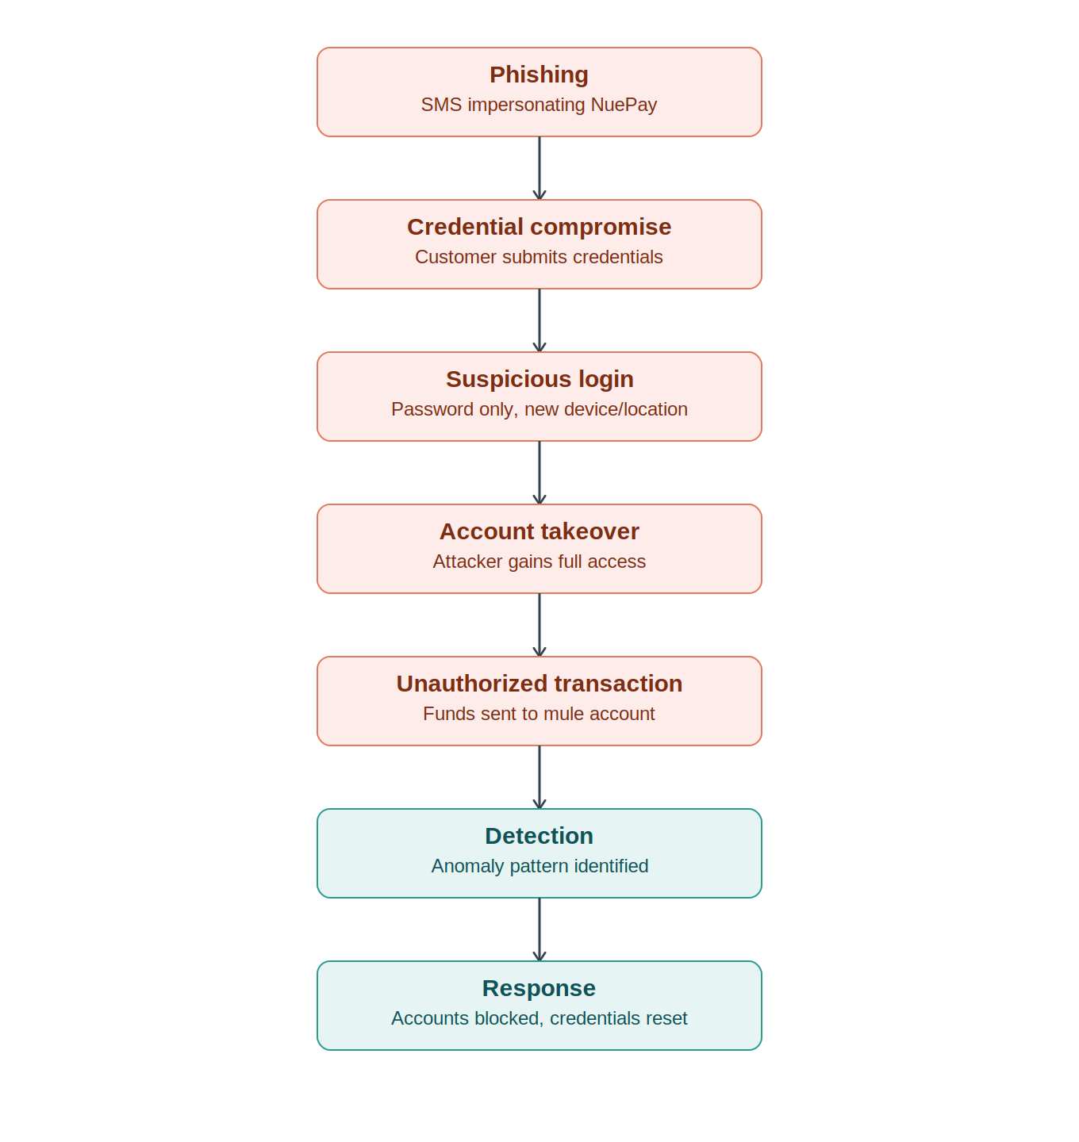
Critical Finding
GHS 13,950.00
moved out of 3 customer accounts to a single external account,
within minutes of each phishing-driven login
Root cause: OTP was NuePay’s standard second factor, but was not enforced on every login path, so a stolen password alone was sufficient for full account access.

Slide 7
Recommendations
1
Enforce OTP on every login path
No login path should accept password alone. Closes the primary root cause.
2
Act on device/location anomaly flags
Auto-block or step-up verify when new-device and new-location flags fire together, instead of only logging them.
3
Customer phishing awareness messaging
Standing notice that NuePay never requests verification via SMS link, plus an easy reporting path.

Slide 8
Lessons Learned
Log correlation across authentication and transaction data was the core investigative skill; the incident only becomes visible when the two files are read together.
AI-assisted analysis correctly surfaced the primary anomaly, but required human verification to correlate across files and map to MITRE ATT&CK.
A control that exists (OTP) is not the same as a control that is enforced, and the gap between the two was the actual root cause.
Next time: build the anomaly-detection and transaction datasets together from the start, rather than sequentially.

