Slide 1
How Do Hurricanes Form?
1-3 곽민석 류성현 배성현 전병준 최진웅

Slide 2
Key words/Interpretation

Slide 3
Hurricanes from only over ocean water that has a temperature of 26 or more
degrees Celsius. This is why they are common in tropics where water
temperatures are high all year round. When warm air rises, creating low
pressure over the water surface, cooler air from near by enters to fill the area.
As this process continues, the resulting clouds begin to expand, giving rise
to rains and thunderstorms. The thunderstorms then begin to move in
circles around a central point, due to the rotation of Earth.
This point is called a tropical depression. As the tropical depression moves
over warmer waters, the clouds expand and the wind begin to build up speed,
, becoming a "tropical strom." As the storm grows, the wind increases,
achieving speeds of as much as 118km per hour. At this point the storm
officially becoes a hurricane It is now a huge storm that can be seen from
space. Interestingly enough, the strom has a calm center, which is called
the "eye."
8. Topic/Main Sentences

Slide 4
degree
- 도 (각도)
- 학위
- 온도

Slide 5
rotate(V)
- 회전하다
- 교대하다
rotation(N)
- 회전
- 자전

Slide 6
Tropical Depression
-열대성 저기압
Tropical(Adj)
- 열대의
Depression
- 우울함
- 저기압

Slide 7
enpand(v)
- 확장하다
- 팽창하다

Slide 8
Topic/Main Sentences

Slide 9
1. The conditions and processes on which hurricanes are formed.
2. The name of winds according to their size.

Slide 10
Q 1.2

Slide 11
Why are hurricanes common in the tropics?
>It is because water temperatures there are high all year round
How fast should a storm be for it to be officially called a hurricane?
>A storm is officially called a hurricane its speed reaches about 118 km per hour.

Slide 12
Hurricanes from only over ocean water that has a temperature of 26 or more
degrees Celsius. This is why they are common in tropics where water
temperatures are high all year round. When warm air rises, creating low
pressure over the water surface, cooler air from near by enters to fill the area.
As this process continues, the resulting clouds begin to expand, giving rise
to rains and thunderstorms. The thunderstorms then begin to move in
circles around a central point, due to the rotation of Earth.
This point is called a tropical depression. As the tropical depression moves
over warmer waters, the clouds expand and the wind begin to build up speed,
, becoming a "tropical strom." As the storm grows, the wind increases,
achieving speeds of as much as 118km per hour. At this point the storm
officially becoes a hurricane It is now a huge storm that can be seen from
space. Interestingly enough, the strom has a calm center, which is called
the "eye."

Slide 13
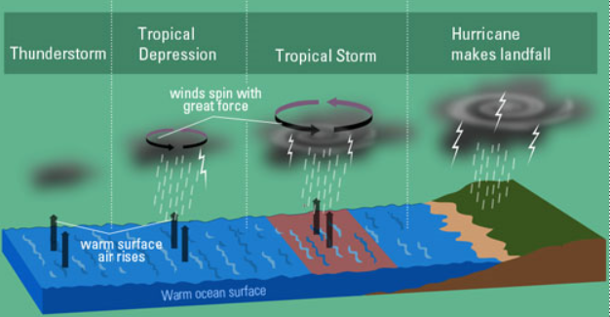

Slide 14
Grammer

Slide 15
How Do Hurricanes Form?
Hurricanes form only over ocean water (that
has a temperature of 26 or more degrees Celsius).
주격관계대명사
This is why they are common in the tropics
where water temperatures are high all year
round.
의문사(명사절)
관계부사

Slide 16
How Do Hurricanes Form?
When warm air rises, (creating low pressure
over the water surface), cooler air from nearby
enters to fill the area.
자동사(수동태ⅹ)
분사 구문
‘~하기 위해서’to부정사(목적)

Slide 17
How Do Hurricanes Form?
As this process continues, the resulting clouds
begin to expand, [giving rise to rains and
thunderstorms.]
‘~하면서’(부사절 접속사)
분사 구문
▶ begin : to부정사와 동명사를 목적어로 취하는 동사

Slide 18
How Do Hurricanes Form?
The thunderstorms then begin to move in circles around a central point, due to the rotation of
Earth.
‘~ 때문에’(전치사구) =>뒤에 명사구가 온다.
This point is called a tropical depression.
수동태

Slide 19
How Do Hurricanes Form?
As the tropical depression moves over warmer waters, the clouds expand and the winds begin to build up speed, [becoming a "tropical storm.“]
이어 동사
분사 구문
At this point the storm officially becomes a hurricane. It is now a huge storm [that can be
seen from space.]
관계대명사

Slide 20
How Do Hurricanes Form?
Interestingly enough, the storm has a calm
center, which is called the "eye.“
Interestingly를 수식
관계대명사(계속적 용법)
▶which :
[문장전환] ~ the storm has a calm center, and it
is called the “eye”

Slide 21
END

