Slide 1
UTAS Social Network Analysis System
Social Network Analysis for Student Political Campaign Planning
Hassan Benjamin · Final Year Project Defense · University of Technology and Applied Sciences
Notes:
Good morning/afternoon. My project is a web-based Social Network Analysis system that maps student friendship networks at UTAS and turns that structure into practical guidance for student political campaign planning. I will walk through the problem, how I built the system, how I collected real data with Google Forms, and what the analysis of that data actually shows.

Slide 2
Presentation Outline
The problem and objectives
Related work the project builds on
Methodology and technology stack
Data collection through Google Forms
Cleaning real survey data
The system: walkthrough and live deployment
Results of the analysis and what they mean
Limitations, future work, and conclusion
Notes:
One minute on the roadmap so the panel knows where we are going. Mention the live demo is available at the end if time permits.

Slide 3
The Problem
Campaigns run on instinct. TESCON and TEIN organisers plan outreach from personal familiarity and guesswork about who is popular.
Networks are invisible. Nobody can see who actually connects otherwise-separate friend groups, or which parts of campus a campaign keeps missing.
Effort goes to the wrong people. Outreach lands on students who were already reachable, while genuinely well-placed students are never identified.
The gap: no structured, evidence-based tool exists for this at UTAS.
Notes:
Frame the problem in one sentence: student campaigns are planned blind. The friendship network that decides how influence spreads exists, but nothing measures it. That is the gap the system fills.

Slide 4
Objectives
Main: design and implement a web-based SNA system that models UTAS student friendship networks to support evidence-based campaign planning.
1. A relational data model and survey-based import pipeline for student and friendship data.
2. Centrality, PageRank, community-detection, and bridge-node algorithms over the network.
3. A role-based web interface with dashboards, rankings, an interactive graph, and reports.
4. A campaign-planning feature that turns the analytics into named outreach recommendations.
Notes:
Read the main objective, then note each specific objective maps to a part of the finished system -- and all four were met, which Chapter 5 of the thesis walks through.

Slide 5
Related Work
Mameli et al. (2022): SocMINT tracked an Italian election with graph metrics + sentiment on social media. Borrowed the graph-centred instinct; dropped platform scraping.
Khan et al. (2020): community detection revealed real supporter strength on Twitter. Same premise, but on consented survey data.
Liu et al. (2026): students in central/bridging positions had measurably better civic outcomes -- the closest study to this setting.
Paulis (2020): network position predicts party activism better than formal role.
Stier et al. (2018): campaigns unknowingly narrow their message to their own network -- exactly what bridge-node analysis guards against.
Notes:
One line per study. The common thread: network position predicts influence and engagement. The difference: every one of these worked on public social-media data or an existing dataset -- this project is an operational tool on primary, consented survey data.

Slide 6
Methodology & Technology
Process: Agile, iterative cycles -- plan, design, build, test, review -- each leaving a working system.
Backend: Python, Flask REST API, SQLAlchemy, SQLite
Analysis: NetworkX (degree, betweenness, closeness, eigenvector, PageRank), python-louvain (community detection), bridge-node identification
Frontend: React + TypeScript, Tailwind CSS, interactive force-directed graph
Auth: JWT with three roles -- Student, Campaign Manager, Administrator -- enforced on the API
Quality: 78 automated backend tests; TypeScript checks; live verification
Notes:
Keep this brief unless asked. The panel cue: every algorithm named here is an established, peer-reviewed technique -- the contribution is applying them in one operational system for this specific campus problem.

Slide 7
Data Collection — Google Forms
Instrument: structured survey; each submission names one close friend (3-5 encouraged).
Section 1 - About You: name, gender, programme, college, year, party, religion, tribe, regional capital, hometown
Section 2 - About This Friend: the same attributes for the named friend
Scope: campus-wide -- friends from any class, programme, or college count.
Consent: voluntary, informed responses; no scraping of any social-media platform.
Import: the Forms spreadsheet exports to Excel and imports directly into the system.
Notes:
Explain why survey and not scraping: platform terms of service forbid it, and consent matters when real students' relationships are being stored. Each response is one edge in the graph; the importer matches or creates both students and links them.

Slide 8
Cleaning Real Survey Data
The same programme, a dozen spellings: "BSC COMPUTER SCIENCE", "Bsc. computer science", "Computer Science" -- all one department.
Fix: automatic normalisation on every import and edit; B.Ed correctly kept distinct from BSc.
A phantom student: one respondent typed "I don't have a friend in csc104" as the friend's name -- the importer created a fake student from it.
Fix: non-answer detection plus scripted, re-runnable cleanup of the affected records.
Lesson: self-reported data needs deliberate cleaning; future rounds should use dropdowns wherever the valid answers are known.
Notes:
This slide earns credibility -- real fieldwork is messy and the panel knows it. The phantom-student story lands well told plainly: someone politely declined to name a friend, and the system briefly believed that sentence was a person. It is fixed systematically, not by hand.

Slide 9
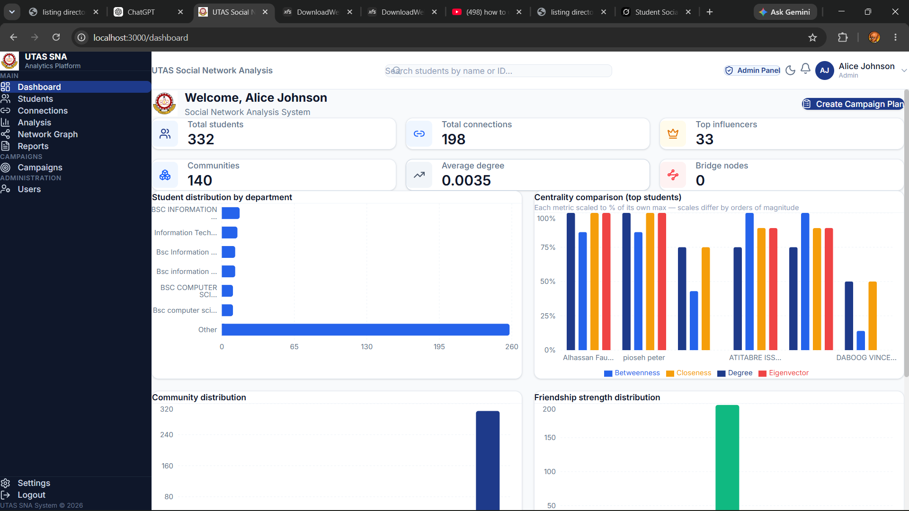
The System — Dashboard
KPI cards, distribution charts, quick actions, and recent activity.
Notes:
Entry point after login. Total students, connections, influencers, communities, average degree, and bridge nodes at a glance, with charts underneath. Role-based: a plain student account sees this read-only.

Slide 10
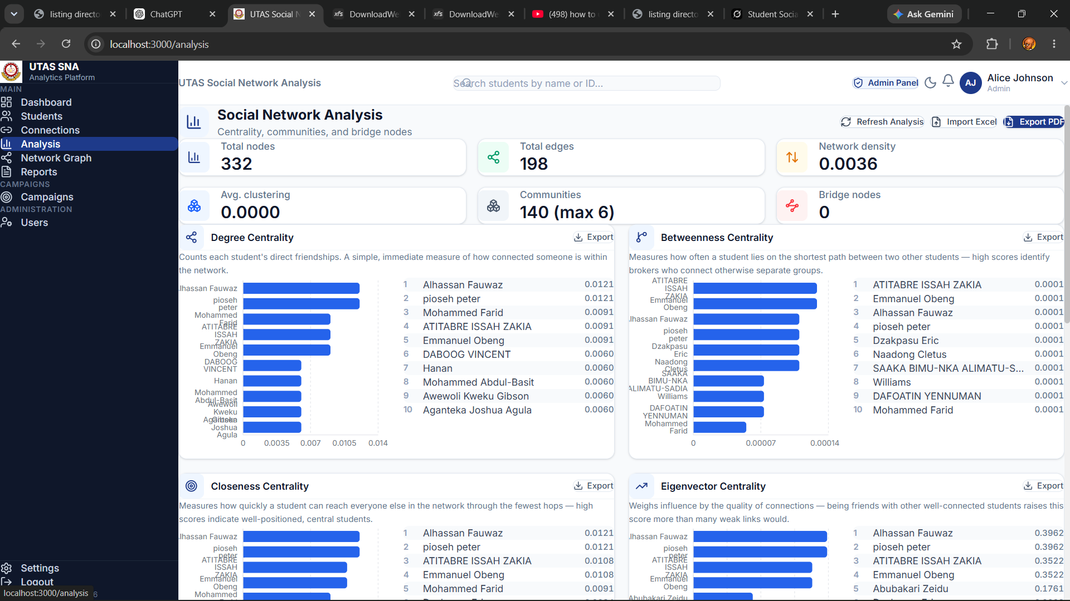
The System — Analysis
A ranked card per centrality metric, with descriptions and CSV export.
Notes:
Each metric gets a card with a plain-language description of what it measures, a ranked chart of students, and an export button. Import and re-run controls live here for campaign managers and admins.

Slide 11
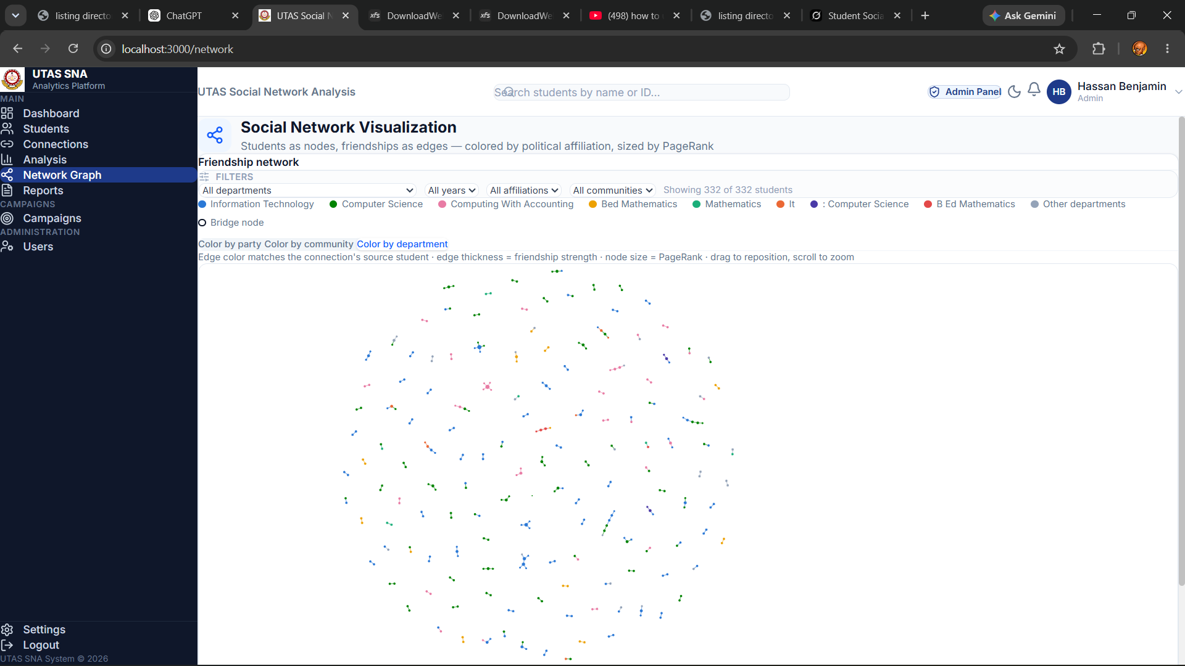
The System — Network Graph
Force-directed friendship graph; node colour selectable by party, community, department, tribe, religion, hometown, district, or regional capital.
Notes:
The visual heart of the system. Node size is PageRank; the colour dropdown regroups the same graph by any shared attribute, so department clusters, hometown clusters, and religious communities are all visible in the one campus network. If demoing live, switch the colour mode here -- it is the strongest moment.

Slide 12
Results — The Numbers
Two survey rounds combined: a class cohort, then a campus-wide round -- 717 students and 408 friendships in one graph.
15 students appeared in both rounds and became single nodes, joining the two datasets instead of leaving them as separate islands.
77 bridge students identified -- each one a cut vertex whose removal would break the network into more pieces.
Influence tiers: 72 High, 143 Medium, 502 Low.
315 communities; the largest holds 8 students. Density 0.0016, avg 1.14 friends each.
Cohort shape: IT (184) and Computer Science (164) lead, then Nursing (77); 205 TEIN and 93 TESCON.
Notes:
Lead with the combination: two rounds, one graph, joined by the 15 students who appear in both. Then the headline -- 77 bridge students. If asked why the network still looks sparse, that is the next slide.

Slide 13
Results — What They Mean
77 bridges is the finding that matters: these are named students a campaign could not have identified any other way -- the structural form of Granovetter's weak ties.
Bridges span programmes: Computer Science, IT and Computing with Accounting, not concentrated among the most-connected few -- exactly Borgatti's (2006) point that seeding is not the same as ranking by centrality.
The network is still sparse, and that is a survey artefact: most respondents named one friend, so density is 0.0016 and 315 communities stay small.
Clustering is zero because friends-of-friends were never named -- not because UTAS students lack mutual circles.
The fix is in survey design, not the method: asking each respondent for 3-5 friends would change what the analysis can see, at no extra cost.
Notes:
The honest framing: the structure the system found is real and useful, and the thinness is a property of how much each respondent was asked to give. If a panel member presses on sparsity, agree with them and point to the survey instrument as the lever.

Slide 14
A Result Worth Checking Twice
For most of the project the system reported 0 bridge nodes. That looked entirely plausible -- a sparse network with no cut vertices is a believable result.
It was a defect. Bridges were sought among students whose neighbours spanned two or more Louvain communities. But Louvain gives every disconnected component its own community, so on fragmented survey data no student could ever satisfy that test.
Found by cross-checking, not by inspection: comparing the system's output against an independent calculation of the graph's articulation points, which found 77 in the same data.
The lesson: a plausible-looking number is not evidence of a correct one. Every reported figure should be verified against an independent method.
Notes:
This slide is optional if time is short, but it answers 'how do you know your system is correct?' better than any assurance could. It shows a real defect, found by verification rather than luck, and corrected -- which is what a panel wants to see from an engineer.

Slide 15
From Analysis to Action
One-click campaign plan: reads the live analysis and creates a campaign with a concrete, named outreach plan -- top influencers to engage, coverage gaps to fill.
Recommendations per campaign: top influencers and bridge students, filtered to the campaign's target party.
Expert advice: a rule-based advisor interprets the metrics in plain language -- e.g. flagging network sparsity and suggesting what to collect next.
Why it matters: the output is an action list with names, not a table of numbers.
Notes:
This is the decision-support layer -- the difference between a dashboard and a tool. The expert advisor is a classic knowledge-driven DSS: explicit rules over the computed metrics, so its advice is explainable to a non-technical organiser.

Slide 16
Deployment & Quality
Live on the internet: frontend on Firebase Hosting, backend on PythonAnywhere -- myapplication-65e7d8b9.web.app
Free-tier hosting throughout: no running cost, so the system outlives the assessment period.
78 automated backend tests: auth, students, connections, campaigns, analysis endpoints, and the survey importer.
Role-based security: every restriction enforced in the API, not just hidden in the interface.
Google Sign-In alongside username/password authentication.
Notes:
Two proof points: it is deployed (usable from any phone or laptop right now, no setup) and it is tested (78 automated tests run against every change). Offer the live demo here if the panel wants it.

Slide 17
Limitations & Future Work
Data sparsity: most respondents named one friend, so density stays low; asking for 3-5 each is the single highest-value change to a future round.
Undirected graph only: mutual friendship; directional ties would need different centrality measures.
Batch analysis, not real-time: on-demand recomputation; a live pipeline is future work.
No sentiment or prediction yet: the literature points to both as natural next layers.
Anonymisation: a built-in redaction step for real names/emails is the first thing to add next.
Notes:
Name the limitations before the panel does. Each one has a designed answer: more data, a directed model, a recomputation pipeline, and the predictive layer Liu et al. demonstrated. Anonymisation is an ethics point worth raising yourself -- it shows awareness, not weakness.

Slide 18
Conclusion
All four objectives met: data pipeline, full SNA engine, role-based interface, campaign planner.
Real primary data, collected by consent through Google Forms and cleaned for analysis.
A working, deployed, tested system -- not a prototype or a mock-up.
Replaces guesswork with evidence about who to approach and where the coverage gaps are.
Notes:
Close the loop with the opening: campaigns were planned blind; now there is a live tool that maps the network, measures influence, and hands organisers a named plan. Thank the supervisor and panel and invite questions.

Slide 19
Thank You — Questions?
Live system: myapplication-65e7d8b9.web.app
Notes:
Common questions to be ready for: How is this different from a spreadsheet? (structural metrics are invisible in raw rows.) Is it your own work? (system, architecture, and application are mine; the algorithms are established peer-reviewed techniques.) Why so few connections? (coverage, not method -- and the campus-wide round is addressing it.) Ethics? (consented survey, no scraping, anonymisation flagged as next step.)

