Slide 1
CUSTOMER RELATIONSHIP MANAGEMENT SALES ANALYSIS Presentation
KWAMENA BONDZIE

Slide 2
Project analysis slide 2
CRM Sales Analysis
VISUALIZE
PROJECT OVERVIEW
CRM SALES ANALYSIS
ANALYSIS
ASK QUESTIONS
PROCESS
PREPARE DATA

Slide 3
Project analysis slide 3
Project Overview
Overview
Objectives
This Project shows analysis of a company’s customer relationship management (CRM) sales dataset that includes information about accounts, products, sales pipelines, and sales teams.
The company seeks to optimize its sales strategies and drive growth by gaining a deeper understanding of its accounts, products, sales pipeline, and sales team

Slide 4
Project analysis slide 4
Ask Questions
What is the Distribution of deals in the pipeline?
Who are the top-performing sales agents?
What is the average deal length?
Sales Pipeline Analysis
Sales Team Analysis
Who are the most effective managers?
Deal stage over time
Which sales agent is most effective at selling a specific product?

Slide 5
Project analysis slide 4
Ask Questions
What is the total number of Products sold?
Which sector have the most accounts?
What is the trend for revenue and product quantity over time?
Which accounts have the highest average revenue per order?
Product Performance
Account Analysis
What is the revenue and profit generated by each product?
What is the revenue and profit generated from each sector?

Slide 6
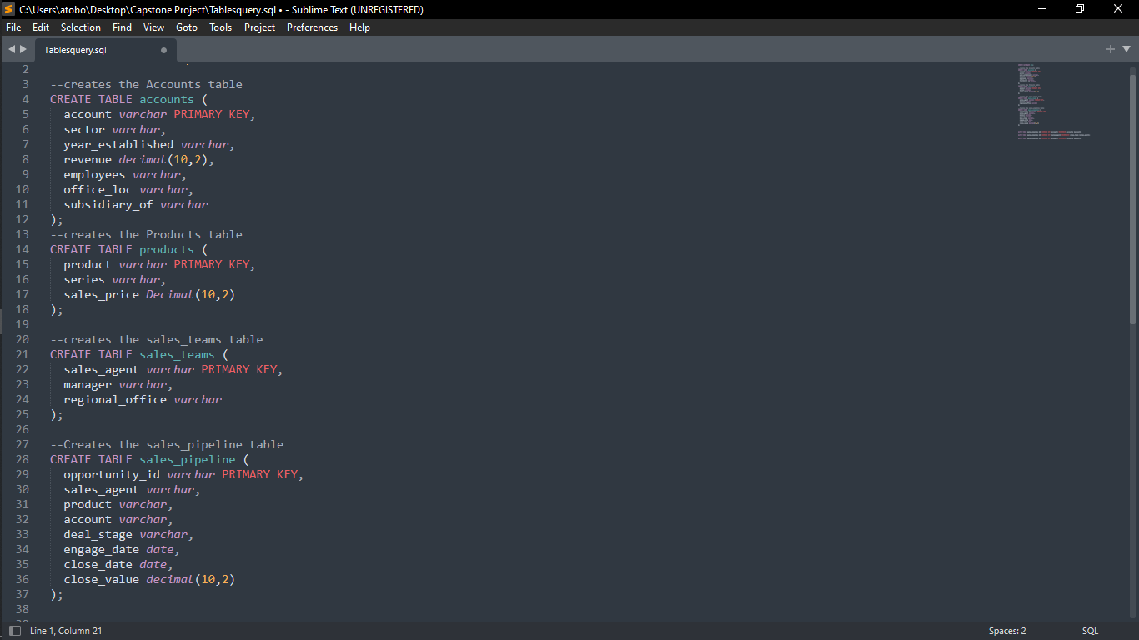
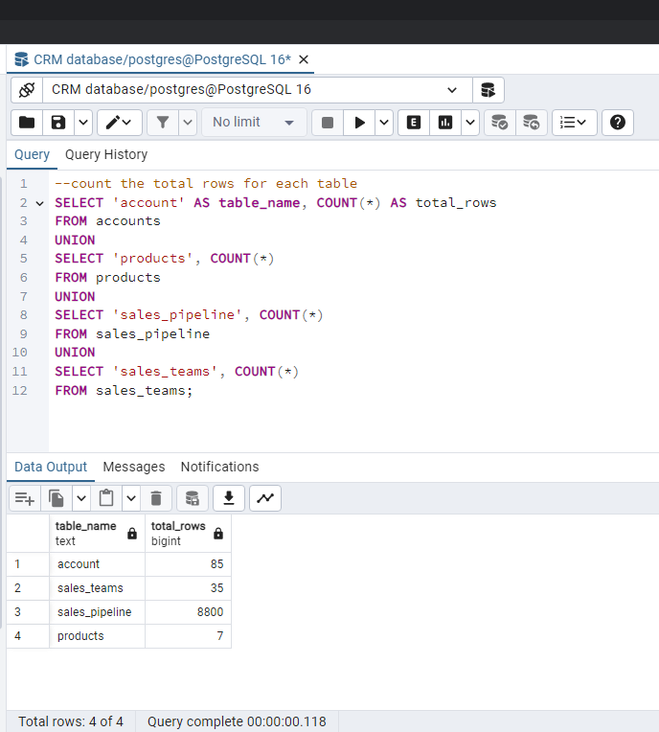
Project analysis slide 5
Prepare Data
Create Tables and Import Data

Slide 7
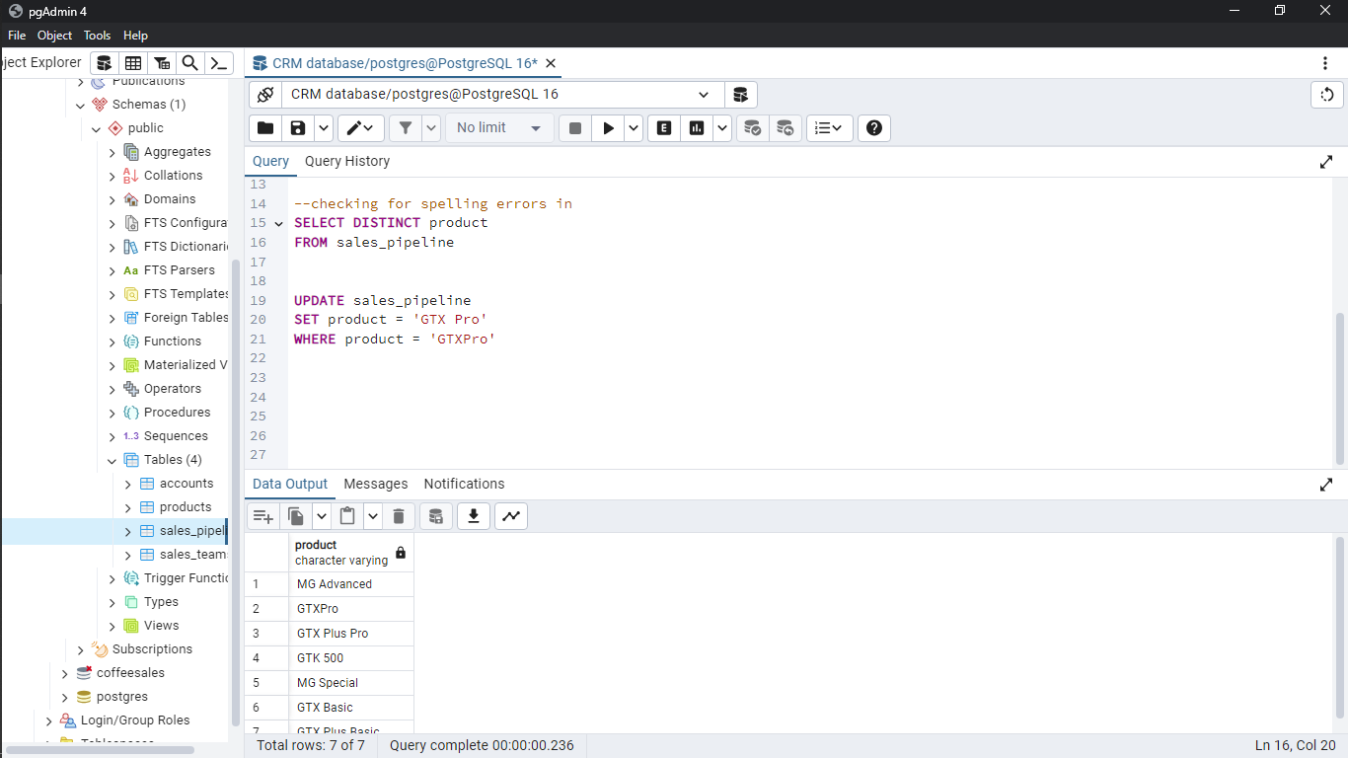
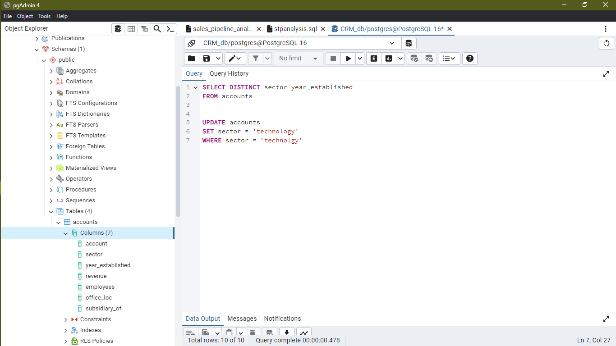
Project analysis slide 5
Prepare Data
Perform Data Cleaning
Check for errors in mostly the Primary key columns to ensure its uniqueness before establishing relationship between the tables

Slide 8
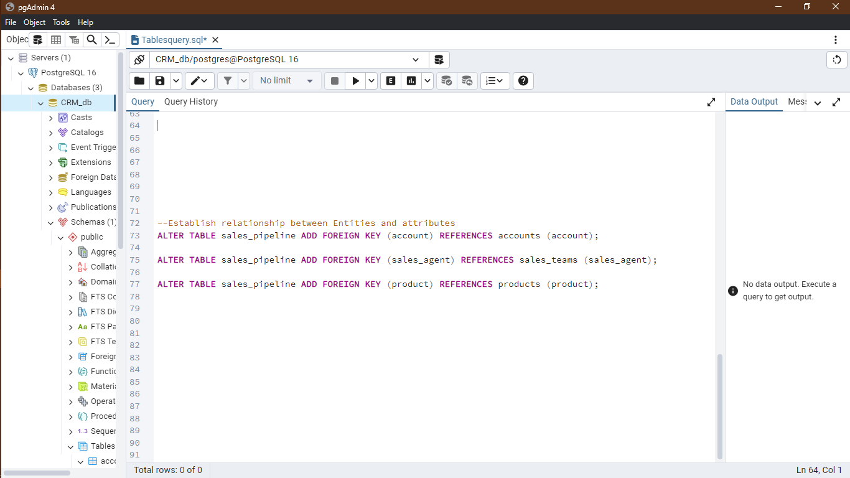
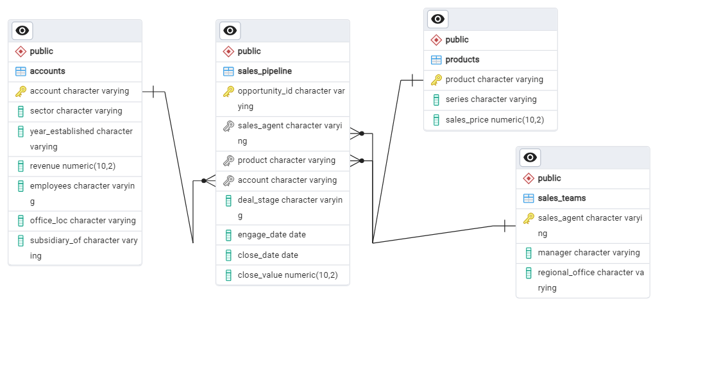
Project analysis slide 5
Prepare Data
Entity Relationship Design
Design ER diagram to guide you on how DB is structured
Alter table created and establish Relationship between the tables

Slide 9
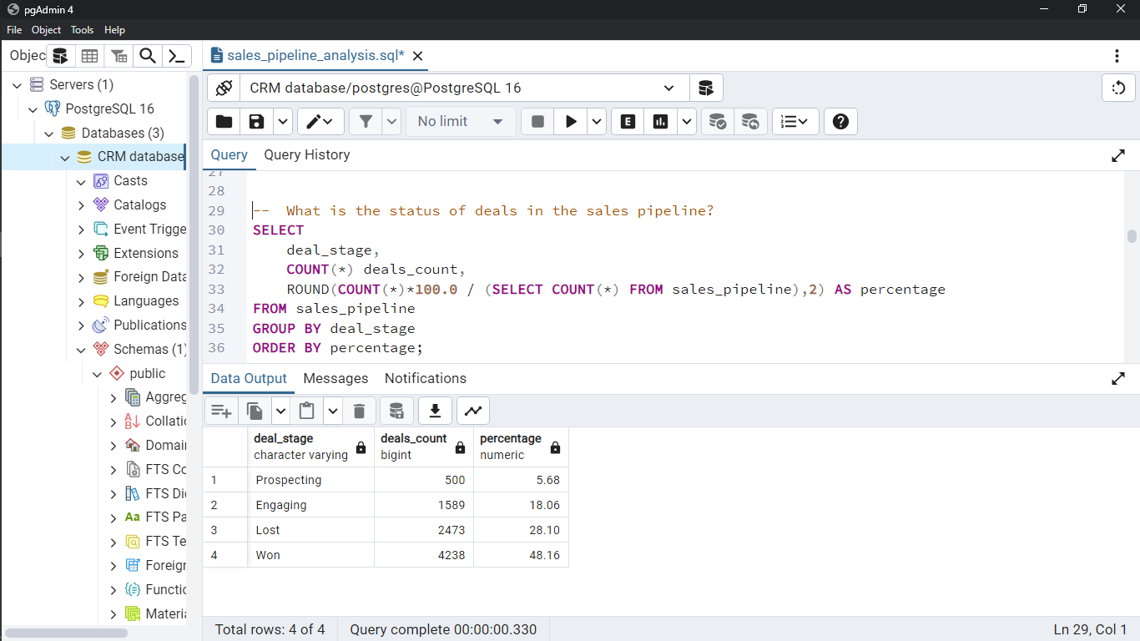
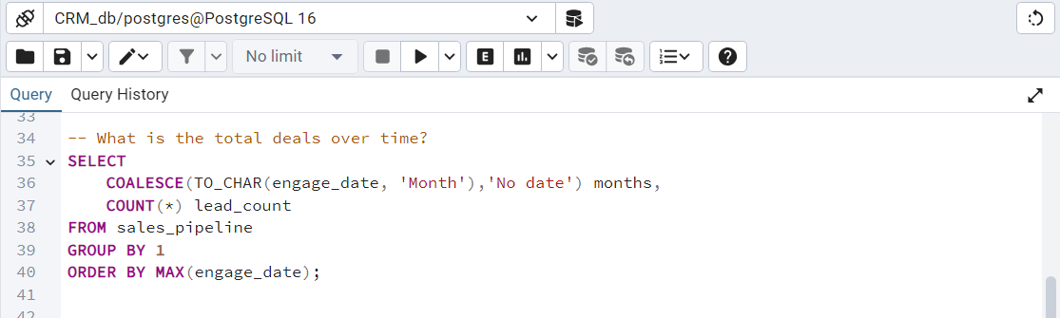
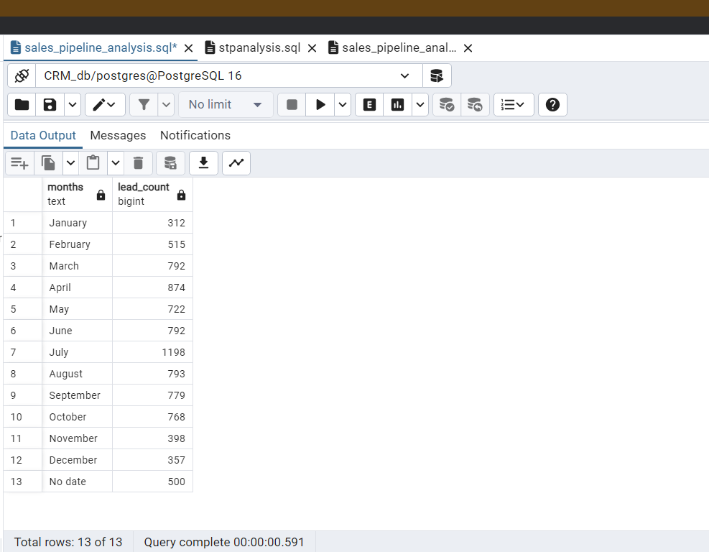
Project analysis slide 5
Process & Analyze
SQL queries – Sales Pipeline

Slide 10
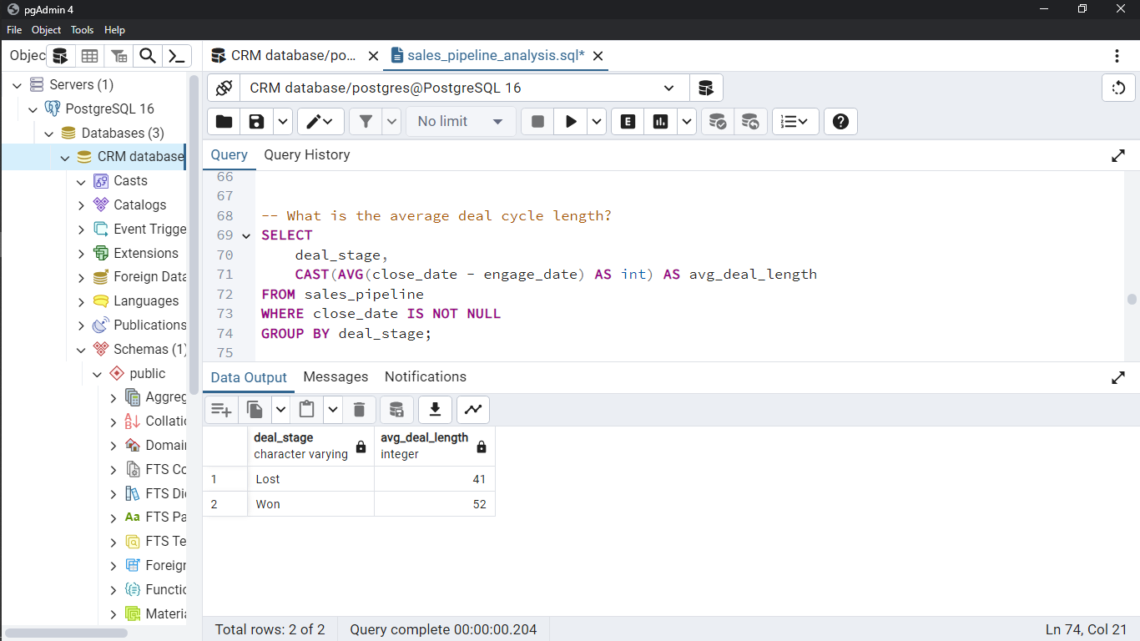
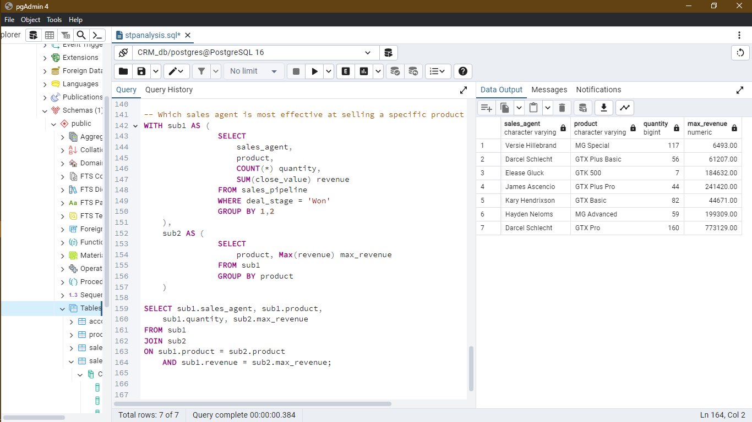
Project analysis slide 5
Process & Analyze
SQL queries – Sales Team

Slide 11
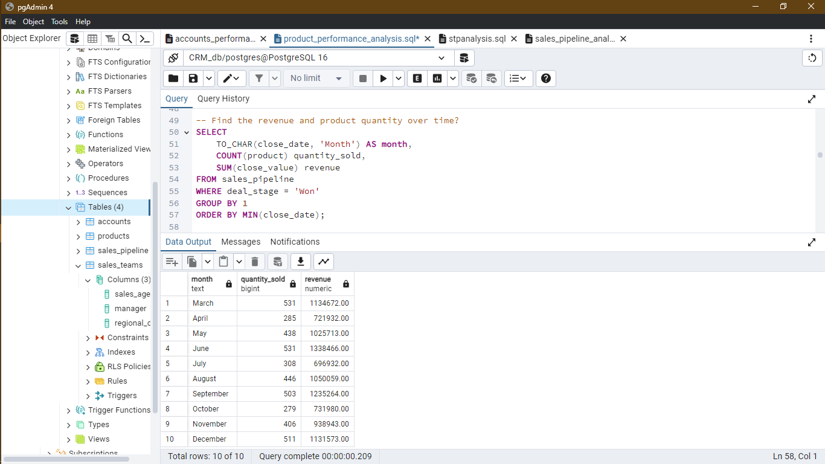
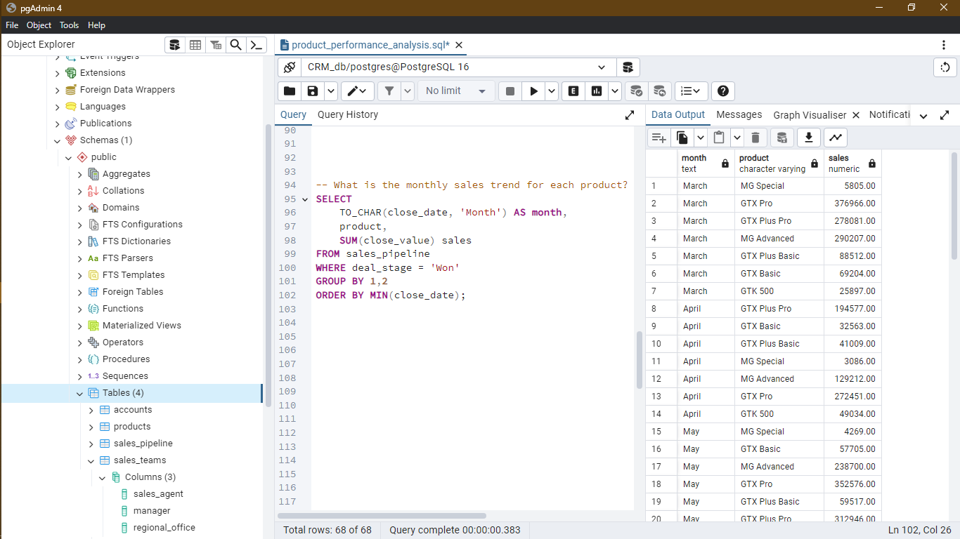
Project analysis slide 5
Process & Analyze
SQL queries – Product

Slide 12
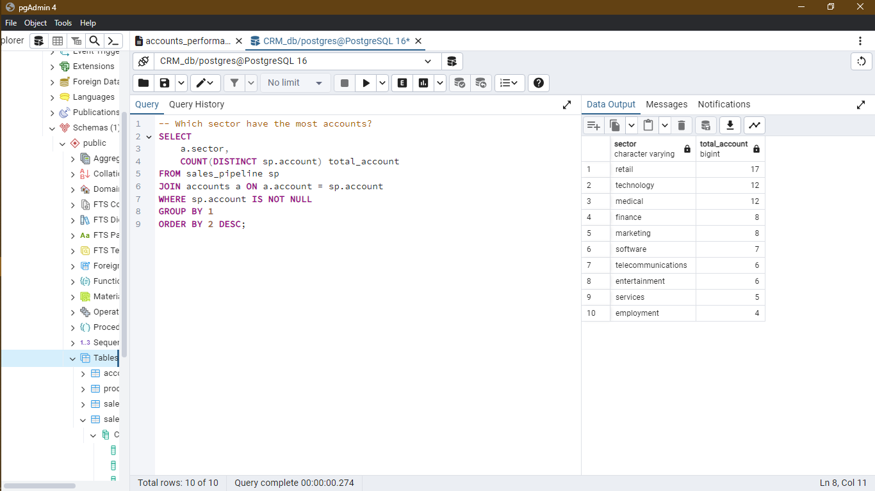
Project analysis slide 5
Process & Analyze
SQL queries – Account

Slide 13
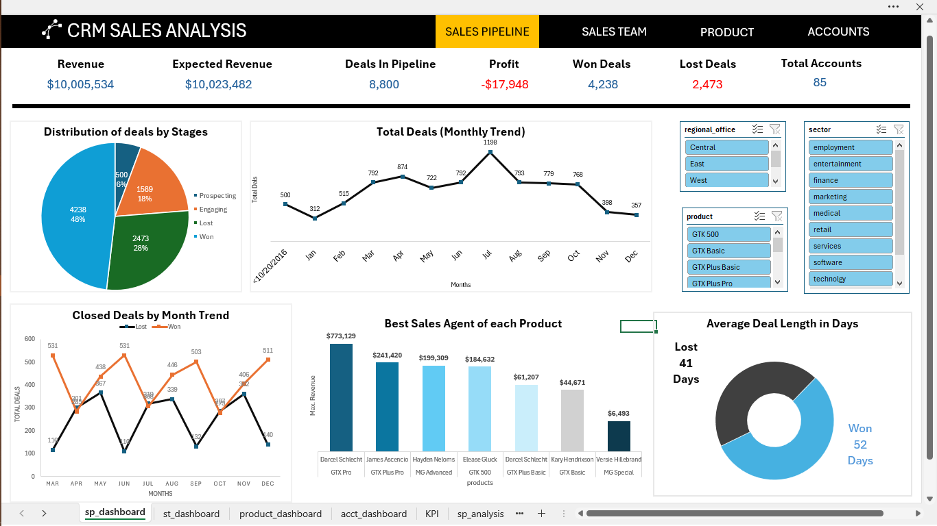
Project analysis slide 6
Dashboard 1

Slide 14
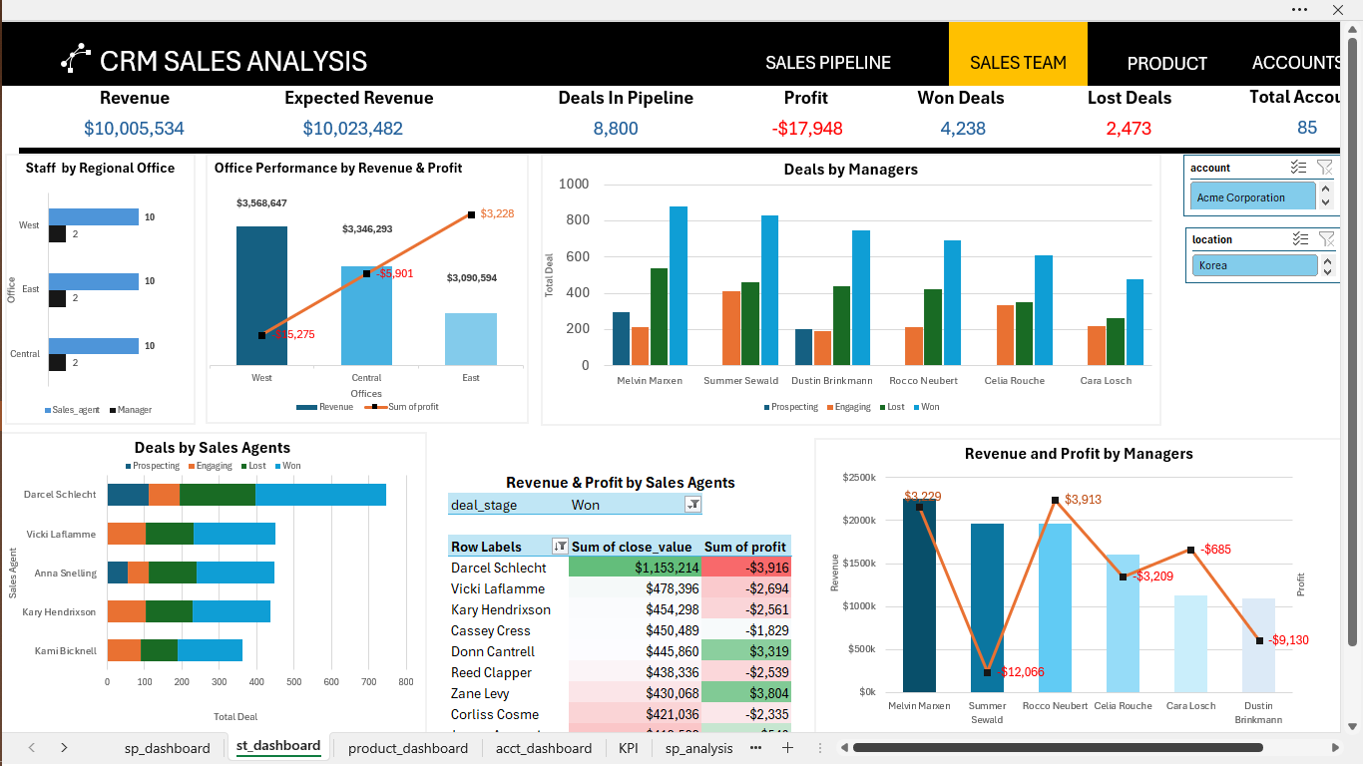
Project analysis slide 6
Dashboard 3

Slide 15
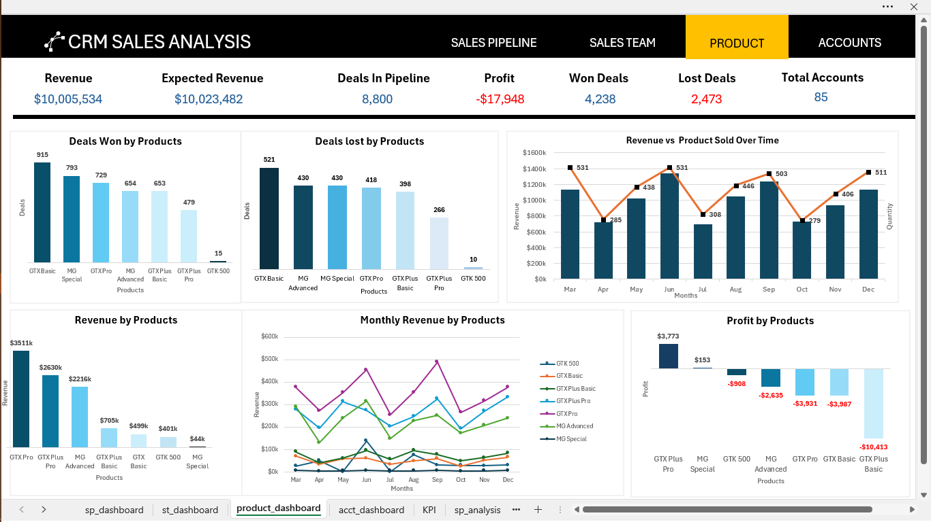
Project analysis slide 6
Dashboard 2

Slide 16
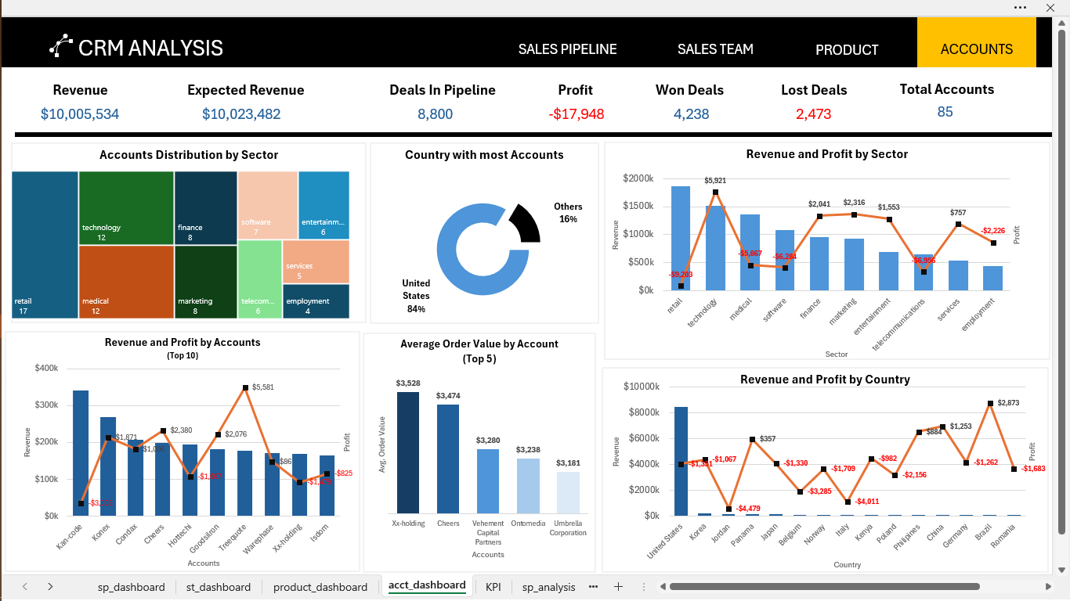
Project analysis slide 6
Dashboard 2

Slide 17
Project analysis slide 8
Conclusions
Findings
Recommendations
The total number of deals generated which covered the period of October 2016 to December 2017 was 8,800.
Out of the 8,800 deals, the data showed almost half (48.1%) of the deals have been won, the company continues to engage with about 18.06% of the deals, lost about 28.10% of the deals and about 5.6% of the deals are at the prospecting stage.
The analysis revealed that despite strong sales figures, the company faced losses after product sales.
To fine-tune pricing, you can consider implementing dynamic pricing strategies. This strategy encompasses setting prices based on market demand, competitor pricing, and customer behavior.
To take on this strategy, there is a need-to-know preferences and price sensitivity to tailor pricing strategies to maximize profits while remaining competitive in the market

Slide 18
Thank You

