Slide 1
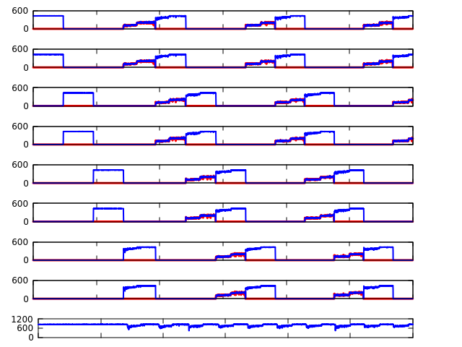
SSD1
c
SSD2
SSD3
SSD4
Throughput (MB/sec)
SSD5
SSD6
SSD7
b
SSD8
USER
600
1200
1800
2400
3000
3600
Time (sec)

Slide 2
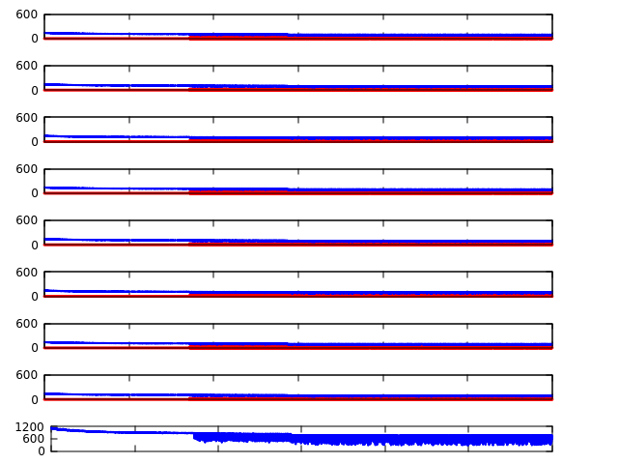
SSD1
SSD2
SSD3
SSD4
Throughput (MB/sec)
SSD5
SSD6
SSD7
SSD8
a
USER
600
1200
1800
2400
3000
3600
Time (sec)

Slide 3
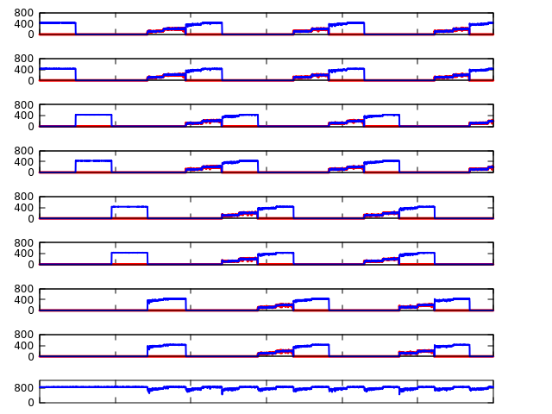
b
Throughput (MB/sec)
a
Time (Sec)

Slide 4
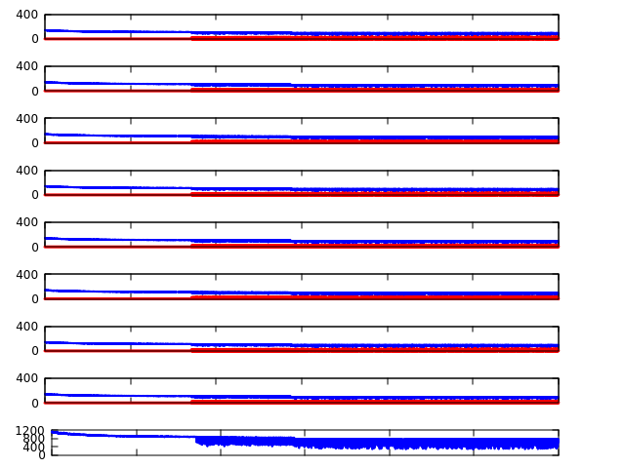
Throughput (MB/sec)
c
Time (Sec)

