Slide 1
Project Procession Report
COMP 6905 – Software engineering
Instructor: Dr. Adrian Fiech
Group member：
Chenxiao Jia, Kwangsub Ahn, Yin Zhang, Yiwen Yang

Slide 2
Agenda
Iteration Plan
Rate of Procession
Focus
COMP 6905 – Software Engineering
2015 Fall

Slide 3
Iteration Plan
In our schedule, we have three phrases, and in each part the project will be implemented the following functions:
Register host family, register mentor, view general information and login page (16th NOV )
Choose host family, assign mentor, view and update staff, ( 24th NOV)
Communication board, post and view events ( 2nd DEC)
COMP 6905 – Software Engineering
2015 Fall

Slide 4
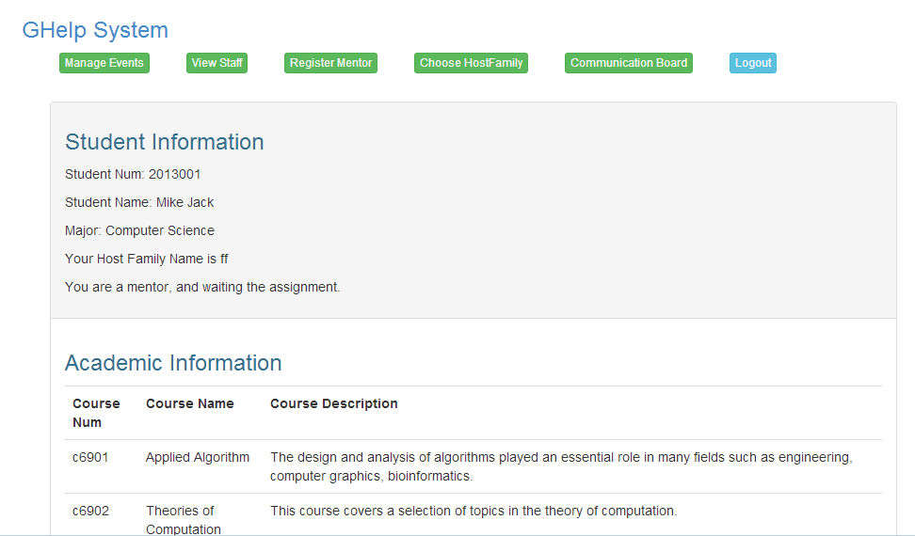
Rate of Procession
COMP 6905 – Software Engineering
2015 Fall

Slide 5
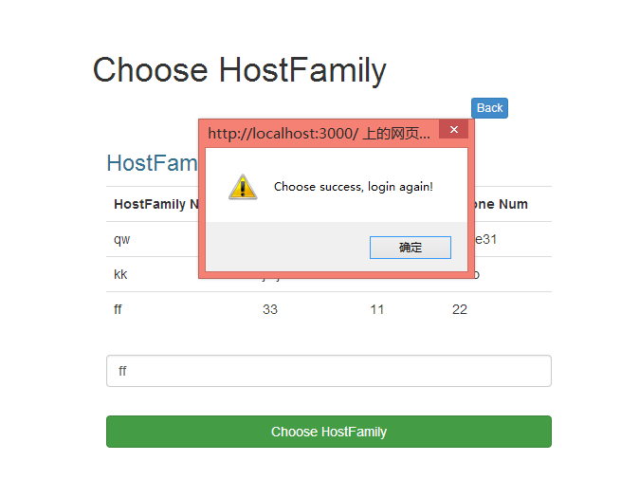
Rate of Procession
COMP 6905 – Software Engineering
2015 Fall

Slide 6
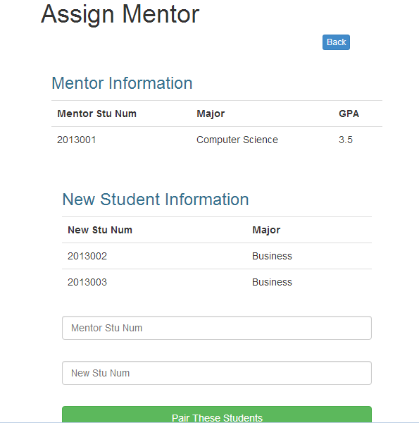
Rate of Procession
COMP 6905 – Software Engineering
2015 Fall

Slide 7
Focus
Consideration on security for different users using system in abnormal situations
Efficiency of Data Structure and searching methods
COMP 6905 – Software Engineering
2015 Fall

