Slide 1
Capstone Design Project
Health Care System

Slide 2
Table of contents
Topic
Implementation
Main Functions
Demonstration
Improvements
QnA

Slide 3
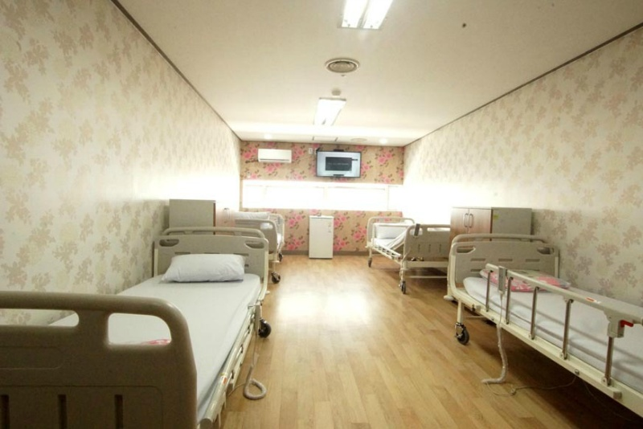

Topic

Slide 4
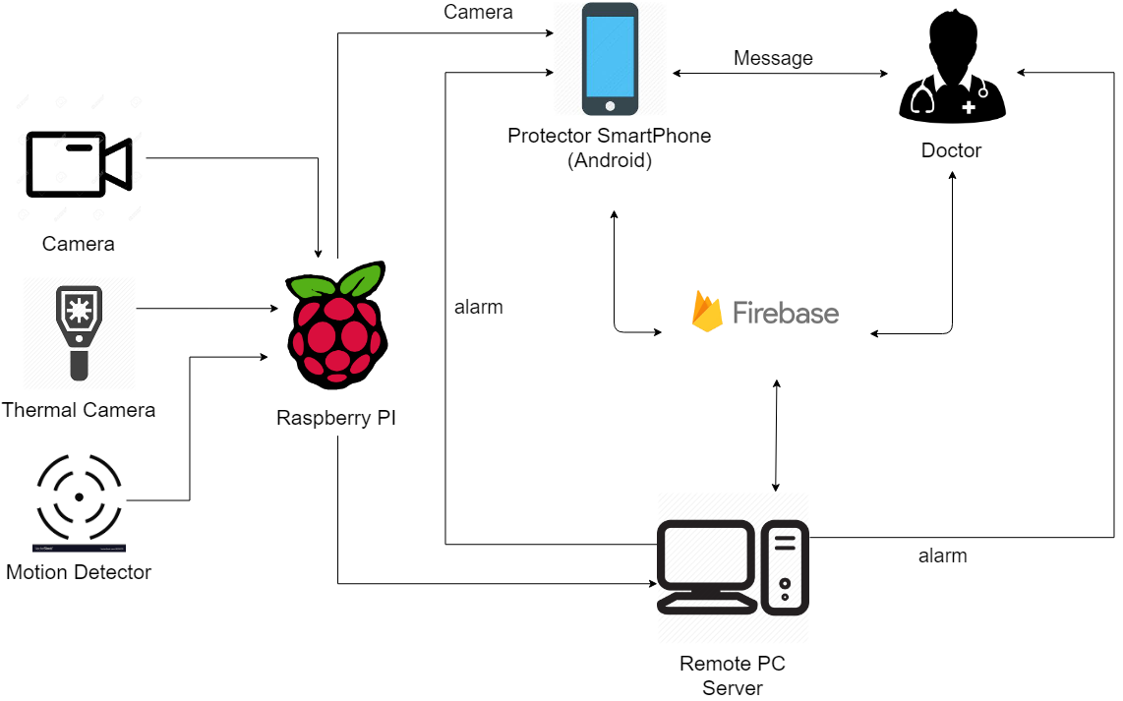
Implementation

Slide 5
Main Functions – Streaming

Slide 6
Main Functions – Temperature detection

Slide 7
Main Functions – Motion detection

Slide 8
Demonstration

Slide 9
Improvements
Performance of devices
Just single person target
Deep learning model

Slide 10
QnA

Slide 11
THANK YOU

