Slide 1
MIE1624 Assignment 2 -
Predicting Kaggle Data Scientist Compensations
Alex Kwan - 1001559057

Slide 2
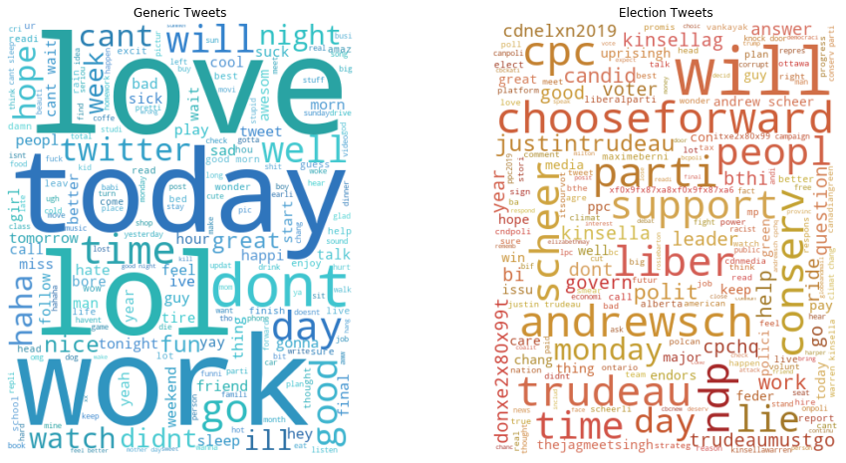
Introduction & Exploratory Data Analysis
Goal:
  Use Sentiment Analysis to understand how public opinion on Twitter can tell us about the 2019 Canadian Election
  Evaluate how a model trained on generic tweets predicts the sentiment of political tweets
  Evaluate NLP models to predict the reason for negative sentiment political tweets
2 Raw Datasets:
  Generic Tweets with sentiment from 2009, n = 200,000
  Political Tweets with sentiment and reason, n =2,133

Slide 3
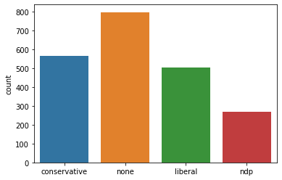
Data Cleaning Rules and Feature Engineering
For both datasets, cleaned by lower case, stemming, remove all links, remove nltk stopwords, remove HTML tags
For political tweets:
Remove stop words with specific words and hashtags for the Canadian Election ("Canada", "#elxn43", "PM", "Vote2019"
Predicted Party in mentioned of tweet using count of keywords associated with each party
  Liberal: #ChangeForward, #TrudeauMustGo, @JustinTrudeau, black face, SNC Lavalin, #LPC
  Conservative: #ScheerLies, @AndrewScheer, #CPC
  NDP: @JagmeetSingh, orange, #NDP

Slide 4
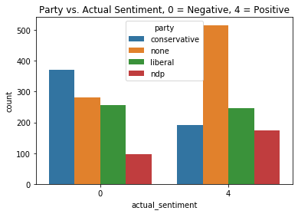
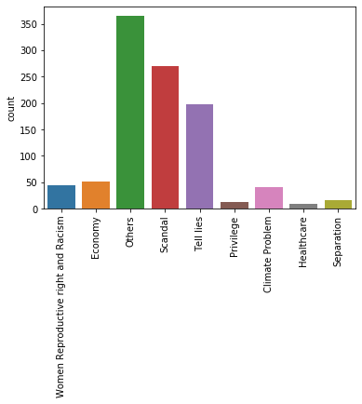
Visualizations
The actual (not predicted) number of positive and negative sentiment tweets correlates to the election results of Liberals 1st, Conservatives 2nd, NDP 3rd:
Conservatives have the most tweets, but >60% are negative
Liberals are second in tweets, with # positive = # negative
NDP have the fewest tweets
Common negative sentiment reasons are
unclear (Other)
scandal (black face, SNC Lavalin)
lies (Trudeau failure to keep promises and Scheer making false claims)

Slide 5
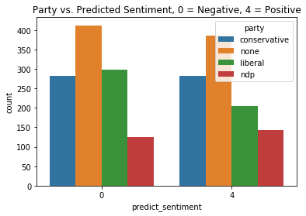
Model Results
Generic Tweets Sentiment Prediction (5k features)
Political Tweets Sentiment Prediction
(5004 features, extra 4 from party classification)
Algorithm | WF Accuracy | TF-IDF Accuracy
Logistic Regression | 0.7358 | 0.7336
K-NN | N/A | N/A
Naive Bayes | 0.727 | 0.649
SVM | 0.733 | 0.732
Decision Trees | 0.584 | 0.591
Random Forest | 0.606 | 0.602
XG Boost | 0.690 | 0.690
Evaluating the Logistic Regression with WF (Word Frequency) Features for Sentiment Prediction of Political Tweets: Accuracy = 0.503 :(
→ Model trained on generic tweets unable to classify political tweets
Using multi-class Logistic Regression to predict the negative sentiment reason, Accuracy = 0.5478 :(
→ Small # of training samples for most classes
→ Overfitting since #features > # training examples

Slide 6
Discussion and Future Work
Sentiment Analysis is useful, confirms that higher proportion critical of the Conservatives since twitter demographics skew to a younger crowd:
Conservatives want to cut education, OSAP, don't support gay marriage and birth control which conflicts with the values of the younger population (who have debt, support taxes, support LGBT)
But, poor performance of models trained on generic tweets to predict sentiment of political tweets which could be misleading since it over-predicts the # of positive sentiment Conservative tweets and also poor performance on predicting the reason for negative sentiment due to small sample sizes.
Future Work:
Train models on actual political tweets not generic tweets from 10 years ago
Better cleaning to remove common contractions and emojis, use counts of hashtags
Word embeddings(fastText), deep learning

